Slide 1
Numberblocks
Support Materials
Series 2, Episode 12
Fluffies

Slide 2
Practitioner Notes

Slide 3
Episode Description
A small ball of fur falls out of the sky and befriends One. When One counts it, it starts tickling her. Two arrives and catches two more and gets tickled, and soon lots more fall. They run off to warn the others, but one by one, everyone up to Six is rolling on the floor, covered in tickly fluffies. Seven arrives, but he is not ticklish, so they decide to turn into Sevens to escape the fluffies. They do, and finally Eight arrives and regroups into ‘Octoblock tickle mode’ to tickle the fluffies, who run away.

Slide 4
Maths in the Episode
Counting to 7 and one-to-one mapping
The Numberblocks appear successively in order from One to Eight. Each time a Numberblock appears he/she counts the number of corresponding fluffies which have landed on each block, e.g. Six has six fluffies. This is illustrating one-to-one correspondence mapping: each Numberblock has the same number of fluffies as blocks.
Number bonds to 7
Pairs of Numberblocks combine to make themselves into Sevens (1+6, 2+5, 3+4) demonstrating the part-part-whole relationships for the number bonds for 7.

Slide 5
Using Mathematical Language
During this episode children will experience one-to-one correspondence.
Use this language to describe this mapping:
“One fluffy for each block.”
“Two has 2 fluffies because he is made from 2 blocks.”
“Three has 3 fluffies because she is made from 3 blocks.”
Older children will begin to describe the part-part-whole relationship for number bonds for 7, e.g.:
“7 is the whole: 5 is a part, and 2 is a part and 7 is the whole”
(with actions – holding the 5 in one hand and the 2 in the other, bringing together and separating to show the whole and the parts).

Slide 6
Talk and Discuss Together

Slide 7
Talk and Discuss Together
Watch the episode of Numberblocks. First ask the children what they noticed and allow them to talk to you and each other. The following slides are designed to stimulate children and adults to talk about the episode and draw out some key aspects of the mathematics.

Slide 8
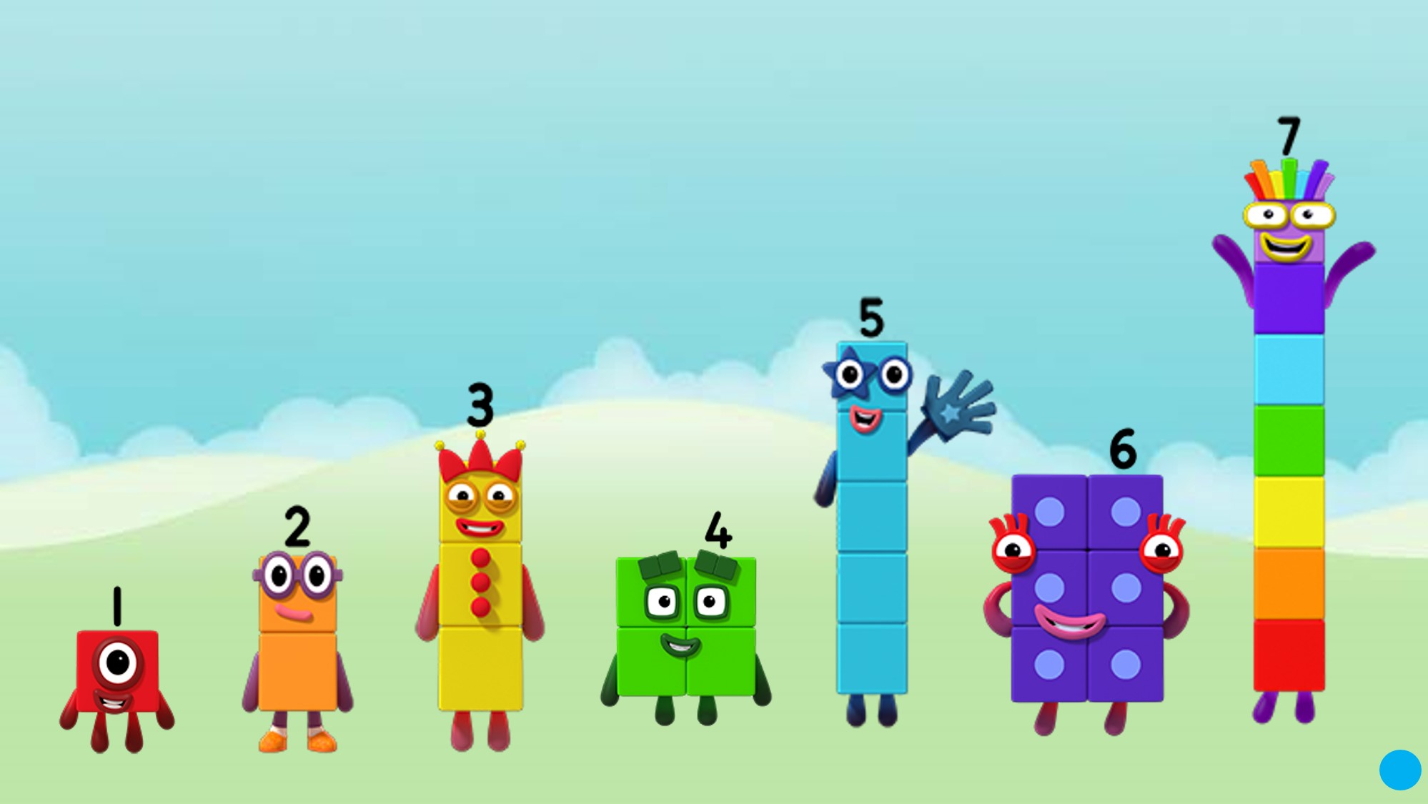
Images © 2017 Alphablocks Ltd. All Rights Reserved.
Notes:
After watching the episode, discuss how being tickled makes you feel. Some parts of us are more ticklish than others. (It may be appropriate to address consent when tickling someone else.) What objects can make you feel ticklish (feathers, cuddly toys, etc)?
Who wasn’t ticklish in the programme (Seven)?
Discuss what the children noticed about the number of fluffies that each Numberblock had attached to them. For example, one fluffy for each block.
“Two has 2 fluffies because he is made from 2 blocks.”

Slide 9
Click on the numerals
Images © 2017 Alphablocks Ltd. All Rights Reserved.
Notes:
This slide is animated.
Ask: “What do you notice in the picture?” (6 fluffies, One, Two, and Three.)
In turn, ask how many fluffies each one can have. Click on the respective numerals to attach the correct number of fluffies.

Slide 10
Images © 2017 Alphablocks Ltd. All Rights Reserved.
Notes:
Activity:
In advance fill some bags with small craft pom-poms so that there are bags of pom-poms for each number from 1 to 7.
Lay out pictures of each Numberblock.
Hand out bags to pairs of children and ask them to work out which Numberblock’s pom-poms they have got. Demonstrate their answer by matching a pom-pom to each block that the Numberblock is made from.

Slide 11
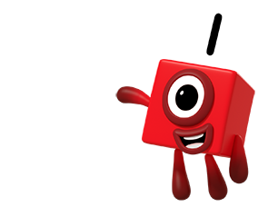
How many fluffies?
Images © 2017 Alphablocks Ltd. All Rights Reserved.
Notes:
The next set of slides are for practising counting strategies.
The slides are animated:
Click on each fluffy: the fluffy will move up and down to aid counting.
Click on the background: a Numberblock for that number of fluffies will appear.
Counting strategies to draw attention to:
point, move and say
point, move into a row and say
point and say (e.g. from a distance so objects can’t be touched)
track with eyes and say
subitise and count-on (a more sophisticated strategy for children fluent with the counting numbers to 10).
Ask children to select the same number of pom-poms from a box in front of them, and match their pom-poms to the ones on the screen.
Encourage children to choose their counting strategy – how could we count these? Notice if two children use different counting strategies, and compare their answers. Ask what’s the same and what’s different about how child X and child Y counted the fluffies.
Ask: does the order of the count matter?
Model incorrect counting such as counting one fluffy twice (see if the children notice the mistake).
Encourage children to subitise small quantities. For example, say the quantity by recognising the amount rather than counting (1, 2, 3 should be possible).
For some numbers (4, 6, 7) there are two slides: in the first, the quantity is represented in a familiar regular arrangement; in the second, the fluffies are organised in a less familiar irregular arrangement to stimulate different counting strategies.

Slide 12
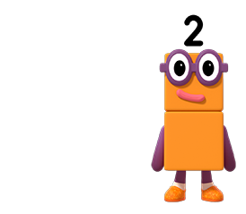
How many fluffies?
Images © 2017 Alphablocks Ltd. All Rights Reserved.

Slide 13
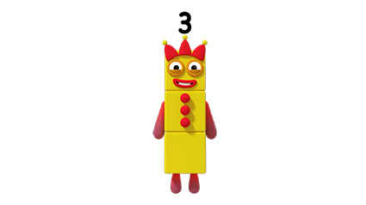
How many fluffies?
Images © 2017 Alphablocks Ltd. All Rights Reserved.

Slide 14
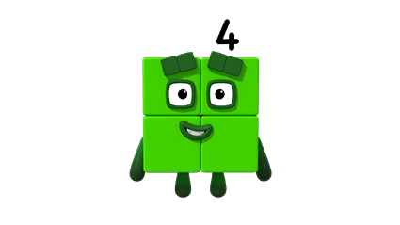
How many fluffies?
Images © 2017 Alphablocks Ltd. All Rights Reserved.

Slide 15
How many fluffies?
Images © 2017 Alphablocks Ltd. All Rights Reserved.

Slide 16
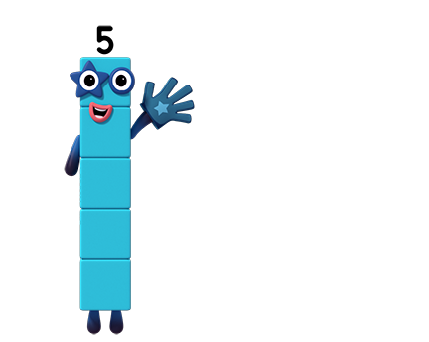
How many fluffies?
Images © 2017 Alphablocks Ltd. All Rights Reserved.

Slide 17
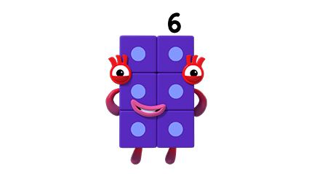
How many fluffies?
Images © 2017 Alphablocks Ltd. All Rights Reserved.

Slide 18
How many fluffies?
Images © 2017 Alphablocks Ltd. All Rights Reserved.

Slide 19
How many fluffies?
Images © 2017 Alphablocks Ltd. All Rights Reserved.

Slide 20
How many fluffies?
Images © 2017 Alphablocks Ltd. All Rights Reserved.

Slide 21
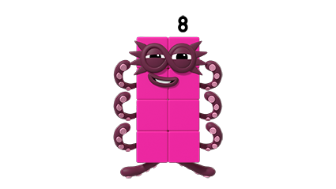
How many fluffies?
Images © 2017 Alphablocks Ltd. All Rights Reserved.

Slide 22
Enabling Environments

Slide 23
Enabling Environments
Playing and Exploring
Provide clear plastic bags of craft pom-poms (1-8) and Numberblocks made from linking cubes 1-8 to match on the ‘Magic Maths’ table. Alternatively, provide empty bags for the children to fill with the correct number of pom-poms for each Numberblock 1-8.
Active Learning
Notice if children consistently count different quantities 1-8. Notice the counting strategies chosen (point, move and say, subitising and counting-on, etc. See notes on slide 11).
Creating and Thinking Critically
Provide opportunities for children to choose to count purposefully, e.g. saying how many cups are needed on their table for snacktime, or asking at tidy-up time to check no pieces are missing from a set.

Slide 24
Learning Together in Y1

Slide 25
Images © 2017 Alphablocks Ltd. All Rights Reserved.
Notes:
After watching the episode discuss how being tickled makes you feel. Some parts of us are more ticklish than others. (It may be appropriate to address consent when tickling someone else.) What objects can make you feel ticklish (feathers, cuddly toys, etc)?
Who wasn’t ticklish in the programme (Seven)?
Discuss the episode: what did you notice?
Why did the other Numberblocks want to combine to make Seven? (Because Seven wasn’t ticklish.)
Using a set of Numberblocks made from linking cubes, invite the children to explore how to make Seven from One, Two, Three, Four, Five and Six.

Slide 26
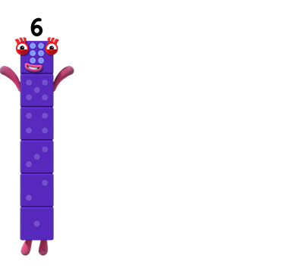
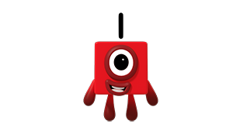
Images © 2017 Alphablocks Ltd. All Rights Reserved.
Notes:
Slides 26 to 28 are animated to show the combining of two Numberblocks to total 7. One Numberblock jumps on top of another to combine to make Seven. This structure is then represented in a part-part-whole model, a bar model and then an equation. Discuss with children and help them to make connections between the 3 representations. Ask children to discuss or write the bar model and then the equation before these are shown. Ask them what each number represents in each and help them to link to the original context of 2 Numberblocks combining.
Use the stem sentence:
“7 is the whole: 1 is a part, and 6 is a part and 7 is the whole” (with actions – holding the 1 in one hand and the 6 in the other, bringing together and separating to show the whole and the parts).

Slide 27
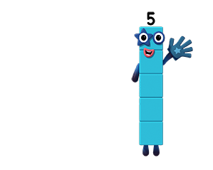
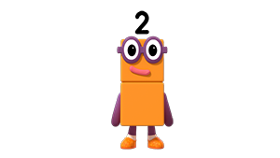
Images © 2017 Alphablocks Ltd. All Rights Reserved.

Slide 28
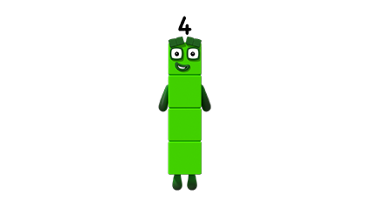
Images © 2017 Alphablocks Ltd. All Rights Reserved.

Slide 29
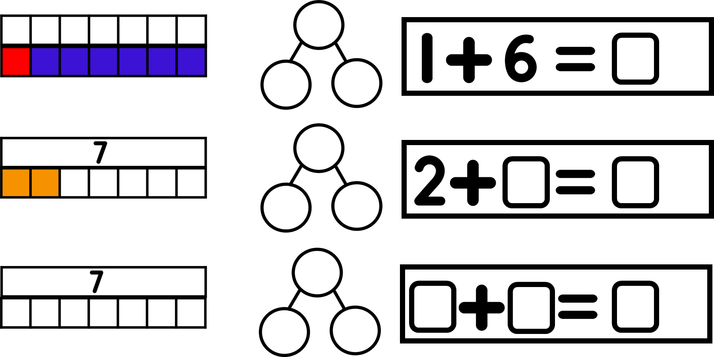
Images © 2017 Alphablocks Ltd. All Rights Reserved.
Notes:
Ask the children to work independently on this task, completing the missing information for bonds for 7.
Complete together to check answers.
What could be the next in the sequence?

Slide 30
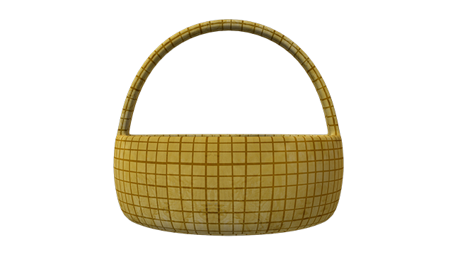
Seven puts all of his fluffies in both baskets.
?
Images © 2017 Alphablocks Ltd. All Rights Reserved.
Notes:
These next four slides (30 to 33) enable the children to apply their learning of number bonds for 7 in a new context.
The number of fluffies in one basket is known. The children must use their number bonds to work out how many fluffies are in the other basket.
Click 1 reveals the quantity of fluffies and the numeral.

Slide 31
Seven puts all of his fluffies in both baskets.
?
Images © 2017 Alphablocks Ltd. All Rights Reserved.

Slide 32
Seven puts all of his fluffies in both baskets.
?
Images © 2017 Alphablocks Ltd. All Rights Reserved.

Slide 33
Seven puts all of his fluffies in both baskets.
?
Images © 2017 Alphablocks Ltd. All Rights Reserved.

