Slide 1
1.2 Introducing 'whole' and 'parts’: part–part–whole
Representations | Year 1
Number, Addition and Subtraction

Slide 2
How to use this presentation
You can find the teacher guide 1.2 Introducing 'whole' and 'parts': part–part–whole by following the link below.

Slide 3

1.2 Part–part–whole – step 1:1

Slide 4

1.2 Part–part–whole – step 1:1

Slide 5

1.2 Part–part–whole – step 1:2

Slide 6


1.2 Part–part–whole – step 1:3

Slide 7
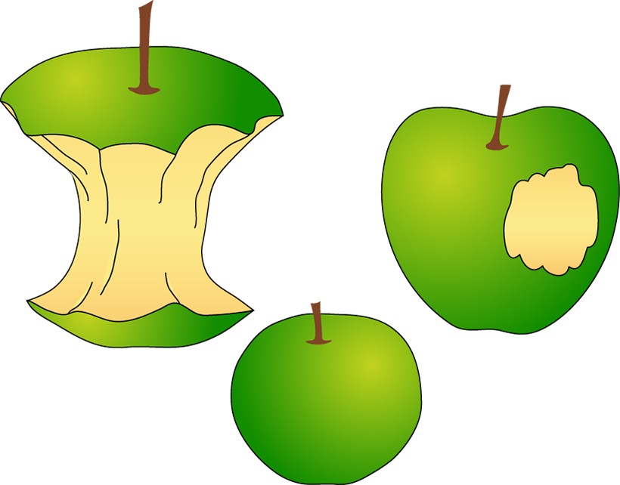
1.2 Part–part–whole – step 1:3

Slide 8




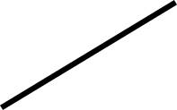











1.2 Part–part–whole – step 2:1

Slide 9
1.2 Part–part–whole – step 2:1

Slide 10

1.2 Part–part–whole – step 2:3

Slide 11
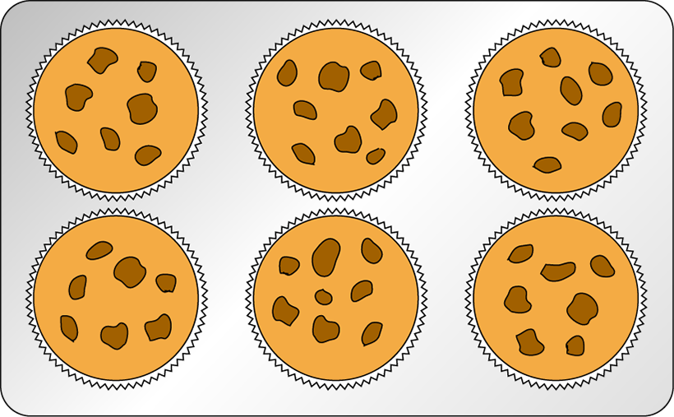
1.2 Part–part–whole – step 3:1

Slide 12
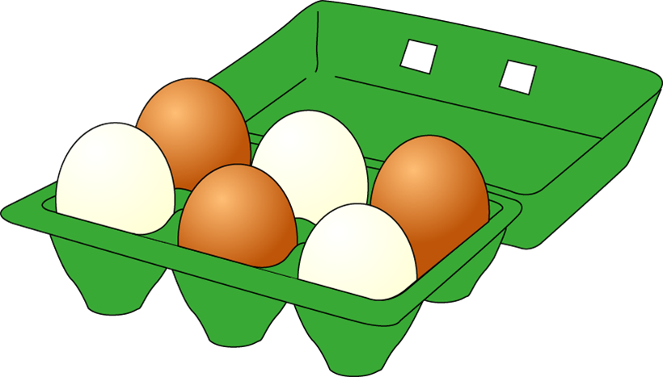
1.2 Part–part–whole – step 3:2

Slide 13
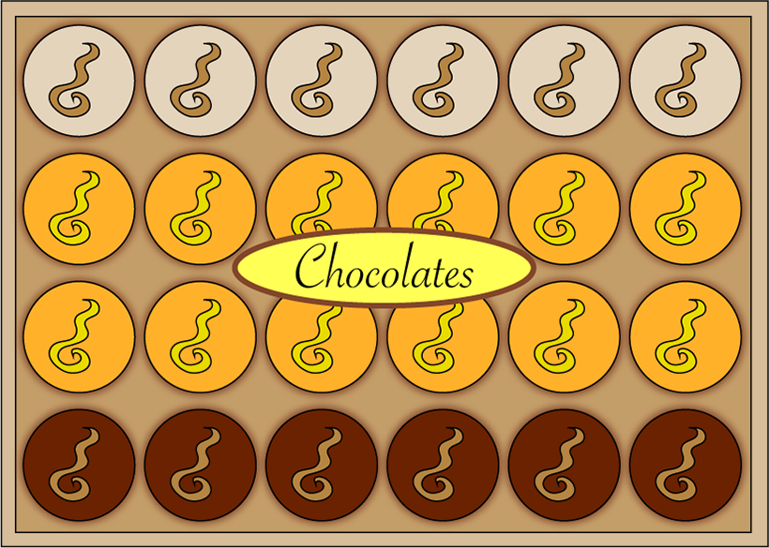
1.2 Part–part–whole – step 3:2

Slide 14
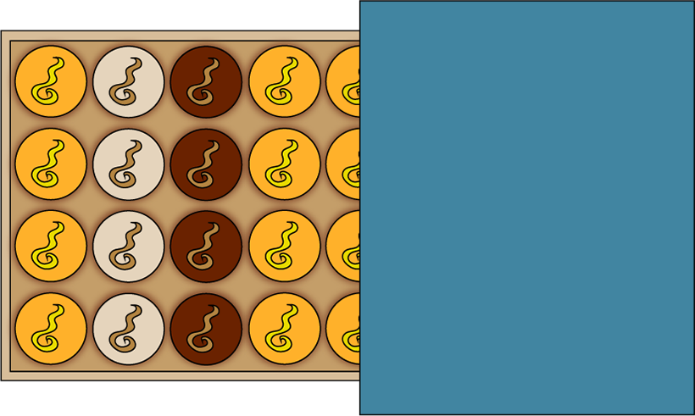
1.2 Part–part–whole – step 3:2

Slide 15
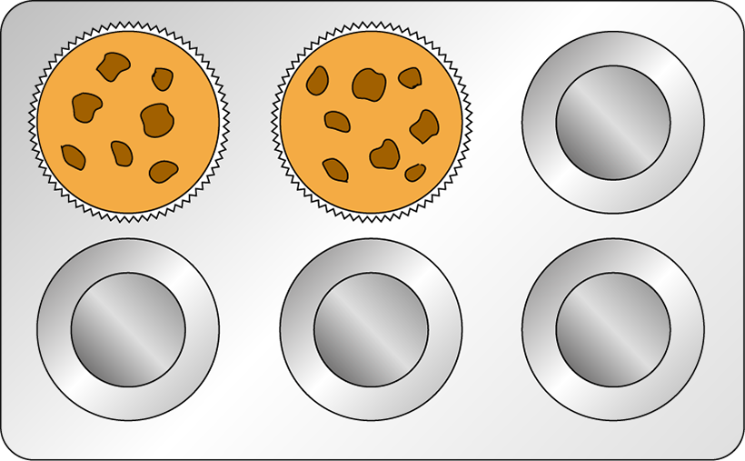
1.2 Part–part–whole – step 3:2

Slide 16


1.2 Part–part–whole – step 3:3

Slide 17

1.2 Part–part–whole – step 3:4

Slide 18
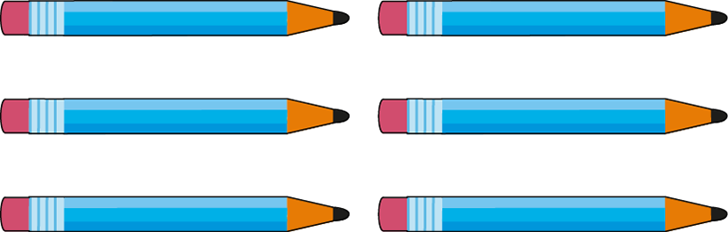
1.2 Part–part–whole – step 3:4

Slide 19


1.2 Part–part–whole – step 3:5

Slide 20
1.2 Part–part–whole – step 3:5

Slide 21
1.2 Part–part–whole – step 3:5

Slide 22
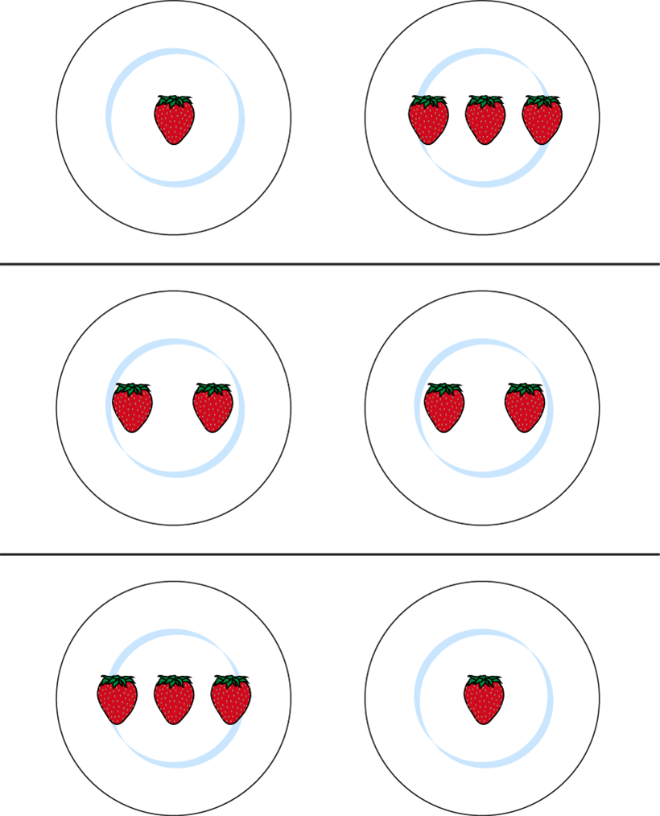
1.2 Part–part–whole – step 3:5

Slide 23




1.2 Part–part–whole – step 4:1

Slide 24
1.2 Part–part–whole – step 4:1

Slide 25
1.2 Part–part–whole – step 4:1
5

Slide 26






1.2 Part–part–whole – step 4:2

Slide 27
1.2 Part–part–whole – step 4:2

Slide 28
1.2 Part–part–whole – step 4:2

Slide 29




1.2 Part–part–whole – step 4:3
3

Slide 30
1.2 Part–part–whole – step 4:3
2
3
1

Slide 31

1.2 Part–part–whole – step 4:4

Slide 32
1.2 Part–part–whole – step 4:4

Slide 33
1.2 Part–part–whole – step 4:4

Slide 34
1.2 Part–part–whole – step 4:4

Slide 35
1.2 Part–part–whole – step 4:4
5
3
2

Slide 36
1.2 Part–part–whole – step 4:4
5
2
3

Slide 37
1.2 Part–part–whole – Steps 4:4
1.2 Part–part–whole – step 4:4
5
1
4

Slide 38
1.2 Part–part–whole – step 4:4
5
4
1

Slide 39

1.2 Part–part–whole – step 4:7

Slide 40
1.2 Part–part–whole – step 4:7

Slide 41
1.2 Part–part–whole – printable cherry diagram

