Slide 1
Year 4, Unit 5
7 times tables and patterns

Slide 2
Year 4, Unit 5
These materials heavily reflect the prioritisation approach of the ready-to-progress criteria in the DfE Primary Mathematics Guidance 2020 and on the PPTs that exemplify them on the NCETM website. They also include other relevant National Curriculum content. Related sections of the NCETM Primary Mastery Professional Development Materials provide small-step teaching guidance.
Ready-to-progress criteria addressed by this unit
Teaching of this unit supports the following criteria from the ‘DfE Mathematics Guidance: key stages 1 & 2’ (the 335-page document available as a download)
4NF-1 page 160
Prior learning
If the following ready-to-progress criteria, contained in the same DfE guidance document as above, were secured in Year 1, children will be ready to start on this unit.
3NF-2 Page 100

Slide 3
Contents
The links below take you to the starting slide of each learning outcome.
1 | Pupils represent counting in sevens as the 7 times table
2 | Pupils explain the relationship between adjacent multiples of seven
3 | Pupils use their knowledge of the 7 times table to solve problems
4 | Pupils identify patterns of odd and even numbers in the times tables
5 | Pupils represent a square number
6 | Pupils use knowledge of divisibility rules to solve problems
Click the arrow button to return to this Contents slide.

Slide 4
Year 4, Unit 5, Learning Outcome 1
Learning Outcome 1
Pupils represent counting in sevens as the 7 times table
The following slides have been collated to support the teaching of this learning outcome.

Slide 5
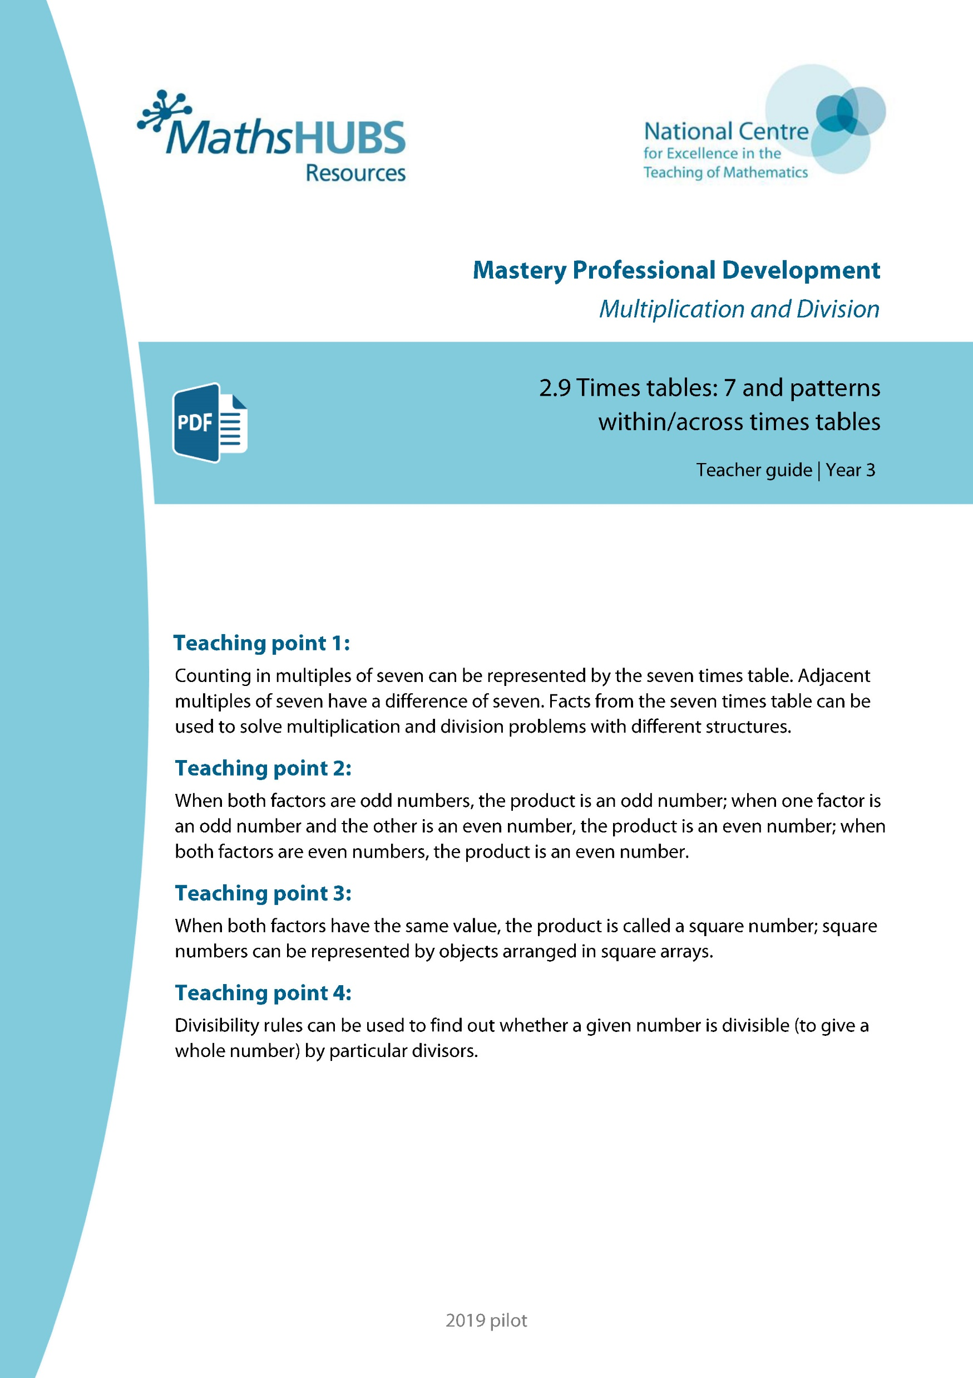
Year 4, Unit 5, Learning Outcome 1
Additional teacher guidance for this outcome should be read first and can be found in this segment of the NCETM Primary Mastery Professional Development Materials:
2.9 Times Tables: 7 and patterns within / across times tables
The spine materials are divided into ‘teaching points’ and ‘steps in learning’.
Teaching point | Steps in learning | Pages
1 | 1:1-1:7 | 4-12

Slide 6
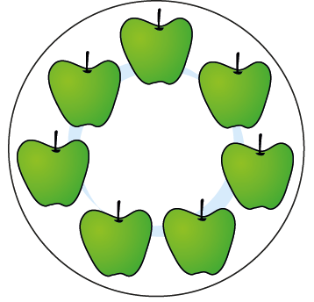
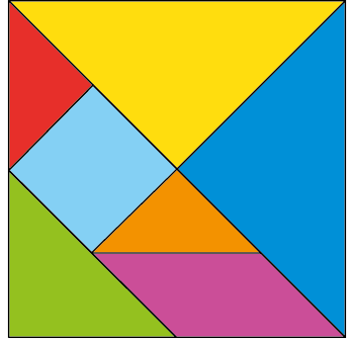


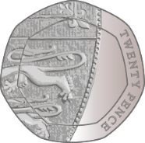
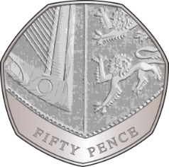

2.9 The 7 times table and patterns Step 1:1
Notes:
What’s the same?
What’s different?

Slide 7




2.9 The 7 times table and patterns Step 1:2
How many players? Count in groups of 7.
0
7
14
There are 14 players.
2 × 7 = 14
7 × 2 = 14
Notes:
Seven, fourteen. There are fourteen players.
There are two groups of seven; there are fourteen altogether.
There are seven, two times; there are fourteen altogether.
Two is a factor.
Seven is a factor.
The product of two and seven is fourteen.
Fourteen is the product of two and seven.

Slide 8
2.9 The 7 times table and patterns Step 1:3
0
7
14
21
28
35
42
49
56
63
70
77
84

Slide 9
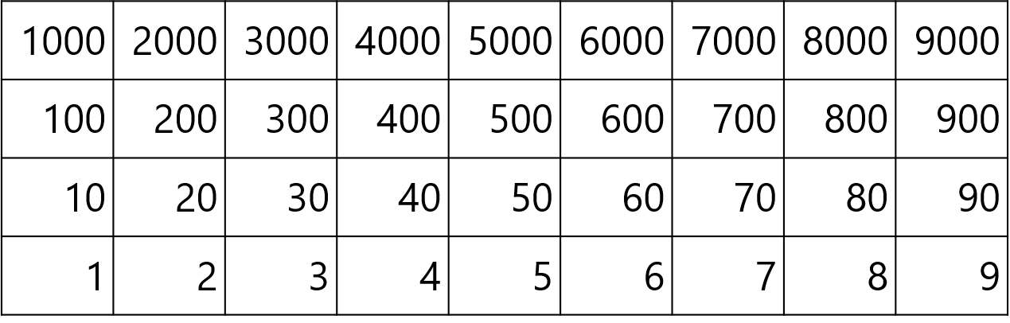
2.9 The 7 times table and patterns Step 1:3

Slide 10






2.9 The 7 times table and patterns Step 1:4
Number of teams
Total number of players
0
1
2
3
4
5
6
0
7
14
21
28
35
42
0
2 × 7 = 14
3 × 7 = 21
4 × 7 = 28
5 × 7 = 35
6 × 7 = 42
0 × 7 = 0
1 × 7 = 7
7 × 0 = 0
7 × 1 = 7
7 × 2 = 14
7 × 3 = 21
7 × 4 = 28
7 × 5 = 35
7 × 6 = 42

Slide 11
2.9 The 7 times table and patterns Step 1:5
Number of teams | Total number of players
0 | 0
1 | 7
2 | 14
3 | 21
4 | 28
5 | 35
6 | 42
7 | 49
8 | 56
9 | 63
10 | 70
11 | 77
12 | 84
0 × 7 = 0 | 7 × 0 = 0
1 × 7 = 7 | 7 × 1 = 7
2 × 7 = 14 | 7 × 2 = 14
3 × 7 = 21 | 7 × 3 = 21
4 × 7 = 28 | 7 × 4 = 28
5 × 7 = 35 | 7 × 5 = 35
6 × 7 = 42 | 7 × 6 = 42
7 × 7 = 49 | 7 × 7 = 49
8 × 7 = 56 | 7 × 8 = 56
9 × 7 = 63 | 7 × 9 = 63
10 × 7 = 70 | 7 × 10 = 70
11 × 7 = 77 | 7 × 11 = 77
12 × 7 = 84 | 7 × 12 = 84

Slide 12
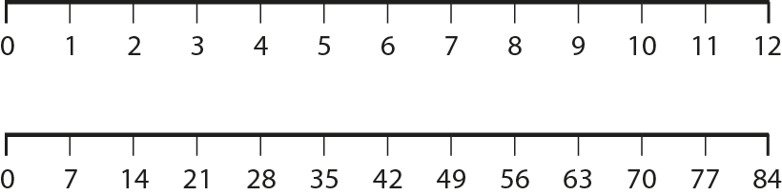
2.9 The 7 times table and patterns Step 1:6

Slide 13

2.9 The 7 times table and patterns Step 1:7
How many spots?
2 × 7 =
14
7 × 2 =
14
Notes:
Complete the equations to show how many spots there are altogether.

Slide 14

2.9 The 7 times table and patterns Step 1:7
How many spots?
3
× 7 =
21
7 ×
3
=
21

Slide 15

2.9 The 7 times table and patterns Step 1:7
How many spots?
4
×
7
=
28
7
×
4
=
28

Slide 16
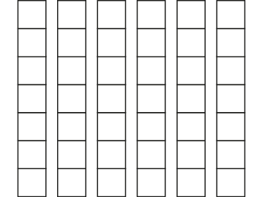
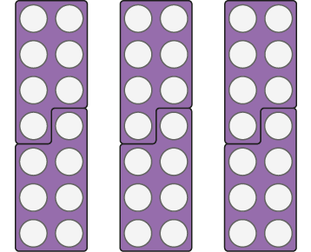
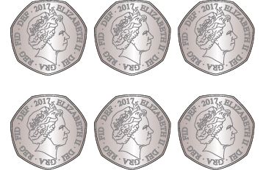
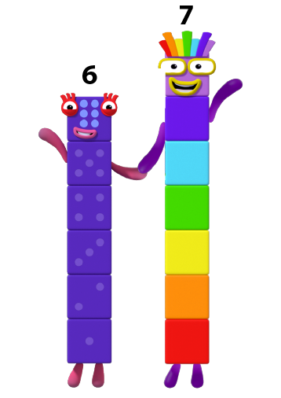
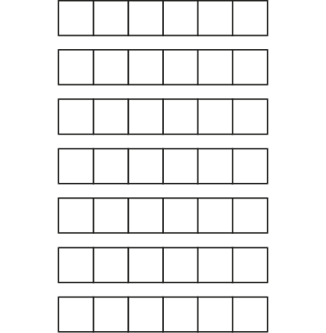

2.9 The 7 times table and patterns Step 1:7
Represents 6 groups of 7?
© 2017 Alphablocks Ltd. All rights reserved.
Notes:
Six vertical strips of seven squares: does show groups of seven.
6 × 7 = 42 7 × 6 = 42
Three pairs of seven value base-ten number boards: does show groups of seven.
6 × 7 = 42 7 × 6 = 42
Six fifty-pence coins: does show groups of seven (seven sides or seven points on each coin).
6 × 7 = 42 7 × 6 = 42
Three tangrams: does show groups of seven.
3 × 7 = 21 7 × 3 = 21
Numberblocks: does not show groups of seven (it shows six and seven together, not six multiplied by seven).
Seven horizontal strips of six squares: does not show groups of seven (it shows seven groups of six which,
although represented by 6 × 7 = 42 and 7 × 6 = 42, is not the same interpretation of the multiplication fact).

Slide 17
Year 4, Unit 5, Learning Outcome 2
Learning Outcome 2
Pupils explain the relationship between adjacent multiples of seven
The following slides have been collated to support the teaching of this learning outcome.

Slide 18
Year 4, Unit 5, Learning Outcome 2
Additional teacher guidance for this outcome should be read first and can be found in this segment of the NCETM Primary Mastery Professional Development Materials:
2.9 Times Tables: 7 and patterns within / across times tables
The spine materials are divided into ‘teaching points’ and ‘steps in learning’.
Teaching point | Steps in learning | Pages
1 | 1:8-1:9 | 13-16

Slide 19
2.9 The 7 times table and patterns Step 1:8
 |  |  |  |  |  |  |  | × 7
0 × 7 | = | 0 | 7 × 0 | = | 0 |  | 0 | 0
1 × 7 | = | 7 | 7 × 1 | = | 7 |  | 1 | 7
2 × 7 | = | 14 | 7 × 2 | = | 14 |  | 2 | 14
3 × 7 | = | 21 | 7 × 3 | = | 21 |  | 3 | 21
4 × 7 | = | 28 | 7 × 4 | = | 28 |  | 4 | 28
5 × 7 | = | 35 | 7 × 5 | = | 35 |  | 5 | 35
6 × 7 | = | 42 | 7 × 6 | = | 42 |  | 6 | 42
7 × 7 | = |  | 7 × 7 | = |  |  | 7
8 × 7 | = | 56 | 7 × 8 | = | 56 |  | 8 | 56
9 × 7 | = | 63 | 7 × 9 | = | 63 |  | 9 | 63
10 × 7 | = | 70 | 7 × 10 | = | 70 |  | 10 | 70
11 × 7 | = |  | 7 × 11 | = |  |  | 11
12 × 7 | = |  | 7 × 12 | = |  |  | 12
↓ + 7
7 × 7 = 6 × 7 + 7
49
49
49
↑ − 7
= 42 + 7
7 × 7 = 8 × 7 − 7
= 49
= 56 − 7
= 49
↓ + 7
11 × 7 = 10 × 7 + 7
12 × 7 = 11 × 7 + 7
77
77
77
↓ + 7
= 70 + 7
= 77 + 7
84
84
84
= 77
= 84

Slide 20

2.9 The 7 times table and patterns Step 1:8
5 × 7 =
35
7 × 7 =
49
5 × 7 = 35
7 × 7 = 5 × 7
+ 14
+ 7
+ 7
= 35 + 14
5 × 7
7 × 7

Slide 21


2.9 The 7 times table and patterns Step 1:8
12 × 7 =
84
10 × 7 = 70
12 × 7 = 10 × 7 + 7 + 7
12 × 7 = 10 × 7 + 14
12 × 7 = 70 + 14
= 84
7
14
7

Slide 22
Year 4, Unit 5, Learning Outcome 3
Learning Outcome 3
Pupils use their knowledge of the 7 times table to solve problems
The following slides have been collated to support the teaching of this learning outcome.

Slide 23
Year 4, Unit 5, Learning Outcome 3
Additional teacher guidance for this outcome should be read first and can be found in this segment of the NCETM Primary Mastery Professional Development Materials:
2.9 Times Tables: 7 and patterns within / across times tables
The spine materials are divided into ‘teaching points’ and ‘steps in learning’.
Teaching point | Steps in learning | Pages
1 | 1:10-1:11 | 17-18

Slide 24
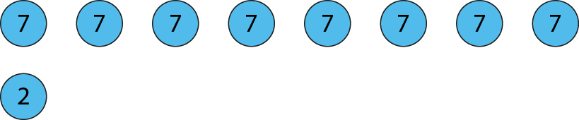


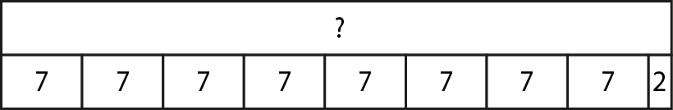
2.9 The 7 times table and patterns Step 1:10
8 dance sections, 7 children in each. Plus 2 narrators.
How many children altogether?
58
8 × 7 + 2
= 56 + 2
= 58
Notes:
Seven children are needed in each of the eight dance sections in the school assembly.
Two children are also needed as narrators.
How many children are needed altogether?

Slide 25
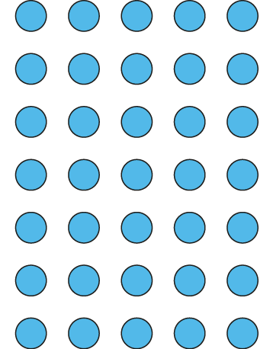
2.9 The 7 times table and patterns Step 1:11
Circle the groups of 7.
Circle the 7 equal groups.
There are groups of 7.
There are 7 groups of .
5
5
5
7 × = 35
5
× 7 = 35

Slide 26
Year 4, Unit 5, Learning Outcome 4
Learning Outcome 4
Pupils identify patterns of odd and even numbers in the times tables
The following slides have been collated to support the teaching of this learning outcome.

Slide 27
Year 4, Unit 5, Learning Outcome 4
Additional teacher guidance for this outcome should be read first and can be found in this segment of the NCETM Primary Mastery Professional Development Materials:
2.9 Times Tables: 7 and patterns within / across times tables
The spine materials are divided into ‘teaching points’ and ‘steps in learning’.
Teaching point | Steps in learning | Pages
2 | 2:1-2:4 | 19-23

Slide 28


2.9 The 7 times table and patterns Step 2:1
2 × 7 = 14
4 × 7 = 28
6 × 7 = 42
3 × 7 = 21
5 × 7 = 35
7 × 7 = 49
1 × 7 = 7
7 × 2 = 14
7 × 4 = 28
7 × 6 = 42
7 × 3 = 21
7 × 5 = 35
7 × 7 = 49
7 × 1 = 7
even
odd
odd
odd
even
odd
odd
odd
even
odd
even
odd

Slide 29
2.9 The 7 times table and patterns Step 2:4
Odd or even?
 | product is odd | product is even
21 × 7
= 147
✓
predict
odd
odd
7 × 32
= 224
predict
✓
odd
even
46 × 7
= 322
✓
predict
even
odd
8 × 68
= 544
✓
predict
even
even

Slide 30
Year 4, Unit 5, Learning Outcome 5
Learning Outcome 5
Pupils represent a square number
The following slides have been collated to support the teaching of this learning outcome.

Slide 31
Year 4, Unit 5, Learning Outcome 5
Additional teacher guidance for this outcome should be read first and can be found in this segment of the NCETM Primary Mastery Professional Development Materials:
2.9 Times Tables: 7 and patterns within / across times tables
The spine materials are divided into ‘teaching points’ and ‘steps in learning’.
Teaching point | Steps in learning | Pages
3 | 3:1-3:4 | 24-28

Slide 32
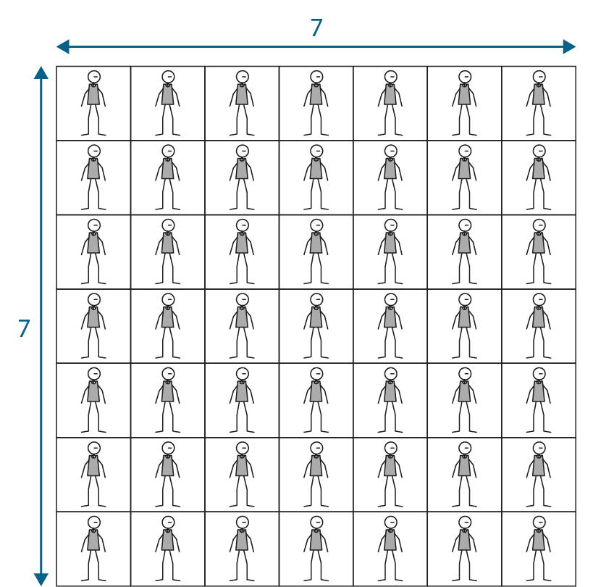
2.9 The 7 times table and patterns Step 3:1
7 teams, each with 7 players.
7
7
7 × 7 =
49
The factors are the same.
The product is a square number.
Notes:
Both of the factors are the same.
So the product is a square number.
This can be represented by a square-shaped array.

Slide 33

2.9 The 7 times table and patterns Step 3:1
4
4
4 × 4 =
16
The factors are the same.
The product is a square number.
Notes:
Both of the factors are the same.
So the product is a square number.
This can be represented by a square-shaped array.

Slide 34

2.9 The 7 times table and patterns Step 3:1
© 2017 Alphablocks Ltd. All rights reserved.
2 × 2 = 4

Slide 35
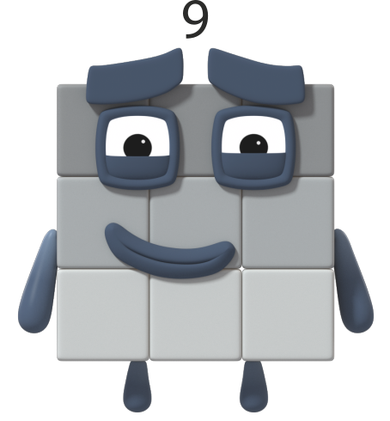
2.9 The 7 times table and patterns Step 3:1
© 2017 Alphablocks Ltd. All rights reserved.
3 × 3 = 9

Slide 36

2.9 The 7 times table and patterns Step 3:2
7
×
7
=
4
9
7²
=
4
9
Notes:
There are seven netball teams, each with seven players.
We can write this as seven times seven equals forty-nine.
Both factors are the same, so we can also write this as seven squared equals forty-nine.

Slide 37
2.9 The 7 times table and patterns Step 3:3
× | 0 | 1 | 2 | 3 | 4 | 5 | 6 | 7 | 8 | 9 | 10 | 11 | 12
0 | 0 | 0 | 0 | 0 | 0 | 0 | 0 | 0 | 0 | 0 | 0 | 0 | 0
1 | 0 | 1 | 2 | 3 | 4 | 5 | 6 | 7 | 8 | 9 | 10 | 11 | 12
2 | 0 | 2 | 4 | 6 | 8 | 10 | 12 | 14 | 16 | 18 | 20 | 22 | 24
3 | 0 | 3 | 6 | 9 | 12 | 15 | 18 | 21 | 24 | 27 | 30 | 33 | 36
4 | 0 | 4 | 8 | 12 | 16 | 20 | 24 | 28 | 32 | 36 | 40 | 44 | 48
5 | 0 | 5 | 10 | 15 | 20 | 25 | 30 | 35 | 40 | 45 | 50 | 55 | 60
6 | 0 | 6 | 12 | 18 | 24 | 30 | 36 | 42 | 48 | 54 | 60 | 66 | 72
7 | 0 | 7 | 14 | 21 | 28 | 35 | 42 | 49 | 56 | 63 | 70 | 77 | 84
8 | 0 | 8 | 16 | 24 | 32 | 40 | 48 | 56 | 64 | 72 | 80 | 88 | 96
9 | 0 | 9 | 18 | 27 | 36 | 45 | 54 | 63 | 72 | 81 | 90 | 99 | 108
10 | 0 | 10 | 20 | 30 | 40 | 50 | 60 | 70 | 80 | 90 | 100 | 110 | 120
11 | 0 | 11 | 22 | 33 | 44 | 55 | 66 | 77 | 88 | 99 | 110
12 | 0 | 12 | 24 | 36 | 48 | 60 | 72 | 84 | 96 | 108 | 120

Slide 38
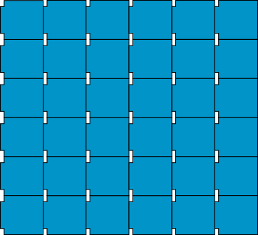
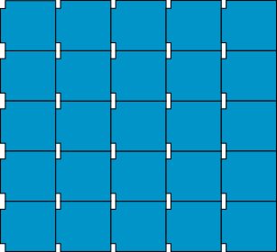
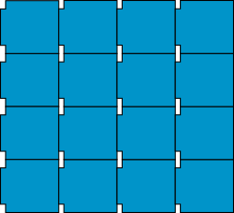
2.9 The 7 times table and patterns Step 3:4
4 × 4 = 16
5 × 5 = 25
6 × 6 = 36
4² = 16
5² = 25
6² = 36

Slide 39
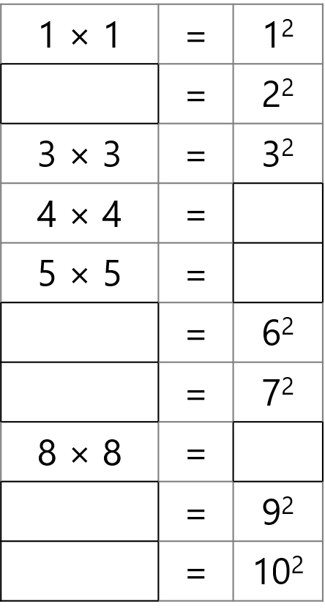
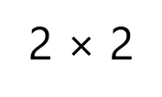


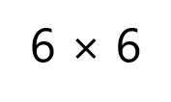
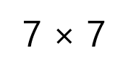

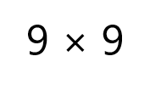
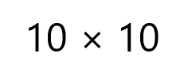
2.9 The 7 times table and patterns Step 3:4
Notes:
Fill in the missing parts of the equations.

Slide 40
2.9 The 7 times table and patterns Step 3:4
4² > 4 + 4
>
4² > 4 × 2
>
4² = 4 × 4
=
>
4² > 4 + 2
Notes:
Fill in the missing symbols. (<, >, or =).

Slide 41
Year 4, Unit 5, Learning Outcome 6
Learning Outcome 6
Pupils use knowledge of divisibility rules to solve problems
The following slides have been collated to support the teaching of this learning outcome.

Slide 42
Year 4, Unit 5, Learning Outcome 6
Additional teacher guidance for this outcome should be read first and can be found in this segment of the NCETM Primary Mastery Professional Development Materials:
2.9 Times Tables: 7 and patterns within / across times tables
The spine materials are divided into ‘teaching points’ and ‘steps in learning’.
Teaching point | Steps in learning | Pages
4 | 4:1-4:3 | 29-32

Slide 43
2.9 The 7 times table and patterns Step 4:2
Divisibility rules in ‘families’ – 2, 4 and 8
2
A number is divisible by 2 if the ones digit is
even.
4
If halving a number gives an even value, then
the number is divisible by 4.
and
For numbers with more than two digits: if the
final two digits are divisible by 4 then the
number is divisible by 4.
8
If halving a number twice gives an even value,
the number is divisible by 8.

Slide 44
2.9 The 7 times table and patterns Step 4:2
Divisibility rules in ‘families’ – 5 and 10
5
A number is divisible by 5 if the ones digit is
5 or 0.
10
A number is divisible by 10 if the ones digit
is 0.

Slide 45
2.9 The 7 times table and patterns Step 4:2
Divisibility rules in ‘families’ – 3, 6 and 9
3
For a number to be divisible by 3, the sum
of the digits of the number must be divisible
by 3.
6
For a number to be divisible by 6, the number
must be divisible by both 2 and 3.
9
For a number to be divisible by 9, the sum of the digits of the number must be divisible by 9.

Slide 46
2.9 The 7 times table and patterns Step 4:2
Divisibility rules in numerical order
2 | A number is divisible by 2 if the ones digit is even.
3 | For a number to be divisible by 3, the sum of the digits of the number must be divisible by 3.
4 | If halving a number gives an even value, then the number is divisible by 4. and For numbers with more than two digits: if the final two digits are divisible by 4 then the number is divisible by 4.
5 | A number is divisible by 5 if the ones digit is 5 or 0.

Slide 47
2.9 The 7 times table and patterns Step 4:2
Divisibility rules in numerical order
6 | For a number to be divisible by 6, the number must be divisible by both 2 and 3.
8 | If halving a number twice gives an even value, the number is divisible by 8.
9 | For a number to be divisible by 9, the sum of the digits of the number must be divisible by 9.
10 | A number is divisible by 10 if the ones digit is 0.

Slide 48
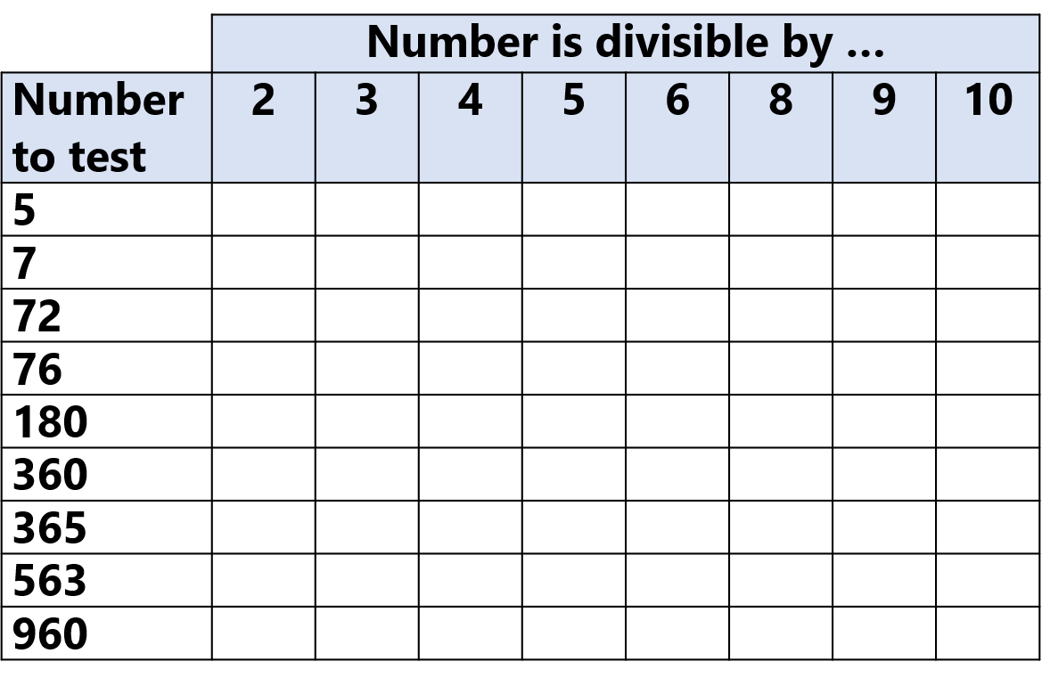

2.9 The 7 times table and patterns Step 4:3
Notes:
Tick to show which numbers are divisible by 2, 3, 4, 5, 6, 8, 9, 10.

