Slide 1
Series 3 Episode 3
Numberblocks Express

Slide 2
Practitioner Notes

Slide 3
Episode Description
Only Five can stop the runaway train but it's not as easy as it seems. Obstacles get in the way and Five keeps separating into smaller Numberblocks. Thankfully they all have ideas for how to recombine to get back to Five again because only Five can stop the train.

Slide 4
Maths in the Episode
Numberbonds up to 5
In this episode we see can see numbers to 5 being partitioned in different ways. Every time Five is recombined, she is partitioned again in a different way. There are no written equations shown in the episode although the language of addition (four plus one) and subtraction (five minus one) is used throughout to represent addition as ‘aggregation’ and subtraction as ‘partitioning’. The focus of learning is on the concept of wholes and parts being partitioned and recombined.

Slide 5
Using Mathematical Language
Use these stem sentences to rehearse the mathematical ideas in the programme:
“<5 is the whole, <3> is a part and <2> is a part.”
“<5> is the whole, <2> is a part, <2> is a part and <1> is a part.”
“<5> can be partitioned into <2> and <2> and <1>”
“<4> plus <1> equals 5.”
“<5> minus <1> equals <4>.”
Notes:
< > indicates what can be changed in the stem sentence.

Slide 6
Talk and Discuss Together

Slide 7
Talk and Discuss Together
Watch the episode of Numberblocks. Use the following picture as a stimulus. Who has been on a train? Do the things that happened to Five, normally happen on trains? What do you notice about the train? Where do you think the driver goes? Which Numberblock can stop the train? What happened to Five in this episode?
The following slides are designed to stimulate children and adults to talk about the episode and draw out some key aspects of the mathematics.

Slide 8
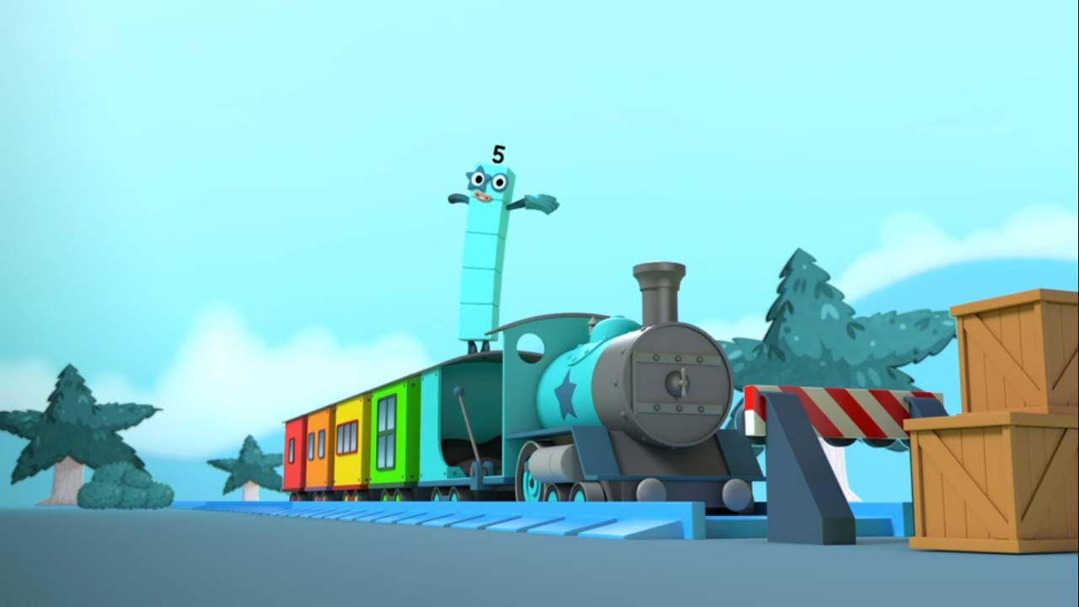
Images © 2017 Alphablocks Ltd. All Rights Reserved.
Notes:
Use this picture as the stimulus for Talk and Discussion (slide 7).

Slide 9
Enabling Environments in Reception

Slide 10
Enabling Environments
Playing and Exploring
Set up the class train set. Sort the carriages into different colours. Find different ways to make a train with 5 carriages. Compare the trains and count the numbers of different colours. E.g. 2 red carriages and 3 yellow carriages.
Active Learning
Notice if children can hold up 1,2,3,4,5 fingers without counting. Can they show you five in different ways using their fingers?
Creating and Thinking Critically
Play ‘musical carriages’ (like musical chairs) with 5 children. Set up 5 big boxes as coaches or chairs in a row facing in one direction as though they are on a train. Play the Numberblocks Express song. When paused all sit on a chair. Play again and remove one ‘carriage’. Pause the music. How many sitting? How many left out? Repeat until no seats are left.

Slide 11
Learning Together in Y1

Slide 12

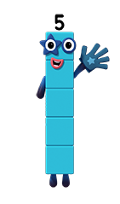

How can I get on the Numberblocks Express?
Images © 2017 Alphablocks Ltd. All Rights Reserved.
Notes:
Read the speech bubble: “How can I get on the Numberblocks Express?”
Notice that there is only one carriage.
So, Five can remain as a ‘whole’ and jump in the red carriage.

Slide 13
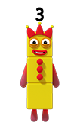
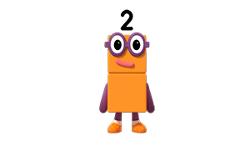
How can I get on the Numberblocks Express?
Images © 2017 Alphablocks Ltd. All Rights Reserved.
Notes:
Use this slide to investigate ways to partition Five into two parts so a part can go into each carriage.
Read the speech bubble and discuss how Five could partition.
Say: “Five can be partitioned two and three.”
Is there another way that Five could ride in the carriages?

Slide 14
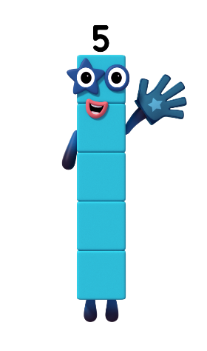


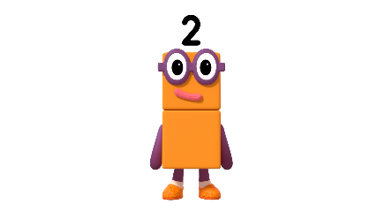


How can I get on the Numberblocks Express?
Images © 2017 Alphablocks Ltd. All Rights Reserved.
Notes:
Use this slide to investigate ways to partition 5 into 3 parts.
Discuss what happens to Five as she gets on the train.
What is different to the previous way Five was partitioned?
Say “Five can be partitioned into two and two and one.”
Is there another way that Five could ride in three carriages?

Slide 15
Further activities for Y1
Explore further ways of separating 5 into 3, 4 and 5 carriages. Use next three slides as base boards to explore with cubes.
Create other opportunities to ‘notice’ how five can be partitioned, e.g. Five children (including boys and girls) in a line, some wearing hats, some wearing hats and glasses. How could we partition the five children in different ways? Can we find ways to partition them into three ‘parts’? How can we represent this using a picture, diagram or equation?
Write numbers in part-whole models (‘cherry’ model or bar model). Five is the whole.
Write the partitioning as equations. (Five as Two and Three can be recorded as an addition in different ways: 2 + 3 = 5, 3 + 2 = 5, 5 = 2 + 3, 5 = 3 + 2)
Write the missing numbers in equations. E.g. 5 = 2 + o +1

Slide 16
Images © 2017 Alphablocks Ltd. All Rights Reserved.
Notes:
Print off this slide for investigating partitioning into 3 parts. See slide 15.

Slide 17

Images © 2017 Alphablocks Ltd. All Rights Reserved.
Notes:
Print off this slide for investigating partitioning into 3 parts. See slide 15.

Slide 18
Images © 2017 Alphablocks Ltd. All Rights Reserved.
Notes:
Print off this slide for investigating partitioning into 3 parts. See slide 15.

Slide 19
Learning Together in Y2

Slide 20
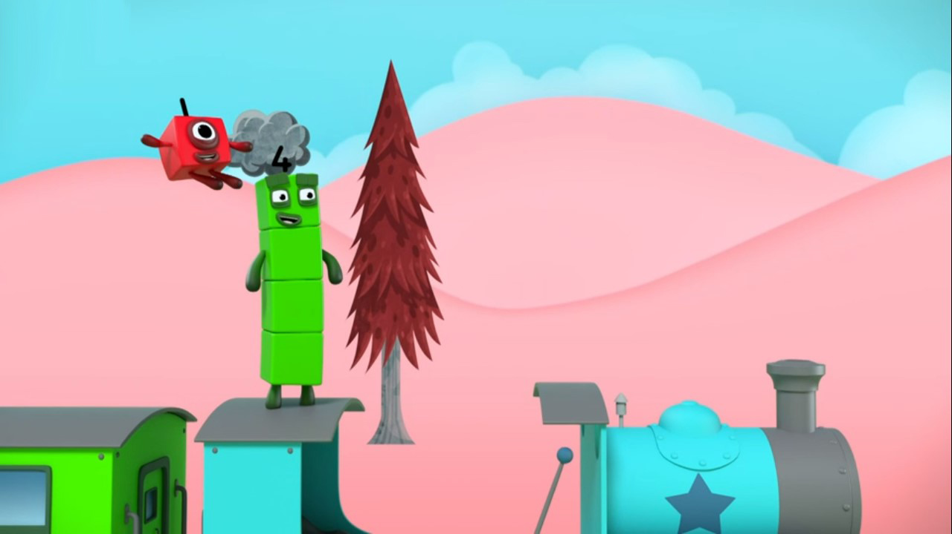





Images © 2017 Alphablocks Ltd. All Rights Reserved.
Notes:
Use this slide to represent the ‘story’ with an equation.
What was happening in this part of the episode? (Children might see and describe it as a partitioning (taking apart) story or as a reduction (taking away) story. Either of these can be represented using the subtraction equation 5 - 1 = 4 although the focus in this episode is on partitioning.)
How does the equation 5 - 1 = 4 represent what was happening in the story? (Five partitioned into one and four.)

Slide 21
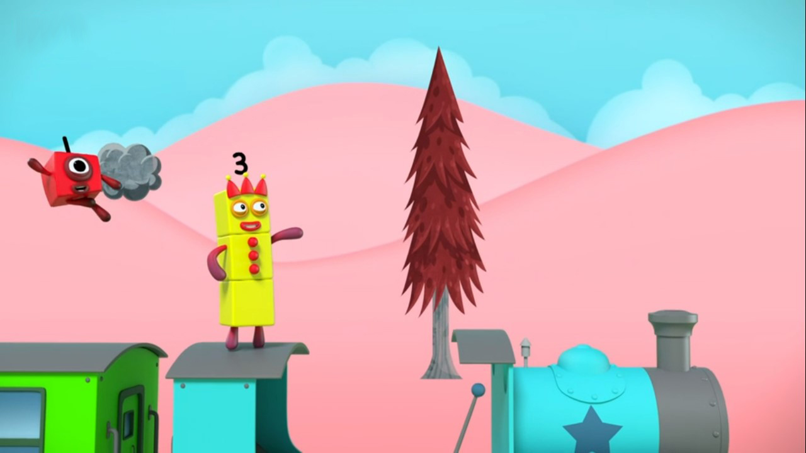

Images © 2017 Alphablocks Ltd. All Rights Reserved.
Notes:
Use this slide to represent the ‘story’ with an equation.
What was happening in this part of the episode? What was happening before One broke off Three? (Four was standing on the engine.)
If this equation is telling the story of Four partitioning into One and Three, how can this equation represent this story?
What does each number in the equation mean?

Slide 22
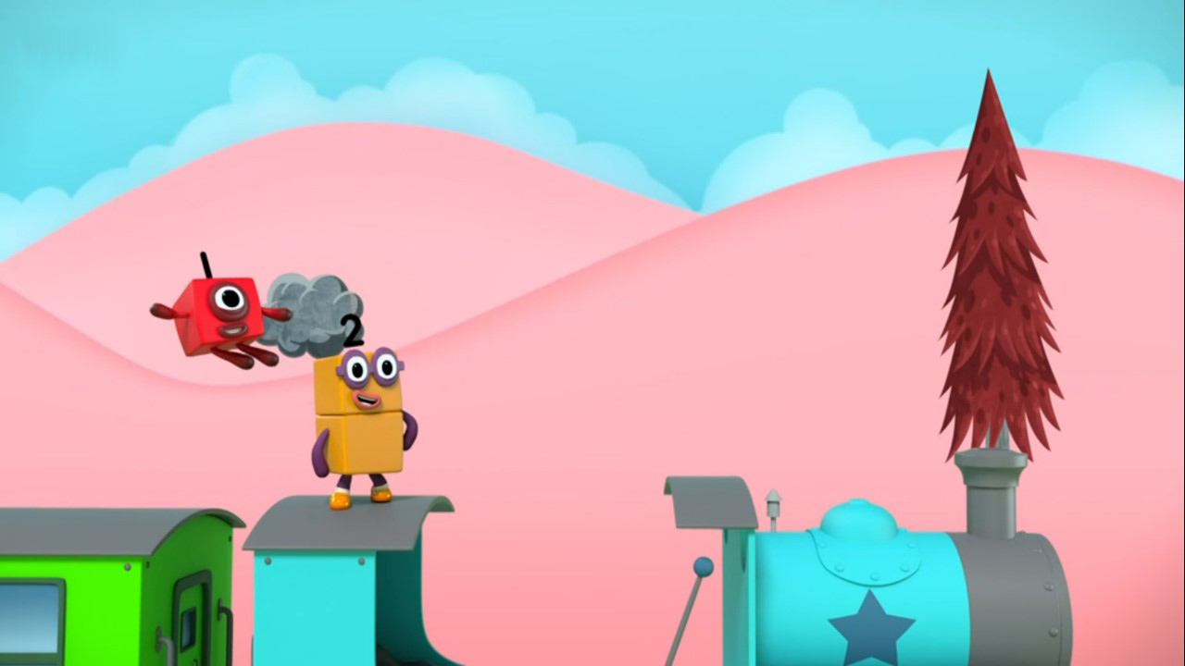

Images © 2017 Alphablocks Ltd. All Rights Reserved.
Notes:
Use this slide to represent the ‘story’ with an equation.
What was happening in this part of the episode? What was happening before One broke off Three? (Four was standing on the engine.)
If this equation is telling the story of Three partitioning into One and Two, how can this equation represent this story?
What does each number in the equation mean?

Slide 23
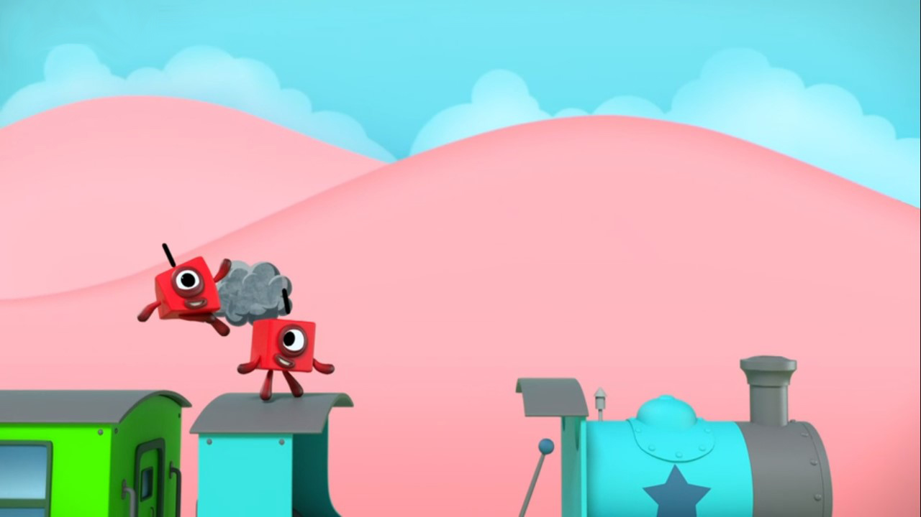
Images © 2017 Alphablocks Ltd. All Rights Reserved.
Notes:
Use this slide to represent the ‘story’ with an equation.
What was happening in this part of the episode?
If this equation is telling the story of Two partitioning into One and One, how can this equation represent this story?

Slide 24
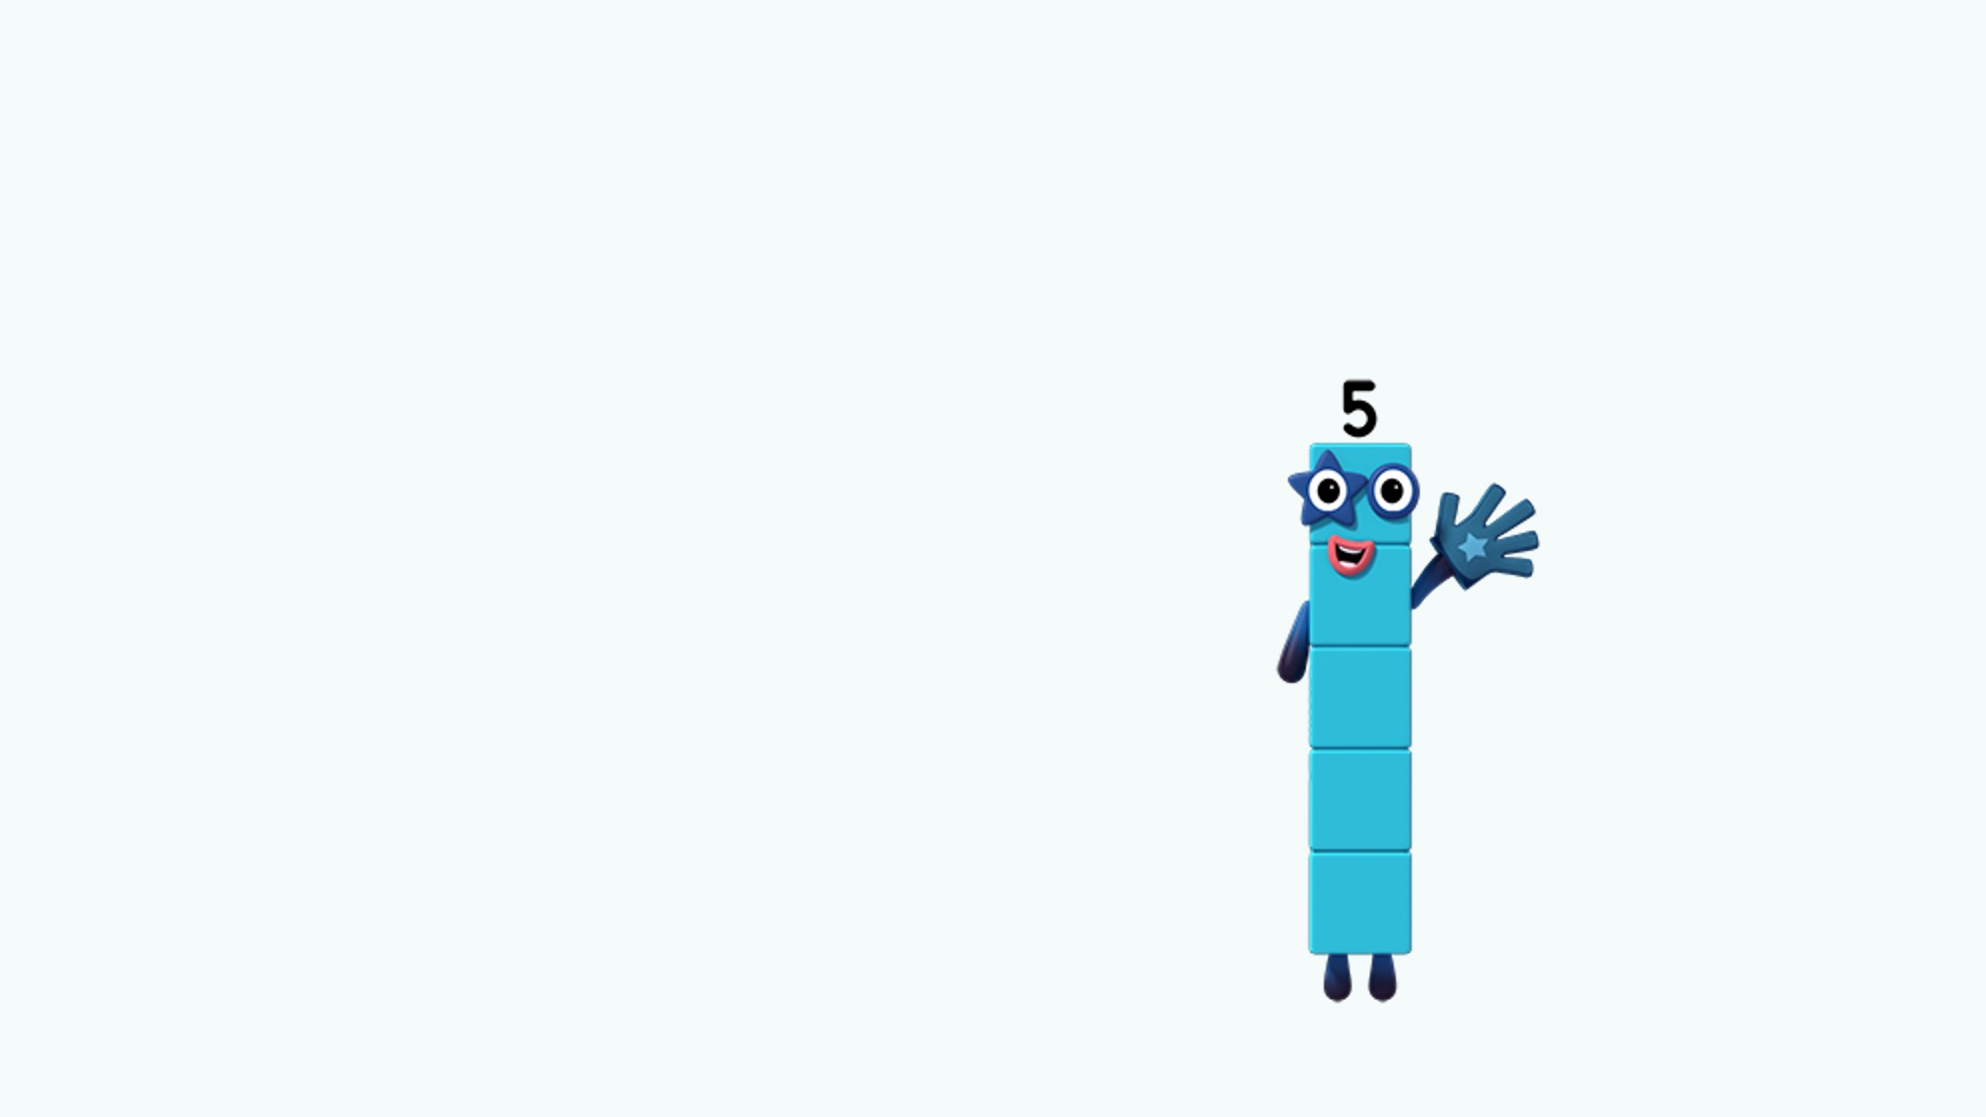

What stays the same?
What is changing?
Images © 2017 Alphablocks Ltd. All Rights Reserved.
Notes:
Use this slide to discuss the relationships between the equations in the sequence.
What is staying the same? (The subtrahend is staying the same – it is always 1.)
What is changing? (The minuend and the difference.)
What pattern can you see? (The minuend and difference are decreasing by one each time.)
Can you use this pattern to predict the next equation in the sequence?

Slide 25
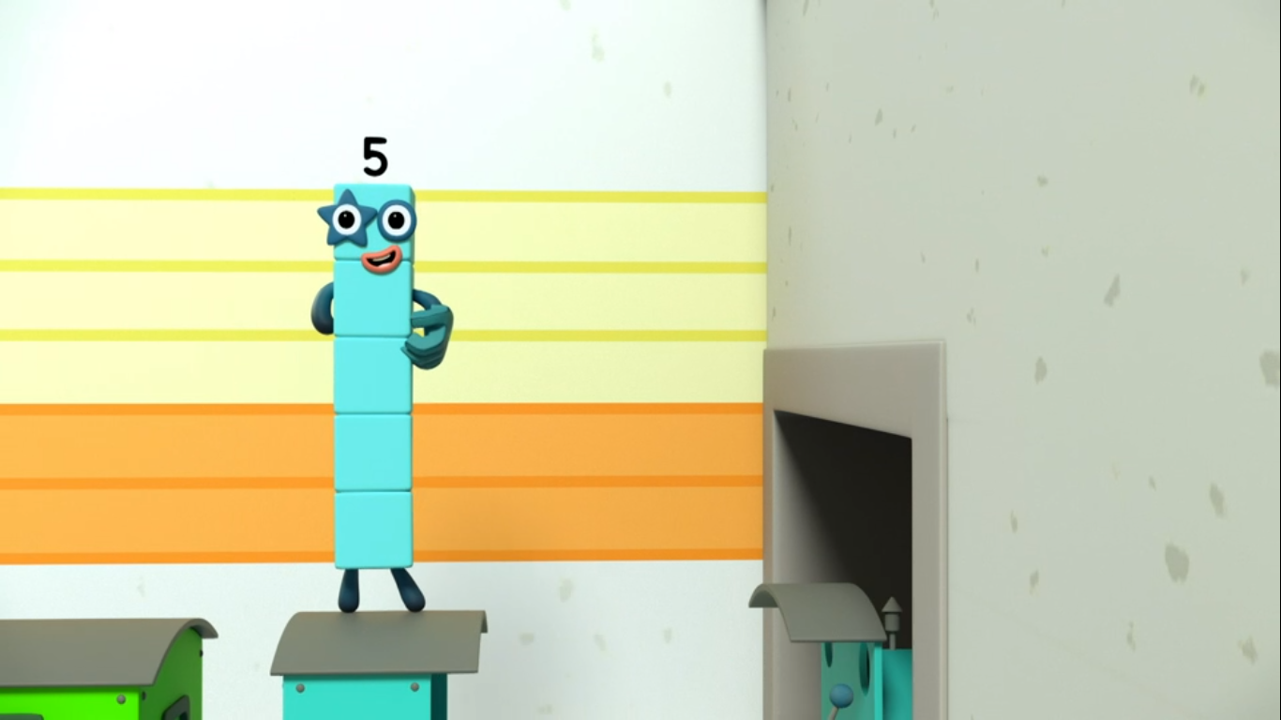
Images © 2017 Alphablocks Ltd. All Rights Reserved.
Notes:
Use this slide to represent the ‘story’ with an equation.
What was happening in this part of the episode?
If this equation is telling the story of Five partitioning into Three and Two, how can this equation represent this story?
What does each number in the equation mean?

Slide 26
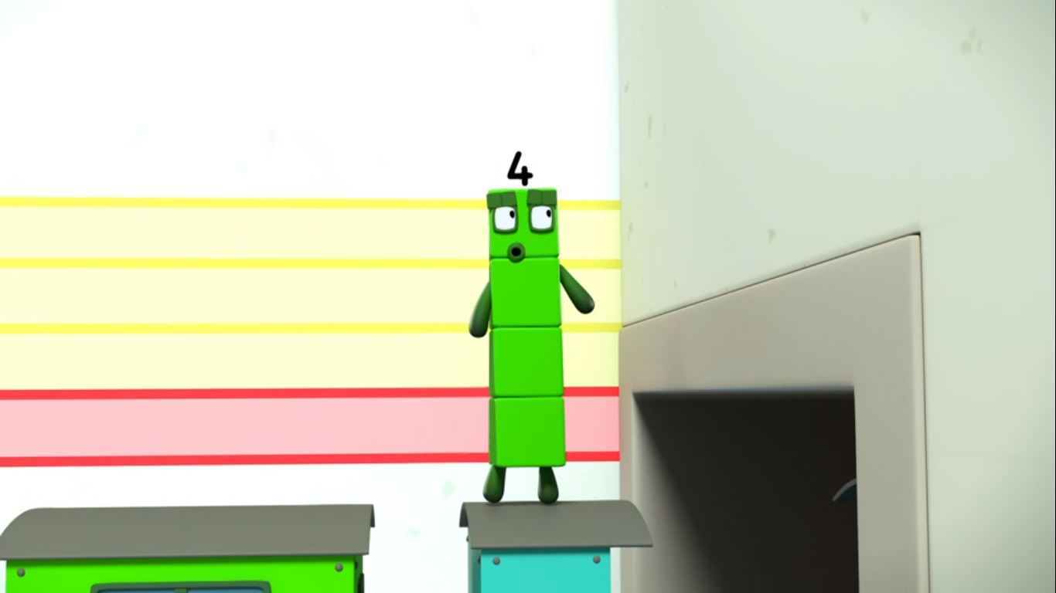
Images © 2017 Alphablocks Ltd. All Rights Reserved.
Notes:
Use this slide to represent the ‘story’ with an equation.
What was happening in this part of the episode?
If this equation is telling the story of Four partitioning into Three and One, how can this equation represent this story?

Slide 27
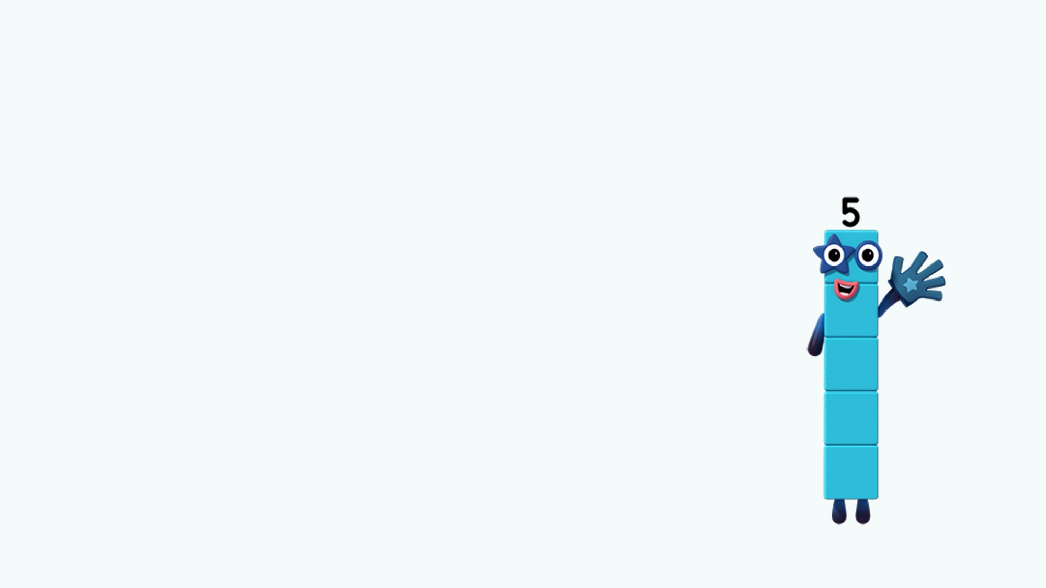
What stays the same?
What is changing?
Images © 2017 Alphablocks Ltd. All Rights Reserved.
Notes:
Use this slide to discuss the relationships between each of the equations in the sequence.
What is staying the same? (The subtrahend is staying the same – it is always 3.)
What is changing? (The minuend and the difference.)
What pattern can you see? (The minuend and the difference are decreasing by one in each equation.)
Can you use this pattern to predict the next equation in the sequence?

Slide 28
Further activities for Y2
Explore different subtraction calculations that can be written using 1,2,3,4 and 5 which can be represented with cubes (to ensure that children ensure that the minuend (whole) is greater than the subtrahend (part).
Find different ways to group the calculations e.g. all calculations that have -2 in them.
Find ways to order the calculation, e.g. 5 – 2 = 3, 4 – 2 = 2, 3 – 2 = 1 etc. so that a pattern can be described.
Pick three calculations. Find something that is the same about two out of the three.

