Slide 1
Year 2, Unit 8
Addition and subtraction of two-digit numbers (2)

Slide 2
Year 2, Unit 8
These materials heavily reflect the prioritisation approach of the ready-to-progress criteria in the DfE Primary Mathematics Guidance 2020 and on the PPTs that exemplify them on the NCETM website. They also include other relevant National Curriculum content. Related sections of the NCETM Primary Mastery Professional Development Materials provide small-step teaching guidance.
Ready-to-progress criteria addressed by this unit
Teaching of this unit supports the following criteria from the ‘DfE Mathematics Guidance: key stages 1 & 2’ (the 335-page document available as a download)
2AS-4 Page 66
Prior learning
If the following ready-to-progress criteria, contained in the same DfE guidance document as above, were secured in Year 2, children will be ready to start on this unit.
2AS-3 Page 62

Slide 3
Contents
The links below take you to the starting slide of each learning outcome.
1 | Pupils explain strategies used to add
2 | Pupils add a two-digit number to a two-digit number
3 | Pupils add a two-digit number to a two-digit number when not crossing ten (i)
4 | Pupils add a two-digit number to a two-digit number when not crossing ten (ii)
5 | Pupils add a two-digit number to a two-digit number when crossing ten
6 | Pupils explain strategies used to subtract
7 | Pupils subtract a two-digit number from a two-digit number
Click the arrow button to return to this Contents slide.

Slide 4
Contents
The links below take you to the starting slide of each learning outcome.
8 | Pupils partition the subtrahend to help with subtraction
9 | Pupils subtract a two-digit number from a two-digit number when not crossing ten (i)
10 | Pupils subtract a two-digit number from a two-digit number when not crossing ten (ii)
11 | Pupils subtract a two-digit number from a two-digit number when crossing ten
12 | Pupils subtract efficiently using knowledge of two-digit numbers
Click the arrow button to return to this Contents slide.

Slide 5
Year 2, Unit 8, Learning Outcome 1
Learning Outcome 1
Pupils explain strategies used to add
The following slides have been collated to support the teaching of this learning outcome.

Slide 6
Year 2, Unit 8, Learning Outcome 1
Additional teacher guidance for this outcome should be read first and can be found in this segment of the NCETM Primary Mastery Professional Development Materials:
1.15 Addition: two-digit and two-digit numbers
The spine materials are divided into ‘teaching points’ and ‘steps in learning’.
Teaching point | Steps in learning | Pages
1 | 1:1 | 4-5

Slide 7
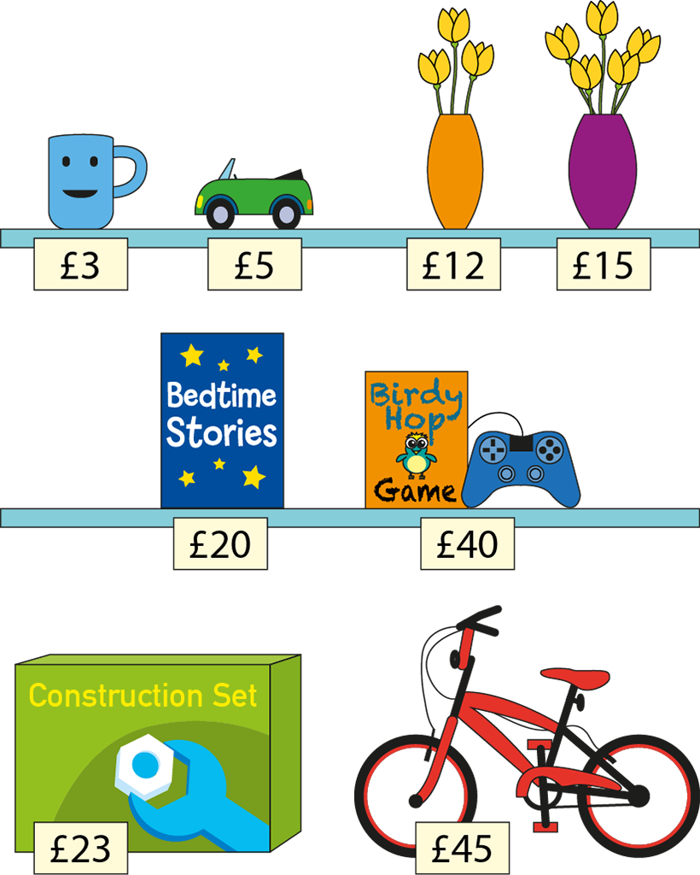
1.15 Addition: two-digit + two-digit – step 1:1

Slide 8
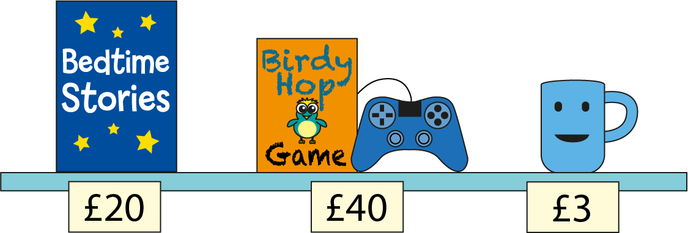
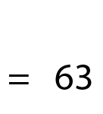
1.15 Addition: two-digit + two-digit – step 1:1
= £63

Slide 9
Year 2, Unit 8, Learning Outcome 2
Learning Outcome 2
Pupils add a two-digit number to a two-digit number
The following slides have been collated to support the teaching of this learning outcome.

Slide 10
Year 2, Unit 8, Learning Outcome 2
Additional teacher guidance for this outcome should be read first and can be found in this segment of the NCETM Primary Mastery Professional Development Materials:
1.15 Addition: two-digit and two-digit numbers
The spine materials are divided into ‘teaching points’ and ‘steps in learning’.
Teaching point | Steps in learning | Pages
1 | 1:2 | 5-7

Slide 11
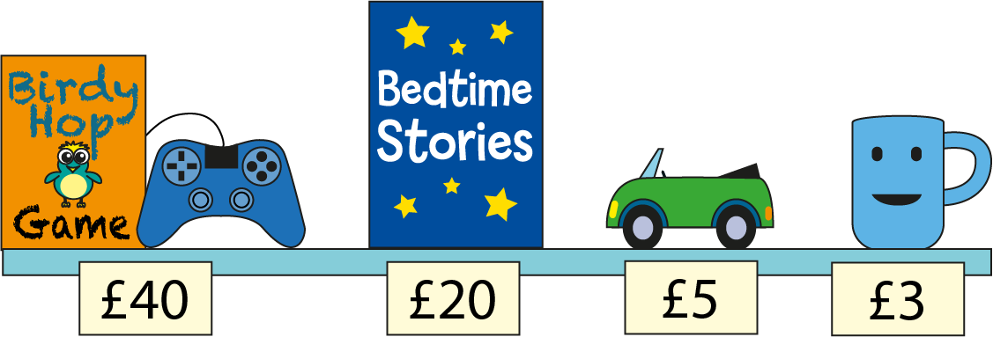
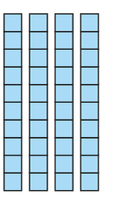
1.15 Addition: two-digit + two-digit – step 1:2
= £68

Slide 12
1.15 Addition: two-digit + two-digit – step 1:2
= £68

Slide 13
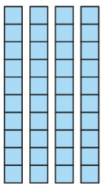
1.15 Addition: two-digit + two-digit – step 1:2
= £68

Slide 14
1.15 Addition: two-digit + two-digit – step 1:2
= £68

Slide 15
2AS-4 Add and subtract within 100 – part 2
Can you read the prices? What do you notice about them?
How can we add the prices to find the total cost of all the items?
If we add the multiples of ten, what is the total? What number facts help us calculate without counting? What is the total for the prices which are one-digit numbers?
How do we know what 60 plus 8 is without counting?
40 + 5 + 20 + 3
= 68
40 + 20 = 60
5 + 3 = 8

Slide 16
Year 2, Unit 8, Learning Outcome 3
Learning Outcome 3
Pupils add a two-digit number to a two-digit number when not crossing ten (i)
The following slides have been collated to support the teaching of this learning outcome.

Slide 17
Year 2, Unit 8, Learning Outcome 3
Additional teacher guidance for this outcome should be read first and can be found in this segment of the NCETM Primary Mastery Professional Development Materials:
1.15 Addition: two-digit and two-digit numbers
The spine materials are divided into ‘teaching points’ and ‘steps in learning’.
Teaching point | Steps in learning | Pages
2 | 2:1-2:3 | 8-10

Slide 18
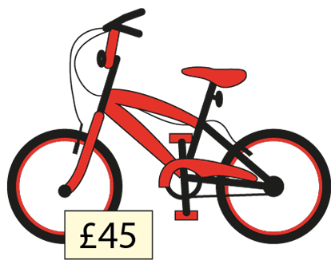
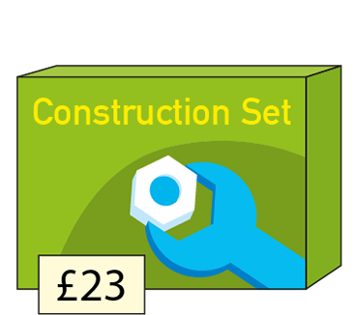
1.15 Addition: two-digit + two-digit – step 2:1
40 + 5 + 20 + 3
45 + 23

Slide 19
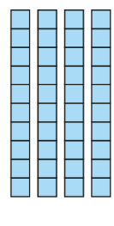
1.15 Addition: two-digit + two-digit – step 2:1
= £68

Slide 20
1.15 Addition: two-digit + two-digit – step 2:1
= £68

Slide 21
1.15 Addition: two-digit + two-digit – step 2:2

Slide 22
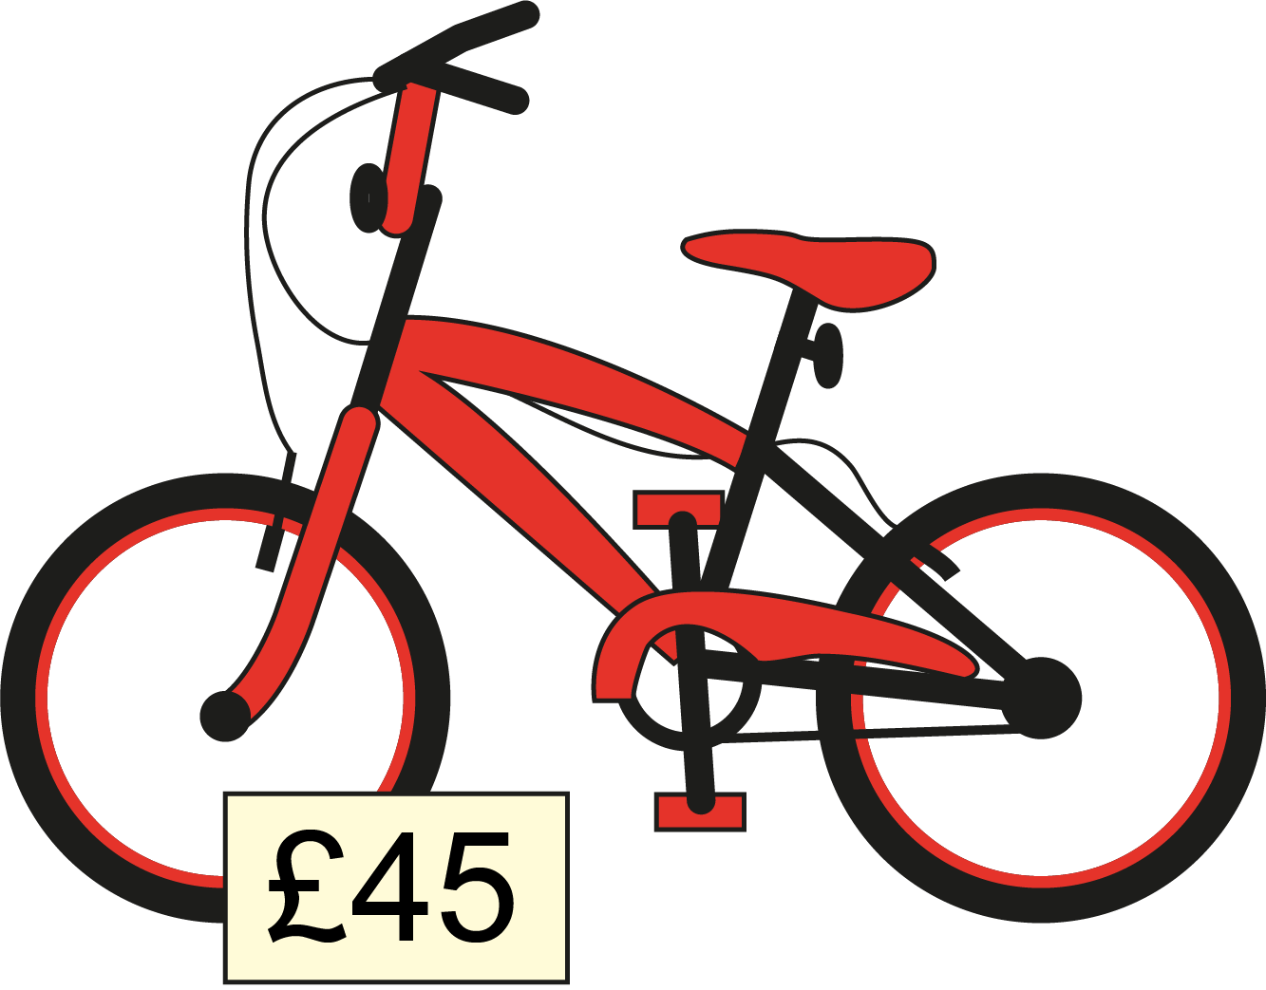
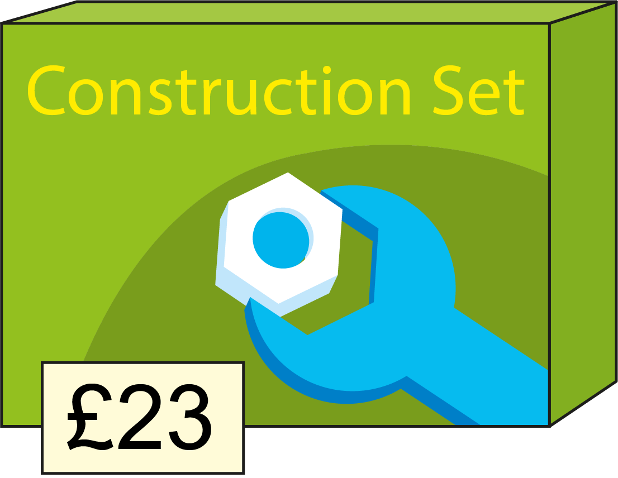
2AS-4 Add and subtract within 100 – part 2
What do you notice about these prices?
Can we partition the numbers to help us add tens and ones?
What multiples of ten can you add?
How can you combine the tens and ones without needing to count?
45 + 23
= 68
40 + 20 = 60
First I partition both numbers.
Then I add the tens. Then I add the ones.
Then I combine all of the tens and all of the ones.
5 + 3 = 8

Slide 23
2AS-4 Add and subtract within 100 – part 2
40 + 5 + 20 + 3
45 + 23
Compare the sets of prices. What do you notice?
Why did they have the same total?
Which numbers did you need to partition to calculate?
Why did we not need to partition the first set of prices?

Slide 24
Year 2, Unit 8, Learning Outcome 4
Learning Outcome 4
Pupils add a two-digit number to a two-digit number when not crossing ten (ii)
The following slides have been collated to support the teaching of this learning outcome.

Slide 25
Year 2, Unit 8, Learning Outcome 4
Additional teacher guidance for this outcome should be read first and can be found in this segment of the NCETM Primary Mastery Professional Development Materials:
1.15 Addition: two-digit and two-digit numbers
The spine materials are divided into ‘teaching points’ and ‘steps in learning’.
Teaching point | Steps in learning | Pages
2 | 2:4-2:5 | 10-12

Slide 26
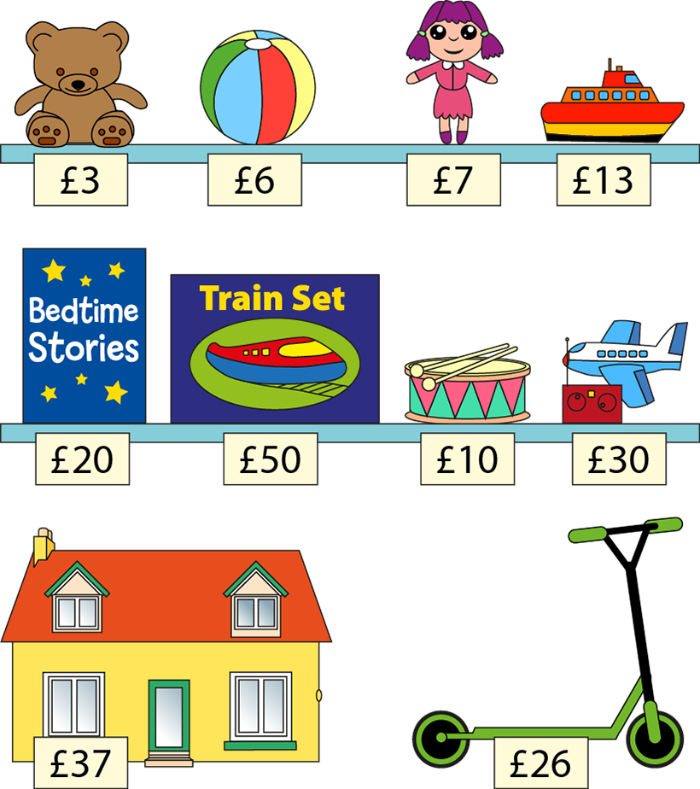
1.15 Addition: two-digit + two-digit – step 2:4

Slide 27
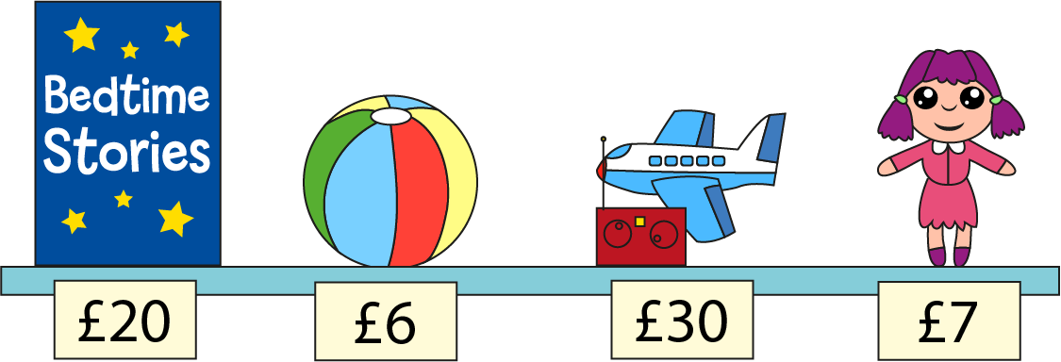
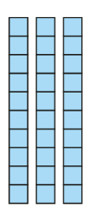
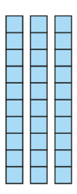
1.15 Addition: two-digit + two-digit – step 2:4
= £63

Slide 28
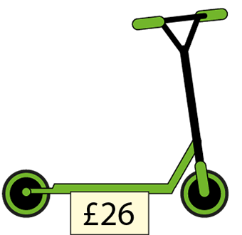
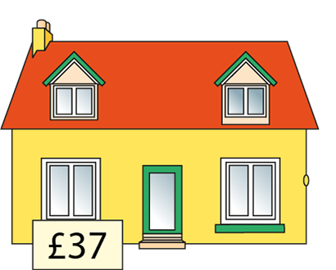
1.15 Addition: two-digit + two-digit – step 2:5
20 + 6 + 30 + 7
26 + 37

Slide 29
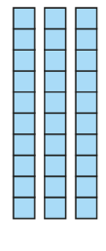
1.15 Addition: two-digit + two-digit – step 2:5
= £63

Slide 30
1.15 Addition: two-digit + two-digit – step 2:5
= £63

Slide 31
Year 2, Unit 8, Learning Outcome 5
Learning Outcome 5
Pupils add a two-digit number to a two-digit number when crossing ten
The following slides have been collated to support the teaching of this learning outcome.

Slide 32
Year 2, Unit 8, Learning Outcome 5
Additional teacher guidance for this outcome should be read first and can be found in this segment of the NCETM Primary Mastery Professional Development Materials:
1.15 Addition: two-digit plus two-digit numbers
The spine materials are divided into ‘teaching points’ and ‘steps in learning’.
Teaching point | Steps in learning | Pages
2 | 2:6-2:8 | 12-14

Slide 33
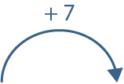
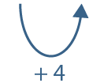
1.15 Addition: two-digit + two-digit – step 2:6
26 + 37 =
26 + 30 + 7
= 63

Slide 34
1.15 Addition: two-digit + two-digit – step 2:7

Slide 35
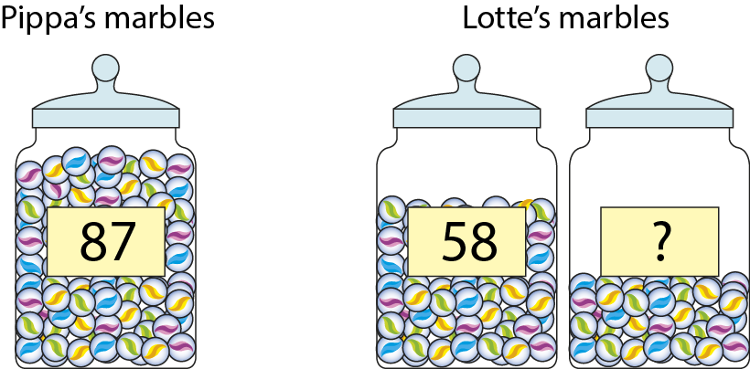
1.15 Addition: two-digit + two-digit – step 2:8
Notes:
Pippa has eighty-seven marbles. Lotte has fewer marbles than Pippa. In one jar Lotte has fifty-eight marbles. What is the maximum number of marbles Lotte could have in the second jar?

Slide 36
2AS-4 Add and subtract within 100 – part 2
Complete these calculations, thinking about when you need to partition. Write the partitioned numbers before you calculate.
40 + 6 =
50 + 6 =
50 + 7 =
40 + 5 + 10 + 2 =
20 + 3 + 10 + 1 =
50 + 10 + 3 + 2 =
45 + 12 =
23 + 11 =
34 + 21 =
21 + 34 =
41 + 21 =
55 + 20 =

Slide 37
2AS-4 Add and subtract within 100 – part 2
Arranging Additions and Sorting Subtractions
https://nrich.maths.org/14726

Slide 38
Year 2, Unit 8, Learning Outcome 6
Learning Outcome 6
Pupils explain the strategies used to subtract
The following slides have been collated to support the teaching of this learning outcome.

Slide 39
Year 2, Unit 8, Learning Outcome 6
Additional teacher guidance for this outcome should be read first and can be found in this segment of the NCETM Primary Mastery Professional Development Materials:
1.16 Subtraction: two-digit and two-digit numbers
The spine materials are divided into ‘teaching points’ and ‘steps in learning’.
Teaching point | Steps in learning | Pages
1 | 1:1 | 3-4

Slide 40
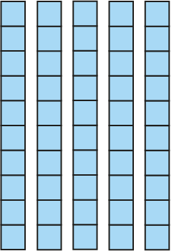
1.16 Subtraction: two-digit and two-digit numbers – step 1:1
56
− 2
= 54

Slide 41
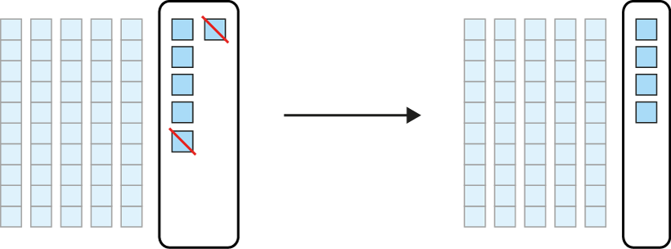
1.16 Subtraction: two-digit and two-digit numbers – step 1:1
56
− 2
= 54

Slide 42
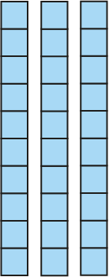
1.16 Subtraction: two-digit and two-digit numbers – step 1:1
56
− 20
= 36

Slide 43
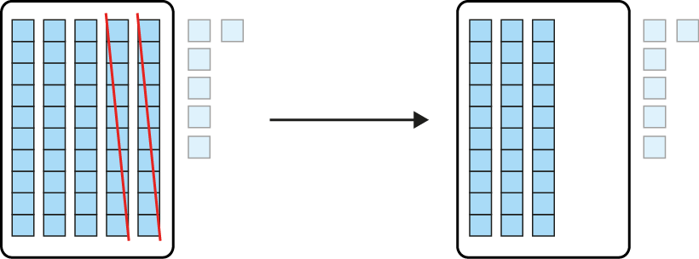
1.16 Subtraction: two-digit and two-digit numbers – step 1:1
56
− 20
= 36

Slide 44
Year 2, Unit 8, Learning Outcome 7
Learning Outcome 7
Pupils subtract a two-digit number from a two-digit number
The following slides have been collated to support the teaching of this learning outcome.

Slide 45
Year 2, Unit 8, Learning Outcome 7
Additional teacher guidance for this outcome should be read first and can be found in this segment of the NCETM Primary Mastery Professional Development Materials:
1.16 Subtraction: two-digit and two-digit numbers
The spine materials are divided into ‘teaching points’ and ‘steps in learning’.
Teaching point | Steps in learning | Pages
1 | 1:2-1:3 | 4-5

Slide 46
1.16 Subtraction: two-digit and two-digit numbers – step 1:2
45
− 20
− 3
= 22
Notes:
At first I had forty-five biscuits. Then I sold twenty biscuits, and then I dropped three biscuits. How many are left?

Slide 47
1.16 Subtraction: two-digit and two-digit numbers – step 1:2
45
− 3
− 20
= 22
Notes:
At first I had forty-five biscuits. Then I dropped three biscuits, and then I sold twenty biscuits. How many are left?

Slide 48
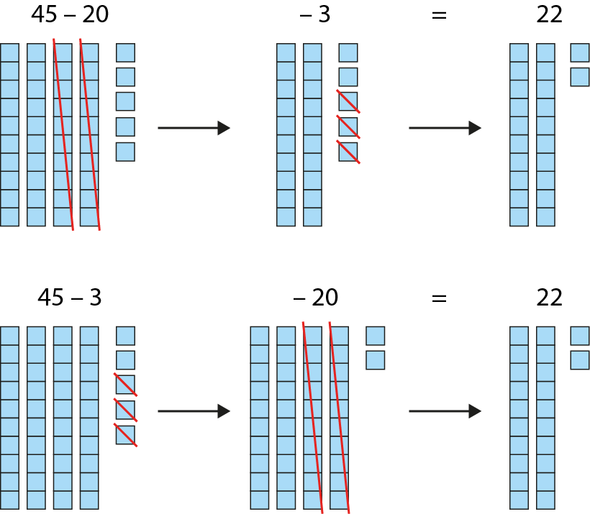
1.16 Subtraction: two-digit and two-digit numbers – step 1:2

Slide 49
1.16 Subtraction: two-digit and two-digit numbers – step 1:2
45
− 20
− 3
= 22
45
− 3
− 20
= 22

Slide 50
Year 2, Unit 8, Learning Outcome 8
Learning Outcome 8
Pupils partition the subtrahend to help with subtraction
The following slides have been collated to support the teaching of this learning outcome.

Slide 51
Year 2, Unit 8, Learning Outcome 8
Additional teacher guidance for this outcome should be read first and can be found in this segment of the NCETM Primary Mastery Professional Development Materials:
1.16 Subtraction: two-digit and two-digit numbers
The spine materials are divided into ‘teaching points’ and ‘steps in learning’.
Teaching point | Steps in learning | Pages
2 | 2:1-2:2 | 6-7

Slide 52
1.16 Subtraction: two-digit and two-digit numbers – step 2:1
45 − 20 − 3
45 − 23
Notes:
At first I had forty-five biscuits. Then I sold twenty biscuits, and then I dropped three biscuits. How many are left?
vs.
There were forty-five children in the playground. Then twenty-three of them went into the dinner hall. How many children are still in the playground?

Slide 53
1.16 Subtraction: two-digit and two-digit numbers – step 2:2
45
− 23

Slide 54
1.16 Subtraction: two-digit and two-digit numbers – step 2:2
45
− 23

Slide 55
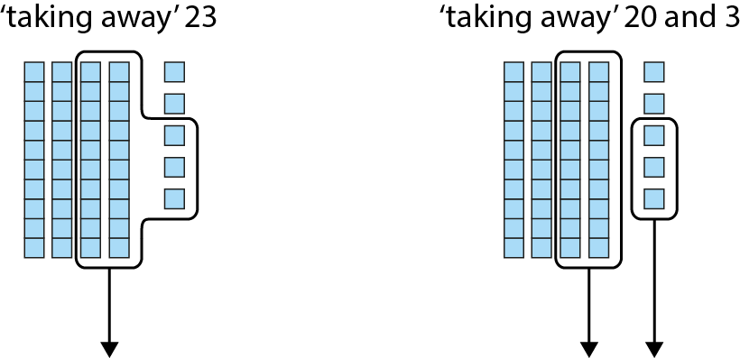
1.16 Subtraction: two-digit and two-digit numbers – step 2:2

Slide 56
1.16 Subtraction: two-digit and two-digit numbers – step 2:2

Slide 57
Year 2, Unit 8, Learning Outcome 9
Learning Outcome 9
Pupils subtract a two-digit number from a two-digit number when not crossing ten (i)
The following slides have been collated to support the teaching of this learning outcome.

Slide 58
Year 2, Unit 8, Learning Outcome 9
Additional teacher guidance for this outcome should be read first and can be found in this segment of the NCETM Primary Mastery Professional Development Materials:
1.16 Subtraction: two-digit and two-digit numbers
The spine materials are divided into ‘teaching points’ and ‘steps in learning’.
Teaching point | Steps in learning | Pages
2 | 2:3 | 7-9

Slide 59
1.16 Subtraction: two-digit and two-digit numbers – step 2:3

Slide 60
Year 2, Unit 8, Learning Outcome 10
Learning Outcome 10
Pupils subtract a two-digit number from a two-digit number when not crossing ten (ii)
The following slides have been collated to support the teaching of this learning outcome.

Slide 61
Year 2, Unit 8, Learning Outcome 10
Additional teacher guidance for this outcome should be read first and can be found in this segment of the NCETM Primary Mastery Professional Development Materials:
1.16 Subtraction: two-digit and two-digit numbers
The spine materials are divided into ‘teaching points’ and ‘steps in learning’.
Teaching point | Steps in learning | Pages
2 | 2:4-2:5 | 9-10

Slide 62
1.16 Subtraction: two-digit and two-digit numbers – step 2:4

Slide 63
1.16 Subtraction: two-digit and two-digit numbers – step 2:4

Slide 64
1.16 Subtraction: two-digit and two-digit numbers – step 2:5

Slide 65
1.16 Subtraction: two-digit and two-digit numbers – step 2:5

Slide 66
Year 2, Unit 8, Learning Outcome 11
Learning Outcome 11
Pupils subtract a two-digit number from a two-digit number when crossing ten
The following slides have been collated to support the teaching of this learning outcome.

Slide 67
Year 2, Unit 8, Learning Outcome 11
Additional teacher guidance for this outcome should be read first and can be found in this segment of the NCETM Primary Mastery Professional Development Materials:
1.16 Subtraction: two-digit and two-digit numbers
The spine materials are divided into ‘teaching points’ and ‘steps in learning’.
Teaching point | Steps in learning | Pages
2 | 2:6-2:8 | 11-14

Slide 68
1.16 Subtraction: two-digit and two-digit numbers – step 2:6

Slide 69
1.16 Subtraction: two-digit and two-digit numbers – step 2:6
59
1
59

Slide 70
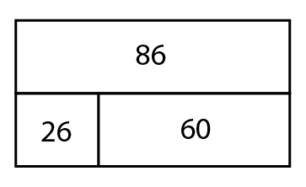
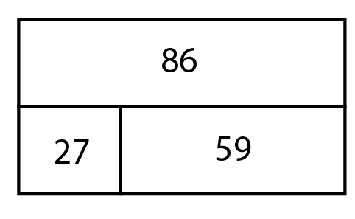
1.16 Subtraction: two-digit and two-digit numbers – step 2:6
59
1
59

Slide 71
1.16 Subtraction: two-digit and two-digit numbers – step 2:7

Slide 72
1.16 Subtraction: two-digit and two-digit numbers – step 2:7

Slide 73
1.16 Subtraction: two-digit and two-digit numbers – step 2:8

Slide 74
1.16 Subtraction: two-digit and two-digit numbers – step 2:8

Slide 75
1.16 Subtraction: two-digit and two-digit numbers – step 2:8
25
35
Notes:
Paul had sixty-five stickers. He gave thirty stickers to Andrew and sixteen stickers to Alicia. How many stickers does Paul have left?’

Slide 76
Year 2, Unit 8, Learning Outcome 12
Learning Outcome 12
Pupils subtract efficiently using knowledge of two-digit numbers
The following slides have been collated to support the teaching of this learning outcome.

Slide 77
Year 2, Unit 8, Learning Outcome 12
Additional teacher guidance for this outcome should be read first and can be found in this segment of the NCETM Primary Mastery Professional Development Materials:
1.16 Subtraction: two-digit and two-digit numbers
The spine materials are divided into ‘teaching points’ and ‘steps in learning’.
Teaching point | Steps in learning | Pages
2 | 2:9 | 14-15

Slide 78
1.16 Subtraction: two-digit and two-digit numbers – step 2:9
35 − 34
= 1

Slide 79
1.16 Subtraction: two-digit and two-digit numbers – step 2:9

Slide 80
2AS-4 Add and subtract within 100 – part 2
Complete these calculations, thinking about when you need to partition. Write the partitioned numbers before you calculate. Think do you need to partition the minuend (the first number) when you subtract.
40 – 20 =
42 – 20 =
54 – 2 =
54 – 22 =
65 – 44 =
66 – 44 =
44 – 21 =
44 – 22 =
44 – 23 =
52 – 11 =
68 – 15 =
66 – 22 =

Slide 81
2AS-4 Add and subtract within 100 – part 2
Arranging Additions and Sorting Subtractions
https://nrich.maths.org/14726

