Slide 1
Numberblocks
Support Materials
Series 2, Episode 11
Odds and Evens

Slide 2
Practitioner Notes

Slide 3
Episode Description
The Numberblocks get together to play bounceball - first they split into two teams of alternate numbers, who decide to call themselves the Even Tops and the Odd Blocks. Wearing helmets, they face off across a net and bounce a ball on their heads to try to score. During the game they all split into Twos, turn into cheerleaders and hop onto each other, while One and Two commentate.

Slide 4
Maths in the Episode
Odds and Evens
The Numberblocks are arranged ‘twowise’ to expose the odd and even structure of numbers 1-10. The even Numberblocks have smooth ‘even-top’ heads. The odd Numberblocks have an ‘odd’ block on top, illustrating that an odd number is an even number plus 1.
When the Numberblocks are sorted into odds (1, 3, 5, 7, 9) and evens (2, 4, 6, 8, 10) they notice that the adjacent Numberblocks differ by two.
Equal Groups
The Numberblocks 1-10 are split into two equal teams.

Slide 5
Using Mathematical Language
During this episode children will experience sorting the numbers from 1-10 into odds and evens.
Children should practise describing numbers to 10 using ‘odd’ and ‘even’.
“____ is even because it is made with twos.”
“____ is odd because it has one on top.”
Children may begin to describe the relationship between adjacent numbers:
“An even number comes after an odd number.”
“An odd number comes after an even number.”
“An even number comes before an odd number.”
“An odd number comes before an even number.”

Slide 6
Talk and Discuss Together

Slide 7
Talk and Discuss Together
Watch the episode of Numberblocks. First ask the children what they noticed and allow them to talk to you and each other. The following slides are designed to stimulate children and adults to talk about the episode and draw out some key aspects of the mathematics.

Slide 8
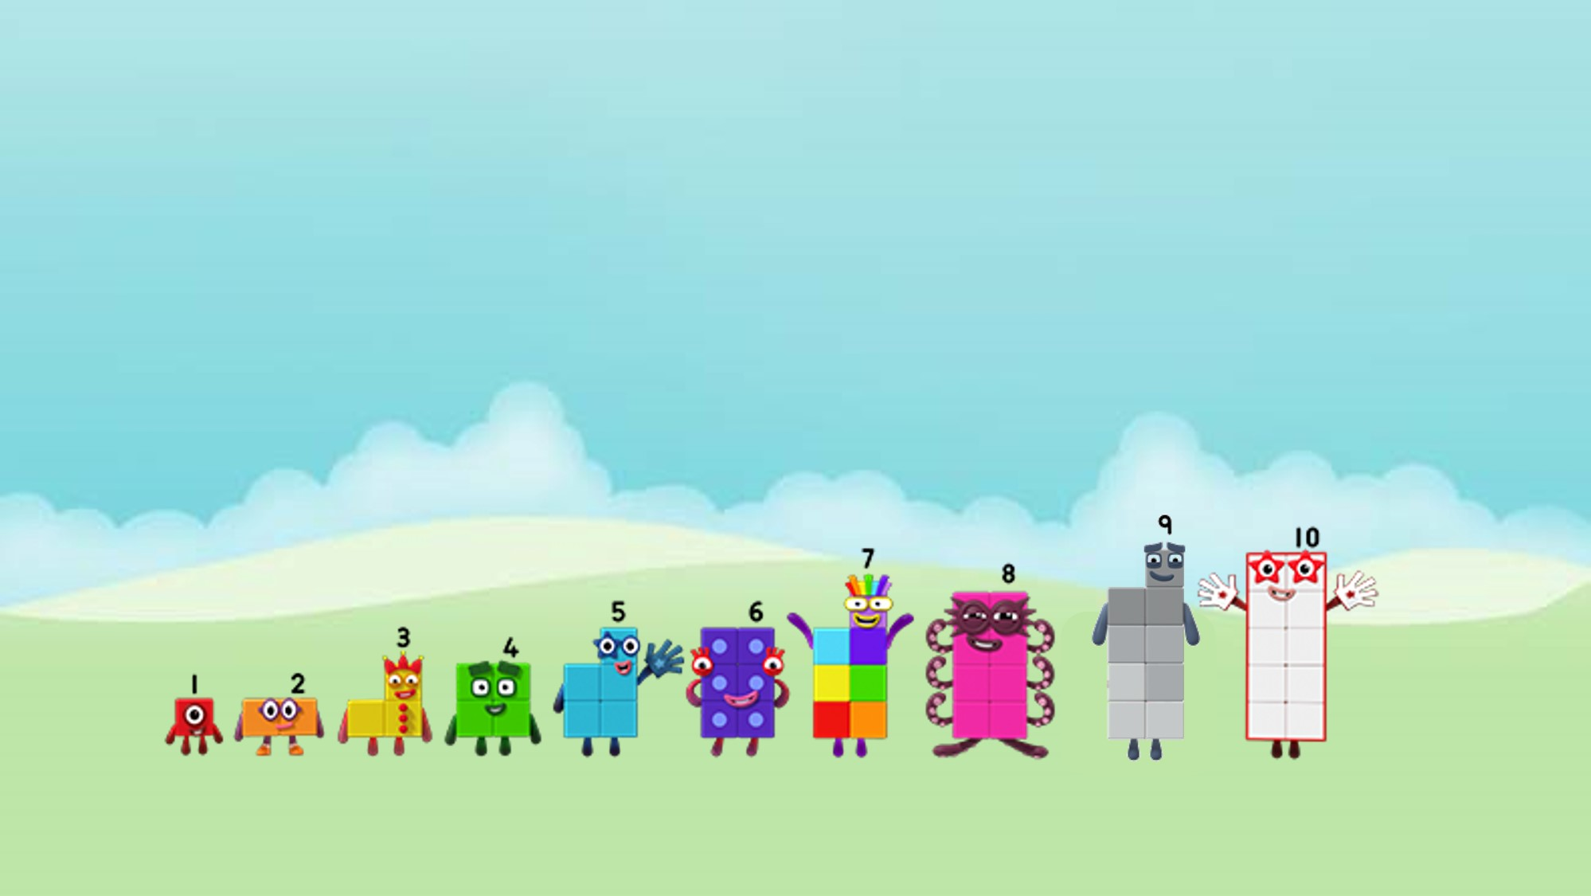
Images © 2017 Alphablocks Ltd. All Rights Reserved.
Notes:
After watching the episode: discuss examples of when the children get into two teams or groups. What games need two teams to play?
Invite a group of 6 children to get into two teams to play a throwing game with a beanbag. Teams stand opposite each other and throw the bean bag to your opposite partner. Each person gets 3 throws and scores 1 point for a catch. (So maximum team score could be 9 (all three children catch their beanbag three times). Organise the remainder of the group of children to keep account of the score.
After the game, invite another group (this time 7) and get into two teams to play the same game. What’s the problem? One person won’t have a partner. Can anyone explain why? What could we do? Send one away? Ask one more to join in? Which would be kinder? Invite one more to come and play and replay the game.

Slide 9

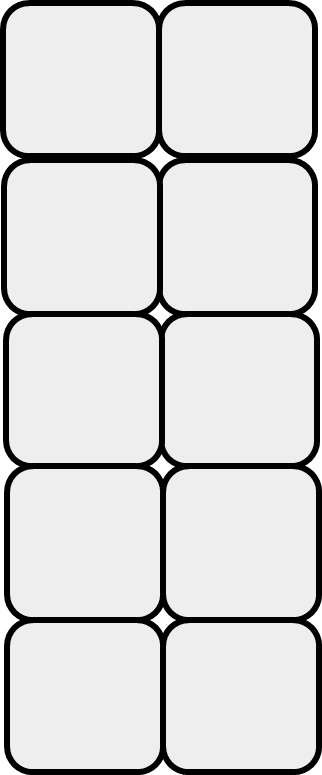
Odd Blocks
Even Tops
Images © 2017 Alphablocks Ltd. All Rights Reserved.
Notes:
Sort the Numberblocks into Odd Blocks and Even Tops teams.
Put a set of Numberblocks (made with linking cubes) into a feely bag. Invite the children to put in their hand and explore the shapes. Can you pick out an Odd Block? Who can pick out an Even Top?
How do you know which is which?
This slide is animated:
Discuss which team each block should go in. Have 3D versions of the Numberblocks available to demonstrate rotations to check flat tops.
.

Slide 10
Images © 2017 Alphablocks Ltd. All Rights Reserved.
Notes:
Discuss how Three was made (in a previous episode One jumped onto Two and made Three). Act this out with a One and Two Numberblock (tower). Swap One on top of Two for Three.
This slide is animated to show what happens when One jumps on top of Two and creates Three.
Watch what happens.
Invite the children to make Even Top Two and find a One and place on Even Top Two to make Odd Block Three.

Slide 11
Images © 2017 Alphablocks Ltd. All Rights Reserved.
Notes:
This slide is animated and follows the same structure as the previous slide, but this time an even number is combined with another even number. Talk about what happens and compare with the previous slide.

Slide 12
Enabling Environments

Slide 13
Enabling Environments
Playing and Exploring
Provide a feely bag of Numberblocks 1-10 as Even Tops or Odd Blocks on the ‘Magic Maths’ table. Provide two trays to sort the Odd Blocks and Even Tops.
Active Learning
Notice whether children actively find a partner when asked to do so. Look for examples when children are building a bridge and need to balance each side with the same number of blocks, or build a ramp where one end must be taller than the other end.
Creating and Thinking Critically
Look for opportunities where children need to separate small world characters into two groups, e.g. people in buses, animals in fields. Model the phrase:
I wonder if we can put the same number in each field?

Slide 14
Learning Together in Y1

Slide 15
Images © 2017 Alphablocks Ltd. All Rights Reserved.
Notes:
Discuss the episode. Look at the Numberblocks on this slide. Which Numberblocks were in the Odd Blocks team? Which were in the Even Tops team? What do you notice about the odd and even numbers?

Slide 16
odds
evens
Images © 2017 Alphablocks Ltd. All Rights Reserved.
Notes:
Sort the teams into Odd Blocks and Even Tops
Put a set of Numberblocks (made with linking cubes) into a feely bag. Invite the children to put in their hand and explore the shapes. Can you pick out an Odd Block? Who can pick out an Even Top?
How do you know which is which?
This slide is animated:
Discuss which team each block should go in. Have 3D versions of the Numberblocks available to demonstrate rotations to check flat tops.

Slide 17






Images © 2017 Alphablocks Ltd. All Rights Reserved.
Notes:
This slide is animated.
Click 1: One jumps onto Two to make Three.
Click 2: the equation ‘3 = 2 + 1’ appears.
Discuss what each number represents in the equation.

Slide 18


Images © 2017 Alphablocks Ltd. All Rights Reserved.
Notes:
Use this slide to begin to see the relationship between odd and even numbers, and that when two even numbers are added the sum is even.
This slide is animated.
Click 1: 2 jumps onto another 2 to make 4.
Click 2: the equation ‘4 = 2 + 2’ appears. Discuss what each number represents, referring to the blocks.

Slide 19

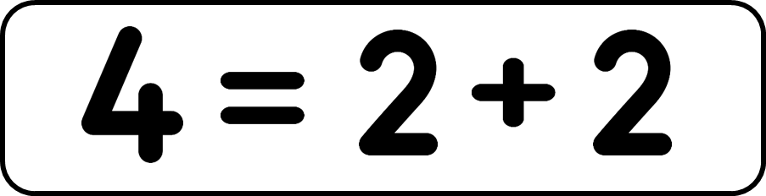
Images © 2017 Alphablocks Ltd. All Rights Reserved.
Notes:
Use this slide to begin to see how odd numbers are built from multiples of two and one.
This slide is animated.
The previous number sentences generated are beginning to build in the top left corner.
Ask:
What do you notice?
What’s the same and what’s different about these odd numbers?
What’s the same and what’s different about this even number and this odd number?

Slide 20

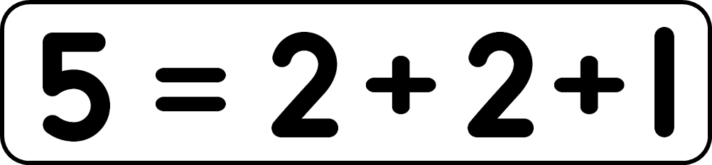
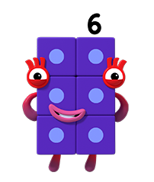
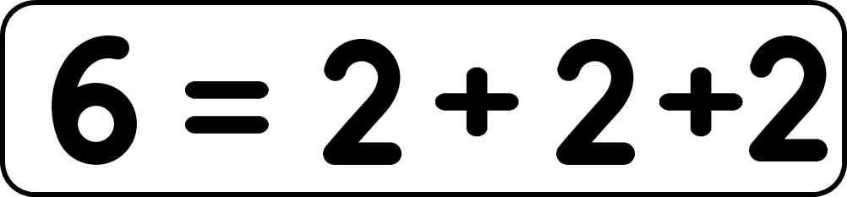
I am made from twos.
Images © 2017 Alphablocks Ltd. All Rights Reserved.
Notes:
This slide is animated.
Ask the children to act out making six from five (made from 2 twos and 1 one). Exchange 2 ones for 1 two (children will not have met 3 twos).
Discuss what the number sentence could be for ‘6 = ____ ‘(there maybe a number of possible suggestions: write these down).
Click 1: another two appears
Click 2: another two jumps on to two; one jumps on to the 2 twos. Another one jumps on to the 2 twos. Another two appears over the top 2 ones. Six appears over the top of the 3 twos. Six jumps to one side and changes into Numberblock Six.
Discuss what happened in the animation. What could the equation or number sentence be? Can you use a pattern in the number sentences to work out what the next one might be for 6?
Click 3: the equation ‘6 = 2 + 2 + 2’ appears.
Click 4: Six appears with a speech bubble. “I am made from _____ twos”.
Click 5: 3 appears in the empty box.

Slide 21
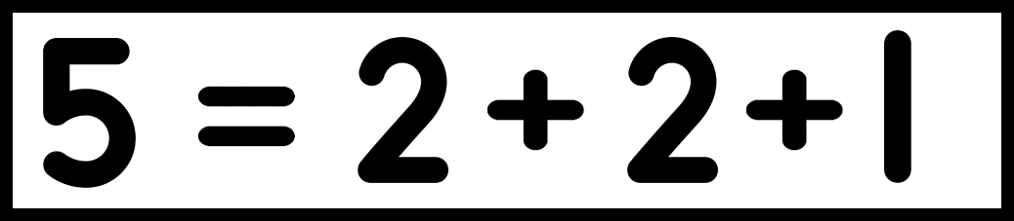



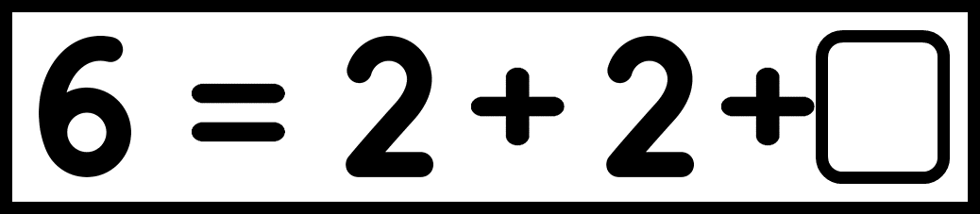
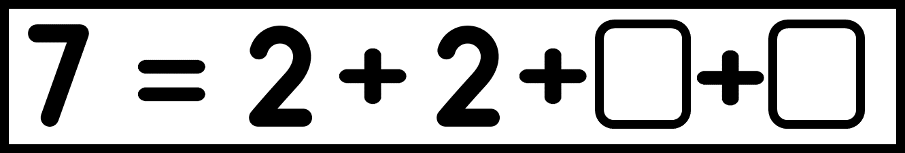

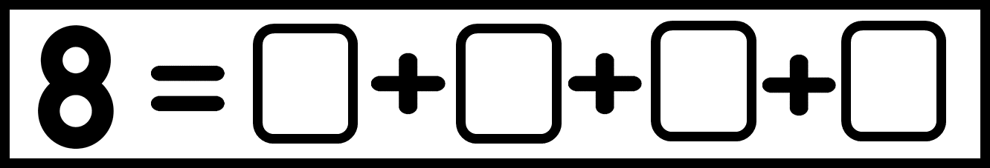


Images © 2017 Alphablocks Ltd. All Rights Reserved.
Notes:
Ask the children to work independently on this task. Ask them to show how they know, using squared paper.
Use the slide to check work.

