Slide 1
Series 3 Episode 12
Numberblock Rally

Slide 2
Practitioner Notes

Slide 3
Episode Description
The Numberblocks are all set for a rally in their pedal cars. Only one can lift the trophy at the end. Who will get to the end of the race without losing anything from their pedal car? The episode explores taking away.

Slide 4
Maths in the Episode
Subtraction as taking away
In this episode the Numberblocks’ pedal cars come into difficulty with blocks falling off. This episode introduces the idea of subtraction as reduction, using a ‘first, then, now’ story structure. It introduces the subtraction symbol ( – ) to represent the situations.

Slide 5
Using Mathematical Language
Use these stem sentences to rehearse the mathematical ideas in the programme:
“<7> blocks take away <4> blocks leaves <3> blocks.”
“If there are <7> blocks and <4> are taken away, then <3> blocks are left.”
“<7> minus <4> equals <3>.”
Notes:
< > indicates what can be changed in the stem sentence.

Slide 6
Talk and Discuss Together

Slide 7
Talk and Discuss Together
Watch the episode of Numberblocks. Use the following picture as a stimulus. Has anyone ever ridden a pedal car?
What happened to some of the pedal cars?
The following slides are designed to stimulate children and adults to talk about the episode and draw out some key aspects of the mathematics.

Slide 8
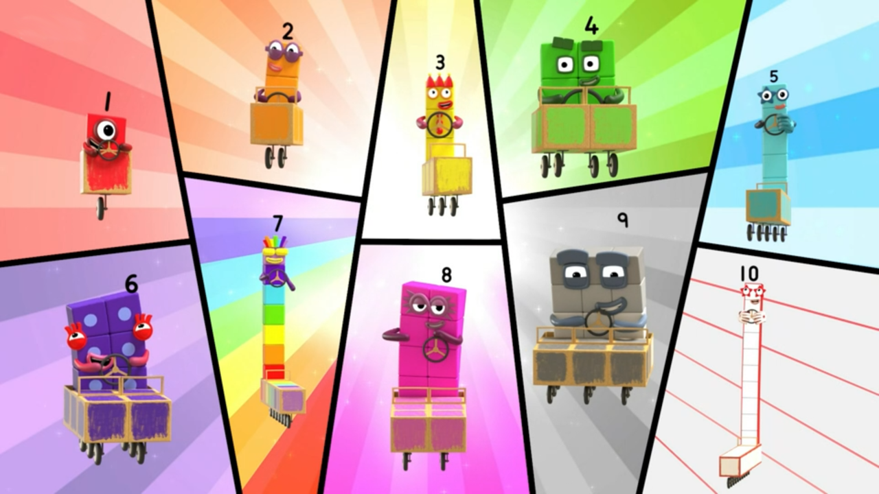
Images © 2017 Alphablocks Ltd. All Rights Reserved.
Notes:
Use this picture as the stimulus for Talk and Discussion (slide 7).

Slide 9
Enabling Environments in Reception

Slide 10
Enabling Environments
Playing and Exploring
Provide opportunities for children to make up and enact their own stories using subtraction as reduction, for example, farm animals moving to a new field, ducks leaving the pond.
Active Learning
Identify opportunities for experiencing this structure (‘taking away’) in real situations, for example, the numbers of pencils left in a pencil pot/ children left to go outside/ pieces of fruit left after snack time.
Creating and Thinking Critically
Explore taking away using dice and counters or other small parts. Play a simple game with a dice, taking away from a collection the number rolled on the dice. Who can get to 0 from 10? As the game is played, talk about what is happening, ‘first you had 6 conkers, then you took 2 away, now you have 4 left…I wonder if you will roll four next time to take them all away and have none left!’
Songs and rhymes also offer varied opportunities for exploring this structure. For example, Five Little Ducks, Ten Green Bottles, Five Little Monkeys. Sing the song and act it out with children, encouraging children to show on their fingers how many things are left.

Slide 11
Learning Together in Y1

Slide 12
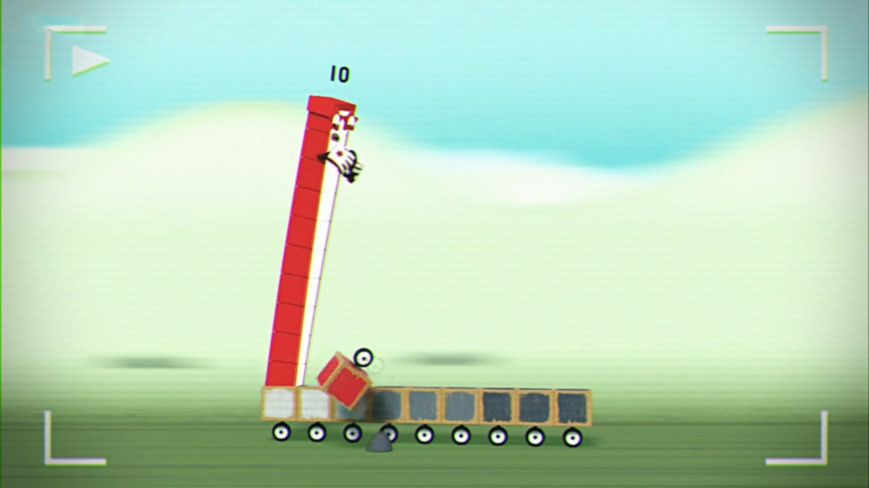
First there were blocks.
Then block fell off.
Now there are blocks left.
Images © 2017 Alphablocks Ltd. All Rights Reserved.
Notes:
Use these slides to introduce the tens frame and equation to represent the ‘first, then, now’ subtraction story.
What do you notice? What happened to Ten’s pedal car?
Make links between the ‘first, then, now’ story and the counters on the tens frame.
Read the subtraction equation as “10 minus 1 equals 9.”
Explicitly encourage children to connect each number/ symbol to the relevant part of the story.
What does the ten represent?
What does the minus one represent?
What does the nine represent?

Slide 13
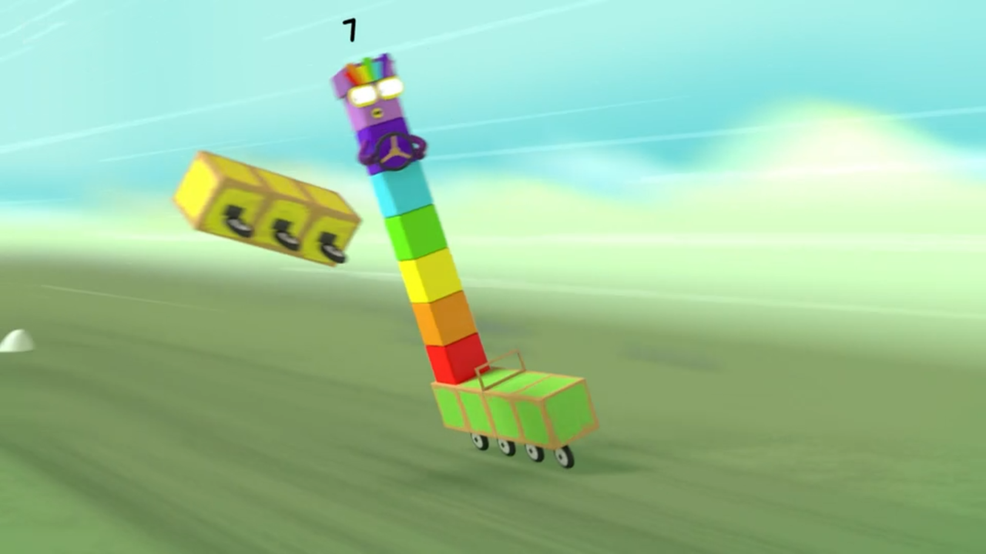
First there were blocks.
Then block fell off.
Now there are blocks left.
Images © 2017 Alphablocks Ltd. All Rights Reserved.
Notes:
Print off slide 14 to give to pairs/ small groups.
Talk about the picture and then represent it with cubes on the tens frame. Write an equation.
Work through the slide to check answers, ensuring children can connect the story with the tens frame and the equation.

Slide 14
First there were blocks.
Then block fell off.
Now there are blocks left.
Images © 2017 Alphablocks Ltd. All Rights Reserved.
Notes:
Hidden slide: print this off to give to pairs/ small groups to work with alongside slide 13.

Slide 15
Further activities for Y1
Use a different context to explore ‘first, then, now’ stories for subtraction. For example, people getting off a bus, apples falling from a tree, pencils taken from a pot, balls taken from a basket, and represent the stories using a tens frame or blocks.
Use crossing out to represent taking away in pictorial representations.
Invent ‘first, then, now’ subtraction stories from pictorial representations.
Invent ‘first, then, now’ subtraction stories from equations.

Slide 16
Learning Together in Y2

Slide 17
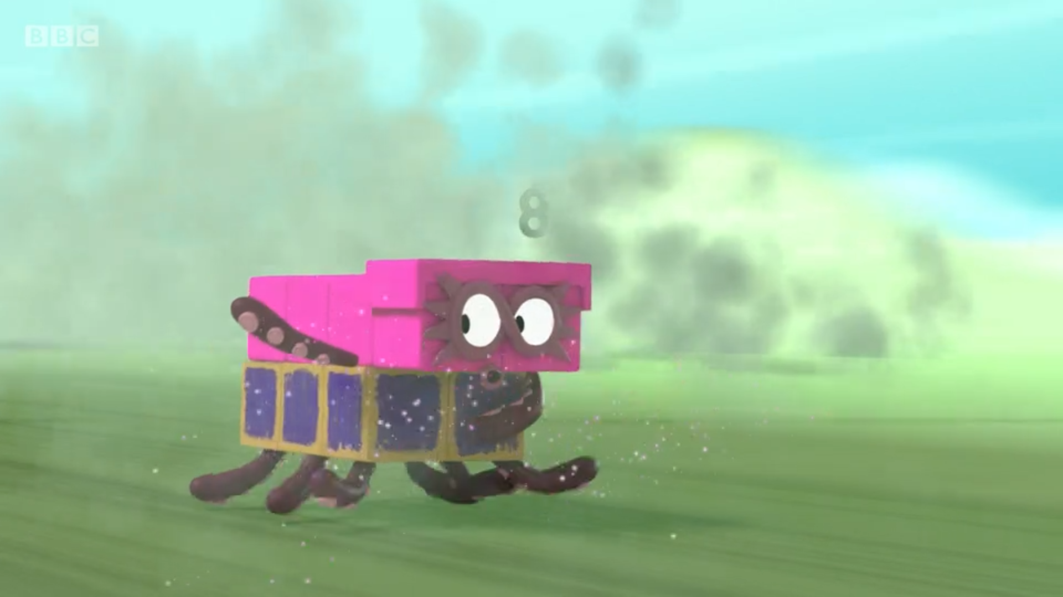
What’s the story?
Images © 2017 Alphablocks Ltd. All Rights Reserved.
Notes:
Use these slides to secure understanding of what each number in the equation means, and to identify the subtrahend (what is ‘taken away’) in each story.
What has happened to Eight’s pedal car? (Eight has lost some blocks. There are only six left.)
How many blocks do you think Eight lost?
Work through the slide discussing how the counters and the equation represent the story.

Slide 18
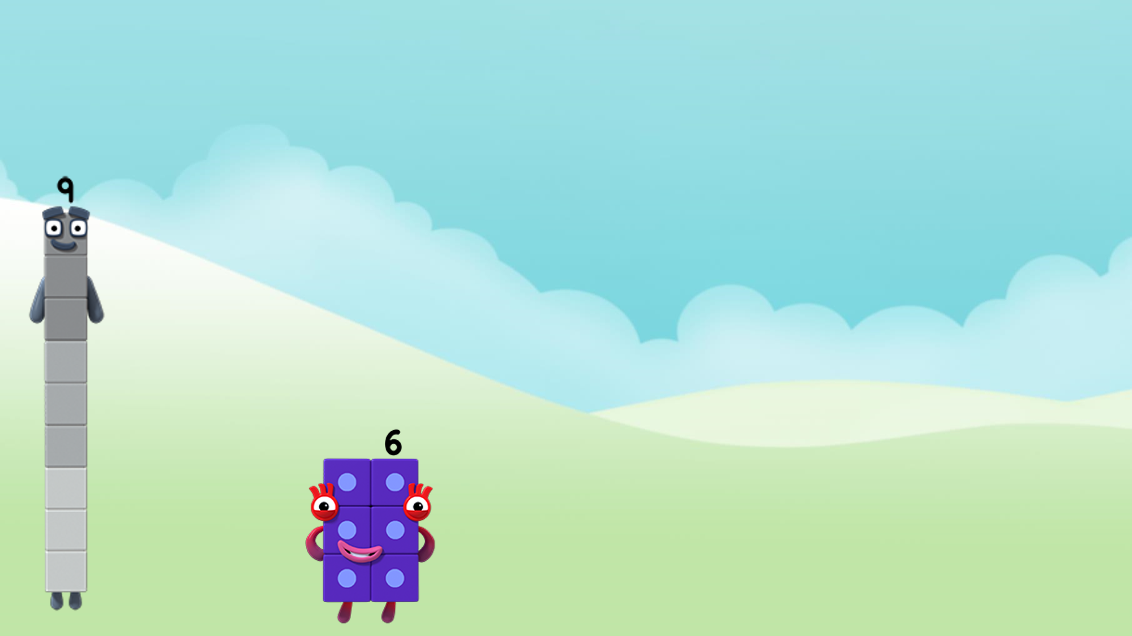
Images © 2017 Alphablocks Ltd. All Rights Reserved.
Notes:
How did Nine turn into Six?
Use the tens frame to explore. Represent the story with the equation.

Slide 19
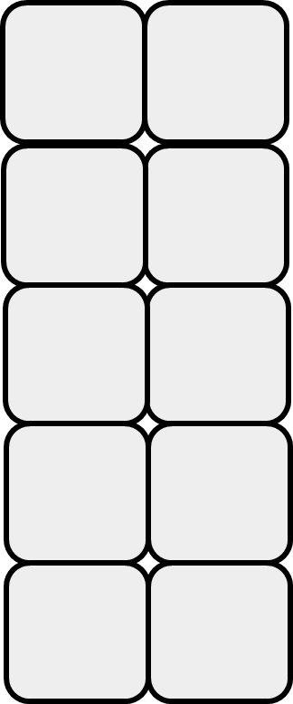
Images © 2017 Alphablocks Ltd. All Rights Reserved.
Notes:
How can we turn 10 into 6?
How many blocks need to be taken away?
Use the tens frame to explore. Represent the story with the equation.

Slide 20
What stays the same?
What is changing?
Images © 2017 Alphablocks Ltd. All Rights Reserved.
Notes:
Use this slide to compare the equations generated in the previous 3 slides.
Look for patterns in the sequence.
What stays the same in the 3 equations? What changes in the equations?
Model/explore with cubes, if needed, why the difference (6) stays the same.
Can children predict the next equation and explain how they know?

Slide 21
Images © 2017 Alphablocks Ltd. All Rights Reserved.
Notes:
What do you notice about the equation? What is missing?
Discuss how we can complete the equations. Encourage children to work systematically from a given starting point, for example, 10 - ? = 5

Slide 22
Further activities for Y2
The subtraction equations used in the previous slide introduce the idea of ‘constant difference’.
Represent 3 or 4 equations (for example, 8-3=5; 9-4=5; 7-2=5) with the same difference using concrete or pictorial representations, for example, cubes or counters.
Order a set of equations with the same difference by looking for a pattern in the minuend/ subtrahend. 7-3=4; 8-4=4; 9-5=4.
Explore other ways of varying the minuend and subtrahend whilst keeping the difference the same. For example, provide 2 or 3 subtraction equations with the same difference and ask the children to look for a pattern, and use the pattern to continue the sequence of equations.
Use one equation to solve another. For example, if 9 – 3 = 6 then use this to complete this equation o – 4 = 6; use pictorial representations to show your reasoning.

