Slide 1
Understanding solutions balance an equation
KS3 Mastery PD Materials: Exemplified Key Ideas
Materials for use in the classroom or to support professional development discussions
(from 2.2 Solving linear equations)
Summer 2021

Slide 2
About this resource
These slides are designed to complement the 2.2 Solving linear equations Core Concept document and its associated Theme Overview document 2 Operating on number, both found in the Secondary Mastery Professional Development pages.
These slides re-present the key examples from the Core Concept document so that the examples can be used either directly in the classroom or with a group of teachers. There are prompt questions alongside the examples, and further clarification in the notes.
These slides do not fully replicate the Core Concept document, so should be used alongside it. Reference to specific page numbers, and to other useful NCETM resources, can be found in the notes for each slide.
This slide deck is not designed to be a complete PD session, rather it is a selection of resources that you can adapt and use as needed when planning a session with a group of teachers.

Slide 3
About this resource
The slides are structured as follows:
The big picture:
Where does this fit in?
What do students need to understand?
Why is this key idea important?
Prior learning
Misconceptions
Exemplified key ideas
Reflection questions
Appendices:
Key vocabulary
Representations and structure
Previous and Future learning
Useful links
The exemplified key idea slides have the following symbols to indicate how they have been designed to be used:
Into the classroom
The examples are presented on these slides so that they could be used in PD, but also directly in the classroom. The notes feature suggested questions and things teachers might consider when using with students.
PD discussion prompts
These slides look at the examples in more detail, with question prompts to promote discussion among maths teachers. The notes feature reference to further information and guidance within the Core Concepts document.

Slide 4
Where does this fit in?
The NCETM has identified a set of six ‘mathematical themes’ within Key Stage 3 mathematics that bring together a group of ‘core concepts’.
The second of these themes is Operating on number, which covers the following interconnected core concepts:
2.1 Arithmetic procedures
2.2 Solving linear equations
Notes:
Linked on this slide is the Theme Overview document of Operating on number. This document includes why it is important, the key underpinning knowledge and links to prior and future learning. There is also guidance about how the five big ideas of Teaching for Mastery relate specifically to this theme.

Slide 5
Where does this fit in?
Within this core concept, 2.2 Solving linear equations, there are four statements of knowledge, skills and understanding.
These, in turn, are broken down into thirteen key ideas. The highlighted key idea is exemplified in this slide deck.
Notes:
For key ideas marked with an asterisk, we exemplified the common difficulties and misconceptions that students might have and included elements of what teaching for mastery may look like. We have provided examples of possible student tasks and teaching approaches.
Within these slides are ‘classroom-ready’ versions of the examples for the key idea that has been highlighted. There are also slides that may be useful for discussion in a professional development session

Slide 6
What do students need to understand?
2.2.1.3 Understand that a solution is a value that makes the two sides of an equation balance
Understand that the solution to an equation is a particular snapshot of a relationship between a variable and an expression.
Understand that the solution to an equation is the value of the variable at which two expressions are balanced.
What prior knowledge might your students already have?
What language might they use to describe this key idea?
What questions might you want to ask to assess their prior learning?

Slide 7
Why is this key idea important? (1)
It is important for students to appreciate that number and algebra are connected, and that the solving of equations is essentially concerned with operations on, as yet, unknown numbers..
Understanding the ‘=’ sign as ‘having the same value as’, and the correct use of order of operations, along with inverse operations, are key to the solving of equations. Students also need to understand the difference between an expression and an equation, and the different roles that letters might take.
For example, 3x + 7 is an expression where the variable x, and therefore the expression as a whole, can take an infinite number of values. It also has a duality about it – it is a process and the result of that process. It is a way of describing a set of operations on a variable (i.e. multiply by three and add seven), as well as a way of representing the actual result when x is multiplied by three and seven is added. When some restriction is put on this expression, as in 3x + 7 = 10, the letter x ceases to represent a variable but is now an unknown, the specific value of which will make the equation true. It is important that students experience this sense of the infinite (as in the values an expression can take) and the finite (specific values to satisfy an equation.
Notes:
A more detailed overview of the core concept of Solving linear equations can be found on page 2 of the 2.2 Core Concept document.
The background to each key idea is also explored in more detail on the following pages:
2.2.1 Understand what is meant by finding a solution to a linear equation with one unknown – pages 6-7
2.2.2 Solve a linear equation with a single unknown on one side where obtaining the solution requires one step – page 7
2.2.3 Solve a linear equation with a single unknown where obtaining the solution requires two or more steps (no brackets) – page 7-8
2.2.4 Solve efficiently a linear equation with a single unknown involving brackets – page 8

Slide 8
Why is this key idea important? (2)
In Key Stage 2, students were introduced to the use of symbols and letters to represent variables and unknowns in mathematical situations. Therefore, students should be able to express missing-number problems algebraically and find pairs of numbers that satisfy an equation with two unknowns. Key Stage 3 builds on this experience by providing opportunities for students to understand the concept of a ‘solution’ to a (linear) equation.
Students should appreciate that x = 5 is a linear equation (to which the solution is obvious) and that all other linear equations which are a transformation of this have the same solution. This also links to the awareness that linear equations have only one solution.
It is important that students do not just learn and blindly follow a set of procedural rules for solving equations without this sense of what a solution means. Deep, conceptual understanding allows students to be fluent and flexible problem-solvers.
Much of this learning is new and is built upon in Key Stage 4; therefore, it is essential that students are given time to develop a secure and deep understanding of these important ideas and techniques.
Notes:
A more detailed overview of the core concept of Solving linear equations can be found on page 2 of the 2.2 Core Concept document.
The background to each key idea is also explored in more detail on the following pages:
2.2.1 Understand what is meant by finding a solution to a linear equation with one unknown – pages 7 and 8
2.2.2 Solve a linear equation with a single unknown on one side where obtaining the solution requires one step – page 8
2.2.3 Solve a linear equation with a single unknown where obtaining the solution requires two or more steps (no brackets) – page 9
2.2.4 Solve efficiently a linear equation with a single unknown involving brackets – pages 9 and 10

Slide 9
Prior learning
What prior knowledge might your students already have?
What language might they use to describe this key idea?
What questions might you want to ask to assess their prior learning?
Upper Key Stage 2 Learning Outcome
Express missing number problems algebraically
Find pairs of numbers that satisfy an equation with two unknowns
Enumerate possibilities of combinations of two variables
Notes:
You may find it useful to speak to your partner schools to see how the above has been covered and the language used.
You can find further details regarding prior learning in the following segments of the NCETM primary mastery professional development materials:
• Year 4: 2.10 Connecting multiplication and division, and the distributive law
• Year 5: 1.28 Common structures and the part–part–whole relationship
• Year 5: 1.29 Using equivalence and the compensation property to calculate
• Year 5: 2.18 Using equivalence to calculate
• Year 5: 2.22 Combining multiplication with addition and subtraction
• Year 6: 1.31 Problems with two unknowns
• Year 6: 2.28 Combining division with addition and subtraction
Within the Operating on number Theme Overview document, you can also find a broader description of students’ potential previous learning (page 6), alongside further information about key underpinning knowledge (page 2).

Slide 10
Prior learning
Key Stage 3 Learning Outcome
1.4.1 Understand and use the conventions and vocabulary of algebra including forming and interpreting algebraic expressions and equations
1.4.2 Simplify algebraic expressions by collecting like terms to maintain equivalence
1.4.3 Manipulate algebraic expressions using the distributive law to maintain equivalence
2.1.1 Understand and use the structures that underpin addition and subtraction strategies
2.1.2 Understand and use the structures that underpin multiplication and division strategies
2.1.3 Know, understand and use fluently a range of calculation strategies for addition and subtraction of fractions
2.1.4 Know, understand and use fluently a range of calculation strategies for multiplication and division of fractions
2.1.5 Use the laws and conventions of arithmetic to calculate efficiently
What representations might your students already be familiar with?
What language might they use?
How does this fit in with your curriculum progression?
Notes:
Please note: Numerical codes refer to statements of knowledge, skills and understanding in the NCETM breakdown of Key Stage 3 mathematics.
Within the Operating on number Theme Overview document, you can also find a broader description of students’ potential previous learning (page 4), alongside further information about key underpinning knowledge (page 2).

Slide 11
Checking prior learning
The following slides contain questions for checking prior learning.
What representations might students use to support their understanding of these questions?
What variation might you put in place for these questions to fully assess students’ understanding of the concept?
How might changing the language of each question change the difficulty?
Why are these such crucial pre-requisites for this key idea?

Slide 12
Checking prior learning
Which of the following statements do you agree with?
Explain your decisions
The value 5 satisfies the symbol sentence 3 x + 2 = 17
The value 7 satisfies the symbol sentence 3 + x 2 = 10 +
The value 6 solves the equation 20 – x = 10
The value 5 solves the equation 20 ÷ x = x – 1
b)
I am going to buy some 10p stamps and some 11p stamps.
I want to spend exactly 93p.
Write this as a symbol sentence and find whole number values that satisfy your sentence.
Now tell me how many of each stamp I should buy.
Notes:
References to the questions (links on final slide):
NCETM primary assessment materials: year 6, page 29
NCETM primary assessment materials: year 6, page 29

Slide 13
Common difficulties and misconceptions
What aspects of this key idea might pupils find challenging?
What misconceptions might pupils have?
When teaching this topic, you may find students encounter difficulties with…
The shift from understanding a letter as a variable, to solving an equation
The meaning of algebraic expressions and equality
More information, and some suggestions for overcoming these challenges, can be found on the following slides

Slide 14
Common difficulties and misconceptions (1)
The shift from understanding a letter symbol as a variable (‘x can be any number’), to solving an equation (‘What is the value of x?’), can be a challenge for students who do not understand that the solution to an equation is a snapshot of the expression at one point as the variable changes.
Students might view an equation such as 4x + 3 = 7 as an invitation to start a process, subtracting three and dividing by four, without necessarily understanding what the process is leading to (other than the answer to the question).
It is important that students understand what it means to solve an equation – that the expressions that form the equation now share the same value. The solution to the equation identifies the value of x at which that equality can be found.
Therefore, students should understand that if they have found a solution to the equation, they can easily check its accuracy themselves, by substituting it back into the equation. This can be very empowering.
Notes:
More detail can be found on pages 9-10 of the 2.2 Core Concept document.

Slide 15
Common difficulties and misconceptions (2)
As students progress to solving more complex equations, it is important that they have a deep understanding of the meaning of algebraic expressions and of equality.
When solving one- or two-stage equations (such as 4x + 3 = 7), a common approach is to think of the expression 4x + 3 as describing a sequence of operations on x (i.e. multiply by four and then add three). Because the result of this sequence of operations on x is seven, the solution process can be thought of as operating on seven by reversing this sequence (i.e. subtracting three and then dividing by four), as shown in this function diagram:
However, such an approach does not work with more complex linear equations, such as 4x + 3 = 3x + 10, so it is important that students have an alternative way of thinking about expressions and equality.
Notes:
More detail can be found on pages 9-10 of the 2.2 Core Concept document.

Slide 16
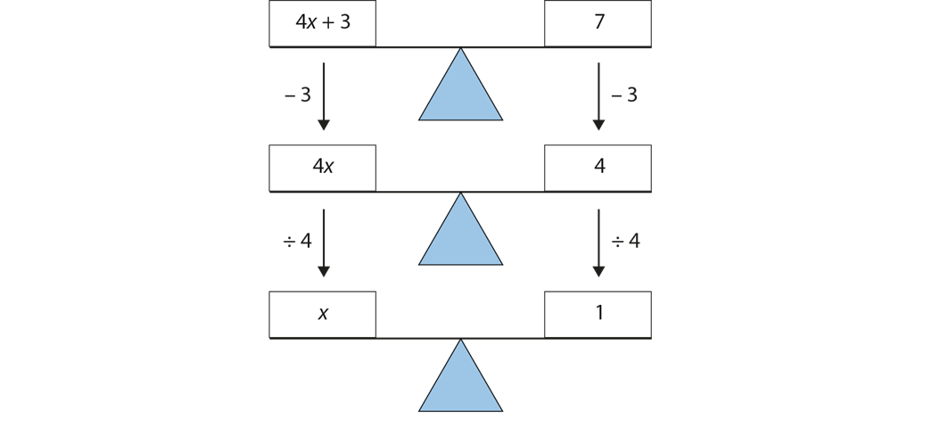
Common difficulties and misconceptions (2 cont’d)
This requires students to see an expression, such as 4x + 3, not as a sequence of operations, but as the result of such a sequence.
In this metaphor, both sides of the equation have the same value, and as long as any transformation that is applied is applied to both sides, equality will be maintained. This sense of an equation is captured in the classic balance diagram.
This is not an ‘either/or’ situation, and students will benefit from having both senses of an expression and an equation, and being able to understand both methods of solution. In fact, they complement each other.
The notion of an expression as a sequence of operations (as in the first ‘doing and undoing’ approach) helps students see which transformations to apply to both sides of the equation, and in what order, when using the second ‘balance’ approach.
Notes:
More detail can be found on pages 9-10 of the 2.2 Core Concept document.

Slide 17
Understand that the solution to an equation is a particular snapshot of a relationship between a variable and an expression
Example 1
What’s the same and what’s different about these three equations?
A: m + n = 10
B: 7 + n = 10
C: m + m = 10
Notes:
Suggested questioning:
What could m and/or n be in each equation? Is there always more than one possible value?
How else could you write part C?
What is the same and what is different about each equation?
Equation A is a formula, but B and C are not – what do you think ‘formula’ might mean?
Things for you to think about:
The intention in Example 1 is to draw students’ attention to the way in which a linear equation has one fixed solution, while a formula, such as that offered in equation A, has a range of possible correct solutions. Students who may have worked with letters representing only variables may find the shift to there being just one correct value for the letter symbol to be a challenging one. This question may give an opportunity to confront this challenge explicitly.

Slide 18
Understand that the solution to an equation is a particular snapshot of a relationship between a variable and an expression
Example 1
Students may have worked with letters representing variables, and so find it challenging that there is just one correct value for the letter in an equation. How does this example help to challenge this?
What would you want to discuss with your students?
What’s the same and what’s different about these three equations?
A: m + n = 10
B: 7 + n = 10
C: m + m = 10
Notes:
This example can be found on page 10 of the 2.2 Core Concept document.

Slide 19
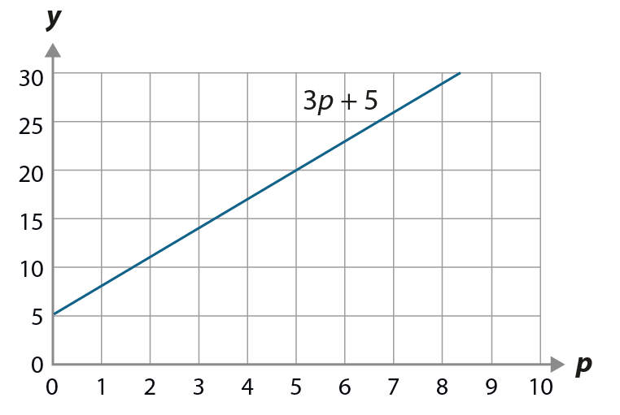
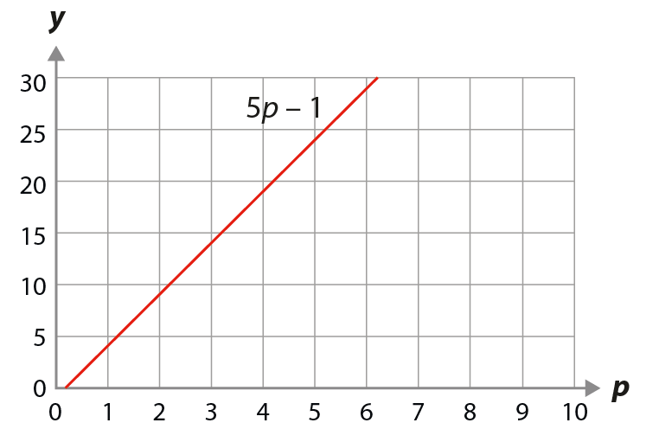
Understand that the solution to an equation is a particular snapshot of a relationship between a variable and an expression
Examples 2, 3 and 4
p | 3p + 5 | 5p − 1
−5 | –10 | –26
–4 | –7 | –21
–3 | –4 | –16
–2 | –1 | –11
–1 | 2 | –6
0 | 5 | –1
1 | 8 | 4
2 | 11 | 9
3 | 14 | 14
4 | 17 | 19
5 | 20 | 24
6 | 23 | 29
7 | 26 | 34
8 | 29 | 39
9 | 32 | 44
10 | 35 | 49
11 | 38 | 54
12 | 41 | 59
Examples 2, 3 and 4 use different representations of the same two expressions.
How does each example build upon the understanding gained from the previous one?
How will you use them to plan a coherent sequence of learning?
Notes:
These examples can be found on pages 11-13 of the 2.2 Core Concept document.

Slide 20
Understand that the solution to an equation is a particular snapshot of a relationship between a variable and an expression
Example 2
p | 3p + 5 | 5p − 1
−5 | –10 | –26
–4 | –7 | –21
–3 | –4 | –16
–2 | –1 | –11
–1 | 2 | –6
0 | 5 | –1
1 | 8 | 4
2 | 11 | 9
3 | 14 | 14
4 | 17 | 19
5 | 20 | 24
6 | 23 | 29
7 | 26 | 34
8 | 29 | 39
9 | 32 | 44
10 | 35 | 49
11 | 38 | 54
12 | 41 | 59
This table shows the outcome of substituting different values of p into the expressions 3p + 5 and 5p − 1 calculated using a spreadsheet.
Use the table to write down:
The value of 3p + 5 when p = 7.
The value of 5p − 1 when p = 7.
The value of p when 5p – 1 = 29.
The value of p when 3p + 5 = 29.
Notes:
Suggested questioning:
When p is the same, will the value of each expression be the same or different?
When the value of the expression is the same, will the value of p be the same or different?
Is the answer for each question unique? Why or why not?
Things for you to think about:
The role of the letter as a variable is made explicit in this representation, as two different expressions are evaluated with increasing values of p.
In parts a) and b), students have the opportunity to see that the same value of p results in each expression taking a different value.
In parts c) and d), students’ attention should be drawn to the fact that, when given the outcome of evaluating an expression, they are able to identify the value of p, and that the same outcome has resulted from different values of p. Students should also be aware that (for these linear expressions) there is a unique value of p for each outcome of each expression.

Slide 21
Understand that the solution to an equation is a particular snapshot of a relationship between a variable and an expression
Example 2
p | 3p + 5 | 5p − 1
−5 | –10 | –26
–4 | –7 | –21
–3 | –4 | –16
–2 | –1 | –11
–1 | 2 | –6
0 | 5 | –1
1 | 8 | 4
2 | 11 | 9
3 | 14 | 14
4 | 17 | 19
5 | 20 | 24
6 | 23 | 29
7 | 26 | 34
8 | 29 | 39
9 | 32 | 44
10 | 35 | 49
11 | 38 | 54
12 | 41 | 59
How does this example support students to understand the role of the letter as a variable?
What other questions might you want to ask, using this example as a basis?
This table shows the outcome of substituting different values of p into the expressions 3p + 5 and 5p − 1 calculated using a spreadsheet.
Use the table to write down:
The value of 3p + 5 when p = 7.
The value of 5p − 1 when p = 7.
The value of p when 5p – 1 = 29.
The value of p when 3p + 5 = 29.
Notes:
This example can be found on page 11 of the 2.2 Core Concept document.

Slide 22
Understand that the solution to an equation is a particular snapshot of a relationship between a variable and an expression
Example 3
This line graph shows the value of 3p + 5 for different values of p.
This line graph shows the value of 5p − 1 for different values of p.
Use the line graph to write down the value of 3p + 5 when p = 7.
Use the first line graph to write down the value of p when 3p + 5 = 29.
Use this line graph to write down the value of 5p − 1 when p = 7.
Use the second line graph to write down the value of p when 5p − 1 = 29.
Notes:
Suggested questioning:
How did you find each solution?
How was this example the same and different to example 2?
Complete the sentence: when the value of p is __, the value of 3p + 5 is ___.
Things for you to think about:
In Example 3, the same expressions and prompts are used as in Example 2, but the representation has been changed from a table of values to a graph. The key awareness for students here is that p represents a variable, but at certain points a snapshot of that variable can be taken and statements made about the values. For example, when p = 7, then 3p + 5 = 26 and when 3p + 5 = 29, then p = 8. The graphs may represent the continuous nature of the variable more accurately but be less intuitive for students to interpret, so it is important to give time for them to understand the connection between the graphs and the table from Example 2.

Slide 23
Understand that the solution to an equation is a particular snapshot of a relationship between a variable and an expression
Example 3
How does this example support students to understand the role of the letter as a variable?
What other questions might you want to ask, using this example as a basis?
How will you ensure students make the connection between these graphs and the table in example 2?
These line graphs show the value of 3p + 5 (blue) and 5p – 1 (red) for different values of p.
Use the line graph to write down the value of 3p + 5 when p = 7.
Use the first line graph to write down the value of p when 3p + 5 = 29.
Use this line graph to write down the value of 5p − 1 when p = 7.
Use the second line graph to write down the value of p when 5p − 1 = 29.
Notes:
This example can be found on page 12 of the 2.2 Core Concept document.

Slide 24
Understand that the solution to an equation is a particular snapshot of a relationship between a variable and an expression
Examples 2 and 3
p | 3p + 5
−5 | –10
–4 | –7
–3 | –4
–2 | –1
–1 | 2
0 | 5
1 | 8
2 | 11
3 | 14
4 | 17
5 | 20
6 | 23
7 | 26
8 | 29
9 | 32
10 | 35
11 | 38
12 | 41
This line graph and table both show the value of 3p + 5 for different values of p. Write down the value of 3p + 5 when p = 7.
What is the same and different about each representation?
How does each representation help you to find the value of 3p + 5 when p = 7?
Notes:
Suggested questioning:
What is the same? What is different?
Does the table show every value of 3p + 5? Does the line graph show every value of 3p + 5?
Which would you use to find the value of 3p + 5 when p = 2.5?
Things for you to think about:
In Example 3, the same expressions and prompts are used as in Example 2, but the representation has been changed from a table of values to a graph. The key awareness for students here is that p represents a variable, but at certain points a snapshot of that variable can be taken and statements made about the values. For example, when p = 7, then 3p + 5 = 26 and when 3p + 5 = 29, then p = 8. The graphs may represent the continuous nature of the variable more accurately but be less intuitive for students to interpret, so it is important to give time for them to understand the connection between the graphs and the table from Example 2.

Slide 25
Understand that the solution to an equation is a particular snapshot of a relationship between a variable and an expression
Examples 2 and 3
p | 3p + 5 | 5p − 1
−5 | –10 | –26
–4 | –7 | –21
–3 | –4 | –16
–2 | –1 | –11
–1 | 2 | –6
0 | 5 | –1
1 | 8 | 4
2 | 11 | 9
3 | 14 | 14
4 | 17 | 19
5 | 20 | 24
6 | 23 | 29
7 | 26 | 34
8 | 29 | 39
9 | 32 | 44
10 | 35 | 49
11 | 38 | 54
12 | 41 | 59
How do each of these representations help students to understand p as a variable?
What are the strengths and limitations of each representation?
Notes:
The graphs may represent the continuous nature of the variable more accurately but be less intuitive for students to interpret, so it is important to give time for them to understand the connection between the graphs and the table from Example 2.
This example can be found on pages 12 and 13 of the 2.2 Core Concept document.

Slide 26
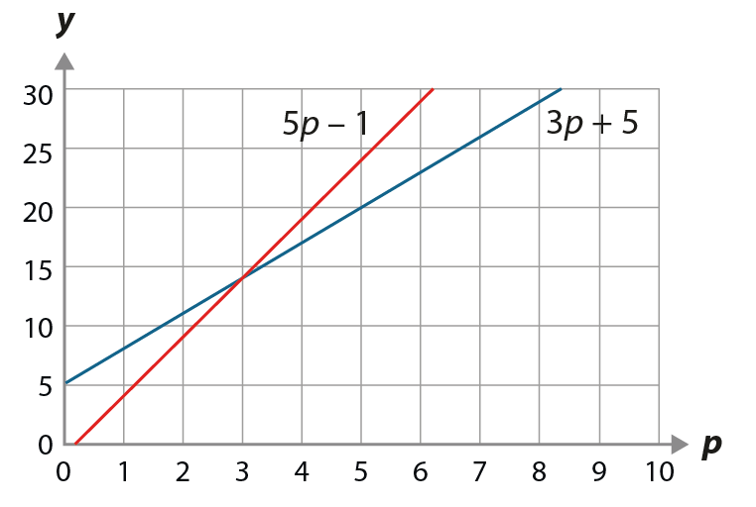
Understand that the solution to an equation is the value of the variable at which two expressions are balanced
Example 4
p | 3p + 5 | 5p − 1
−5 | –10 | –26
–4 | –7 | –21
–3 | –4 | –16
–2 | –1 | –11
–1 | 2 | –6
0 | 5 | –1
1 | 8 | 4
2 | 11 | 9
3 | 14 | 14
4 | 17 | 19
5 | 20 | 24
6 | 23 | 29
7 | 26 | 34
8 | 29 | 39
9 | 32 | 44
10 | 35 | 49
11 | 38 | 54
12 | 41 | 59
Both lines have been drawn on the same axes.
Use the table to find the point where the expression 3p + 5 and the expression 5p − 1 both share the same value.
Use the table to write down the value of p when 3p + 5 = 5p − 1.
Use the graph to find the point where the expression 3p + 5 and the expression 5p − 1 both share the same value.
Use the graph to write down the value of p when 3p + 5 = 5p − 1.
Notes:
Suggested questioning:
What is the same/different about parts a and b? How about parts c and d?
How many solutions are there where both expressions share the same value?
What do you notice about the point on the graph where 5p – 1 and 3p + 5 share the same value?
Things for you to think about:
Example 4 builds on Example 2 and should be seen as a continuation of it. The graph and question parts c and d are animated to reduce how visually busy this slide is at first; the next slide gives the two representations without text so that you can ask the questions verbally.
Parts a) and b) are both focusing attention on a key point, the solution to 3p + 5 = 5p – 1, but offering slightly different interpretations. The intention is to give students the opportunity to make sense of the solution to an equation as the point at which both ‘sides’ of the equation have the same value.
The graph with both expressions represented offers the same connection to Example 3. Again, students’ attention should be drawn to the point at which the two expressions share the same value, this time understanding that this is a unique point on the graph.

Slide 27
Understand that the solution to an equation is the value of the variable at which two expressions are balanced
Example 4
p | 3p + 5 | 5p − 1
−5 | –10 | –26
–4 | –7 | –21
–3 | –4 | –16
–2 | –1 | –11
–1 | 2 | –6
0 | 5 | –1
1 | 8 | 4
2 | 11 | 9
3 | 14 | 14
4 | 17 | 19
5 | 20 | 24
6 | 23 | 29
7 | 26 | 34
8 | 29 | 39
9 | 32 | 44
10 | 35 | 49
11 | 38 | 54
12 | 41 | 59
Both lines have been drawn on the same axes.
Notes:
Example 4 builds on Example 2 and should be seen as a continuation of it. This slide offers a less visually busy comparison of the two representations of these expressions.

Slide 28
Understand that the solution to an equation is the value of the variable at which two expressions are balanced
Example 4
Both lines have been drawn on the same axes.
How does asking the same question in different ways build students’ understanding of solutions to equations?
How confident are your students with graphical representations of equations? What skills or knowledge might you want to revisit first?
p | 3p + 5 | 5p − 1
−5 | –10 | –26
–4 | –7 | –21
–3 | –4 | –16
–2 | –1 | –11
–1 | 2 | –6
0 | 5 | –1
1 | 8 | 4
2 | 11 | 9
3 | 14 | 14
4 | 17 | 19
5 | 20 | 24
6 | 23 | 29
7 | 26 | 34
8 | 29 | 39
9 | 32 | 44
10 | 35 | 49
11 | 38 | 54
12 | 41 | 59
Use the table to find the point where the expression 3p + 5 and the expression 5p − 1 both share the same value.
Use the table to write down the value of p when 3p + 5 = 5p − 1.
Parts c) and d) ask students to repeat a) and b) using the graph.
Notes:
More detail about this example can be found on page 13 of the 2.2 Core Concept document.

Slide 29
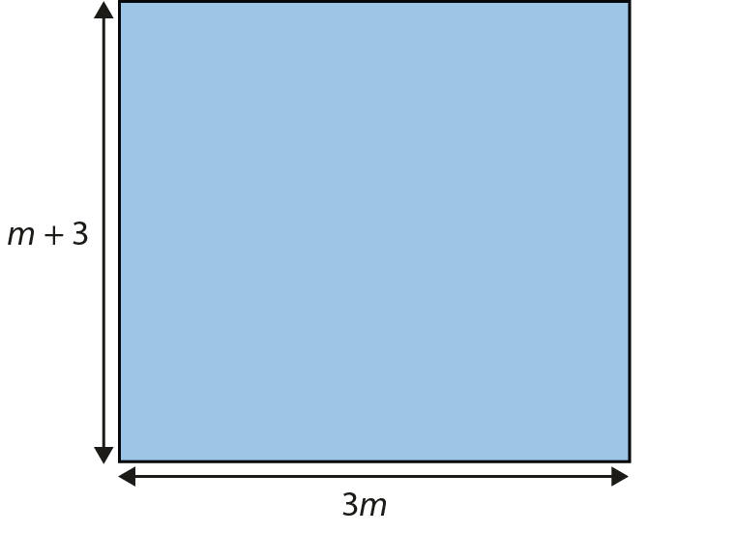
Understand that the solution to an equation is the value of the variable at which two expressions are balanced
Example 5
This rectangle is not drawn to scale.
If drawn accurately, would the rectangle be short and wide, or tall and thin? Explain how you know.
Is there a value (or values) of m for which the shape will become a square? Explain how you know.
Notes:
Suggested questioning:
What would the rectangle look like if m was __? How would it change if m was bigger/smaller?
If the rectangle is a square, what do you know about m + 3 and 3m? How could you write this as an equation?
Things for you to think about:
In Example 5, the representation is used to support students in developing their understanding of the letter symbol as a variable, and the continuous nature of that variable, as they imagine the ways in which the shape will change as m changes. Once students have spent time with the task, you might like to prompt them by asking them to sketch the rectangle when m is very small, then when m is very large, and discuss the differences in the shapes.
Part b) then fixes the relationship between the height and the width of the rectangle. Here, the representation can be used to draw attention to the equality of the expression giving the height and the expression giving the width. You might like to generate a set of results using a spreadsheet and a graphical representation (as in Example 4) to make explicit the connections between these different representations to students. Using these different representations should convince students that there will only be one point at which the height and width are equal, and that is the solution to the equation.

Slide 30
Understand that the solution to an equation is the value of the variable at which two expressions are balanced
Example 5
How does the rectangle representation support students to understand the letter symbol as a variable? How can it be used to emphasise the continuous nature of that variable?
How could you use tabular or graphical representations to show different values of m, and different solutions to part b?
If drawn accurately, would the rectangle be short and wide, or tall and thin? Explain how you know.
Is there a value (or values) of m for which the shape will become a square? Explain how you know.
This rectangle is not drawn to scale.
Notes:
More detail about how you might used this example can be found on pages 13-15 of the 2.2 Core Concept document.
A similar task was used in the ICCAMS project, in which students were asked: ‘Which is bigger, 2n or n + 2?’ A link to this project is on the final slide; see page 17 of the 2.2 Core Concept document for more information about this similar task and some points to consider when teaching.

Slide 31
Understand that the solution to an equation is the value of the variable at which two expressions are balanced
Example 5a
Find a value of m where…
the height is double the width
the height is three times the width
the width is one unit longer than the height
the height is one unit longer than the width
the height is five units longer than the width.
This rectangle is not drawn to scale.
Notes:
Some students might work on finding values in which there are different relationships between the height and width of the rectangle. This slide offers some suggested constraints for students to work on. These questions give a chance to further consider the role of the equals sign in the equation and to explore the limitations of numerical results when finding solutions that are not possible in the context of the problem (such as the solution to the final prompt here).

Slide 32
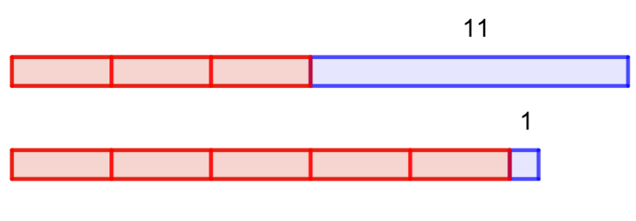
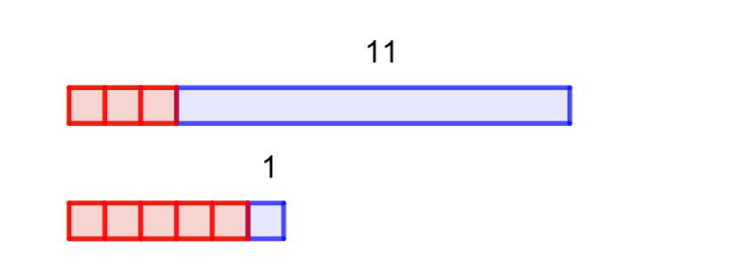
Understand that the solution to an equation is the value of the variable at which two expressions are balanced
Example 6a
The bars in this diagram represent the expressions 3x + 11 and 5x + 1:
The value of x (the length of the first bar) can vary, and in this diagram, it is 1:
Notes:
Example 6 is separated over two slides, and animated, to support students to understand the representation.
A single slide version, which may be more suitable for printing, can be found on slide 34.
Suggested questioning:
What happens to my bars as I make the value of x bigger?
For what value of x will the bottom bar be longer than the top bar? For what value will they be equal?
What will happen as my value of x increases further still?
Things for you to think about:
Here, a bar diagram is used to show the variable nature of the letter symbol in two expressions, and to identify the point and value of x at which they are equal. This is an alternative way to consider the shift from the variable nature of the letter symbol in an expression to the unknown nature when working with an expression. A GeoGebra file for this representation is available online; the link can be found on the final slide.

Slide 33
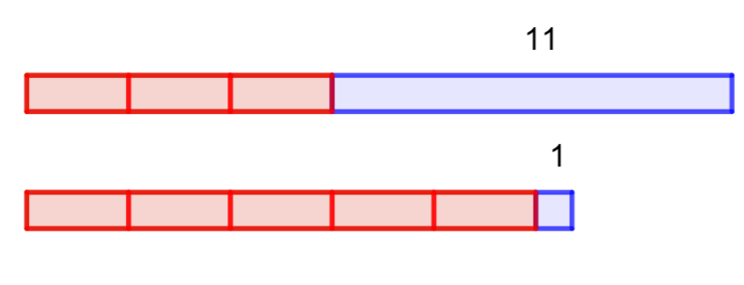
Understand that the solution to an equation is the value of the variable at which two expressions are balanced
Example 6b
Here are some snapshots of the bars at different values:
At 2.8:
What length of the bar for x will make the top and the bottom bars have the same total length?
Write down the solution to the equation 3x + 11 = 5x + 1.
At 4.3:
At 6.2:
Notes:
Example 6 is separated over two slides, and animated, to support students to understand the representation.
A single slide version, which may be more suitable for printing, can be found on slide 34.
Suggested questioning:
What happens to my bars as I make the value of x bigger?
For what value of x will the bottom bar be longer than the top bar? For what value will they be equal?
What will happen as my value of x increases further still?
Things for you to think about:
Here, a bar diagram is used to show the variable nature of the letter symbol in two expressions, and to identify the point and value of x at which they are equal. This is an alternative way to consider the shift from the variable nature of the letter symbol in an expression to the unknown nature when working with an expression. A GeoGebra file for this representation is available online; the link can be found on the final slide.

Slide 34
Understand that the solution to an equation is the value of the variable at which two expressions are balanced
Example 6 (no animation)
The bars in this diagram represent the expressions 3x + 11 and 5x + 1:
The value of x (the length of the first bar) can vary, and in this diagram, it is 1:
Here are some snapshots of the bars at different values:
at 2.8:
at 4.7:
at 6.2:
What length of the bar for x will make the top and the bottom bars have the same total length?
Write down the solution to the equation 3x + 11 = 5x + 1.
Notes:
This is a single slide version of example 6, without animation. It may be more suitable for printing.
Suggested questioning:
What happens to my bars as I make the value of x bigger?
For what value of x will the bottom bar be longer than the top bar? For what value will they be equal?
What will happen as my value of x increases further still?
Things for you to think about:
Here, a bar diagram is used to show the variable nature of the letter symbol in two expressions, and to identify the point and value of x at which they are equal. This is an alternative way to consider the shift from the variable nature of the letter symbol in an expression to the unknown nature when working with an expression. A GeoGebra file for this representation is available online; the link can be found on the final slide.

Slide 35
Understand that the solution to an equation is the value of the variable at which two expressions are balanced
Example 6
How does this bar model support students to understand the variable nature of the letter symbol in two expressions, and to appreciate the point at which they are equal?
How might a dynamic representation (see notes) give students further insight into what it means to solve an equation?
Notes:
More detail about the intention behind this example, including a link to a GeoGebra file with a dynamic representation of this example, can be found on pages 15-16 of the 2.2 Core Concept document.

Slide 36
Understand that the solution to an equation is the value of the variable at which two expressions are balanced
Example 7
(i) Explain you would find out if b = 9 is a solution to the equation 13b – 11 = 106.
(ii) Is b = 9 a solution to the equation 13b – 11 = 106?
(i) Explain you would find out if b = 9 is a solution to the equation 10b + 15 = 105.
(ii) Is b = 9 a solution to the equation 10b + 15 = 105?
Explain how you could use your previous answers to find out if b = 9 is also a solution to 13b – 11 = 10b + 15.
Notes:
Suggested questioning:
How will you decide if b=9 is a solution? Is there more than one way to do this?
What does the equals sign mean?
Is the solution to 13b – 11 = 10b + 15 greater or less than b=9? How do you know?
Things for you to think about:
In parts a) and b) of Example 7, students are asked to explain how to check a solution. They might decide to do this by substitution, or by solving the original equation. Listening to their responses is likely to give an insight into their current understanding. In part c), students are then asked to use the two previous solutions to decide on the solution to an equation (comprising the two previous expressions). Students’ attention should be drawn to the use of the equals sign and the value of each ‘side’ of the equation when b = 9, in order to deduce that the equation given in part c) cannot be correct when b = 9.

Slide 37
Understand that the solution to an equation is the value of the variable at which two expressions are balanced
Example 7
(i) Explain you would find out if b = 9 is a solution to the equation 13b – 11 = 106.
(ii) Is b = 9 a solution to the equation
13b – 11 = 106?
(i) Explain you would find out if b = 9 is a solution to the equation 10b + 15 = 105.
(ii) Is b = 9 a solution to the equation
10b + 15 = 105?
Explain how you could use your previous answers to find out if b = 9 is also a solution to 13b – 11 = 10b + 15.
How might your students approach parts a and b? What does this tell you about their understanding of solutions equations?
How will you draw students’ attention to the use of the equals sign in part c?
Notes:
This example can be found on page 16 of the 2.2 Core Concept document.

Slide 38
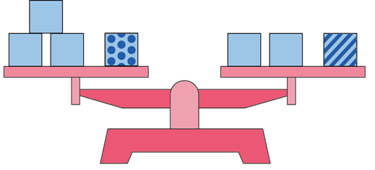
Understand that the solution to an equation is the value of the variable at which two expressions are balanced
Example 8
These scales are balanced.
All of the plain boxes have the same weight.
Is the striped box heavier or lighter than the spotty box? Explain how you know.
Can you describe how much heavier or lighter the striped box is than the spotty box?
This equation describes the weight on the scales: 3x + 7 = 2x + m
Do you agree that m is more than 7? How much more? Explain how you know.
If we are told that m = 8, can you find a value of x that makes the scales balance? Explain how you know your answer is correct.
Notes:
Suggested questioning:
What does it mean if these scales are balanced? What would happen if one of the boxes was removed?
Is the striped box heavier or lighter than the spotty box?
How much heavier or lighter must the striped box be?
What is the same/different about the equation compared with the scales? What must x represent? What must 7 represent? What must m represent?
Things for you to think about:
Example 8 uses two different representations of the same relationship to encourage students to make explicit the connection between the balancing scales and the algebraic equation. As in previous examples, the solution to the equation is approached by comparing the relationships present rather than by taking an algorithmic approach. The intention is to make sense of what is meant by the solution of an equation, and to see that this solution is the fixed point at which two different expressions are equal.
When working on parts c) and d), students have more information than in the diagram, but it is presented in a way that may be less intuitive for them.
Students should be encouraged to work with both representations and to make connections between the two.

Slide 39
Understand that the solution to an equation is the value of the variable at which two expressions are balanced
Example 8
What questions might you need to ask to support students to make connections between the balance representation and the equation?
As before, this example looks for the solution by comparing the relationships present rather than following an algorithm: what might students gain from this approach?
These scales are balanced.
All of the plain boxes have the same weight.
Is the striped box heavier or lighter than the spotty box? Explain how you know.
Can you describe how much heavier or lighter the striped box is than the spotty box?
This equation describes the weight on the scales: 3x + 7 = 2x + m
Do you agree that m is more than 7? How much more? Explain how you know.
If we are told that m = 8, can you find a value of x that makes the scales balance? Explain how you know your answer is correct.
Notes:
More detail about the way students might approach this example can be found on pages 16-17 of the 2.2 Core Concept document.

Slide 40
Understand that the solution to an equation is the value of the variable at which two expressions are balanced
Example 9
Decide which of these equations has h = 5 as a solution, which has h = 0 as a solution and which has no solution.
4h + 9 = 4h + 10
7h + 5 = 3h + 5
2h = 3h − 5
5 = 5h + 5
Notes:
Suggested questioning:
How would you know if h = 5 is a solution? How would you know if h = 0 is a solution?
Which of these have no solution? How do you know?
Things for you to think about:
Example 9 offers a set of equations for students to consider. Although the question can be answered through the use of a procedure, this is not necessary. Students should be able to reason their way to a solution by using their understanding of what it means to find a solution to an equation. The examples used here are different from those with which students might be familiar, offering zero as a solution and also no solution, and so exploring the ‘edges’ of what it means to be able to solve an equation.

Slide 41
Understand that the solution to an equation is the value of the variable at which two expressions are balanced
Example 9
How will you encourage students to reason their way to a solution, rather than using a procedure to solve each equation?
How might these examples help you to explore the ‘edges’ of what it means to be able to solve an equation with your students?
Decide which of these equations has h = 5 as a solution, which has h = 0 as a solution and which has no solution.
4h + 9 = 4h + 10
7h + 5 = 3h + 5
2h = 3h − 5
5 = 5h + 5
Notes:
More detail about the sequencing of this example can be found on page 17 of the 2.2 Core Concept document.

Slide 42
Reflection questions
What other mathematical concepts will be supported by students’ stronger understanding of this key idea?
What mathematical language will you continue to use to support pupils to make connections with other areas?
Which representations might you continue to use to further develop students’ understanding?

Slide 44
Appendices
You may choose to use the following slides when planning or delivering a PD session. They cover:
Key vocabulary
Representations and structure
Previous learning
Future learning
Library of links

Slide 45
Key vocabulary
Term | Definition
coefficient | Often used for the numerical coefficient. More generally, a factor of an algebraic term. Example 1: In the term 4xy, 4 is the numerical coefficient of xy but x is also the coefficient of 4y and y is the coefficient of 4x. Example 2: in the quadratic equation 3x² + 4x – 2, the coefficients of x² and x are 3 and 4 respectively.
equation | A mathematical statement showing that two expressions are equal. The expressions are linked with the symbol = Examples: 7 – 2 = 4 + 1 4x = 3 x² − 2x + 1 = 0
linear | In algebra, describing an expression or equation of degree one. Example: 2x + 3y = 7 is a linear equation. All linear equations can be represented as straight line graphs.
solution | A solution to an equation is a value of the variable that satisfies the equation, i.e. when substituted into the equation, makes it true. A solution set is the set of values that satisfy a given set of equations or inequalities.
unknown | A number that is not known. Example: In the expression 2x − 5, x represents an unknown. When presented with more information, such as in the form of an equation (e.g. 2x – 5 = 6), this unknown can be found.
variable | A quantity that can take on a range of values, often denoted by a letter, x, y, z, t, …, etc.

Slide 46
Representations and structure
There are a number of different representations that you may wish to use to support students’ understanding of this key idea. These might include:
Tables and graphs
Tables and graphs can be used to draw attention to the continuous nature of variables, as well as the unique points where a variable is a solution to a linear equations. See examples 2-4 in this slide deck.
Bar models
Bar models can be very useful to support students in representing (literally, re-presenting) problems to reveal additive and multiplicative structures, including those involving unknown values.
Balance models
The balance model is a classic representation (or metaphor) for equality.
Notes:
More information about the representations and structure involved in this key idea can be found:
On page 8 of the Theme Overview document.
In the ‘Using mathematical representations at KS3’ documents
Links to all of these can be found on the final slide.

Slide 47
Previous learning (1)
From Upper Key Stage 2, students will bring experience of:
multiplying multi-digit numbers up to four digits by a two-digit whole number using the formal written method of long multiplication
dividing numbers up to four digits by a two-digit whole number using the formal written method of long division, and interpreting remainders as whole number remainders, fractions, or by rounding, as appropriate for the context
dividing numbers up to four digits by a two-digit number using the formal written method of short division where appropriate, and interpreting remainders according to the context
performing mental calculations, including with mixed operations and large numbers
using their knowledge of the order of operations to carry out calculations involving the four operations
solving addition and subtraction multi-step problems in contexts, deciding which operations and methods to use and why
Notes:
Theme 2 Operating on number

Slide 48
Previous learning (2)
From Upper Key Stage 2, students will bring experience of:
solving problems involving addition, subtraction, multiplication and division
using estimation to check answers to calculations and determine, in the context of a problem, an appropriate degree of accuracy
adding and subtracting fractions with different denominators and mixed numbers, using the concept of equivalent fractions
multiplying simple pairs of proper fractions, writing the answer in its simplest form [e.g. $\frac{1}{4}×\frac{1}{2}=\frac{1}{8}$]
dividing proper fractions by whole numbers [e.g. $\frac{1}{3}÷2=\frac{1}{6}$]
multiplying one-digit numbers with up to two decimal places by whole numbers
using written division methods in cases where the answer has up to two decimal places.
Notes:
Theme 2 Operating on number

Slide 49
Future learning
In KS4, students will build on the core concepts in this mathematical theme to:
calculate with roots and with integer {and fractional} indices
calculate exactly with fractions, {surds} and multiples of $π$; {simplify surd expressions involving squares [e.g. $\sqrt{12}=\sqrt{(4×3)}=\sqrt{4}×\sqrt{3}=2\sqrt{3}$ ] and rationalise denominators}
calculate with numbers in standard form A × 10^{n}, where 1 ≤ A < 10 and n is an integer
solve two simultaneous equations in two variables (linear/linear {or linear/quadratic}) algebraically; find approximate solutions using a graph
translate simple situations or procedures into algebraic expressions or formulae; derive an equation (or two simultaneous equations), solve the equation(s) and interpret the solution
solve linear inequalities in one {or two} variable{s}, {and quadratic inequalities in one variable}; represent the solution set on a number line, {using set notation and on a graph}.
Please note: Braces { } indicate additional mathematical content to be taught to more highly attaining students. Square brackets [ ] indicate content schools are not required to teach by law.
Notes:
Theme 2 Operating on Number

Slide 50
Library of links
The following resources from the NCETM website have been referred to within this slide deck:
NCETM Secondary Mastery Professional Development
2 Operating on number Theme Overview Document
2.2 Solving linear equations Core Concept Document
Using mathematical representations at KS3 | NCETM
NCETM primary mastery professional development materials
NCETM primary assessment materials
There are also references to:
ICCAMS Maths
GeoGebra file for example 6

