Slide 1
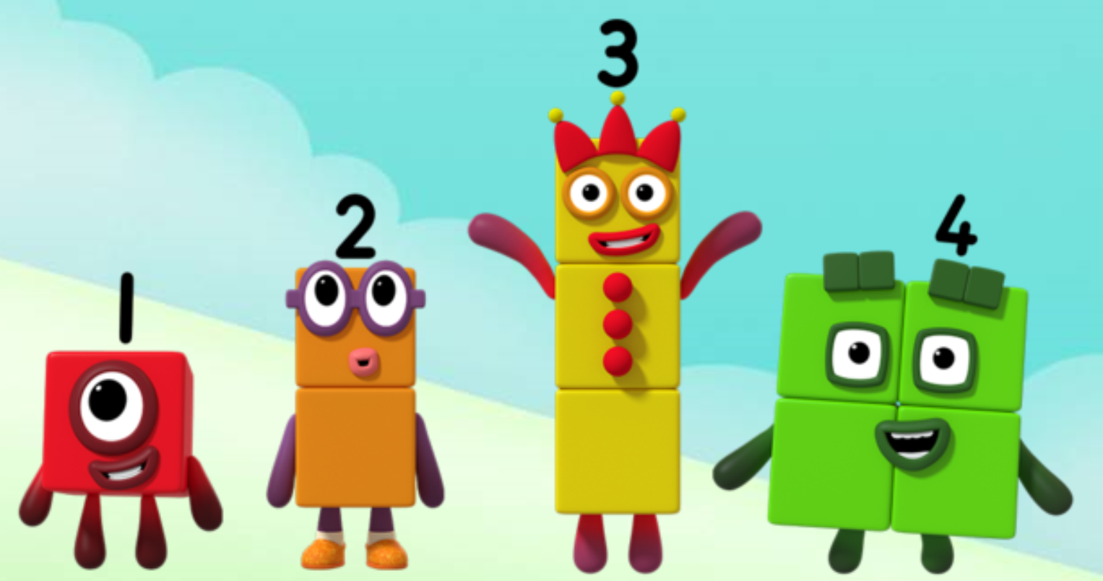
Series 1 Episode 15
Hide and Seek

Slide 2
Maths in the Episode
To watch this episode, please go to BBC iPlayer - Numberblocks. Look for Series 1: Hide and Seek.
Number bonds to 5
In this episode children can see how five can be split into different parts. They see that these parts can join together again to make five. So, one and four combine to make five, and three and two combine to make five. It does not matter which way these pairs of numbers combine, they always make five!

Slide 3
Talk and discuss together
Watch the episode together.
Ask your child what they noticed and be interested in anything they have to say.
Use the following pictures and activities to explore and talk about the maths involved.

Slide 4
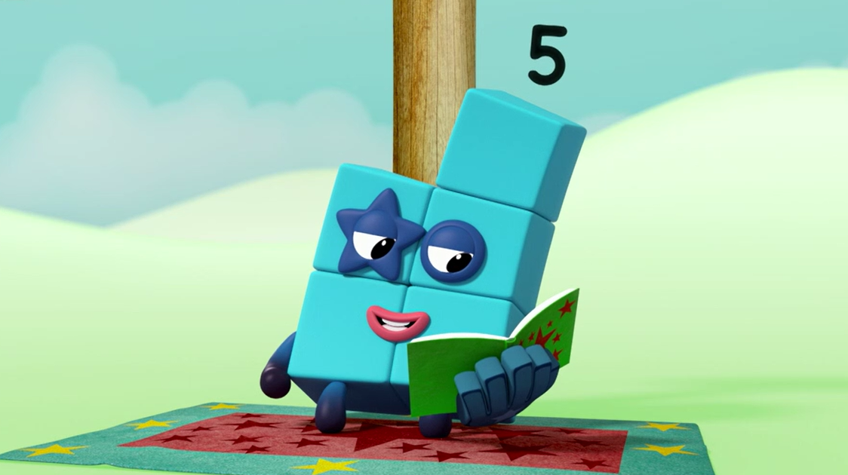
Can you help me find the other Numberblocks to make another ME?
Images © 2017 Alphablocks Ltd. All Rights Reserved.

Slide 5
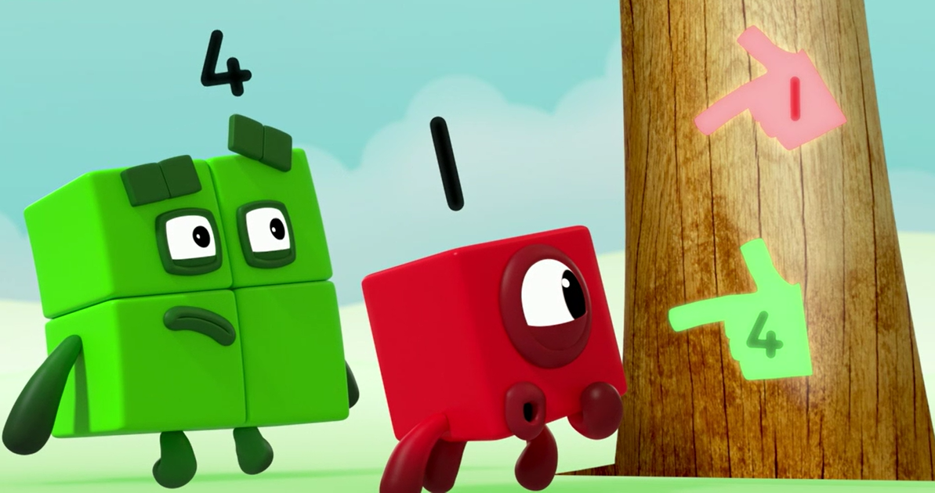
Images © 2017 Alphablocks Ltd. All Rights Reserved.

Slide 6
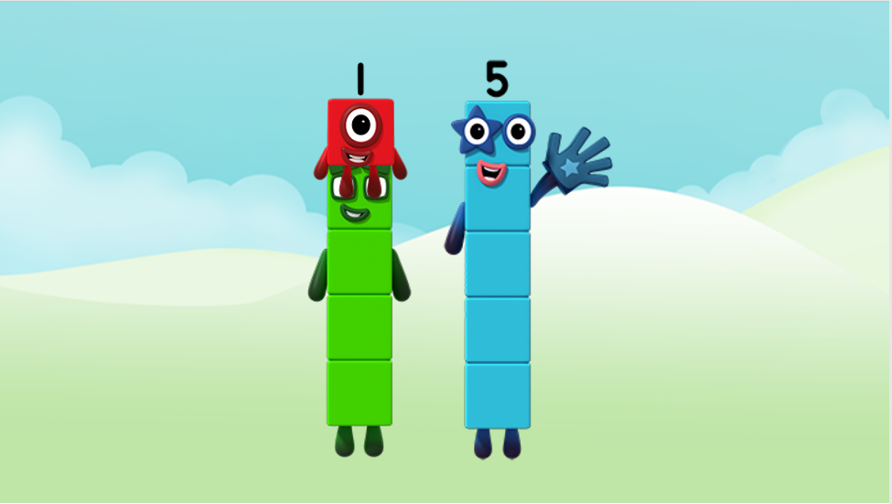
One and Four can join to make Five!
Another ME!
Images © 2017 Alphablocks Ltd. All Rights Reserved.

Slide 7
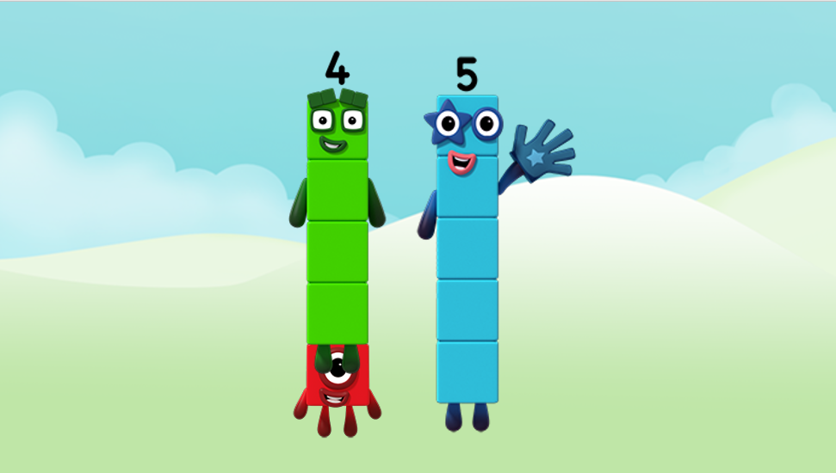
Four and One can join to make Five!
Another ME!
Images © 2017 Alphablocks Ltd. All Rights Reserved.

Slide 8
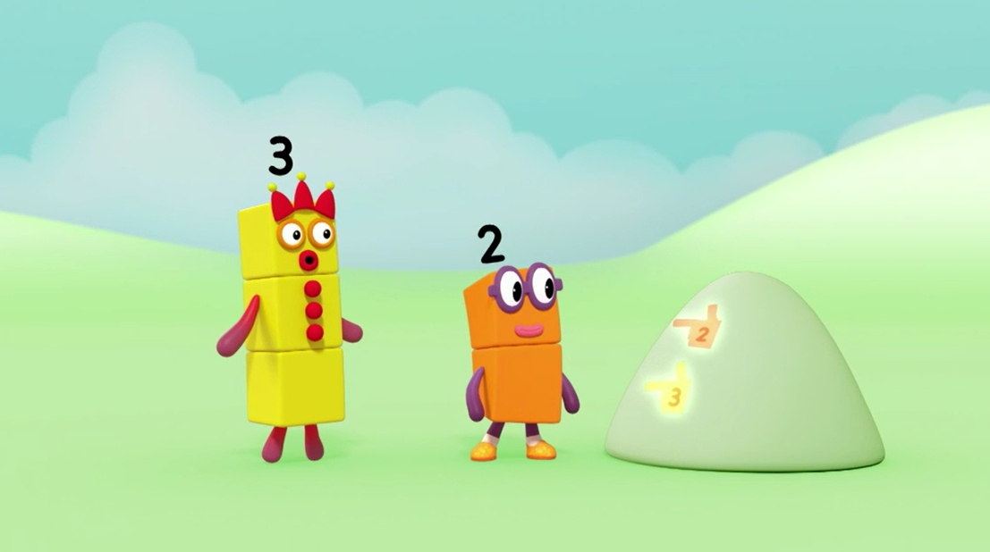
Images © 2017 Alphablocks Ltd. All Rights Reserved.

Slide 9
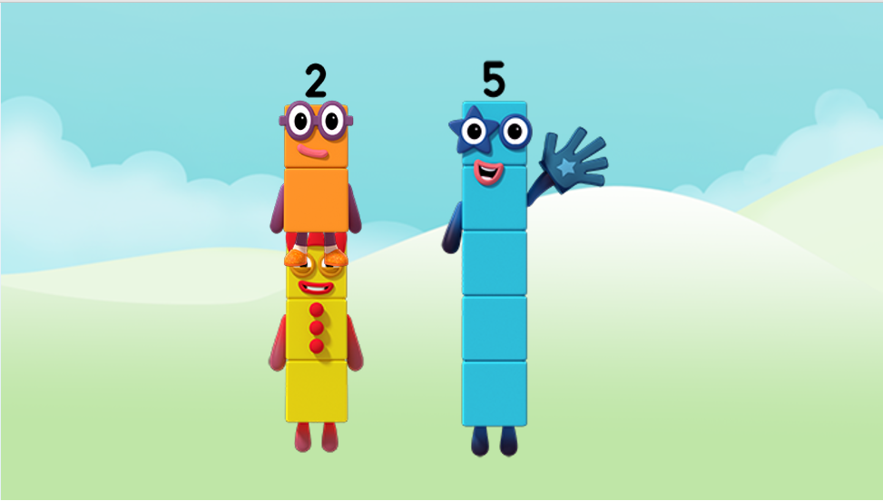
Two and Three can join to make Five!
Another ME!
Images © 2017 Alphablocks Ltd. All Rights Reserved.

Slide 10
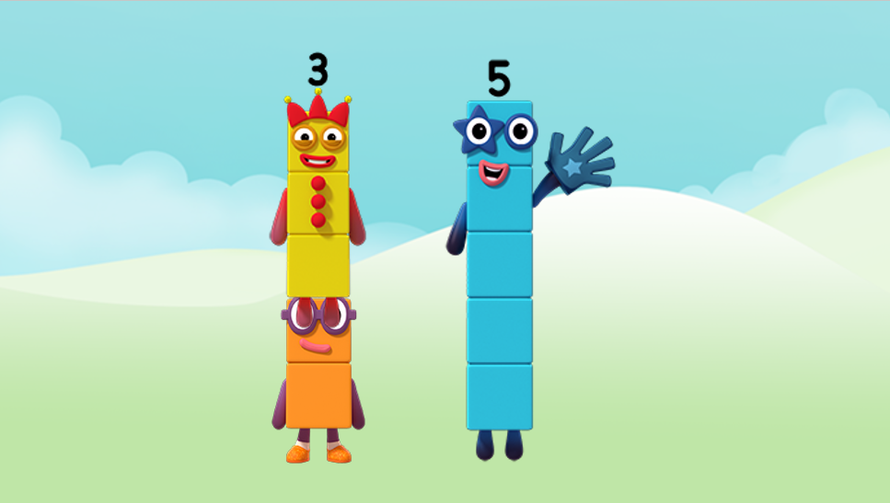
Three and Two can join to make Five!
Another ME!
Images © 2017 Alphablocks Ltd. All Rights Reserved.

Slide 11
Around the home
Find five small objects and put them into two piles. Can you see a pile of two and a pile of three? Or can you see four and one? Tell someone what you see.
Draw a picture of five things which you can describe as ‘two and three’ or ‘one and four’.
It could be…five cats, one big cat and four small cats; five flowers, one red flower and four yellow flowers; five children at the park, two children on the swing and three children on the slide.
Show five on your fingers using two hands. Say whether you have four and one or two and three on each hand.
Put some small objects into a box or under a cloth, put in your hand and take some of them out. Can you say how many are still in the box or under the cloth?

Slide 12
General tips that can make a difference in maths
Provide lots of opportunities to say how many things you can see (up to 5) without counting.
Whenever you talk about a small set of objects, say the number. For example, please pick up those 3 teddies or look at those 2 dogs.
Count up (starting from one) when walking upstairs and count back when walking downstairs.
Count lots of different objects, big and small, and ask ‘How many are there?’ Your child should be able to tell you without going back and re-counting. If they can’t, then tell them: ‘There are 6 altogether’.
Play with fingers, firstly practise counting fingers.
Ask your child to put their fingers down and then say or hold up a number such as 3. Can they do it without counting? Can they do it using different fingers? Can they do it using fingers from two hands?
Play board games with your child which involve moving along numbered tracks, such as ‘Snakes and Ladders’. Check that your child counts along the track correctly, moving one square for each number counted.
Regular use of these simple ideas, whenever the opportunity arises, will improve your child’s maths.

Slide 13
General tips that can make a difference in maths
Notice when there are two amounts and one is more than the other, or they are the same. For example, I have 2 eyes and 2 ears, or I have more chips than peas.
Talk about and describe shapes you can see outside or around your home. For example, count corners, talk about straight/curved edges, flat/curved surfaces. If you have building blocks then talk about and describe the things that are built.
In the bath or at the sink, play with containers, pouring water, counting how many small pots are needed to fill the big container.
Encourage your child to draw a picture of their number work and explain their mark-making to you, for example, how many leaves they find on a walk. This doesn’t necessarily mean writing the numerals (1, 2, 3, 4… etc.).
Sing counting songs and rhymes. You can find some on the internet, but children love it if you join in with them!
Make a deliberate maths mistake from time to time and ask your child to explain why you are wrong. For example, say that 4 is bigger than 5.
Regular use of these simple ideas, whenever the opportunity arises, will improve your child’s maths.

