Slide 1
Series 3 Episode 15
Ten Again

Slide 2
Practitioner Notes

Slide 3
Episode Description
The Numberblock friends all want to do different things today, so Ten finds a clever way to do them all. Find out all the ways to make Ten.

Slide 4
Maths in the Episode
Number bonds for 10
In this episode the Numberblocks combine together to make Ten. Knowing all the pairs of numbers that combine to make 10 is essential knowledge which enables children to develop efficient and flexible calculating strategies.

Slide 5
Using Mathematical Language
Use these stem sentences to rehearse the mathematical ideas in the programme:
“<3> and <7> make 10”.
“<3> plus <7> is equal to 10”.
“<3> plus <7> is equal to <7> plus <3>”.
Notes:
< > indicates what can be changed in the stem sentence.

Slide 6
Talk and Discuss Together

Slide 7
Talk and Discuss Together
Watch the episode of Numberblocks. Use the following picture as a stimulus. What activities did the Numberblocks do? Which ones would you like to do?
The following slides are designed to stimulate children and adults to talk about the episode and draw out some key aspects of the mathematics.

Slide 8
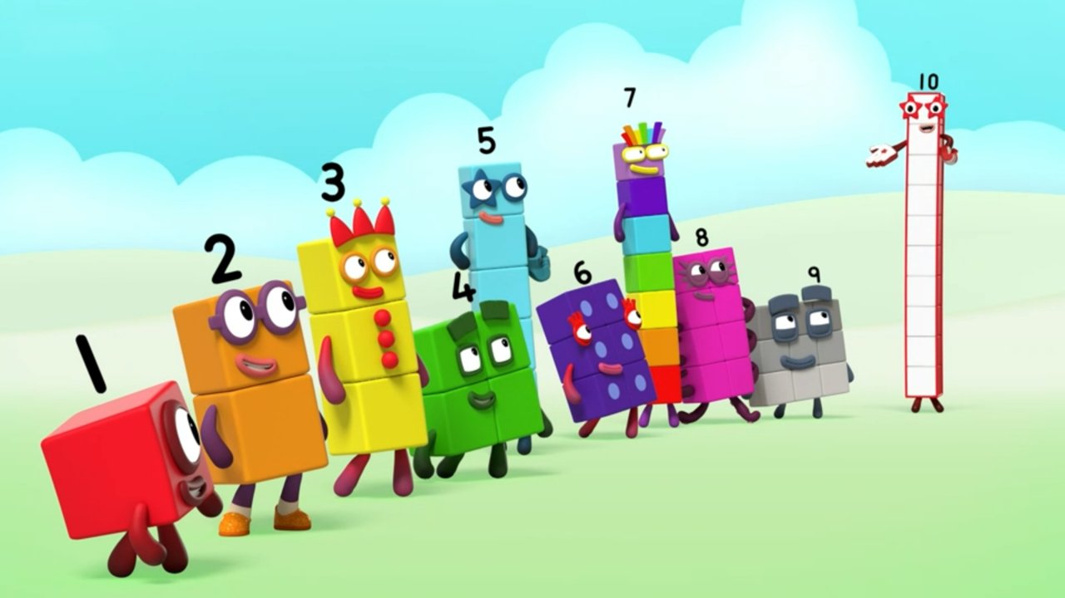
Images © 2017 Alphablocks Ltd. All Rights Reserved.
Notes:
Use this picture as the stimulus for Talk and Discussion (slide 7).

Slide 9
Enabling Environments in Reception

Slide 10
Enabling Environments
Playing and Exploring
Set up a class shop with a limit of 10 items to buy at the self-checkout with two bags/ baskets. How many of your items can you put in each bag? (For example, 3 things in one bag, 7 things in the other bag).
Explore bonds for 10 using balance scales with a Numberblock Ten on one side and smaller Numberblocks on the other, or using weighted number plates.
Active Learning
Look for opportunities to use fingers to explore complements to 10. That is, 3 fingers down, 7 fingers up.
Creating and Thinking Critically
Provide children with large tens frames to fill with objects, either indoors or outdoors. As they collect objects, encourage them to place them in order on the frame, then identify ‘how many more’ they need to collect to fill the frame by looking at the empty spaces.

Slide 11
Learning Together in Y1

Slide 12


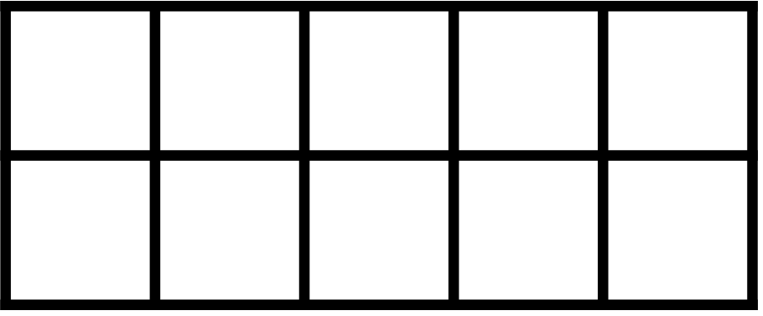
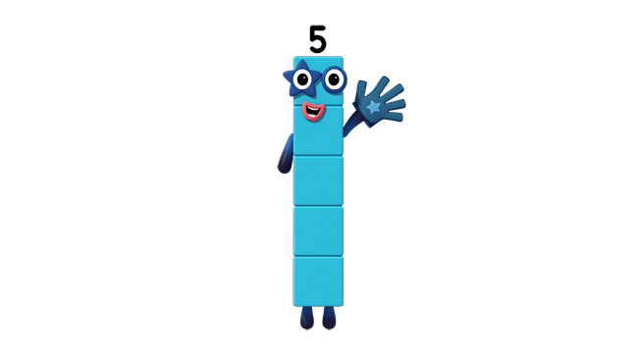
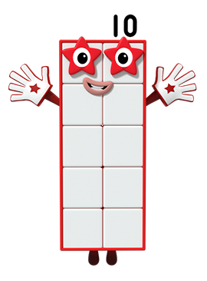
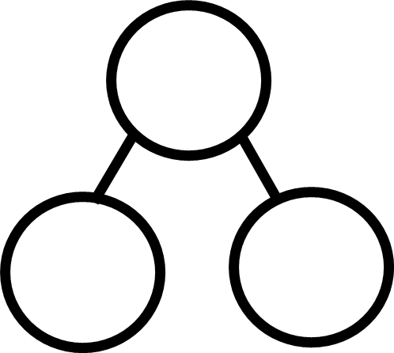
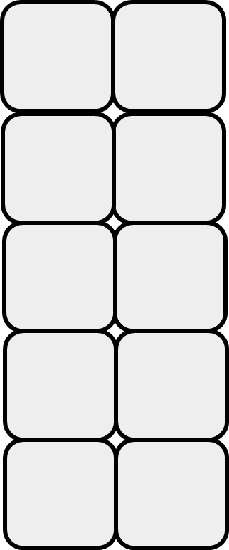

Ten again!
Images © 2017 Alphablocks Ltd. All Rights Reserved.
Notes:
Use the next two slides to explore representations of 10 partitioned into 2 parts.
As the slides animate, say to children: ‘When Numberblocks give you a quick peek, can you see which pairs of numbers they are using to make Ten?’
Discuss how the same pairs of numbers to make 10 are represented in the tens frame and part-whole diagram.
Children can join in, saying, ‘TEN AGAIN!’

Slide 13
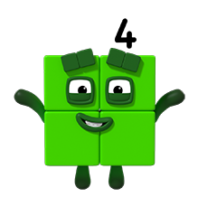
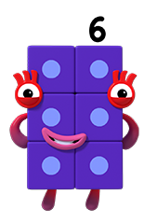


Ten again!
Images © 2017 Alphablocks Ltd. All Rights Reserved.
Notes:
We have just seen Five and Five make Ten. Which other Numberblocks could combine to make Ten?
After discussion, ask children to find other bonds of ten using counters or cubes.
They could record bonds of ten pictorially and with numerals, in part-whole diagrams or in a ‘ten house’.

Slide 14
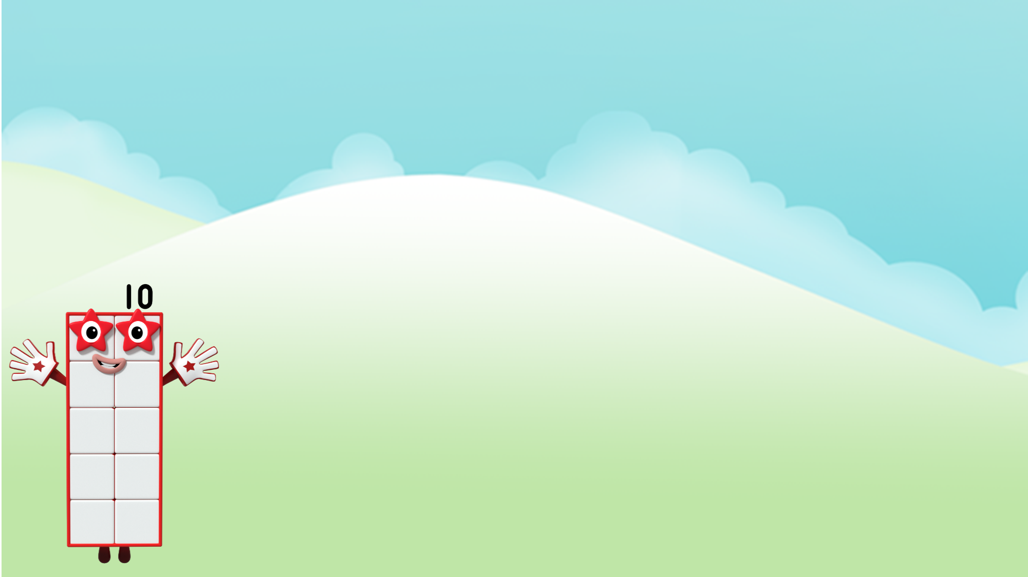
Make Ten again!
Images © 2017 Alphablocks Ltd. All Rights Reserved.
Notes:
Use this slide to check answers.
Why do you think the top row only has one Numberblock in it? (Ten doesn’t need any other blocks - she is already Ten!)

Slide 15
Further activities for Y1
Practise representing bonds of 10 with different concrete and pictorial representations, for example, a tens frame (either fill the frame with two coloured counters and look at different parts, or partly fill the frame and ask children to identify the complement to ten by looking at the spaces.)
Practise recalling bonds of ten using concrete and pictorial representations. For example, use a coat hanger with clothes pegs (arranged as five and five in two colours), hang a cloth over some of the pegs and encourage children to reason about the hidden pegs using the five and five structure.
Play matching games with cards with numbers or quantities on.
Play Ten Bingo: children write five numbers between 0 and 10, adult to call out or show a number and children can cross off one of their numbers if it is the complement of 10.

Slide 16
Learning Together in Y2

Slide 17
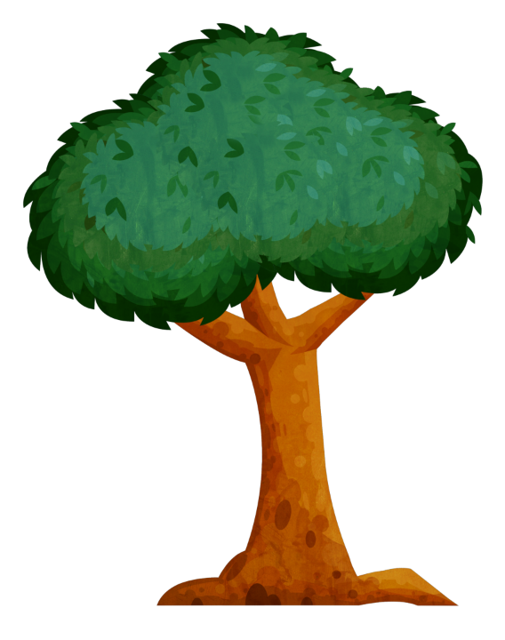
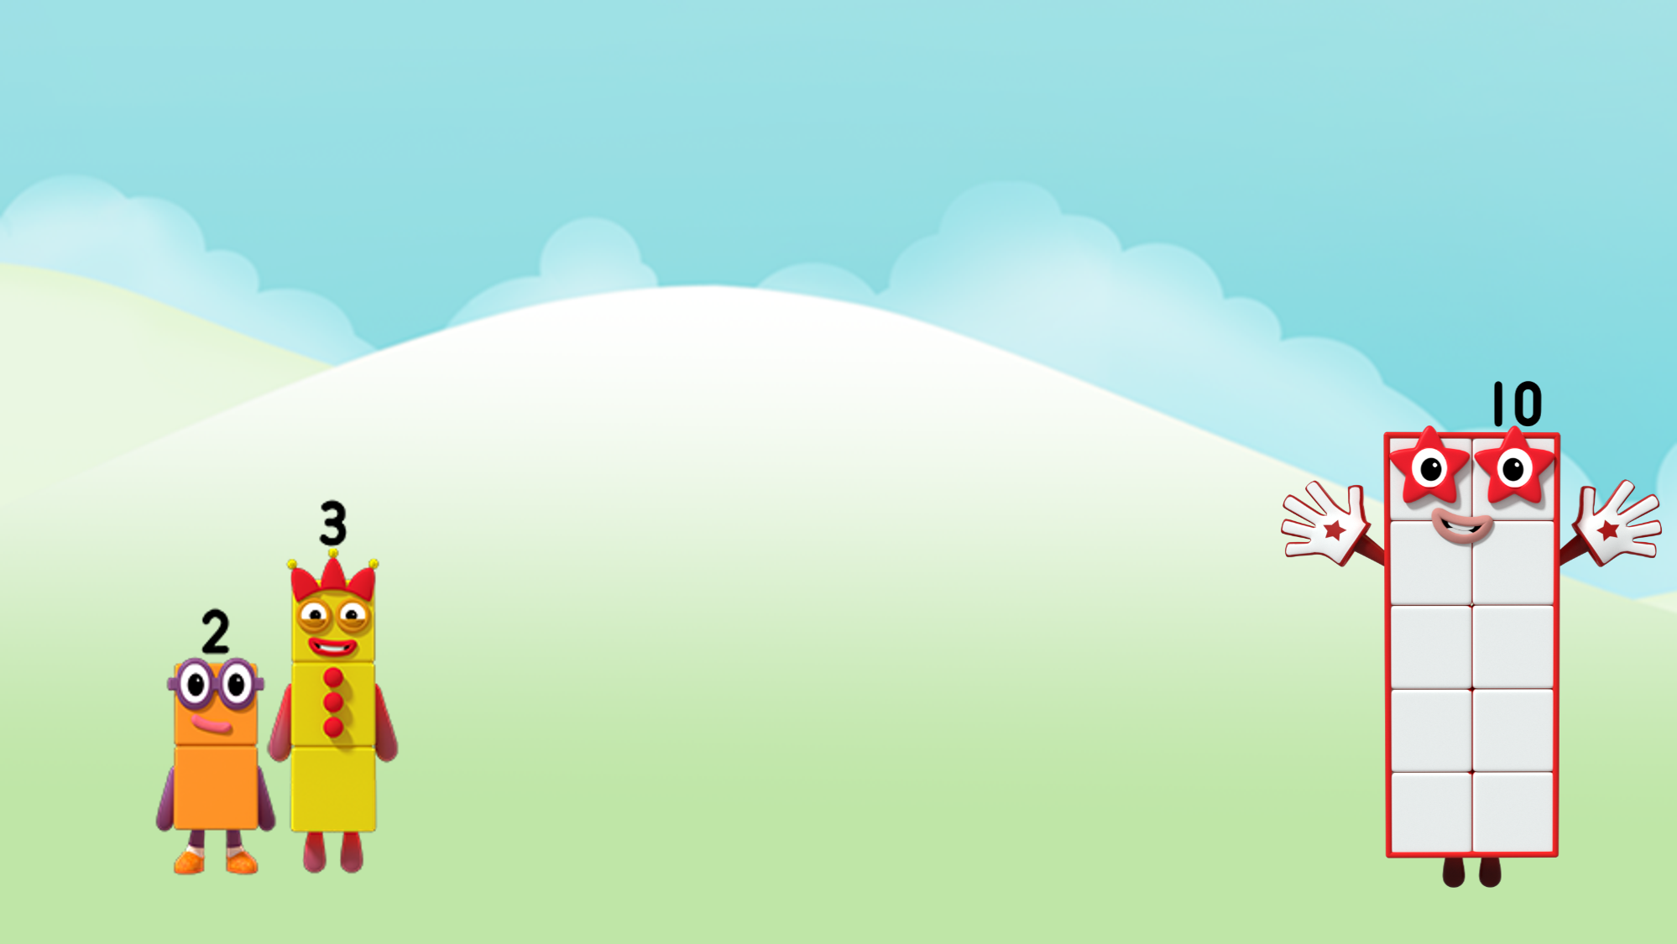
Who is behind the tree to make Ten again?
We make Ten again!
Images © 2017 Alphablocks Ltd. All Rights Reserved.
Notes:
The Numberblocks want to play a game with each other to make ‘Ten Again!’ Can you help? Two and Three need to combine with another Numberblock to make Ten.
Who could be behind the tree to help them? (If we know that 2 and 3 combine to make 5, then we know that 5 needs another 5 to make 10.)

Slide 18
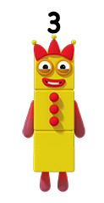
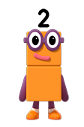
Ten again!
Watch us make Ten again!
Images © 2017 Alphablocks Ltd. All Rights Reserved.
Notes:
Let’s check that Two and Three and Five do make ‘Ten Again’!

Slide 19




Images © 2017 Alphablocks Ltd. All Rights Reserved.
Notes:
Use this slide to explore how the solution can be represented with an equation.
How many parts make 10 in the picture? (3 parts)
How does the equation represent 10 being made from 3 parts?
Can you see link each part to an addend in the equation? Which was the missing part?
Re-cap: we found the missing part by combining the part we could see, and using our knowledge of bonds of ten to help us.

Slide 20

Images © 2017 Alphablocks Ltd. All Rights Reserved.
Notes:
Use this slide to find a missing addend without seeing the blocks.
How can we find the missing addend/ part? (Re-cap strategy from the previous slide where we combined the known parts and used bonds of ten to find the missing part.)
If we know that 5 and 1 makes 6, what does 6 need to make 10?
Is there a way we can check our answer by combining the addends/ parts in different ways? (For example, 1 and 4 make 5 and 5 needs 5 to make 10, or 5 and 4 make 9 and 9 needs 1 more to make 10.)

Slide 21
Images © 2017 Alphablocks Ltd. All Rights Reserved.
Notes:
Use this slide to practise finding a missing addend in different positions in the equation.
What do you notice about the position of the missing part/ addend?
Does it matter that the position of the missing part/ addend changes? Can we still use our bonds of ten to help us?
When the missing addend has been agreed, play ‘convince me’ by asking the children to prove that the answer is correct by combining the addends in a different order.

Slide 22
Further activities for Y2
Continue to consolidate knowledge of bonds of ten in practical ways, including using ‘hiding’ activities. For example, take 10 objects and hide some under a cloth: how many are hiding? With 10 objects in a bag, remove some, how many are still in the bag?
Explore ways to partition 10 into three parts using a range of equipment (for example, Numicon, cubes) and represent partitions with part-part-whole diagrams. Practise writing equations which match the part-part-whole diagrams.
Solve missing number equations with three addends (parts) where 10 is the total (whole) by combining the known parts and using knowledge of bonds of 10 to find the missing addend.
Vary the position of the missing addends.
Investigate possible answers for 3-part equations where 10 is the total and there are two unknowns.

