Slide 1
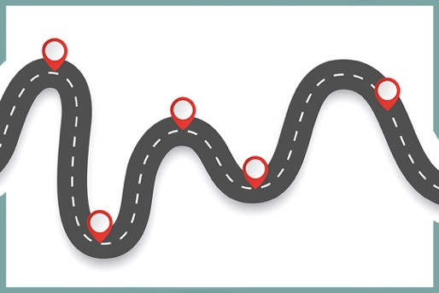
Checkpoints
Year 8 diagnostic mathematics activities
Statistical representations, measures and analysis
Seventeen Checkpoint activities
Twelve additional activities
Published in 2022/23

Slide 2
About this resource
This resource is designed to be used in the classroom with Year 8 students, although it may be useful for other students.
The Checkpoints are grouped around the key ideas in the core concept documents, 5.1 Statistical representations and measures and 5.2 Statistical analysis, part of the NCETM Secondary Mastery Professional Development materials.
Before each set of Checkpoints, context is explored, to help secondary teachers to understand where students may have encountered concepts in primary school.
The 10-minute Checkpoint tasks might be used as assessment activities, ahead of introducing concepts, to help teachers explore what students already know and identify gaps and misconceptions.
Each Checkpoint has an optional question marked . This will provide further thinking for those students who have completed the rest of the activities on the slide.
The notes for each Checkpoint give answers (if appropriate), some suggested questions and things to consider.
After each Checkpoint, a guidance slide explores suggested adaptations, potential misconceptions and follow-up tasks. These may include the additional activities at the end of this deck.

Slide 3
Checkpoints 1–8
Checkpoint | Underpins | Code
1: Porky pies | Statistical representations and analysis | 5.1.2 5.2.2
2a: Comparing charts part 1 2b: Comparing charts part 2
3: Line graphs
4: Where is 20? | Understand place value in decimals, including recognising exponent and fractional representations of the column headings | 1.1.1.2
5: School trip
6: Football goals
7: Meal deal
8: Mr Chips
*This three-digit code refers to the statement of knowledge, skills and understanding in the NCETM’s Sample Key Stage 3 Curriculum Framework (see notes below for more information).
Notes:
In the Sample Key Stage 3 Curriculum Framework, statements of knowledge, skills and understanding are arranged to give an example teaching order. The three-digit code for each statement in the framework is a clickable hyperlink to documents with more detailed information, including the key ideas contained within that statement. These key ideas are also shown on slides 5–8 in this deck.

Slide 4
Checkpoints 9–17
Checkpoint | Underpins | Code
9: Spreading the happiness | Statistical measures and analysis | 5.1.1 5.2.1 5.2.2
10: Equal shares
11: Coming and going
12: Same average | Understand place value in decimals, including recognising exponent and fractional representations of the column headings | 1.1.1.2
13: Towering
14: Meanest team
15: Seven is mean
16: Five cards
17: Sports day
*This three-digit code refers to the statement of knowledge, skills and understanding in the NCETM’s Sample Key Stage 3 Curriculum Framework (see notes below for more information).
Notes:
In the Sample Key Stage 3 Curriculum Framework, statements of knowledge, skills and understanding are arranged to give an example teaching order. The three-digit code for each statement in the framework is a clickable hyperlink to documents with more detailed information, including the key ideas contained within that statement. These key ideas are also shown on slides 5–8 in this deck.

Slide 5
Key ideas
Understand and calculate accurately measures of central tendency and spread | Code
Understand what the mean is measuring, how it is measuring it and calculate the mean from data presented in a range of different ways | 5.1.1.1*
Understand what the median is measuring, how it is measuring it and find the median from data presented in a range of different ways | 5.1.1.2
Understand what the mode is measuring, how it is measuring it and identify the mode from data presented in a range of different ways | 5.1.1.3*
Understand what the range is measuring, how it is measuring it and calculate the range from data presented in a range of different ways | 5.1.1.4
*‘There are additional resources exemplifying these key ideas in the Secondary Mastery Professional Development | NCETM.

Slide 6
Key ideas
Construct accurately statistical representations | Code
Construct bar charts from data presented in a number of different ways | 5.1.2.1
Construct pie charts from data presented in a number of different ways | 5.1.2.2*
Construct pictograms from data presented in a number of different ways | 5.1.2.3
Construct scatter graphs from data presented in a number of different ways | 5.1.2.4
*‘There are additional resources exemplifying these key ideas in the Secondary Mastery Professional Development | NCETM.

Slide 7
Key ideas
Interpret reasonably statistical measures and representations | Code
Understand that the different measures of central tendency offer a summary of a set of data | 5.2.1.1
Understand how certain statistical measures may change as a result in changes of data | 5.2.1.2
Understand range as a measure of spread, including a consideration of outliers | 5.2.1.3
Understand that the different statistical representations offer different insights into a set of data | 5.2.1.4
Use the different measures of central tendency and spread to compare two sets of data | 5.2.1.5*
Use the different statistical representations to compare two sets of data | 5.2.1.6
Recognise relationships between bivariate data represented on a scatter graph | 5.2.1.7
*‘There are additional resources exemplifying these key ideas in the Secondary Mastery Professional Development | NCETM.

Slide 8
Key ideas
Choose appropriately statistical measures and representations | Code
Given a statistical problem, choose what data needs to be analysed to explore that problem | 5.2.2.1
Given a statistical problem, choose appropriate statistical measures to explore that problem | 5.2.2.2*
Given a statistical problem, choose appropriate representations to explore that problem | 5.2.2.3
Given a statistical problem, choose appropriate measures and representations to effectively summarise and communicate conclusions | 5.2.2.4
*‘There are additional resources exemplifying these key ideas in the Secondary Mastery Professional Development | NCETM.

Slide 9
Statistical representations and analysis
Checkpoints 1–8

Slide 10
Statistical representations and analysis
Previous learning | In Key Stage 3 students need to
Key Stage 2 curriculum: Year 4: interpret and present discrete and continuous data using appropriate graphical methods including bar charts and time graphs Year 4: solve comparison, sum and difference problems using information presented in bar charts, pictograms, table and other graphs Year 5: solve comparison, sum and difference problems using information presented in a line graph Year 6: interpret and construct pie charts and line graphs and use these to solve problems Further information about how students may have experienced this key idea in Key Stage 2: Although there are no specific mentions of statistical representation in Teaching mathematics in primary schools, Measurement and Statistics are integrated as applications of number criteria. Similarly, there are many relevant links within the Number strands of Primary Mastery Professional Development. | Continue to accurately construct and interpret the representations covered at Key Stage 2 (bar charts, pie charts and pictograms) Appreciate the differences between a frequency-based chart (such as a bar chart or pictogram) and a proportional chart (such as a pie chart) and how different aspects of the data can, and cannot, be inferred from each. Describe simple mathematical relationships between two variables (bivariate data) in observational and experimental contexts, and illustrate such relationships using scatter graphs. Make an informed choice about what statistical analysis and representation is appropriate use for discrete, continuous and grouped data, and what each type of diagram communicates about the data. Understand the effect that these choices have on the interpretation, and misinterpretation, of data, including the potential impact of outliers. Engage in a range of authentic, real-life contextual problems that require the collection, analysis and representation of data; appreciate the meaning and significance of different ways of presenting data.

Slide 11
Checkpoint 1: Porky pies
Two teachers are comparing the test results from their classes. They draw a pie chart for each class.
Mr Lomax says, ‘More students from my class passed the test.’
Is he correct? Why or why not?
There were nine students in each class who did not pass the test. What can you say about the size of each class?
Notes:
This slide is animated. Each question and the further thinking question will appear separately so you can choose the pace at which to work with your class.
Answers
Mr Lomax is not necessarily correct. A greater proportion of his students passed the test but we do not know how many students were in each class. If their classes were the same size, then this would be true. It would also be true if Mr Lomax had a larger class than Mrs Trubridge. See ‘Things to think about’ for an alternative interpretation of the question.
? Mrs Trubridge’s class is smaller than Mr Lomax’s. Mrs Trubridge’s class must have a total of approximately 20 students, if nine is just less than half. Mr Lomax must have approximately 30 students in his class, if nine is closer to one quarter than one-half or one-third.
Suggested questioning
What is the same and what is different about the two pie charts?
Does Mr Lomax have more students who passed than Mrs Trubridge? How do you know?
How many students might be in each class if Mr Lomax is not correct? How about if he is correct?
Approximately what angle is each sector? How many students might this represent?
Things to think about
Checkpoint 1 asks students to compare two pie charts. There is an ambiguity in the question: students could interpret Mr Lomax’s statements as meaning that more of his students passed than didn’t pass, as the pass sector is greater than half of the pie chart. While it is useful to know that students understand the representation of more than half on the pie chart, the main assessment point here is around comparison and the misconceptions that can arise when looking at two pie charts without knowledge of the total they each represent. Use the ‘Suggested questioning’ to prompt students to make this comparison.

Slide 12
Checkpoint 1: Guidance
Adaptations | Assessing understanding
Support If students find this hard to reason with, they might find it easier to attach values to the pie charts. They might need more definitive angles, so you could use the pie charts in Additional activity A first, so that both charts have more recognisable angles for each sector. Challenge Tell students that the sector for ‘Pass’ on Mrs Trubridge’s pie chart is 198°. What might this mean for the number of children it could represent? Can they use this to estimate for Mr Lomax’s class? Representations Link the pie charts to other representations of proportion they may have seen, such as circles to represent fractions/percentages, or bar models. | Checkpoint 1 features just one question: is Mr Lomax correct? However, it should not be quick task; don’t rush students into giving a definitive yes or no answer. Instead, listen to their reasoning and justifications. Some students might disagree with each other, and you can observe some revealing arguments and counterarguments. Students with the most secure understanding of pie charts will recognise that we do not know if Mr Lomax is correct or not, and might explain under which circumstances he would be right and wrong. If students simply say ‘Yes’, there might be some misconceptions about what pie charts represent. Clarify the concepts of frequency and proportion. This will need to be addressed over time, woven into your teaching of statistics at Key Stage 3. In the short term, play ‘devil’s advocate’ by asking questions such as, ‘How many students are in Mr Lomax’s class? How do you know?’ Much of students’ work on statistics at Key Stages 3 and 4 focuses on the interpretation of data and what we can infer. See how much students are already doing this; if you have time, ask some questions that could be inferred but not necessarily concluded from the data. For example, ‘Who is the better teacher?’ or ‘Whose class will do better in their GCSE?’.
Additional resources Additional activity A is the same task with more recognisable angles for each sector.

Slide 13
Checkpoint 2a: Comparing charts part 1
Which questions can you answer by using the pie charts? Why?
Which was the most popular colour in each year?
Compare the number of students who liked yellow best in each year group.
How many more Year 7 students than Year 10 students liked green best?
How many students were in each year group?
Write your own question that could be answered by using the pie charts. What can you find out? What can you not find out?
Notes:
This slide is animated. Each question will appear separately so you can choose the pace at which to work with your class.
Answers
a) Year 7: red. Year 10: black.
b) The same proportion of students liked yellow in each class. We do not know if it was the same number of students as we do not know how many students are in each year group.
c) We do not know how many students liked green best in each year, so we do not know how many more Year 7 students liked green best compared to Year 10 students.
d) We do not know.
? Any questions that refer to proportion are valid, for example, the least popular or a certain fraction/percentage of the year group.
Suggested questioning
What is the same and what is different about these two pie charts?
Which of the questions is it possible to answer? Why?
What information would you need to make the other questions possible to answer?
Things to think about
One of the five big ideas of teaching for mastery is variation: choosing what to vary, and what to keep the same, in order to draw attention to mathematical structure. The questions in Checkpoints 2a and 2b are identical and the values in 2b match the percentages in 2a, so that the differences between the pie charts and bar chart are more explicit. Note that the focus of the Key Stage 3 curriculum is very much upon presenting, interpreting and analysing data; should you wish to discuss data collection with your students, Additional activity L considers the scenario from Checkpoint 2a/b and what might be the purpose of gathering such data.

Slide 14
Checkpoint 2b: Comparing charts part 2
Which questions can you answer by using the bar chart? Why?
Which was the most popular colour in each year?
Compare the number of students who liked yellow best in each year group.
How many more Year 7 students than year 10 students liked green best?
How many students were in each year group?
Write your own question that could be answered by using the bar chart. What can you find out? What can you not find out?
Notes:
This slide is animated. Each question will appear separately so you can choose the pace at which to work with your class.
Answers
a) Year 7: red. Year 10: black.
b) One more student liked yellow best in Year 7 than Year 8 (23 and 22). This is possible now because there are actual numbers of students not just percentages.
c) None – the same number of students liked green best in Year 7 as in Year 10.
d) Year 7: 30 + 50 + 23 + 27 + 38 + 12 + 12 = 192
Year 10: 28 + 14 + 22 + 27 + 29 + 53 + 18 = 191
? Any questions that refer to quantity or proportion are valid, for example, how many liked a certain colour, comparing quantities or asking for a fraction/percentage of the year group (although these require more ‘working out’ than on a pie chart).
Suggested questioning
What is the same and what is different about these two pie charts?
Which of these questions is it possible to answer? Why?
Which of these questions were easier/harder to answer with the pie chart? Why?
Things to think about
One of the five big ideas of teaching for mastery is variation: choosing what to vary, and what to keep the same, in order to draw attention to mathematical structure. The questions in Checkpoints 2a and 2b are identical (and the values in 2b match the percentages in 2a) so that the differences between the pie chart and bar chart are more explicit. Note that the focus of the Key Stage 3 curriculum is very much upon presenting, interpreting and analysing data; should you wish to discuss data collection with your students, Additional activity L considers the scenario from Checkpoint 2a/b and what might be the purpose of gathering such data.

Slide 15
Checkpoints 2a and 2b: Guidance
Adaptations | Assessing understanding
Support There is a double comparison here – comparing the data for year groups, and two different representations. If students find this challenging, build up to it by offering similar questions but with a single year group (as in Additional activity B). Challenge Ask students to suggest some frequencies that the pie chart could represent. If the percentages have not been rounded, what is the smallest possible total for the year group? Representations Here, the exact same data is represented two ways. This allows for closer comparison of what the two representations, which will both be familiar, can and cannot show. | Explore Checkpoints 2a and 2b together – if you run out of time to explore the bar chart in the same lesson, briefly revisit the pie charts when you do. Key to the assessment point is the comparison between the two representations: identical questions are asked, to see if students recognise that, when the pie chart is shown, some of them are not possible to answer. Question b could expose misconceptions as the two percentages for ‘yellow’ on the pie chart are identical. Those students who are less secure in their understanding of frequency might think this means that the same number of students liked yellow. All the questions are possible for the bar chart, but ask students about whether it is easier or harder to ‘see’ some proportions on a pie chart. For example, if one of the bars represented a half or quarter of the year group, would they be able to tell? How about if the sectors of the pie chart represented a half or quarter?
Additional resources Additional activity B uses a single pie chart and bar chart so that comparisons are made just between the representations, and not between two data sets as well; E explores bar charts further; L looks at why this data may have been collected. Page 53 of Secondary Assessment Materials | NCETM uses a similar premise to assess understanding at Key Stage 3. Key idea 5.2.1.5 from Secondary Mastery Professional Development | NCETM suggests how you might take Comparing two data sets further at Key Stage 3.

Slide 16
Checkpoint 3: Line graphs
Farmer Tim counts the vegetables growing in the greenhouse and for sale in the farm shop. He also measures the temperature over time (in °C) for both places.
He records the information on two line graphs.
Describe what information is shown by the arrows marked a to d.
a
b
d
c
What kind of data could be usefully shown on a line graph? Explain your answer.
Notes:
This slide is animated. Each arrow, and then the further thinking question, will appear separately so you can choose the pace at which to work with your class.
Answers
a) This shows 28 tomatoes are growing in the greenhouse.
b) This shows the temperature in the shop at 12:00 was 22° C.
c) This shows the temperature in the greenhouse at 03:00 was 14° C.
d) This arrow does not show anything as there is no scale between lettuce and cucumber. It is meaningless to use a line graph for non-continuous data.
? Any data where the scale on the x-axis represents a continuous measurement such as change over time.
Suggested questioning
What is the same/different about the two graphs?
What is the same/different about the two lines on each graph?
Tell me the story of this graph.
Is a line graph always a useful/meaningful way to present data?
What graph/chart could you use instead?
Things to think about
Understanding which representation is most appropriate for the data is a concept that is developed throughout KS3 and KS4. This Checkpoint gives an opportunity to assess whether students already have an awareness that line graphs are best for representing trends over time. Students are first introduced to continuous and discrete data in Year 4; see if they use these terms in their explanations here.

Slide 17
Checkpoint 3: Guidance
Adaptations | Assessing understanding
Support The two line graphs show two datasets for students to compare. You could just show line graphs with a single line so the focus is purely on continuous vs discrete data. Challenge There are two different data sets shown on each graph: ask students to make comparisons between the different trends for the temperature graph or the different frequencies for the number of vegetables graph. Representations Students’ experience of the line graph is unlikely to be limited to the mathematics classroom. Make cross-curricular links – speak to colleagues in other departments about when they use line graphs in Key Stage 3. | It is likely that students will have experienced line graphs in primary and early secondary, and that this will not have just been in the mathematics classroom. They might have collected data about temperatures over time, and recorded it in a bar chart, or looked at charts showing trends in geography or science lessons. However, they may not have considered what type of data is best suited to a line graph, or thought about how connecting the points could be meaningless in some situations. Checkpoint 3 probes this understanding: students are shown two graphs and simply asked to read four data points from the graphs. This is possible for parts a to c: a and b refer to recorded data points; c is between points but the data is continuous. However, it is meaningless for d, as the data is discrete and so the space ‘between’ points on the horizontal axis has no statistical meaning. Ask students if the line graph was a good way to display this data, and what other graphs they might choose instead? Students should have experience of the difference between continuous and discrete data – probe their understanding of this. Listen to the language they use to talk about why d is not possible. If they don’t use the terms discrete and continuous, do they still show an understanding of the differences between the two data sets?
Additional resources Additional activity F goes deeper into continuous data, comparing continuously and periodically recorded temperature. Page 39 of Year 6, p29 of Year 5 and p29 of Year 4 Primary Assessment Materials | NCETM show how line graphs might have been used to display data at primary school.

Slide 18
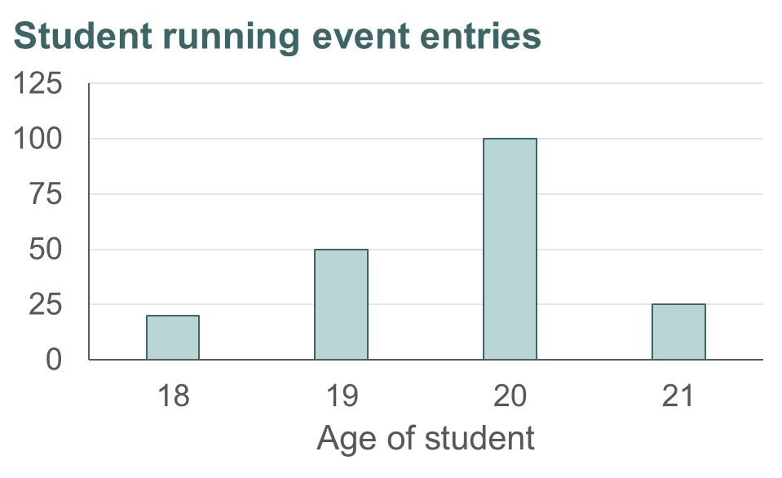
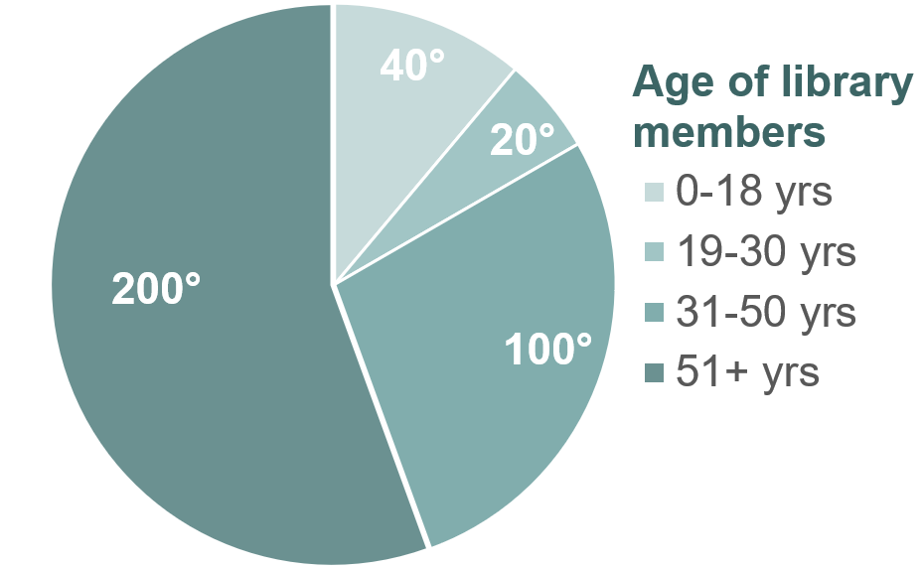
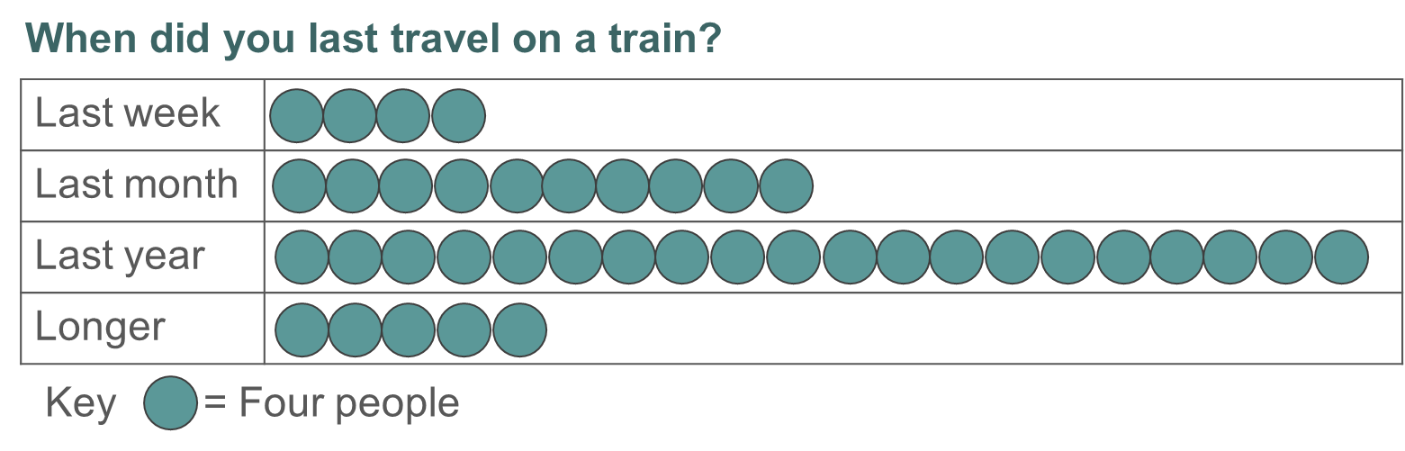
Checkpoint 4: Where is 20?
For each chart, say how a frequency of 20 is represented.
a)
b)
c)
Draw another chart or diagram where a frequency of 20 is represented differently.
Notes:
This slide is animated. Each chart and the further thinking question will appear separately so you can choose the pace at which to work with your class.
Answers
a) Twenty is represented by the smallest bar (i.e. 20 18 year olds were entered).
b) It is not possible to say how 20 has been represented. It could be any of the sectors. If 20 were the yellow sector (age 61+), then the whole pie chart represents 36 people. If 20 were the grey sector (age 31–60), then the whole pie chart represents 72 people. If 20 were the orange sector (age 19–30), then the whole pie chart represents 360 people. If 20 were the blue sector (age 0–18), then the whole pie chart represents 180 people. In this case, the whole pie chart cannot represent 20 people unless the angles had been rounded (as 18° would represent one person).
c) Twenty is represented by the five circles (i.e. 20 people travelled on a train longer ago than in the last year.)
? Students’ responses will vary depending on what diagram they choose. Check they have understood how to represent frequency, and look for students representing other things (such as 20% or 20 as a data category).
Suggested questioning
What does ‘frequency’ mean?
Is the number 20 on a chart always a frequency?
(For part a) Complete the sentence: __ students are aged 20. Which value in that sentence is the frequency?
(For part b) How many people would be in the survey if the (for example, blue) sector represented a frequency of 20?
Things to think about
Students are likely to be familiar with the word ‘frequency’, but does this lead to understanding? Less secure understanding of the word can cause significant problems in later work with statistics, for example leading to mistakes when finding the average from a frequency table. Think about your own definition of what frequency is and how that relates to a bar chart, pie chart and pictogram. Compare with colleagues: does your department have a shared understanding of this term and how to explain it?

Slide 19
Checkpoint 4: Guidance
Adaptations | Assessing understanding
Support If students are distracted by the numerical categories in parts a and b, show the same charts with non-numerical categories. This might help to model that the x-axis or key show descriptions of the data rather than frequencies. Challenge The further thinking question asks students to consider other representations of a frequency of 20. Do the opposite and ask students to think of examples where 20 might be on either axis but the diagram is not representing frequency. Representations The bar chart, pie chart and pictogram are all representations that students will be familiar with from primary school. The focus here is on how they represent frequency. | Checkpoint 4 delves more deeply into students’ understanding of frequency, building on the assessment of proportion and frequency in Checkpoints 1 and 2. Assess whether students understand the word ‘frequency’ in the rubric for the task – ask them what they understand by it. In each of the representations, there are some intentional uses of the number 20 which may mislead students. Can they recognise, for example, that the 20 on the x-axis in part a refers to the students’ age, rather than the frequency of students? It can sometimes be harder to identify frequency in datasets where the categories are also non-numerical. Similarly, the pie chart in part b features categories with an age range that includes 20; an age range of 20 years; and a sector that is labelled with an angle of 20°. Key here is that students recognise that none of these values of 20 is a frequency of 20, and that we cannot tell whether a frequency of 20 is represented. Ask students what more information we would need to decide if 20 is one of the frequencies.
Additional resources Additional activity G features population pyramids, and may be interesting to explore after this Checkpoint. Key idea 5.1.2.2 from Secondary Mastery Professional Development | NCETM suggests how you might teach Constructing pie charts from different representations at Key Stage 3.

Slide 20
Checkpoint 5: School trip
The school carries out a survey to help plan the end of term rewards trip.
Here are the results from two classes, A and B. Each pictogram uses the same scale.
A
Theme park
Museum
Theatre
Zoo
B
Theme park
Museum
Theatre
Zoo
How many people do you think are in each class?
The pictograms are redrawn using this key:
= three people
What might the pictograms look like now?
Notes:
This slide is animated. Each chart, and then the further thinking question, will appear separately so you can choose the pace at which to work with your class.
Answers
Each circle needs to represent a minimum of four people as the smallest proportion shown is one-quarter. There could therefore be 6.5 $×$ 4 = 26 in class A and 7.5 $×$ 4 = 30 in class B. Arguably, each circle could represent any multiple of four. For example, there could be 6.5 $×$ 8 = 52 in class A and 7.5 $×$ 8 = 60 in class B. Students should be able to reason that 26 and 30 are more likely class sizes.
? See the solutions on the following slide.
Suggested questioning
What could a whole circle represent? How do you know?
Are there any values for the circle that are possible but not likely in this context?
How would your answers change if there were no quarter or three-quarter circles in the pictogram?
Things to think about
Pictograms are an incredibly a familiar representation and it is likely that students have been representing data pictorially from their very earliest experiences of number. It can be challenging at Key Stages 3 and 4 to present pictograms in a way that really exposes the depth of students’ thinking. Many examples of pictogram questions are relatively straightforward and procedural. The intention of the potential multiple answers here is to encourage students to reason and justify, exposing what they know about the mathematical structure of this representation.

Slide 21
Checkpoint 5: School trip (solution for further thinking question)
The pictograms are redrawn using this key:
= three people
What might the pictograms look like now?
Using a total of 26 students for class A and 30 for class B:
A
Theme park
Museum
Theatre
Zoo
B
Theme park
Museum
Theatre
Zoo
Notes:
This slide shows the solutions to the further thinking question for Checkpoint 5.

Slide 22
Checkpoint 5: Guidance
Adaptations | Assessing understanding
Support Show just pictogram A and let students reason fully. Write a key using their answers, then show B and ask them whether their key still works, and why or why not. Challenge Give students data represented in a different chart and ask them to draw a pictogram from this representation. Increase challenge by specifying the total number of symbols, so that they have to make the key work from this limitation. Representations Students will have represented data using pictograms throughout primary school and, after the introduction of one-to-many multiplicative relationships in lower Key Stage 2, the symbols in these pictograms may have come to represent frequencies greater than one. | In Checkpoint 5, rather than giving a key and telling students what each circle represents, they are asked to think more deeply about the pair of pictograms and reason about what they could possibly represent. Students should reason that, as there are quarter circle symbols used in chart B, then the minimum number of students a circle can represent is four. When working with data, students need to bring an awareness of context to their interpretations. This Checkpoint offers an opportunity to assess how readily they do this. For example, do they use their knowledge of class sizes to help them decide what is a reasonable key? Prompt to see if they do this by suggesting that each circle could represent eight or 12. Do they reason about what that would mean for the total, and whether this is realistic?
Additional resources Additional activities C and D feature alternative explorations of pictograms. Additional activity L looks at the data collection cycle, and could be used as a structure to consider why this data was collected. Pictograms are readily available in the media and offer rich discussion opportunities about the best ways to present data, particularly where representation can be misleading. Search online or in newspapers for examples to share with students.

Slide 23
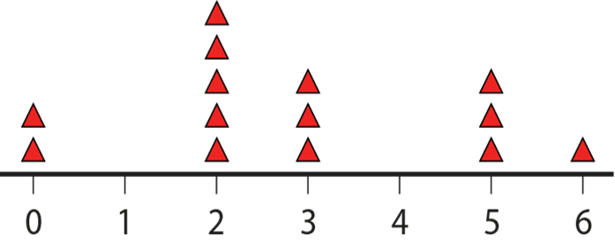
Checkpoint 6: Football goals
Below is a graphic to represent the number of goals scored from 14 matches in a local football league.
Lewis says, ‘In five of the games there were two goals scored.’
Oliver says, ‘There were five goals in the second match.’
Are their statements correct? How do you know?
Lewis splits the graphic into two sections, A and B.
Which section represents more goals?
A
B
The team plays another match. Lewis says, ‘We’re bound to score two goals, as this is the most common score.’
Oliver says, ‘I think we’ll score one goal, as we’ve not had that score yet.’
Are their statements correct? How do you know?
Notes:
This slide is animated. Each question will appear separately so you can choose the pace at which to work with your class. You will need to show students the task in present/slide show mode so that Lewis’s split of the graphic in part b does not act as a distractor for part a.
Answers
a) Lewis is correct: the four triangles above two represent five games with two goals scored.
We do not know if Oliver is correct as there is no way of knowing which triangle represents which match. It is possible that the second match was one of the three games where two goals were scored.
b) Section B represents more goals. A is 0 $×$ 2 + 1 $×$ 0 + 2 $×$ 5 + 3 $×$ 3 + 4 $×$ 0 = 0 + 0 + 10 + 9 + 0 = 19. B is 5 $×$ 3 + 6 $×$ 1 = 15 + 6 = 21.
? Neither Lewis nor Oliver is correct as each new match is independent of the previous ones. Students will not have formally learnt probability at primary school but their answers here might indicate some assumptions that will need to be addressed at Key Stage 3.
Suggested questioning
What does the scale represent?
Where can you ‘see’ the 14 matches in the graphic?
Where can you ‘see’ two goals, three goal and zero goals?
Which column represents the most goals?
How could I work out the total matches? The total goals?
Things to think about
At Key Stages 3 and 4, it is common to find some students struggling to work with data that has numerical categories - for example, in finding the mean from a table or graph. This Checkpoint checks some of the understanding that sits underneath this. Ask students how many matches/goals the graphic represents. Do they understand the need to multiply the number of triangle symbols by the number of goals in that column to find the total number of goals? Do they understand that the 14 triangles represent the total number of matches? Prompt students to notice that the question also tells us how many matches there were in total and that this is helpful information.

Slide 24
Checkpoint 6: Guidance
Adaptations | Assessing understanding
Support Offer a sentence frame to help students to identify where games and goals are represented in the diagram. For example, ‘In the __ column, there are __ triangles, representing __ games. This is a total of __ goals.’ Challenge Ask students to find the mean number of goals to see if they are able to interpret the chart correctly to do this. If they can, ask them to create a different chart with the same mean. Representations Show students the same data presented in a table, pictogram or bar chart and ask them what is the same and what is different. You could also present the data as a list. | Checkpoint 6 picks up on some misconceptions and challenges that may have been exposed during the exploration of frequency in Checkpoint 4. This presents data to students in a diagram that might not be familiar. See whether students can correctly interpret the information from the representation. Part a asks students to reason about two statements. Particularly interesting will be students’ responses to Oliver’s statement: do they recognise the limitation of the representation, and that he could be correct, but this information is not is available? Part b focusses on students’ awareness of the number of goals that is represented by each column of triangles. It is very easy to get in a muddle with data that has numerical categories. For example, the column of five triangles represents five games where there were two goals (as a category), representing a total of 10 goals (actual goals). Students’ answers to part b will reveal how readily they can understand this, and whether you need to do more work on interpreting charts and tables before building in ideas such as mean from a table. The further thinking question strays into prediction, offering an opportunity to check if students understand what is reasonable to infer from a dataset.
Additional resources The graphic used in this Checkpoint is taken from Key Idea 5.1.1.1 of Secondary Mastery Professional Development | NCETM, which uses it to explore ‘Understanding the mean’.

Slide 25
Checkpoint 7: Meal deal
 | Cheese (V) | Chicken | Falafel (V)
Cola | 20 | 36 | 17
Juice | 12 | 27 | 15
Water | 27 | 19 | 16
A shop manager uses the table on the right to record customers’ sandwich and drink choices in the meal deal.
The manager carries out some calculations. What do you think she is working out in each case?
17 + 15 + 16
12 + 27 + 15
27 + 19
20 + 12 + 27 + 17 + 15 + 16
36 ÷ (20 + 36 + 17)
36 ÷ (27 + 36 + 19)
59 + 62 + 48
73 + 54 + 42
The manager wants to draw a graph to show the information in the table. What type of graph might work? What are the challenges?
Notes:
This slide is animated. Each question will appear separately so you can choose the pace at which to work with your class. A printable resource is available on slide 67.
Answers
a) Total number of falafel orders.
b) Total number of juice orders.
c) Number of chicken orders who chose a non-fizzy drink (i.e. juice or water) OR number of water orders who did not select falafel.
d) Total number who chose a vegetarian (V) sandwich (i.e. cheese or falafel).
e) Fraction of cola orders who chose chicken.
f) Fraction of chicken orders who chose cola.
g) Total number of customers (adding the total of every row).
h) Total number of customers (adding the total of every column).
Note questions g and h are both given to enable teachers to check students know that there are two routes to find the total in the table, and are aware of the risk of double counting rows and columns.
? The challenge is showing both variables. A bar chart with three bars per type of drink/filling, or single bars shaded three colours, could work.
Suggested questioning
When might a two-way table be useful for representing data?
Where might you record the totals on this two-way table?
How can I work out a fraction of the whole (or of cheese/cola etc) using this table?
Things to think about
There are some ideas that we assess in the Checkpoints because although they are not in the primary curriculum, they are likely to have been part of a student’s primary experience, in mathematics or elsewhere. Two-way tables are an example of this. It is useful to know how familiar students are with these before teaching statistics and probability at Key Stages 3 and 4.

Slide 26
Checkpoint 7: Guidance
Adaptations | Assessing understanding
Support Give students a printable version of the table so that they can mark in the values that are being used in each calculation. Challenge Ask students to create a new two-way table from a set of clues. For example, ‘Half of the total chose chicken, or ‘Fourteen chicken orders came with cola,’ etc. Examples of such problems, and similar ‘logic grid puzzles’ can be readily found online. Representations Two-way tables are no longer explicitly in the primary curriculum, but it is worth checking students’ understanding of them as it is likely that students have experienced them. They might, for example, have used a two-way table (often referred to as a Carroll diagram) to sort shapes according to whether they do or do not have a specific property, or to organise simple bivariate data such as meal choices by age or gender. | The focus here is on the calculations that can be done from a two-way table and what they might mean. Assess students’ interpretation of the table, and also whether they can think about why it might be useful to know a certain total. For example, why might someone need to add the cheese and falafel, but exclude chicken, as in part d? Parts e and f are deliberately similar. First check that students are aware that both will produce a fraction, and that this might be a useful measure. Then check if they can the identify what fraction each is finding. Listen for whether students notice why parts g and h are the same: these show the two different ways to calculate the total. A common mistake with two-way tables is to include the row/column totals in calculations. Model how you could write the totals, and draw attention to where you might write the overall total (taking care to ensure students don’t double count and add the totals row to the totals column).
Additional resources Page 49 of Secondary Assessment Materials | NCETM shows how two-way tables and Venn diagrams will be linked to probability within Key Stage 3. Additional activity H explores Venn diagrams, which are also not on the primary curriculum but are likely to have been used by students to sort and classify information.

Slide 27
Checkpoint 8: Mr Chips
Mr Chips creates a bar chart to show customers’ favourite sauces.
Create a tally chart to show Mr Chips’ information.
Use either your tally chart or the bar chart to work out:
Which sauce was chosen by one-third of customers?
Which sauce was four times more popular than gravy?
Which two sauces, when added together, were chosen by 25% of people?
Create a pie chart to represent this data.
Notes:
This slide is animated. Each question will appear separately so you can choose the pace at which to work with your class. A blank printable tally chart is on slide 68.
Answers
a) See solutions on the next slide
b) Ketchup
c) Mayonnaise
d) Curry sauce and chilli sauce
? See solutions on next slide.
Suggested questioning
What was the most popular sauce?
How can we compare proportions using this chart?
What is a tally? Why might a tally chart be useful?
Which is easier to calculate from, the tally or the bar chart? Why?
Things to think about
Sometimes, students are unfamiliar with straightforward mathematical ideas – so we have included a Checkpoint on tally charts to check. Tally charts are mentioned in the National Curriculum for Year 2; they may have been used as part of data collection or classroom routines since then.

Slide 28
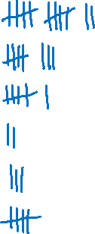
Checkpoint 8: Mr Chips (solutions to part a and further thinking question)
Type of sauce | Tally | Total
Ketchup |  | 12
Mayonnaise |  | 8
Curry sauce |  | 6
Gravy |  | 2
Chilli sauce |  | 3
No sauce |  | 5

Slide 29
Checkpoint 8: Guidance
Adaptations | Assessing understanding
Support Use the printable table so that the focus is on the completion of the table rather than its construction. See also ‘Representations’ below. Challenge The further thinking question asks students to draw a pie chart from the data. You could also reverse this idea by giving students a pie chart and asking them to create a possible bar/tally chart to fit that data. Representations Working between different representations is an important indicator of students’ fluency and depth of understanding. Here, students work between a bar chart, a tally chart and, in the further thinking question, a pie chart. If students find the reference to fractions/percentages hard in parts b to d, consider presenting the values in a bar model (i.e. by connecting the bars of the chart into one diagram) so that the relationships between values are easier to see. | This is one of the most straightforward Checkpoints, and it covers some relatively basic skills. Although students will have experienced tallying at primary, they may not revisit it often as the curriculum progresses, so it is important not to assume that students are still all familiar with this common notation. This task therefore offers a chance to ‘check in’ and assess whether this notation is still fresh in their minds. Students are far more likely to have drawn a bar chart from a table or tally chart, so asking them to work in reverse offers an opportunity to check depth of understanding. Parts b to d explore students’ interpretation of the data, focusing more on relationships between different values than simply reading from either chart. Pay attention to which chart the students use to work out their answers. For part c, for example, do they look at the relative heights of the bars or use the values from the tally chart? The focus on the fractions/percentages of the total might add a layer of complexity that throws some students. Identify these students, and plan for how to build their confidence with working with fractions in statistical contexts.
Additional resources If students struggle with the relationships described in parts b to d, explore the multiplicative relationships Checkpoints | NCETM.

Slide 30
Statistical measures and analysis
Checkpoints 9–17

Slide 31
Statistical measures and analysis
Previous learning | In Key Stage 3 students need to
Key Stage 2 curriculum: Year 6: calculate and interpret the mean as an average Further information about how students may have experienced this key idea in Key Stage 2: There is no mention of the mean in this document in the guidance ‘Teaching mathematics in primary schools’ Primary Mastery Professional Development, Spine 2, Multiplication and division, Year 6 Segment 2.26 Mean average and equal shares (particularly teaching points 1–4) | Continue to calculate the mean as a measure of central tendency, including with data that has been organised in a table/graph and grouped data. Develop their knowledge of calculating measures of central tendency to include the mode and median. Understand range as a measure of spread. Have a strong sense of what the measures of central tendency and spread are actually measuring, enabling them to engage in more sophisticated data analysis and compare sets of data. Understand the importance of having both a measure of central tendency (mean, median and mode) and a measure of spread (range, including a consideration of outliers) in order to appreciate the distribution of a set of data. Be presented with summary data to interrogate, so they can appreciate the limitations of such information when the raw data is no longer available. Use spreadsheets and other technologies in their interrogation of statistics, and analyse large and more complex data sets. Deal with inaccuracies, outliers and other contextual issues to build an appreciation of the realistic nature of statistical analysis.

Slide 32
Checkpoint 9: Spreading the happiness
Three children have some smiley face stickers:
Oskar says, ‘It’s not fair, I only have two!’
How can they share the stickers more fairly?
Zofia finds another smiley face sticker.
Can they still share the stickers fairly? Why or why not?
Maja buys a big box of stickers. They now have a total of 101 stickers.
Can they still share the stickers fairly? Why or why not?
Zofia
Oskar
Maja
The children hold a party. They are not sure if there will be seven or eight people there, but they want to be able to share some smiley face stickers fairly. How many should they buy?
Notes:
This slide is animated. Each question will appear separately so you can choose the pace at which to work with your class.
Answers
a) Zofia should give Oskar one sticker and Maja should give her two. They would each then have five.
b) No, as 16 is not a multiple of three. They would need to have 5$\frac{1}{3}$stickers each and this is not practical.
c) No, they cannot share them fairly as 101 is not a multiple of three: 99 ÷ 3 = 33, so they will have 2 left over.
? They need to buy a number of stickers that is a multiple of both seven and eight, such as 56. Students might interpret this as a continuation of part c and assume they already have 101 stickers. In this case, they could buy 11 more to make a total of 112.
Suggested questioning
What does ‘fair’ mean here?
What do you need to know first to be able to share these stickers fairly?
Is it always possible to share stickers fairly? How about money? Or a volume of liquid?
How could you write your answer as a calculation?
Things to think about
Using a physical representation of the mean can help students to appreciate its mathematical structure, rather than just seeing it as a set of steps. The words ‘mean’ and ‘average’ are not included here, to see if students recognise that the questions could be interpreted as mean questions. Those that make the link are likely to have a deeper conceptual understanding as well as being familiar with the procedure.

Slide 33
Checkpoint 9: Guidance
Adaptations | Assessing understanding
Support Give students manipulatives, such as counters, and ask them to draw three circles so that they can recreate the problem and physically model the totalling and sharing. Challenge ‘Reverse mean’ problems are a helpful way to deepen students’ thinking. For example, tell students a group end up with 15 smiley faces per person. How many smiley faces might there be and how many might be in the group? How many possible answers are there? Representations Visual representations of the mean, such as this, are a helpful way to reinforce the concept behind the procedure. Students can visually see the need to ‘add up all the values’ and how this total is shared equally (using the partitive model for division). | This is a mean Checkpoint, that doesn’t mention the term ‘mean’! Check if students have understood the concept of mean in the context of ‘sharing equally’. See if students recognise that the total number of smiley faces and the number of people are key features in this problem. In parts b and c, the totals are no longer divisible by the number of people to draw attention to the required operation. Listen for whether students identify that they are calculating ‘mean’ and if they offer it as a term for what they are doing. If not, gently prompt by asking if this is similar to any other maths that they have done before.
Additional resources Topic 2.26 of Primary Mastery Professional Development | NCETM models how students might have experienced ‘mean average and equal shares’ at primary school. Page 38 of the Year 6 Primary Assessment Materials | NCETM also gives examples of primary mean questions.

Slide 34
Checkpoint 10: Equal shares
Some friends are sharing a packet of sweets:
Hamza: 5
Sarah: 8
Penny: 9
Arthur: 1
Benny: 0
Lucy: 7
How could they redistribute the sweets to be shared fairly?
How could you write your process for part a as a calculation?
Another friend joins the group. How could they redistribute the sweets now?
How could you write your process for part c as a calculation?
What is the same and different about your answers to parts b and d? Why?
The friends share a packet of sweets every day. The next day, only five of the friends are there. The day after, all seven are there again. Both days, each person gets the same number of sweets. How many sweets might have been in each packet?
Notes:
This slide is animated. Each question will appear separately so you can choose the pace at which to work with your class.
Answers
a) There are 30 sweets in total, so the students would need five each. There are multiple ways to do this. For example Sarah could give three to Benny, Penny could give four to Arthur and Lucy could give two to Benny.
b) (5 + 8 + 9 + 1 + 0 + 7) $÷$ 6 = 5. Students might also write this in two steps: (5 + 8 + 9 + 1 + 0 + 7) = 30. 30 $÷$ 6 = 5
c) Sharing 30 sweets between seven friends would result in four sweets each, with two left over.
d) (5 + 8 + 9 + 1 + 0 + 7) $÷$ 7 = 4 r2 (or 4.2857). Students might also write this in two steps: (5 + 8 + 9 + 1 + 0 + 7) = 30. 30 $÷$ 7 = 4 r2 (or 4.2857)
e) The same: the total of the sweets; the steps in the process (total and then divide by the number of people).
Different: the number that you are dividing by, as the group is a different size.
? There are infinite answers to this question. A valid answer is where the total number of sweets for each day is found by the same multiplier of five as three. So, for example, 10 and 14 (where the children get two sweets each on both days) or 30 and 42 (where the children get six sweets each on both days).
Suggested questioning
What is the same and what is different about your answers to parts a and b and parts c and d?
What does a fair distribution look like? What do you need to know to be able to distribute fairly?
What representation might be helpful to support your thinking?
Things to think about
Checkpoints 10 and 9 are similar. Checkpoint 10 is useful if students have not linked the questions in Checkpoint 9 with the calculation for finding the mean: the link is made much more explicit here. Note that the language of ‘redistribute’ has been included so that you can check students either already understand or are able to infer meaning for this term. If students do find this language challenging, rephrase as ‘How could they share the sweets more fairly?’.

Slide 35
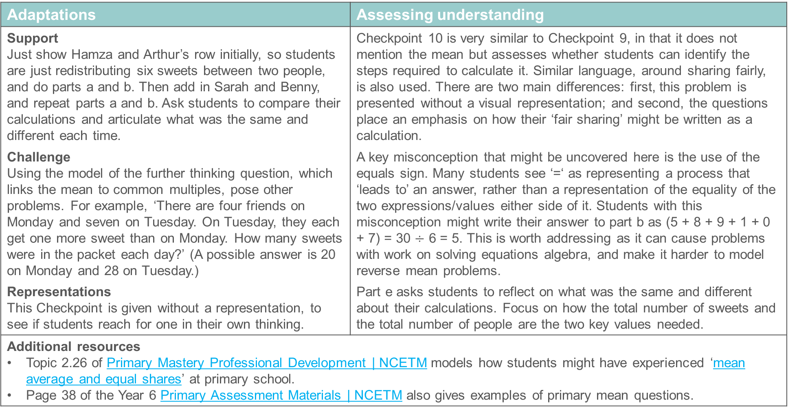
Checkpoint 10: Guidance
Adaptations | Assessing understanding
Support Just show Hamza and Arthur’s row initially, so students are just redistributing six sweets between two people, and do parts a and b. Then add in Sarah and Benny, and repeat parts a and b. Ask students to compare their calculations and articulate what was the same and different each time. Challenge Using the model of the further thinking question, which links the mean to common multiples, pose other problems. For example, ‘There are four friends on Monday and seven on Tuesday. On Tuesday, they each get one more sweet than on Monday. How many sweets were in the packet each day?’ (A possible answer is 20 on Monday and 28 on Tuesday.) Representations This Checkpoint is given without a representation, to see if students reach for one in their own thinking. | Checkpoint 10 is very similar to Checkpoint 9, in that it does not mention the mean but assesses whether students can identify the steps required to calculate it. Similar language, around sharing fairly, is also used. There are two main differences: first, this problem is presented without a visual representation; and second, the questions place an emphasis on how their ‘fair sharing’ might be written as a calculation. A key misconception that might be uncovered here is the use of the equals sign. Many students see ‘=‘ as representing a process that ‘leads to’ an answer, rather than a representation of the equality of the two expressions/values either side of it. Students with this misconception might write their answer to part b as (5 + 8 + 9 + 1 + 0 + 7) = 30 $÷$ 6 = 5. This is worth addressing as it can cause problems with work on solving equations algebra, and make it harder to model reverse mean problems. Part e asks students to reflect on what was the same and different about their calculations. Focus on how the total number of sweets and the total number of people are the two key values needed.
Additional resources Topic 2.26 of Primary Mastery Professional Development | NCETM models how students might have experienced ‘mean average and equal shares’ at primary school. Page 38 of the Year 6 Primary Assessment Materials | NCETM also gives examples of primary mean questions.

Slide 36
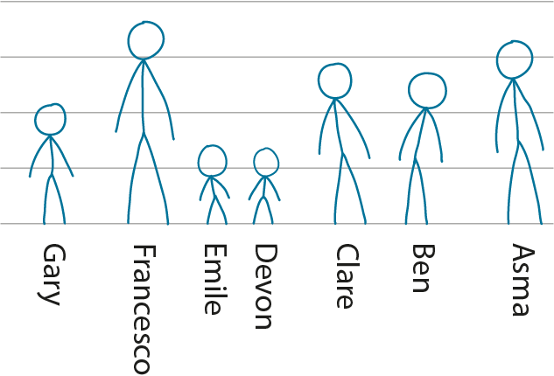
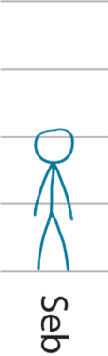
Checkpoint 11: Coming and going
Gary’s height is exactly the average height for the group of people shown below.
If Francesco leaves the group, will Gary be above or below the average height for the remaining group?
If Gary leaves instead, will Ben be above or the below average height for the remaining group?
If no one leaves, but Seb joins, will Gary be above or below the average height?
Francesco is the tallest in the group, and Devon is the shortest. If they both leave, is it possible to say what happens to the average height of the remaining group?
Notes:
This slide is animated. Each question will appear separately so you can choose the pace at which to work with your class.
Answers
a) If Francesco leaves, Gary will be above average height, as the average height will decrease.
b) If Gary leaves instead, the average will not change, so Ben will remain above average height.
c) If Seb joins, the average height will decrease slightly, so Gary will be above average. This is deliberately ambiguous, however. Students could also argue that Seb is about the same height as Gary so the average will not change.
? Without more information, it is not possible to say exactly how the average height will change. It could go up, down or stay the same depending on how much bigger/smaller than the average each of them is and depending on the heights of the rest of the group. As Emile is a similar height to Devon, and there is no-one quite as tall as Francesco, it is likely that the average height would decrease if they both left.
Suggested questioning
What does ‘average’ mean here?
What would happen if another person to same height as ___ joined the group?
What happens if a taller/shorter person leaves?
Things to think about
The word ‘average’ is used in this Checkpoint, rather than mean, so that you can assess students’ understanding of the concept of average. Mean is the only average stated in the primary National Curriculum, so it is assumed this is the average being referring to. The questions and answers are based on what happens to the calculation for mean when various people come and go.

Slide 37
Checkpoint 11: Guidance
Adaptations | Assessing understanding
Support Sketch a smaller group of ‘stick people’ – for example just Asma, Ben, Gary and Emile – before introducing the larger group. Challenge Ask students to suggest some possible values for each person’s height. Representations A rough sketch of ‘stick people’ has been used to introduce some ambiguity and debate. Not including the values means that the focus is on students’ conceptual understanding of averages, rather than their procedural fluency. | There are no numbers in this Checkpoint so, unlike Checkpoints 9 and 10, the focus is less on completing a calculation and more on whether students can reason with the average and how changes will affect it. The word ‘average’ rather than ‘mean’ is used, so that you can see whether students volunteer the word ‘mean’ as an interpretation of it. While students might have identified the ‘most popular’ in a data set, mode and median are no longer in the primary National Curriculum. Some students may have heard these terms, but it is likely that the majority will not. Assess whether students understand what average means and understand that, in this case, Gary’s height is the same as the value that represents the height of the group. When someone taller than Gary leaves, like Francesco does in part a, the average will decrease but Gary’s height won’t, making him above average. Seb’s height is deliberately ambiguous – students could argue that he is the same height as Gary, or slightly smaller/taller. Use this ambiguity to provoke some discussion with students and ask what the effect on the average would be in each of those cases.
Additional resources Key idea 5.1.1.1 from Secondary Mastery Professional Development | NCETM explores Understanding the mean at Key Stage 3.

Slide 38
Checkpoint 12: Same average
The average age of a class of Year 8 students is 12.5.
The average age of their teacher’s family is 12.5.
Does this mean that the teacher’s family are the same age as the Year 8 students? Why or why not?
Here are the ages of the teacher’s family:
0 3 2 5 32 33
Explain how the class of Year 8 students has the same average age as the family.
A smaller family also have an average age of 12.5. What might their ages be?
Notes:
This slide is animated. Each question will appear separately so you can choose the pace at which to work with your class. You will need to use present mode to show this task to students, as the animations prevent the actual ages given in part b from revealing the answer to part a.
Answers
a) No, it does not mean that the family are the same age. That would be unrealistic, particularly as you know that the teacher must be at least 10 years older. There must be some much younger members of the family to average the age out to 12.5.
b) When you add all the ages of the Year 8 students together (which will be lots of 12s and 13s) and divide by the number in the class, you will get the same value as when you add all of the ages of the family together and divide by the number of family members.
? There are infinite possible answers. An example might be 26, 24, 0 and 0, as the total of these ages is equivalent to 12.5 $×$ 4.
Suggested questioning
What does average mean?
How can two different groups have the same average age?
Where is the 12.5 in this data set?
Is 12.5 a useful number to represent this data set?
Things to think about
As with Checkpoint 11, the assumption is that the word average refers to the mean. Revisit this Checkpoint once you have also taught median and mode, and ask students how this new knowledge changes their approach to the task. Do the two data sets still have the same median? How about mode?

Slide 39
Checkpoint 12: Guidance
Adaptations | Assessing understanding
Support Offer more smaller data sets with the same average to model how this is possible. Challenge Expand on the further thinking question by asking, What is the oldest that one of the family members can possibly be?’ Representations This Checkpoint is offered without representations. It might be tempting to use counters to model average here, an alternative representation is the number line. Mark on 12.5 and model (using arrows) the distance to family or class members’ ages. | Checkpoint 12 again focuses on conceptual understanding of the mean, exploring whether students can reason about how averages represent data sets and how two different data sets can produce the same average. The intention is to use this task before Key Stage 3 teaching on averages and measures of spread, so that the mode, median and range are not considered. However, conversations in this task may lead naturally on to their introduction. You might ask which of the two data sets is more ‘spread out’ and see what students do to answer this. Note that students are unlikely to be familiar with the term ‘outlier’ unless they have covered it in Key Stage 3 science. During part a, focus on whether students understand that the family members do not have to be 12.5, or even close to this age, to have an average age of 12.5. Students’ reasoning for part b is likely to reveal a lot about the depth of their understanding of averages. Look out for the representations they use, and listen to their vocabulary. Consider if there are any other language or representations that would help to enhance their reasoning. As a quick further assessment point, ask students how many years and months old someone who is 12.5 has been alive. Watch out for students who say 12 years and five months rather than six months – it is likely they will need more practice of fractions/decimals in relation to time.
Additional resources Key idea 5.2.2.2, Choosing appropriate statistical measures from Secondary Mastery Professional Development | NCETM develops some of the ideas hinted at in this Checkpoint.

Slide 40
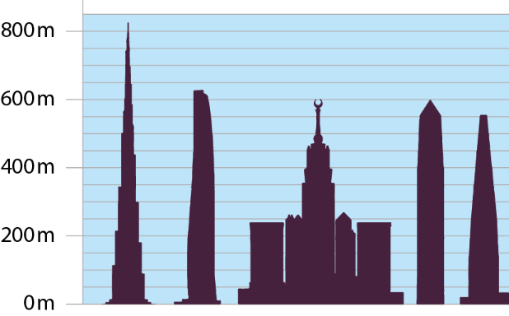
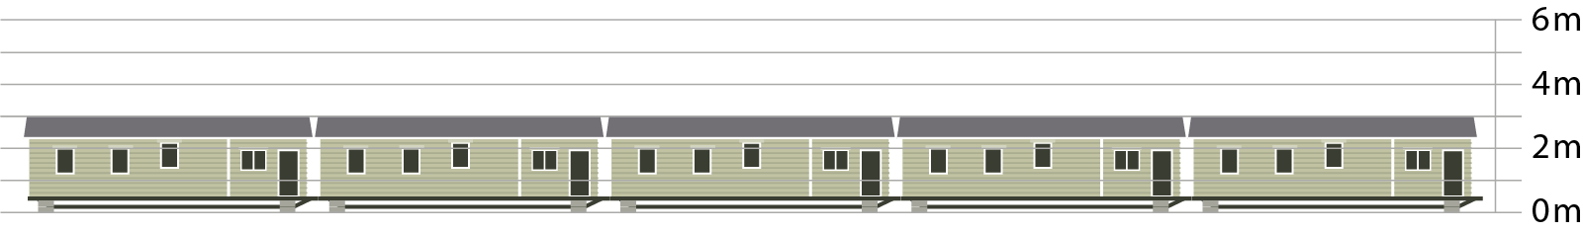
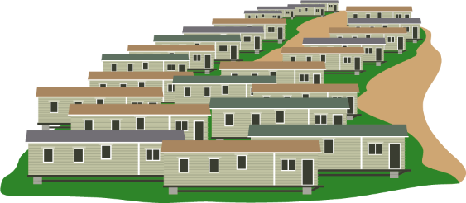
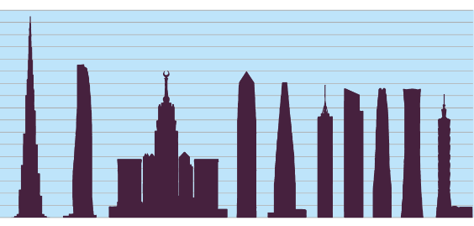

Checkpoint 13: Towering
The top left picture shows the five tallest buildings in the world. The bottom left picture shows five static caravans.
Estimate the mean height of the buildings in each image.
Imagine one caravan swaps with one tower. Estimate the mean height of the buildings in each image now.
Did both of your estimates change by a similar amount? Explain your thinking.
How would your answers to parts a and b be different if the images to the right had been used?
Notes:
This slide is animated. Each question will appear separately so you can choose the pace at which to work with your class. An animated visualisation of part b is on the next slide.
Answers
a) A sensible estimate for the mean of the towers would be around 650 m. A sensible estimate for the mean of the caravans is 3 m.
b) The mean height of the towers would change; it will still be in the region of 600 m but much lower than before.
The mean height of the caravans would change; it will now be much higher than any of the caravans actually are (between 150 and 180 m).
c) Both estimates can be argued to have changed by a similar raw value: swapping the tallest tower would see the tower average change from approximately 643 m to 478 m (a difference of 165 m). The average of the caravans would change from 3 m to 168 m (a difference of 163 m). However, students might argue that the effect is greater for the mean height of the caravans as the new mean height is so much taller than any possible caravan, while the new mean height for towers is still high enough to be considered ‘towering’. They might suggest that the combined height of the four remaining towers has a much bigger effect than the single caravan.
? a) The mean for the towers would be slightly smaller, as five more slightly smaller towers would have brought down the average closer to 600 m. The mean for the caravans would have been the same, as they are still all the same height.
b) The mean height of the nine towers plus caravan would change by even less than when there were four towers plus caravan. The mean height of the one tower plus many caravans would change by less than when there was one tower plus caravans, but it would still end up higher than the height of any caravan.
Suggested questioning
Which mean was easier to estimate? Why?
Does the total number of towers and caravans matter?
What is the effect of a tall tower and a short caravan on the overall average?
Is it possible to have enough caravans to counteract the ‘uplift’ provided by one tower? How about the other way around?
Things to think about
Students are unlikely to have spent much, if any, time considering outliers during their work on mean at primary school, as they are not explicitly referenced within the primary curriculum. This Checkpoint therefore assesses their instinctive reaction to an extreme value being introduced to a data set. Do they recognise that swapping a tower for a caravan will have a large effect on the mean? This might be a useful precursor to teaching on different averages, as it sets up a justification for why the mode or median might be useful. The animations on the following slide might help students to visualise how significant the differences in heights are between the caravans and the towers.

Slide 41
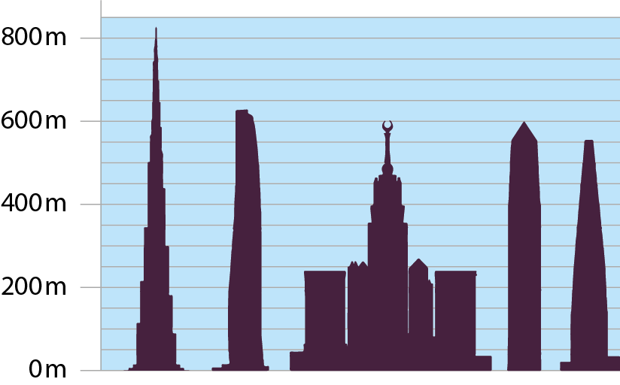




Checkpoint 13: Towering (animated visualization of part b)

Slide 42
Checkpoint 13: Guidance
Adaptations | Assessing understanding
Support Model the same point in the classroom using familiar objects: for example, using different pens in place of the towers; or groups of people, replacing caravans with babies and towers with adults. What would be the effect on the mean if one of each group swapped? Challenge Ask students to consider how big the group of caravans needs to be for the tower to have less of an impact. How many caravans would there need to be for it to raise the mean by less than 10 m? How about 1 m? Representations Comparing the means of two extremely different data sets means that the effects are heightened, so the point can be made more readily. An animated slide follows the Checkpoint to support the idea of swapping a tower for a caravan visually. | Like Checkpoint 11, Checkpoint 13 asks students to reason with the mean so that you can assess their conceptual understanding. Part a asks them to estimate the mean height. You are not looking for precision but a sense of what might be reasonable. For the towers, for example, students should recognise that the one tower that is nearly 800 m will bring the average up, despite the other towers all being approximately the same. Subsequent questions think about the impact that a change has on the mean. For example, can students recognise that the average will change significantly when an outlier is added? Do they think that the mean has to be representative of all of the data points, or do they understand that the inclusion of the tower will mean that the mean height of the caravans will now be significantly taller? The further thinking question asks how the answers would have changed with the inclusion of more caravans or more towers. Students should recognise that, given the caravans are all a standard size, it does not matter how many of them there are, the mean will be the same regardless.
Additional resources Key idea 5.2.2.2, Choosing appropriate statistical measures from Secondary Mastery Professional Development | NCETM develops ideas hinted at in this Checkpoint.

Slide 43
Checkpoint 14: Meanest team
In the 2021–22 football season, Chelsea won the Women’s Super League, scoring an average of 2.91 goals per game.
Maxine says, ‘Wow! Our school team averaged 3.7 goals per match last year. We’re better than Chelsea!’
Do you agree with Maxine? Explain your answer.
Find a possible set of ten values that would result in an average of 3.7 Can you do the same for 2.91?
Notes:
This slide is animated. The further thinking question will appear separately so you can choose the pace at which to work with your class.
Answers
Students’ answers and justifications will vary. They should be able to argue that the two averages are not comparable, as they play in different leagues and so the opposition will be at different standards. A high goal average in a school league does not compare to a lower goal average in a professional league.
? There are infinite possible answers: check all of the answers sum to 37 or 29.1.
Suggested questioning
Why is the mean alone not a useful value here?
Why aren’t these two means comparable?
Does a high mean always mean ‘better’? Why or why not?
Things to think about
Learning on averages is not just about procedures: it is also about interpretation, and understanding what these values mean in context. Checkpoint 14 has a simple, thought-provoking premise and should stimulate some debate amongst students. Listen to – and challenge – their justifications so that you are giving them the opportunity to use mathematical reasoning in their agreement or disagreement with Maxine. You might also like to use data from other football leagues to explore this idea further; for example, for the same season of the Premier League, Manchester City men’s team were the top goal scoring team with an average of 2.61 goals per game.

Slide 44
Checkpoint 14: Guidance
Adaptations | Assessing understanding
Support Looking at real-life data might help to contextualise this concept; football statistics are readily available online. Challenge As with many average/mean tasks, a ‘reverse mean’ task can be a good opportunity to stretch and deepen understanding. Ask students to create a possible set of data for each team. Representations No representations are given, but you could offer visualisations of possible sets of data, perhaps showing one very high score among the school teams’ goals. This could be presented as a bar model with each section representing a different game, a bar chart/table or a list. | It is important that students are not only fluent with statistical procedures, such as finding the mean, but also have a deep and connected understanding of it as a concept: they need to understand what the mean means. Checkpoint 14 offers a simple statement and asks students to agree or disagree with it. Check whether students understand that averages can be misleading, and that more information is often needed to give a clearer picture of a set of data. The answer is obvious – no, Maxine’s school team is not better than Chelsea – but it is students’ reasoning that is important. Prompt them to think beyond simple statements such as, ‘Professional teams are obviously better,’ and consider why the school team might have a higher average. Do they play as many games? What might the quality of the opposition be like? How consistently will they play? What would be the effect on the average of one really high score against a much weaker team? If there is time, it might be interesting to discuss each team’s average in relation the average for their respective leagues. You could create some imagined values here that would prompt the most discussion: for example, if the average number of goals for the Women’s Super League is 3 and the school league is 2.5, how does each club compare to the standard for their league? How about if the average for WSL is 0.9 but for the school league it is 5?
Additional resources Additional activity J offers another interesting ‘misleading’ average, this time in the context of cricket.

Slide 45
Checkpoint 15: Seven is mean
Four sets of data all have a mean of seven.
In which sets of data do you think this average provides a good summary of the information? Why?
A: 1, 1, 1, 1, 1, 1, 43
B: 7, 7, 7, 7, 7, 7, 7
C: 3.5, 4.8, 6.1, 6.9, 13.9, 17.4, 17.4
D: 4, 5, 6, 7, 8, 9, 10
Neha says that one set of data is more spread out than the others. Which data set do you think she is talking about? Which is the least spread out? How do you know?
Notes:
This slide is animated. Each data set, and then the further thinking question, will appear separately so you can choose the pace at which to work with your class.
Answers
A: The mean is not a good summary, as 43 is much bigger than all of the other numbers, which are the same.
B: The mean is a good summary, as all of the numbers are seven.
C: The mean is a good summary, but there is scope for discussion. Many of the numbers are close to the mean of seven; two are particularly close, but there are also three numbers that are quite a bit bigger.
D: The mean is a good summary, as every number has a matching pair that is as much bigger than the mean than it is smaller. Note, however, that distributions do not need to be symmetrical for the mean to be a good summary.
? Neha is referring to set A, as there is a difference of 42 between the biggest and smallest number. The least spread out is B, as all of the numbers are the same.
Suggested questioning
What is the same and what is different about these four sets of data?
Does seven ‘represent’ the data well? Why or why not?
Which of these is best represented by seven? Which is least?
Where seven doesn’t represent the data well, what might you do instead?
Things to think about
Checkpoint 15 relies on the idea of the mean as a summary statistic: that it is a single value that represents a data set. The data sets here have been chosen to provoke discussion about this idea. Revisit this task once other measures of central tendency have been introduced at Key Stage 3, and ask whether the mode or median is a more appropriate value for any of the data sets.

Slide 46
Checkpoint 15: Guidance
Adaptations | Assessing understanding
Support Compare just two datasets at a time: the extremes of A and B make the point clearly. Challenge The further thinking question hints at a measure of spread: build on this by asking students to create a dataset with a mean of seven that is very spread out and then one which is less spread out. Representations Showing these four datasets visually could help students to understand both why seven is the average for all four sets, and also why the mean is not a helpful value for all of them. Use a number line, showing the distance of each value from seven, or a bar model, showing each bar split into lengths representing the seven values in the data set. | As with Checkpoints 12–14, the focus is less on finding the mean and more on understanding what it represents. Assess whether students understand that the mean is meant to be a summary of the data, and to be a single value that could reasonably represent the whole data set. If students see mean solely as a numerical operation, they may be less likely to identify that it is not a useful summary statistic for dataset A. To help avoid this sense of the mean as a solely numerical operation, ask students to suggest real-life contexts that each dataset could represent: does this aid their understanding? For example, dataset A could be the ages of some pre-school children and their childminder. Does seven represent their ages well? Is it useful to know the mean age of all the people in this group? Note that students are unlikely to already be familiar with the term ‘outlier’ unless they have covered it in Key Stage 3 science. This task is intended to be used before Key Stage 3 teaching on averages and measures of spread, so the mode, median and range are not considered here. However, conversations within this task may lead naturally on to their introduction. For example, if you use the further thinking question about which of the four data sets is more spread out, see what students do to answer this. You could revisit this task to check how understanding has developed after teaching at Key Stage 3.
Additional resources Key idea 5.2.2.2, ‘Choosing appropriate statistical measures’ from Secondary Mastery Professional Development | NCETM develops some of the ideas hinted at in this Checkpoint.

Slide 47
Checkpoint 16: Five cards
Molly has five cards with positive integers on. She calculates the mean is five.
She turns over two cards, so they are no longer visible.
What numbers could be on the hidden cards?
How many possible answers are there?
Were the cards in ascending order when Molly turned them over? How do you know?
Molly removes the red card. The mean is now four. What was on the card that she removed?
2
5
7
If the task is repeated, but without positive integers specified, how would your responses to these questions change?
Notes:
This slide is animated. Each question will appear separately so you can choose the pace at which to work with your class.
Answers
a) Any pair of numbers that add to 11.
b) There are five possible answers: 1 and 10; 2 and 9; 3 and 8; 4 and 7; or 5 and 6.
c) It was not possible for the cards to be in ascending order. We know this because, if the red card was 7 or more, then the blue card had to be 4 or less, but 5 comes before the blue card.
d) If the mean is our, the total of the four cards is 16. Therefore the blue card must be 2 and the red card must have been 9.
? There are now infinite possible answers. As long as they sum to 11, any pair is valid. For example, 5.5 and 5.5, 9.99 and 1.01 or 11 and 0. If one of the numbers is greater than 11, then the other will be negative, for example 12 and -1 or 100 and -89).
Suggested questioning
If the mean is five, what does this tell us about the total of all of the cards?
What is the largest number the hidden cards could have? What is the smallest?
Why are there not infinite possible answers? What would need to change for there to be infinite answers?
Things to think about
Reverse mean problems have been used throughout the earlier Checkpoints in this deck as a way to extend the thinking of those students who have completed the main task. All students can engage with the thinking required for these problems, however, and so Checkpoint 16 offers a reverse mean problem as a main task. This allows you to assess students’ understanding of the structure of the mean and how flexibly they can think about it.

Slide 48
Checkpoint 16: Guidance
Adaptations | Assessing understanding
Support Build up to the multiple possible options in this task (with two cards turned) by offering a similar problem with one card turned first. Challenge Give students a similar task, but where the turned-over cards can be negative or decimal. Then ask them to create their own problems. Add further challenge with constraints such as, ‘The missing cards must be multiples of three’, and ask if such a scenario is possible. Representations Number cards are used rather than actual representations of values. Turn the premise of the task into a game by using real digit or playing cards: put students in pairs to practise finding the mean of sets of cards, then ask one partner to set up a problem with one card turned over. You could also recreate the situation using groups of counters (as in Checkpoint 9) but cover one group so that it is not visible. | Checkpoint 16 is a classic reverse mean problem, to stretch students when working with the mean. The structure means that it is a relatively accessible task and useful for checking if students have a deep understanding of the mean and can reason with it. Do students recognise that, as there are five cards with a mean of find, they can find and use the total of all of the numbers by multiplying five by five. Do they understand the significance of this total? Can they give some possible pairs of missing values to make this total? Can they find all possible pairs, or express them using a generalisation? If students are able to complete part a and b, this suggests a fairly secure understanding of the structure of the mean. If they need some more support, consider giving more experience of using representations to find the mean (as in Checkpoint 9) and offer this task again at a later date.
Additional resources Additional activity I is another mean problem with missing values.

Slide 49
Checkpoint 17: Sports day
It’s sports day! Each year group picks three students to do the long jump.
Which year group do you think will have the greatest mean height? Can you be sure?
The Year 10 team has the greatest mean height.
Emily says, ‘This means that they must have the tallest student in their group.’ Do you agree?
Emily says, ‘This also means they will record the longest jump.’ Do you agree?
The average height of a Year 8 student is approximately 157 cm. The world’s tallest man was about 224 cm tall in Year 8.
If he was one of the three members of the Year 8 team, how tall would the other two members of the team have to be for their height to still be ‘average’ for Year 8?
Notes:
This slide is animated. Each question will appear separately so you can choose the pace at which to work with your class.
Answers
a) Students might suggest that the oldest year group in their school has the greatest mean height (so answers may very depending on the age range taught within the school). You cannot be certain this will be the case, although – using the example of an 11-16 secondary school, it is likely that Year 10 or year 11 will have a greater average than Year 7.
b) Not necessarily – another team might have the tallest student but one or two much shorter students who bring the average height down.
c) Not necessarily – it depends how strongly correlated height is to jump length. A shorter student might have stronger muscles or better technique!
? The other two members of the team would need to have a total height of 247 cm, so could be any two numbers that total this – within reason. It is not suitable to suggest, for example, that one Year 8 could be 20 cm and the other 227cm.
Suggested questioning
Will Year __ have a greater mean height than Year __? How do you know?
Does a taller person always have a longer jump? What other factors might affect jump length?
Which sports might be influenced by height? Which might be less influenced?
What is a reasonable estimate for the height of a Year __ student?
Things to think about
Checkpoint 17 assesses whether students understand the concept of the mean without any calculations being involved. Can they use their knowledge of what different year groups look like to make judgements about a sample? From this, can they interpret how height might correlate to distance jumped? If students disagree there will be more opportunities for discussion, so you might wish to prompt with some statements for them to argue against.

Slide 50
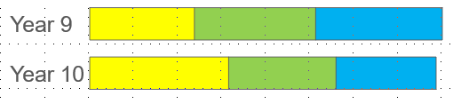
Checkpoint 17: Guidance
Adaptations | Assessing understanding
Support Rather than asking students to think about all year groups, compare just Year 7 and Year 11, and then Year 10 and Year 11, so that they have more specific comparisons to draw on. Challenge Ask students to consider different sports, particularly those where height might provide a greater advantage. Would they draw the same conclusions for these sports? Representations Bar models, or ‘stick person’ sketches such as in Checkpoint 11, could be used effectively to model how the individual heights of each year group’s team might differ. For part b, for example, you could show how the Year 10 team could have a greater average but another team have the tallest person | Checkpoint 17 builds on some ideas around reasoning with the mean that are explored in Checkpoints 11 and 13, but also asks students to think about what conclusions it is reasonable to draw from a set of data. Students should recognise that it is reasonable to assume that the older year groups will be likely to have a greater average height than the younger ones (for example, comparing Year 11 with Year 7) but that the differences in heights between the older year groups are less likely to be significant (for example, comparing Year 10 with Year 11). Students will meet the ideas of correlation and causation in Key Stages 3 and 4, but part c offers an opportunity to check whether they already have a sense of causal relationships in a familiar context. Students should have enough experience of playing or watching sports to recognise that different physiques and other factors can have an impact on performance, and that for this particular sport there are other attributes that could give more of an advantage than height.
Additional resources Page 52 of Secondary Assessment Materials | NCETM explores the conclusions that you can draw from data. Additional Activity K might be an interesting next step as it works in ‘reverse’ by taking a statistic and trying to explain it.

Slide 51
Additional activities
Activities A–L

Slide 52
Activity A: More porky pies
Two teachers are comparing the test results from their classes. They draw a pie chart for each class.
Mr Lomax says, ‘More students from my class passed the test.’
Is he correct? Why or why not?
There were nine students in each class who did not pass the test. What can you say about the size of each class?
Notes:
This slide is animated. Each pie chart, and then the question and further thinking question, will appear separately so you can choose the pace at which to work with your class.
Answers
Mr Lomax is not necessarily correct. A greater proportion of his students passed the test but we do not know how many students were in each class. If their classes were the same size, then this would be true. It would also be true if Mr Lomax had a larger class than Mrs Trubridge.
? Mrs Trubridge’s class is smaller than Mr Lomax’s. Mrs Trubridge’s class must have a total of 18 students, if nine is half. Mr Lomax must have 36 students in his class, if nine is one- quarter.
Suggested questioning
What is the same and what is different about the two pie charts?
How many students might be in each class if Mr Lomax is not correct? How about if he is correct?
What angle is each sector? How many students might this represent?
Things to think about
Additional activity A is identical to Checkpoint 1, but gives more recognisable fractions in the pie charts. See the guidance slide for Checkpoint 1 for more assessment information, including when and why you might use this as an alternative.

Slide 53
Activity B: More comparing charts
Saffie asks her class what their favourite colours are. She records their answers two different charts.
Which of the questions can you answer by using the bar chart and which with the pie chart?
Which was the most popular colour?
What colour was chosen by a quarter of students?
Compare the number of students who liked blue with the number who liked green.
How many more students liked red than blue?
How many students were in the class?
Frequency
Colour
Write your own question that could be answered using the pie chart. What can you find out? What can you not find out?
Notes:
This slide is animated. Each question will appear separately so you can choose the pace at which to work with your class.
Answers
a) Both charts (yellow).
b) Both charts (pink) although it is easier to see on the pie chart.
c) The same number of students liked blue and green in both charts; we know this is 2 from the bar chart but we don’t know the number from the pie chart.
d) From the bar chart, we know that 2 more students liked red than blue. We do not know the actual numbers from the pie chart, although we do know that twice as many liked red than blue.
e) From the bar chart, we can deduce that this was 20 students. We cannot tell this from the pie chart.
? Any question that refers to proportion is valid, for example, least popular or a certain fraction/percentage of the year group.
Suggested questioning
What is the same and what is different about these two charts?
Which of these questions is it possible to answer? Why?
What information would you need to make the other questions possible to answer?
Which answers are clearer on the bar chart compared to the pie chart? How about the pie chart compared to the bar chart?
Things to think about
Additional activity B is identical to Checkpoint 2 but uses single bar and pie charts rather than dual/comparative ones to reduce the information that students are dealing with. See the guidance slide for Checkpoint 2 for more assessment information, including when and why you might use this as an alternative.

Slide 54


Activity C: Pocket money
Three children have a chart for keeping track of the pocket money they earn for doing chores. The smiley face stickers show the chart after week one.
If £21 is the total money earned after week one, what can you deduce from the chart shown?
In week two, sun stickers are added. If each type of sticker represents the same amount, how much does each child now have in total?
The key shows the actual value of each type of sticker. Calculate how much money each child has.
Lucas
Jo
Olivia
= £2
= £6
Is it possible to change the value of each type of sticker to give the same amount of money for each child?
Notes:
This slide is animated. Each question, and the sun graphics, will appear separately so you can choose the pace at which to work with your class.
Answers
a) Each smiley face represents £2 pocket money.
b) If they represented the same amount, then Lucas would have £10, Jo would have £9.50 and Olivia would have £7.
c) Lucas has £14, Jo has £10.50 and Olivia has £13.
? No, it is not possible. For example, if a sun was worth 1.5 times a smiley face, then Lucas and Jo would have the same amount, but Olivia would have less.
Suggested questioning
What might each smiley face represent? What do you need to know to work this out?
What is the same and different about your answers to b and c?
Will the person with the most stickers always have the most money?
Things to think about
Additional activity C offers a different exploration of pictograms and might be used if you feel that students didn’t fully grasp the ideas in Checkpoint 5. This task is arguably more straightforward, as the focus is on identifying the actual key from the information given, rather than the range of possible keys. Part a asks students what they can deduce. It is left open to see if students have the confidence to give all of the possible detail they can work out. If students do not volunteer this information, break the question down into smaller parts, such as, ‘If I know all 10.5 stickers total £21, what must one sticker represent?’ You might find it illuminating to precede this more specific question with questions that focus more on reasoning and comparison. For example, ‘If £21 is the total, will Jo get more or less than half of this?’.

Slide 55
Activity D: Pictogram puzzle
This pictogram shows the different ways that students travel to school. Complete the key and the left-hand column based on the clues.
Key: =
The most popular way to travel is walking.
One-fifth of students travel by scooter.
Less than 10% of students travel by car.
Three times as many students travel by bus than by car.
Nine students travel by bike.
Create your own pictogram puzzle. What is the minimum number of clues you need to give?
Notes:
This slide is animated. The further thinking question will appear separately so you can choose the pace at which to work with your class. A blank, printable version of the pictogram is on slide 69.
Answers
See solutions on the next slide.
? Students’ answers will vary. Check by asking another student to try the puzzle.
Suggested questioning
Which clue will you use first? Is there more than one way to start?
Which of the rows could (clue __) refer to? Which couldn’t it refer to?
Which clue will help you to identify the value of a circle?
Things to think about
Additional activity D is a problem-solving task, asking students to complete a pictogram from a series of clues. These clues draw on different areas of maths – including fractions and multiplicative relationships – and so there are multiple assessment points beyond understanding the pictogram representation. For this reason, we have included it here (alongside Additional activity E), rather than as a main Checkpoint. Although the assessment focus is less sharp, it will be a revealing task to use with students. Listening to their strategies will tell you a lot about their reasoning, their fluency with connecting different mathematical ideas, and their confidence in the face of an unknown problem.

Slide 56
Activity D: Pictogram puzzle (solution)
This pictogram shows the different ways that students travel to school. Complete the key and the left column based on the clues.
Key: =
8 students
The most popular way to travel is walking.
One-fifth of students travel by scooter.
Less than 10% of students travel by car.
Three times as many students travel by bus than by car.
Nine students travel by bike.
Walk
Bus
Bike
Scooter
Car
Create your own pictogram puzzle. What is the minimum number of clues you need to give?

Slide 57
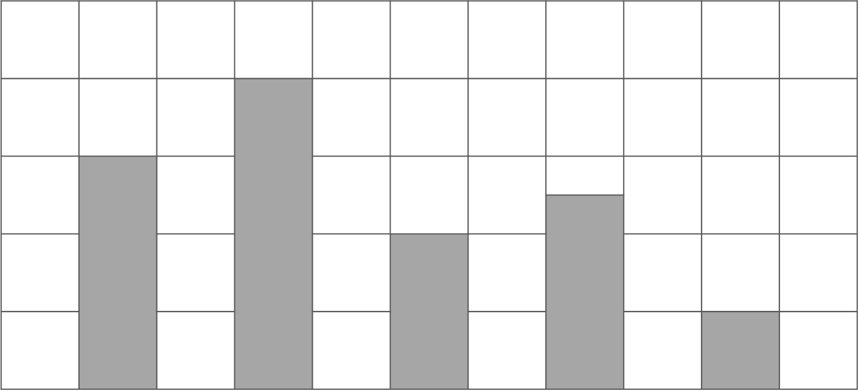
Activity E: Bar chart puzzle
This bar chart shows the different ways that students travel to school.
Label the two axes of the bar chart based on the clues.
The most popular way to travel is walking.
The least common way to travel is on a scooter.
Twice as many people walk as cycle.
The number of people who travel by car is three-quarters of the number of people who walk.
Twelve people travel on the bus.
Create your own bar chart puzzle. What is the minimum number of clues you need to give?
Notes:
This slide is animated. The further thinking question will appear separately so you can choose the pace at which to work with your class. A blank, printable version of the pictogram is on slide 70.
Answers
See solutions on the next slide.
? Students’ answers will vary. Check by asking another student to try the puzzle.
Suggested questioning
What clue will you use first? Is there more than one way to start?
Which of the bars could (clue __) refer to? Which couldn’t it refer to?
Which clue will help you to identify the scale on the y-axis?
Things to think about
Additional activity E is a problem-solving task, asking students to complete a pictogram from a series of clues. These clues draw on different areas of maths – including fractions and multiplicative relationships – and so there are multiple assessment points beyond understanding the bar chart representation. For this reason, we have included it here (alongside Additional activity D), rather than a main Checkpoint. Although the assessment focus is less sharp, it will be a revealing task to use with students. Listening to their strategies will tell you a lot about their reasoning, their fluency with connecting different mathematical ideas, and their confidence in the face of an unknown problem.

Slide 58
Activity E: Bar chart puzzle (solution)
This bar chart shows the different ways that students travel to school. Label the two axes of the bar chart based on the clues.
25
The most popular way to travel is walking.
The least common way to travel is on a scooter.
Twice as many people walk as cycle.
The number of people who travel by car is three-quarters of the number of people who walk.
Twelve people travel on the bus.
20
15
Frequency
10
5
0
Car
Walk
Bike
Bus
Scooter
Create your own bar chart puzzle. What is the minimum number of clues you need to give?

Slide 59
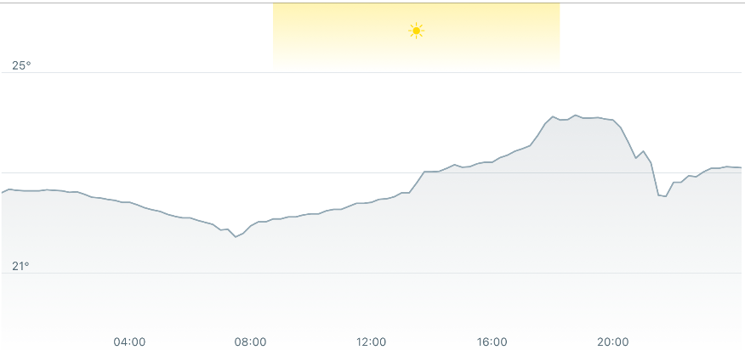
Activity F: Whose line is it anyway?
John and Becky each record the temperatures in their living rooms.
John sets up a sensor to continually record the temperature. Becky uses a thermometer to measure the temperature at five different times over 24 hours.
Which graph belongs to which person? How do you know?
Both John and Becky use their graphs to find the temperature at 18:00. Is this possible?
Whose graph is better? Why?
Can you think of another type of data that could be displayed on a graph like John’s? How about Becky’s?
Notes:
This slide is animated. The graphs and each question will appear separately so you can choose the pace at which to work with your class.
Answers
a) A: Becky, B: John
b) It is possible to be exact on John’s graph, but not on Becky’s – hers could be described as an estimated value. This is because John’s data is continuous but, although time is a continuous measure, Becky only records five set points in time. The lines between her points therefore show the trend not the actual temperature.
c) It depends what you want to use the graph for. John’s graph is more accurate as it shows a continuous record of the temperature. Becky’s graph shows the trend and irons out any small/insignificant changes. This can be useful, although it does miss some features of the data (for example that it reached the peak temperature before 20:00 and not at 20:00).
? You could use John’s graph to represent any data that changes continually over time. For example, electricity/water/gas usage, speed or temperature. You could use Becky’s graph to represent all of the same data, but at fixed points. For example, electricity/water/gas usage by day or by month.
Suggested questioning
What is the same and what is different about these two charts?
What is the same and what is different about the two lines on each chart?
Tell me the story of this graph.
Is a line graph always a useful/meaningful way to present data?
What graph/chart could you use instead?
Things to think about
Additional activity F draws on the ideas in Checkpoint 3, and extends students’ thinking even further. In Checkpoint 3, one of the data sets chosen was not really appropriate for a line graph. Here, both data sets involve temperature over time, but the temperature is measured in different ways and so the line graphs show subtly different things. Do students recognise that Becky’s recording at set times means that her graph shows a trend, whilst John’s continuous monitoring means that his graph shows the actual values at all times? Can students understand that there is a value to either graph, depending on how you need to use the data? These are interesting, and rich, statistical discussions – use this task after some teaching at Key Stage 3, unless the discussions from students for Checkpoint 3 indicate that students are already ready for this level of thinking. Note that the language of ‘extrapolate’ will not be familiar from primary school so ensure the term is explained first..

Slide 60
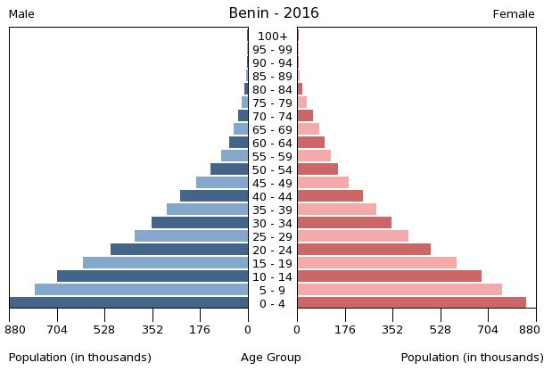
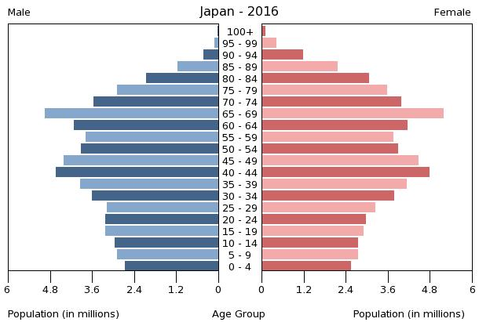
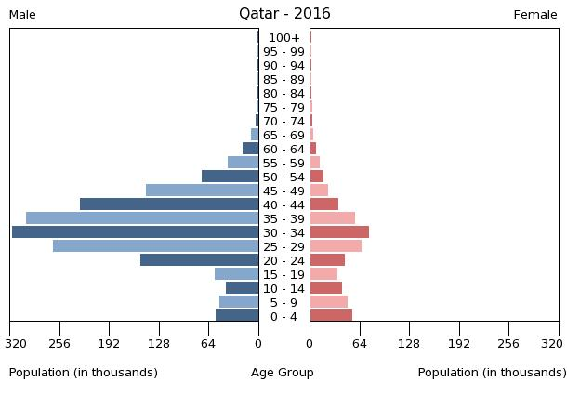
Activity G: Population pyramids
Match the statements to the population pyramids.
There are more men than women.
The biggest population group is babies and toddlers.
There are not many old people.
The biggest population group is working-age men.
The total population is over 100 million.
The number of babies born has gone down over time.
Create your own statements about the population pyramids. Can you think of one that no one else has?
Notes:
This slide is animated. Each statement, and then the further thinking question, will appear separately so you can choose the pace at which to work with your class. If the images are too small, printable versions of the three pyramids can be found on slide 71.
Answers
There are more men than women: Qatar.
The biggest population group is babies and toddlers: Benin.
There are not many old people: Benin and Qatar.
The biggest population group is working-age men: Qatar.
The total population is over 100 million: Japan.
The number of babies born has gone down over time: Japan. (See ‘Things to think about’ below).
? Students’ answers may vary. Additional examples for each country are given below, but these are not exhaustive.
Benin: there is roughly the same number of male and female people; almost no one lives beyond 90.
Japan: the biggest population group is 65–69 year olds; more women than men live to over 75.
Qatar: more babies were born in the last five years than the previous previous years; there are more males than females, except for among the under 15s.
Suggested questioning
What is the same and what is different about each population pyramid?
Are the statements always possible to match to a graph? Are they always ‘true’ from what you can see in the graph?
Which statements are easiest to match and why?
What else do the graphs show us?
Things to think about
Your students are unlikely to have all seen population pyramids before, although they may have seen them in geography or in the wider media. The intention is not to assess whether they understand this particular graph, but to check how they respond more generally to an unfamiliar representation. Are they able to read and understand the graphics? Do they find the unfamiliar to be too off-putting to engage with? The majority of the statements are factual observations from the graphs, so you can assess this reading skill. However, the last statement could be argued to be an interpretation rather than a description – rather than just stating that there are fewer children than adults, and even fewer young children than older children, the statement attempts to explain this phenomenon. Do students recognise that they cannot necessarily tell this from the graph? You might find it helpful to offer some alternative explanations, such as immigration, to see if students understand why the data presented does not necessarily give you enough information to find this conclusion. Explain to students that it is a trend statement, and these are snapshots of data, so they need to make inferences.

Slide 61

Activity H: Pen diagrams
Tilly has 10 pens in her pencil case.
black lid
1
1
3
0
2
0
2
1
She draws a Venn diagram to show the different types of pen.
One category is shown. What might the other two categories be?
She replaces one pen with a new pen.
The Venn diagram now looks like this. Which pen did she remove? What do you know about the new pen?
highlighter
black lid
1
1
3
0
2
0
2
1
Pick three categories and draw a Venn diagram for your own pencil case.
cat
Notes:
This slide is animated. Each question will appear separately so you can choose the pace at which to work with your class.
Answers
a) The other two categories are ‘cat’ pens and ‘highlighters’. Students may notice other properties that are valid; check that they match the numbers given in this Venn diagram.
b) The plain black pen on the right has been removed. It has been replaced by a cat pen (not a highlighter) with a black lid.
? Students’ answers will vary.
Suggested questioning
What are the three categories of pen in the Venn diagram? What other categories could have been chosen?
(Pointing to a pen) which categories does this pen fit into? Where would it go on the diagram?
Which numbers do you think should be swapped? Why? Could you argue this for any other pair of numbers?
Things to think about
Much like the two-way table from Checkpoint 7, Venn diagrams are no longer explicitly in the primary curriculum. However, students will have used them from EYFS onwards, to sort and categorise information. You can even find some examples of Venn diagrams in the post-2016 Key Stage 2 national tests papers where, for example, students are asked to place numbers in a Venn according to properties like even, square and prime. Rather than muddying the assessment point with other mathematical knowledge, this activity uses an image that will not be familiar to students, and gives a completed Venn. The emphasis is therefore on their interpretation of the Venn and whether they can connect it to the image.

Slide 62
Activity I: Mean problem
What is the mean length of words in this question and its answer?
Create your own mean word question.
Notes:
This slide is animated. The further thinking question will appear separately so you can choose the pace at which to work with your class. Note that the simplicity of this task means that students may ask for some clarification:
Length of words refers to number of letters.
Punctuation is not included.
The answer is one word (not a numeral or a sentence).
Answers
Four
? Students’ answers will vary – you might want to ask other students to peer assess to check they work, or check yourself!
Suggested questioning
How will you work this out?
What is the total number of words in the question? How many words will be in the answer?
How many letters are in the question? What is the next multiple (of the total number of words) after this?
Things to think about
Additional activity I is a task that both you and your students should find entertaining – it is very satisfying once you work it out! From an assessment point of view, you can check whether students have a deep enough understanding of the mean to realise that their divisor will need to be one more than the 13 words in the question, and that their dividend must therefore be the next multiple of 14 after their total number of letters. Use the suggested questioning above for some prompts if students find it hard to access.

Slide 63
Activity J: Beginner’s luck
In cricket, the bowling average is the average number of runs the opposing batsman gets before they are out. The best bowlers have a low bowling average.
James Anderson is a leading bowler who has bowled 37 077 times. He has a bowling average of 26.32.
David Gower is a batsman who has bowled 36 times. He has a bowling average of 20.
Is David Gower a better bowler than James Anderson?
Can you think of some other examples of situations where a low average is best? Can you think of some examples where a high average is best?
Notes:
This slide is animated. Each paragraph and the questions will appear separately so you can choose the pace at which to work with your class.
Answers
No, he isn’t! Gower has bowled far fewer times than Anderson, so his average is more likely to be raised by one or two particularly good days. The fact that Anderson has been selected to bowl over 1000 times more than Gower suggests that he is a better bowler.
? Students’ answers may vary. Some more sporting suggestions for a low average being best include golf, any events that are measured using time (such as running), and any games where the fewest turns wins (such as darts or mastermind). Some sporting suggestions for a high average being best include batting in cricket, goals in ball sports like hockey or football, and any events that are measured using distance (such as high jump).
Suggested questioning
Why might having a low average be best? What might it mean?
Why has James Anderson bowled so many more times than David Gower?
Why might Gower’s average be better than Anderson’s?
Things to think about
Cricket is a fantastic sport for statistics, and there are many interesting situations (such as this) that can be used to exemplify useful mathematical points. However, it is not a sport that every student is likely to be familiar with which is why we have used it as an additional activity, with the football context of Checkpoint 14 offering a more accessible context. We have tried to phrase this activity in a way that means that students with little or know experience of cricket can still access the mathematical ideas. You might find it helpful to explain to students that the bowling average is calculated using the number of runs that the opponent scores before they are out, which is why a lower average is better. Key here is to explore why it is unreliable to compare an average calculated from a large data set with an average calculated from a very small data set, and that the small data set is more exposed to being distorted by one or two very low or high values.

Slide 64
Activity K: Queen Elizabeth II
94% of global population were born after Elizabeth ll became Queen.
Source: BBC and UN Population Division
How is this possible?
How do the additional facts below help to explain this statistic?
 | 1952 | 2022
Global population | 2.6 billion | 7.9 billion
Global birth rate | 37.2 babies per 1 000 people | 17.7 babies per 1 000 people
Global life expectancy | 47 years | 73.2 years
Queen Elizabeth II reigned for 70 years. Estimate how many people in the world are older than 70.
Notes:
This slide is animated. Each question will appear separately so you can choose the pace at which to work with your class.
Answers
a) This is possible because only 6% of the world’s population are aged over 70. Students may be able to use some understanding of population growth/life expectancy (see answer part b below) to explain this.
b) Although the birth rate has more than halved over the 70 years of Queen Elizabeth’s reign, there are more people on the planet – nearly four times more! So fewer babies are born per 1000 people, but there are far more people to have these babies. People also live much longer – someone born now has a much greater chance of reaching 70 than someone born at the start of Elizabeth’s reign. Together, these facts mean that approximately 94% of the world’s population is aged under 70.
? 6% of 7.9 billion is approximately 474 000 000
Suggested questioning
Does this surprise you? Why or why not?
What percentage of the global population were born before Elizbeth ll became Queen? How old must this make them?
What does this mean for the number of people who are aged over/under 70 in 2022?
How can this be true if the birth rate was lower in 2022 than 1952?
How many times bigger was the global population in 2022 compared with 1952?
Why is life expectancy important for this statistic?
Things to think about
This is a striking statistic that might prompt discussion with students – show just part a at first, to see how students respond. Students will bring varying levels of knowledge to this activity, depending upon their age and experience. Give some time to hear students’ initial perceptions without showing them the supporting data: how aware are they of the fact that the world’s population has grown so significantly? Are they able to reason that, if 94% of the population were born after Elizabeth became Queen, then 6% were born before and so are older than 70? Part b offers some data to help explain the statistic. The falling birth rate, in particular, might be harder for students to explain. Depending on the quality of the responses you get in part a, you may or may not wish to give students so much for part b. You may find it easier to ‘drip feed’ the facts rather than showing the whole table at once. Instead of using the animations, you could jot down the values and write them on another board one row at a time.

Slide 65
Activity L: Data collection
Mrs Symonds, the headteacher, is redecorating the school hall and wants to use some data to help her decide which colour to choose.
This is her process:
Need to decide new colour for school hall
Survey Year 11’s favourite colours
Represent in a pie chart; choose biggest sector
Is this a sensible data collection process? Why or why not?
Below is part of another data collection process that Mrs Symonds uses.
What might she be trying to find out? Why? How might she collect her data?
Calculate the average number of vehicles per hour passing school at different times of day
Create your own data collection process. What do you want to find out? How will you collect your data? How will you present your data?
Notes:
This slide is animated. Each question will appear separately so you can choose the pace at which to work with your class.
Answers
a) Students’ answers will vary. Students might suggest that asking a year group’s opinion is a sensible thing, however they might also note that it is unfair to just ask one year group and not others (not students are NOT likely to know the word ‘bias’ in this context yet). Students might think about other factors that would contribute to the decision, and whether basing it solely upon students’ opinions is sensible. For example, they might want to consider the cost of different paints, the colour scheme of the school and whether some colours are better than others in a learning environment.
b) Students’ answers will vary. You are looking to see if they can suggest a sensible reason for the first blank box, and a sensible process for the second blank box. For example, the school might be wanting to find out if it’s sensible to employ a lollipop person to help children cross the road, and they might do this by counting the cars that pass at the times that students cross the road.
? Students answers will vary. Again, you are looking to see whether students understand the purpose of data collection: what data are they collecting? Why?
Suggested questioning
Will this survey give her the information she needs? Why or why not?
What else might she do?
Why might finding the average number of vehicles be useful information?
Things to think about
Additional activity L is included as an opportunity to discuss the data collection cycle with students. The data collection cycle is not formally part of the primary curriculum, but students may have experienced some conversations around why we collect data or been asked to answer a question that required some data collection. Students’ experiences of this from primary school are likely to be mixed, and so the task here has a relatively low floor so that you can follow students’ lead with how far to take your questioning. A linear flow chart is used, rather than a full cycle, as this is intended to prompt initial conversations to help you assess students’ current understanding of why and how we collect data, rather than be used as a teaching tool to explain the full, cyclical process. You may notice that part a references the data presented in Checkpoint 2a/b, so you may like to use this as a companion task, to help assess whether students understand why that data might have been collected.

Slide 66
Printable resources

Slide 67
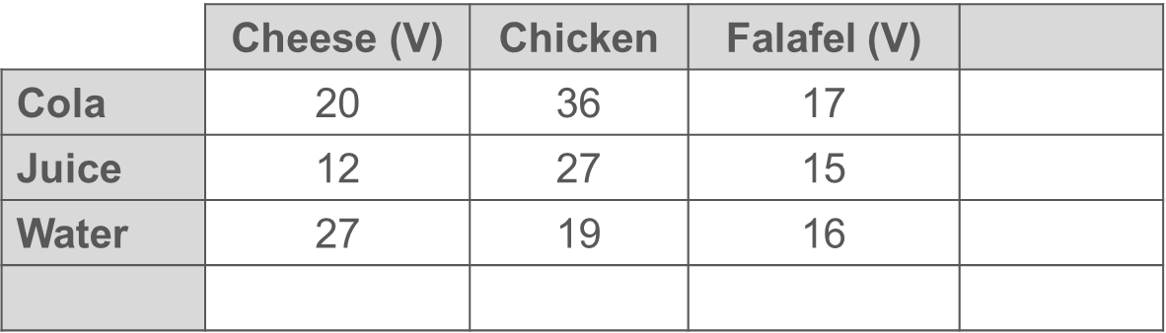
Notes:
These printable tables (five to a page) might be useful with Checkpoint 7.

Slide 68
Notes:
These printable blank tables (two to a page) might be useful for students’ tally charts in Checkpoint 8.

Slide 69
Key: =
Key: =
The most popular way to travel is walking.
One-fifth of students travel by scooter.
Less than 10% of students travel by car.
Three times as many students travel by bus than by car.
Nine students travel by bike.
The most popular way to travel is walking.
One-fifth of students travel by scooter.
Less than 10% of students travel by car.
Three times as many students travel by bus than by car.
Nine students travel by bike.
Notes:
This printable resource (two to a page) might be useful for Additional activity D.

Slide 70
The most popular mode of transport is walking.
The least common mode of transport is on a scooter.
Twice as many people walk as cycle.
The number of people who went in a car is three-quarters of the number of people who walked.
Twelve people go on the bus to school.
The most popular mode of transport is walking.
The least common mode of transport is on a scooter.
Twice as many people walk as cycle.
The number of people who travel by car is three-quarters of the number of people who walk.
Twelve people go on the bus to school.
Notes:
This printable resource (two to a page) might be useful for Additional activity E.

Slide 71
Notes:
This is a printable version of the population pyramids in Additional activity G (one set to a page).

