Slide 1

Checkpoints
Year 7 diagnostic mathematics activities
Understanding multiplicative relationships: fractions and ratio
27 Checkpoint activities
7 additional activities
Published in 2021/22

Slide 2
About this resource
This resource is designed to be used in the classroom with Year 7 students, although it may be useful for other students.
The Checkpoints are grouped around the key ideas in the core concept document, 3.1 Understanding multiplicative relationships, part of the NCETM Secondary Mastery Professional Development materials.
Before each set of Checkpoints, context is explored, to help secondary teachers to understand where students may have encountered concepts in primary school.
The 10-minute Checkpoint tasks might be used as assessment activities, ahead of introducing concepts, to help teachers explore what students already know and identify gaps and misconceptions.
Each Checkpoint has an optional question marked . This will provide further thinking for those students who have completed the rest of the activities on the slide.
The notes for each Checkpoint give answers (if appropriate), some suggested questions and things to consider.
After each Checkpoint, a guidance slide explores suggested adaptations, potential misconceptions and follow-up tasks. These may include the additional activities at the end of this deck.

Slide 3
Checkpoints 1–9
Checkpoint | Underpins | Code
1: Pay rises | Multiplicative relationships | 3.1.1 and 3.1.2
2: Multiplication square
3: Multiply 12
4: Products of 8
5: True or false?
6: Muddy map
7: Playback
8: Pie charts
9: What’s best?
*This three-digit code refers to the statement of knowledge, skills and understanding in the NCETM’s Sample Key Stage 3 Curriculum Framework (see notes below for more information).
Notes:
In the Sample Key Stage 3 Curriculum Framework, statements of knowledge, skills and understanding are arranged to give an example teaching order. The three-digit code for each statement in the framework is a clickable hyperlink to documents with more detailed information, including the key ideas contained within that statement. These key ideas are also shown on slides 6–7 in this deck.

Slide 4
Checkpoints 10–17
Checkpoint | Underpins | Code
10: Splitting bars | Fractions as an example of multiplicative relationships | 3.1.3
11: Strategies
12: Same and different calculations
13: Nine-tenths or minus ten | Understand place value in decimals, including recognising exponent and fractional representations of the column headings | 1.1.1.2
14: Same and different bars
15: Fifteen
16: Savings
17: Clocks
*This three-digit code refers to the statement of knowledge, skills and understanding in the NCETM’s Sample Key Stage 3 Curriculum Framework (see notes below for more information).
Notes:
In the Sample Key Stage 3 Curriculum Framework, statements of knowledge, skills and understanding are arranged to give an example teaching order. The three-digit code for each statement in the framework is a clickable hyperlink to documents with more detailed information, including the key ideas contained within that statement. These key ideas are also shown on slides 6–7 in this deck.

Slide 5
Checkpoints 18–27
Checkpoint | Underpins | Code
18: Shades of orange | Ratio as an example of multiplicative relationships | 3.1.4
19: Dough
20: Imperfect meringues
21: Flowers | Understand place value in decimals, including recognising exponent and fractional representations of the column headings | 1.1.1.2
22: Bunches of flowers
23: Running
24: How many times?
25: Chocolates
26: Unequal shares
27: Euros
*This three-digit code refers to the statement of knowledge, skills and understanding in the NCETM’s Sample Key Stage 3 Curriculum Framework (see notes below for more information).
Notes:
In the Sample Key Stage 3 Curriculum Framework, statements of knowledge, skills and understanding are arranged to give an example teaching order. The three-digit code for each statement in the framework is a clickable hyperlink to documents with more detailed information, including the key ideas contained within that statement. These key ideas are also shown on slides 6–7 in this deck.

Slide 6
Key ideas
Understand the concept of multiplicative relationships | Code
Appreciate that any two numbers can be connected via a multiplicative relationship | 3.1.1.1*
Understand that a multiplicative relationship can be expressed as a ratio and as a fraction | 3.1.1.2
Be able to calculate the multiplier for any given two numbers | 3.1.1.3
Appreciate that there are an infinite number of pairs of numbers for any given multiplicative relationship (equivalence) | 3.1.1.4
Understand that multiplicative relationships can be represented in a number of ways and connect and move between those different representations | Code
Use a double number line to represent a multiplicative relationship and connect to other known representations | 3.1.2.1*
Understand the language and notation of ratio and use a ratio table to represent a multiplicative relationship and connect to other known representations | 3.1.2.2
*‘There are additional resources exemplifying these key ideas in the Secondary Mastery Professional Development | NCETM.

Slide 7
Key ideas
Understand that fractions are an example of a multiplicative relationship and apply this understanding to a range of contexts | Code
Find a fraction of a given amount | 3.1.3.1
Given a fraction and the result, find the original amount | 3.1.3.2
Express one number as a fraction of another | 3.1.3.3
Understand that ratios are an example of a multiplicative relationship and apply this understanding to a range of contexts | Code
Be able to divide a quantity into a given ratio | 3.1.4.1
Be able to determine the whole, given one part and the ratio | 3.1.4.2
Be able to determine one part, given the other part and the ratio | 3.1.4.3*
Use ratio to describe rates (e.g. exchange rates, conversions, cogs, etc.) | 3.1.4.4
*‘There are additional resources exemplifying these key ideas in the Secondary Mastery Professional Development | NCETM.

Slide 8
Multiplicative relationships
Checkpoints 1–9

Slide 9
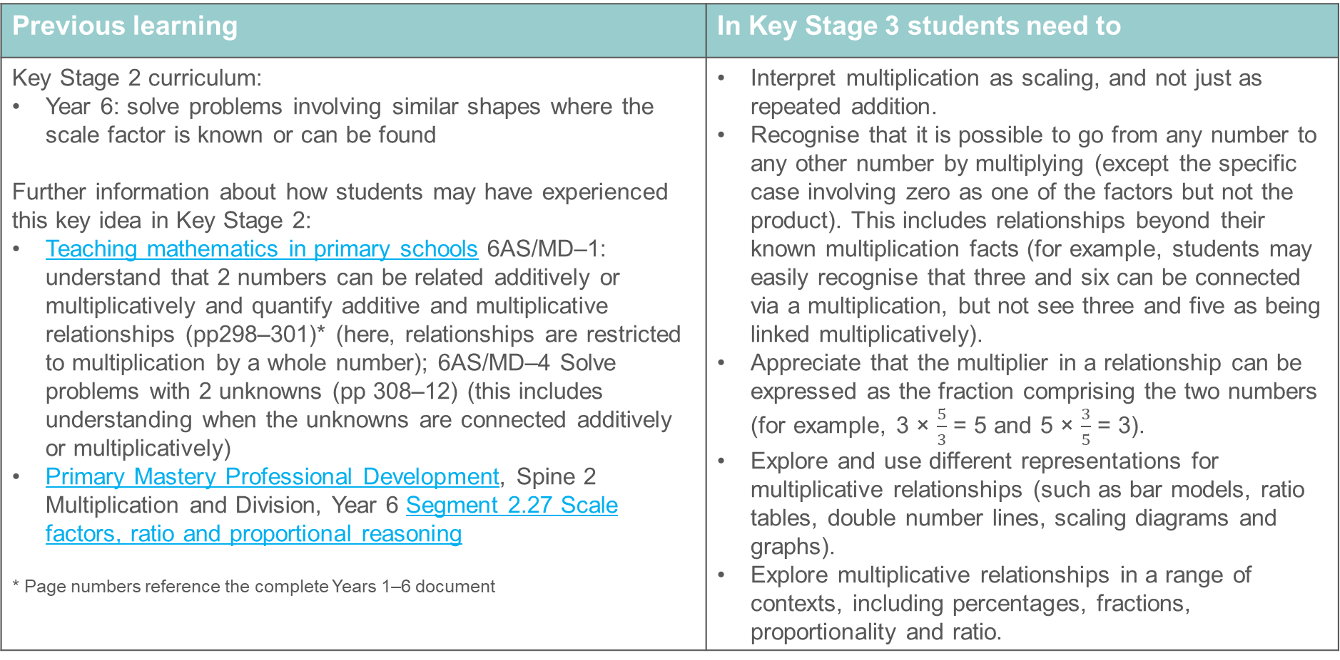
Multiplicative relationships
Previous learning | In Key Stage 3 students need to
Key Stage 2 curriculum: Year 6: solve problems involving similar shapes where the scale factor is known or can be found Further information about how students may have experienced this key idea in Key Stage 2: Teaching mathematics in primary schools 6AS/MD–1: understand that 2 numbers can be related additively or multiplicatively and quantify additive and multiplicative relationships (pp298–301)* (here, relationships are restricted to multiplication by a whole number); 6AS/MD–4 Solve problems with 2 unknowns (pp 308–12) (this includes understanding when the unknowns are connected additively or multiplicatively) Primary Mastery Professional Development, Spine 2 Multiplication and Division, Year 6 Segment 2.27 Scale factors, ratio and proportional reasoning * Page numbers reference the complete Years 1–6 document | Interpret multiplication as scaling, and not just as repeated addition. Recognise that it is possible to go from any number to any other number by multiplying (except the specific case involving zero as one of the factors but not the product). This includes relationships beyond their known multiplication facts (for example, students may easily recognise that three and six can be connected via a multiplication, but not see three and five as being linked multiplicatively). Appreciate that the multiplier in a relationship can be expressed as the fraction comprising the two numbers (for example, 3 × $\frac{5}{3}$ = 5 and 5 × $\frac{3}{5}$ = 3). Explore and use different representations for multiplicative relationships (such as bar models, ratio tables, double number lines, scaling diagrams and graphs). Explore multiplicative relationships in a range of contexts, including percentages, fractions, proportionality and ratio.

Slide 10
Checkpoint 1: Pay rises
Carol earns £4 000 per month.
She gets a pay rise, so she earns £4 500 per month.
Richard earns £400 per month.
He gets a pay rise, so he earns £800 per month.
Who has the best pay rise?
What do you think is a fair pay rise for Carol, if Richard’s pay increases from £400 to £800 per month? Is £4 500 fair or should it be a different amount?
Explain your answer.
Notes:
This slide is animated. Each question will appear separately so you can choose the pace at which to work with your class.
Answers
This is intended as a question that may provoke debate, rather than having a definitive answer.
Students may argue that Carol has the greatest pay rise, as her increase of £500 is greater than Richard’s increase of £400.
Alternatively, students could argue that Richard has the greatest pay rise as his pay has increased by the biggest proportion. An increase of £400 on £400 is a 100% pay rise, while an increase of £500 on £4 000 is a 12.5% pay rise.
Suggested questioning
What is the same about their pay rises? What is different?
Who has seen the biggest change to their salary? Why?
How else could you describe the change to that person’s salary?
Things to think about
Checkpoint 1 explores whether students reach for a sense of proportion when comparing a change in value. The word ‘best’ is open for interpretation; think about how you will structure this in a classroom situation. Will you ask students to discuss in pairs or groups first? Could you assign pupils a ‘stance’ and ask them to come up with a convincing argument for why either Carol or Richard has the best rise?

Slide 11
Checkpoint 1: Guidance
Adaptations | Assessing understanding
Support Offering one perspective to argue against may scaffold the sort of reasoning that is required. For example, ‘Richard's pay rise is best because he's doubled his salary and Carol's is nowhere near that,’ or, ‘Carol's is best because it's gone up by £500 while Richard's has increased by £400’. Challenge Ask students to consider what they think would be a fair pay rise in this context, and to justify their answer. How would they explain to Carol and Richard that it was fair? Can they extend their ‘fair’ scenario to different salaries? Representations Use a bar model to show the difference between the multiplicative and the additive increases in value. Explore the multiplicative situation further, using a double number line with the zeroes aligned and £400 aligned with £4 000 to support students in making sense of possible pay rises. | Explore whether students are aware that they might use proportionality as a comparison, rather than looking just at absolute values and an additive comparison. The use of the ambiguous word ‘best’ gives room for debate. Is Carol’s ‘best’ as it is the greatest absolute amount? Or is Richard’s ‘best’ as it represents the greatest increase as a proportion of original salary? The key understanding to look for is whether students identify that they can describe the pay rise in relation to the original whole amount. Pay attention to the language that students use and whether they naturally connect to fractions and percentages. For example, do they describe Richard’s pay as increasing by 100%, or do they reach for language such as ‘doubling’ instead? It is not the intention to use this Checkpoint as a springboard for discussion about percentage increases. Rather, it is about seeing what language and understanding students bring to an open context, to support planning for future teaching on multiplicative relationships.
Additional resources The top row of questions on p20 of the Year 5 Primary Assessment Materials | NCETM also considers the idea of proportional vs absolute reasoning.

Slide 12
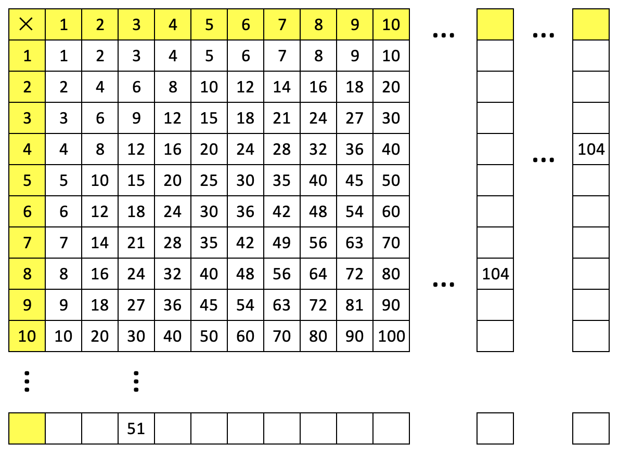
Checkpoint 2: Multiplication square
This is a multiplication square.
It’s been extended in each direction.
How many of the missing numbers can you fill in?
Create another column that could go in between the two extra columns given.
Notes:
This slide is animated. The further thinking question will appear separately so you can choose the pace at which to work with your class. A printable resource is provided on slide 78.
Answers
Row: yellow box = 17, then 17, 34, 51, 68, 85, 102, 119, 136, 153, 170 … 221 … 442
Column 1: yellow box =13, then 13, 26, 39, 52, 65, 78, 91, 104, 117, 130 … 221
Column 2: yellow box = 26, then 26, 52, 78, 104, 130, 156, 182, 208, 234, 260 … 442
? The first 10 multiples of any number between 13 and 26.
Suggested questioning
What do you notice about the two columns given?
What is the relationship between the number given and the row/column it is in?
What was your strategy? Could you work this out another way?
How did you use the 104 in each column to fill in the rest of the column?
Do you notice a relationship between the two 104s in the grid?
Things to think about
Checkpoint 2 does not ask students to complete the missing boxes in any particular order; the order they choose may reveal how flexibly they can think about multiplicative relationships, and how confidently they can calculate. Note that the dots here are used to represent an unknown number of missing columns/rows, in the same way they might be used later in Key Stages 3 and 4 to represent missing numbers or a continuing sequence. Clarify this notation with students and check that they have understood it in this context.

Slide 13
Checkpoint 2: Guidance
Adaptations | Assessing understanding
Support Share that 13 × 8 = 104, if this is preventing access to the reasoning element of the task. Or identify just one or two squares (for example, rows 4 and 2) to attempt first. Your scaffolding may influence their approaches. Challenge Challenge students to reason within/across columns. For example, if you only have the 9 and 10 columns, how can you work out the 18th column? The 19th column? The 38th? Representations The grid is a familiar representation, being used in an unfamiliar way. Students are taken beyond their known multiplication facts to see if they can reason multiplicatively. | The multiplication square is a familiar representation/context to show how students can reason and think with multiplicative relationships. Discuss and compare their strategies, listening for key language, such as multiple, factor, product, inverse. The value given in the first blank column is likely beyond students’ known multiplication facts. They may have some familiarity with the 13 times table, or they may deduce that they can divide 104 by 8. From this they might then reason that the first blank column is 13 × 1, then 13 × 2 and calculate each of these. Others might add the relevant multiples of 10 and 3. Look out for those who rely only on additive reasoning down the column – do they need more support to draw out the multiplicative relationships? Students might not complete the column or row in a linear order: they may identify that, if they halve 104, they can complete the fourth row of the grid. They might then halve 52 to complete the second row, or find the value halfway between 52 and 104 to complete the sixth row. Listen to their justifications: does this approach indicate an over-reliance on doubling and halving, or that they have a greater degree of flexibility with multiplicative reasoning? Check their approach to the blank row, where doubling might be useful but halving will not. In the second blank column, students may start from scratch, identifying that 26 × 4 = 104. The most secure may make the connection that one factor of 104 has been halved, so the other must be doubled.
Additional resources Secondary Mastery Professional Development | NCETM, Key idea 3.1.1.1 looks at ‘connecting any two numbers by multiplication’ and includes further examples using the multiplication square.

Slide 14
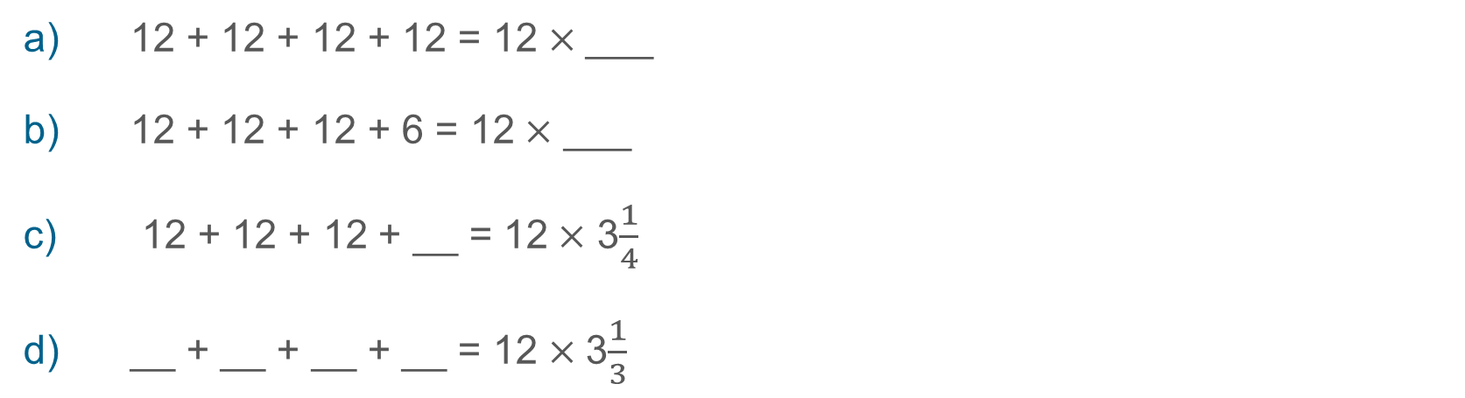
Checkpoint 3: Multiply 12
12 + 12 + 12 + 12 = 12$×$ ___
12 + 12 + 12 + 6 = 12$×$ ___
12 + 12 + 12 + __ = 12$×$ 3$\frac{1}{4}$
__ + __ + __ + __ = 12$×$ 3$\frac{1}{3}$
What other similar calculations can you write with ‘3 and a bit’ 12s?
Notes:
This slide is animated. Each question will appear separately so you can choose the pace at which to work with your class.
Answers
All answers are given as mixed numbers, with the fractional part in its simplest form. Equivalent fractional or decimal answers are also valid.
a) 12 + 12 + 12 + 12 = 12 × 4
b) 12 + 12 + 12 + 6 = 12 × 3$\frac{1}{2}$
c) 12 + 12 + 12 + 3 = 12 × 3$\frac{1}{4}$
d) 12 + 12 + 12 + 4 = 12 × 3$\frac{1}{3}$
? Any valid statement in the pattern 12 + 12 + 12 + n = 12 × 3$\frac{n}{12}$, for example12 + 12 + 12 + 2 = 12 × 3$\frac{1}{6}$
Suggested questioning
What is the same and what is different about each product?
What fraction of 12 is being added when you add 6? How about 4 or 3? How can this help you write the product?
Could any number be used as the fourth number in the addition? Why?
Could you use these to write any other calculations?
Things to think about
Checkpoints 3, 4 and 5 all explore the concept that any two numbers can be connected multiplicatively, using different representations to give students a variety of opportunities to share their understanding. While the concept of connecting any two numbers multiplicatively may feel like a ‘scaling’ view of multiplication, students may be more familiar with repeated addition from primary school. Checkpoint 3 builds on this structure of multiplication and should help you to gauge how readily students will work with non-integer multipliers.

Slide 15
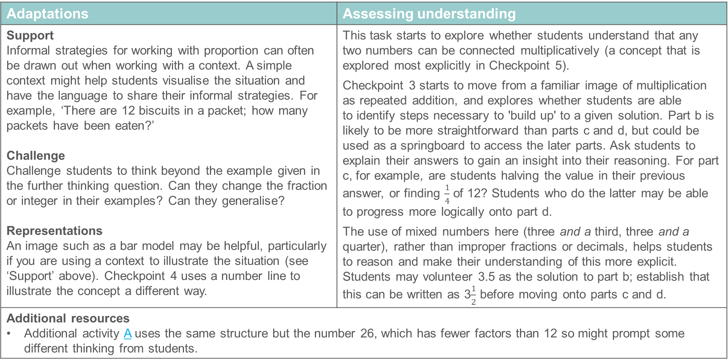
Checkpoint 3: Guidance
Adaptations | Assessing understanding
Support Informal strategies for working with proportion can often be drawn out when working with a context. A simple context might help students visualise the situation and have the language to share their informal strategies. For example, ‘There are 12 biscuits in a packet; how many packets have been eaten?’ Challenge Challenge students to think beyond the example given in the further thinking question. Can they change the fraction or integer in their examples? Can they generalise? Representations An image such as a bar model may be helpful, particularly if you are using a context to illustrate the situation (see ‘Support’ above). Checkpoint 4 uses a number line to illustrate the concept a different way. | This task starts to explore whether students understand that any two numbers can be connected multiplicatively (a concept that is explored most explicitly in Checkpoint 5). Checkpoint 3 starts to move from a familiar image of multiplication as repeated addition, and explores whether students are able to identify steps necessary to 'build up' to a given solution. Part b is likely to be more straightforward than parts c and d, but could be used as a springboard to access the later parts. Ask students to explain their answers to gain an insight into their reasoning. For part c, for example, are students halving the value in their previous answer, or finding $\frac{1}{4}$ of 12? Students who do the latter may be able to progress more logically onto part d. The use of mixed numbers here (three and a third, three and a quarter), rather than improper fractions or decimals, helps students to reason and make their understanding of this more explicit. Students may volunteer 3.5 as the solution to part b; establish that this can be written as 3$\frac{1}{2}$ before moving onto parts c and d.
Additional resources Additional activity A uses the same structure but the number 26, which has fewer factors than 12 so might prompt some different thinking from students.

Slide 16
Checkpoint 4: Products of 8
The arrows point to the products. What are the missing values?
16
17
18
19
20
21
22
23
24
a)
8 × __
c)
8 × __
b)
8 × __
d)
8 × __
e)
8 × __
8 × __
Notes:
This slide is animated. The further thinking question will appear separately so you can choose the pace at which to work with your class.
Answers
All answers are given as mixed numbers, with the fractional part in its simplest form. Equivalent fractional or decimal answers are also valid.
a) 8 × 2 = 16
b) 8 × 3 = 24
c) 8 × 2$\frac{1}{2}$= 20
d) 8 × 2$\frac{3}{4}$= 22
e) 8 × 2$\frac{1}{8}$= 17
? 8 × 2$\frac{5}{16}$= 18$\frac{1}{2}$
Suggested questioning
How can you multiply 8 by a number and a get a result that is not in the 8 times table?
How can you use the number line to help you?
How will you write your missing multiplier? Is there more than one way to do this? Is one way more helpful than the other?
Things to think about
As with Checkpoint 3, Checkpoint 4 looks at non-integer multipliers. This time, a number line representation helps students explore the structure. Consider the progression of questions, and what they reveal about students’ understanding. If students struggle to recognise the familiar fraction of three-quarters in part d, for example, it might be that there is little point continuing to part e immediately. Instead, this task could be revisited once students have received more teaching.

Slide 17
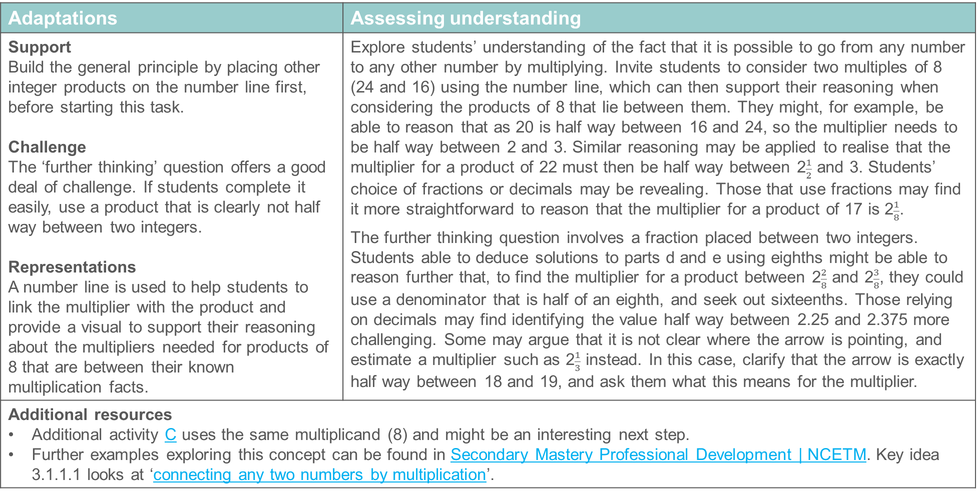
Checkpoint 4: Guidance
Adaptations | Assessing understanding
Support Build the general principle by placing other integer products on the number line first, before starting this task. Challenge The ‘further thinking’ question offers a good deal of challenge. If students complete it easily, use a product that is clearly not half way between two integers. Representations A number line is used to help students to link the multiplier with the product and provide a visual to support their reasoning about the multipliers needed for products of 8 that are between their known multiplication facts. | Explore students’ understanding of the fact that it is possible to go from any number to any other number by multiplying. Invite students to consider two multiples of 8 (24 and 16) using the number line, which can then support their reasoning when considering the products of 8 that lie between them. They might, for example, be able to reason that as 20 is half way between 16 and 24, so the multiplier needs to be half way between 2 and 3. Similar reasoning may be applied to realise that the multiplier for a product of 22 must then be half way between 2$\frac{1}{2}$ and 3. Students’ choice of fractions or decimals may be revealing. Those that use fractions may find it more straightforward to reason that the multiplier for a product of 17 is 2$\frac{1}{8}$. The further thinking question involves a fraction placed between two integers. Students able to deduce solutions to parts d and e using eighths might be able to reason further that, to find the multiplier for a product between 2$\frac{2}{8}$ and 2$\frac{3}{8}$, they could use a denominator that is half of an eighth, and seek out sixteenths. Those relying on decimals may find identifying the value half way between 2.25 and 2.375 more challenging. Some may argue that it is not clear where the arrow is pointing, and estimate a multiplier such as 2$\frac{1}{3}$ instead. In this case, clarify that the arrow is exactly half way between 18 and 19, and ask them what this means for the multiplier.
Additional resources Additional activity C uses the same multiplicand (8) and might be an interesting next step. Further examples exploring this concept can be found in Secondary Mastery Professional Development | NCETM. Key idea 3.1.1.1 looks at ‘connecting any two numbers by multiplication’.

Slide 18


Checkpoint 5: True or false?
Najma says, ‘Write any numbers you like in the blue boxes, and I’ll be able to write a number in the red box so that the multiplication is correct.’
$$×$$
$$=$$
Is Najma correct? Give some examples to support your answer.
Would Najma be correct if the multiplication symbol was a division symbol? Why or why not?
Notes:
This slide is animated. The further thinking question will appear separately so you can choose the pace at which to work with your class.
Answers
Najma is correct, except for a situation where 0 is put in the first blue box and any number except for 0 is used as the product (e.g. 0 $×$ ? = 3 would not work). Otherwise, it is possible to go from any number to any other number by multiplying. If the blue boxes are not connected by an integer multiplication, Najma could use decimals or fractions to complete the red box. For example, 2$×$ 1.5 = 3 or 12$× \frac{12}{13}$ = 13.
? Yes, Najma would still be correct. Division is the inverse of multiplication, so both operations are based on the same mathematical structure.
Suggested questioning
‘__ isn’t in the multiplication tables, so I definitely can’t use that as my product.’ Is this true or false?
Is your red number an integer? How do you know?
If it isn’t an integer, will you think in fractions or decimals? Why?
Are some multipliers easier to think of as either fractions or decimals? Why?
Things to think about
Checkpoint 5 continues the theme of connecting any two numbers multiplicatively, this time offering a more open structure for students to explore. An interesting point to consider here is when to intervene if students only offer numbers that require an integer in the red box, or state that Najma is incorrect. It will be worth planning ahead what counter-examples or prompts you will use to illustrate that Najma is correct, and how you will use these to gauge whether students do not understand the concept at all, or just do not have the fluency to suggest examples that work.

Slide 19
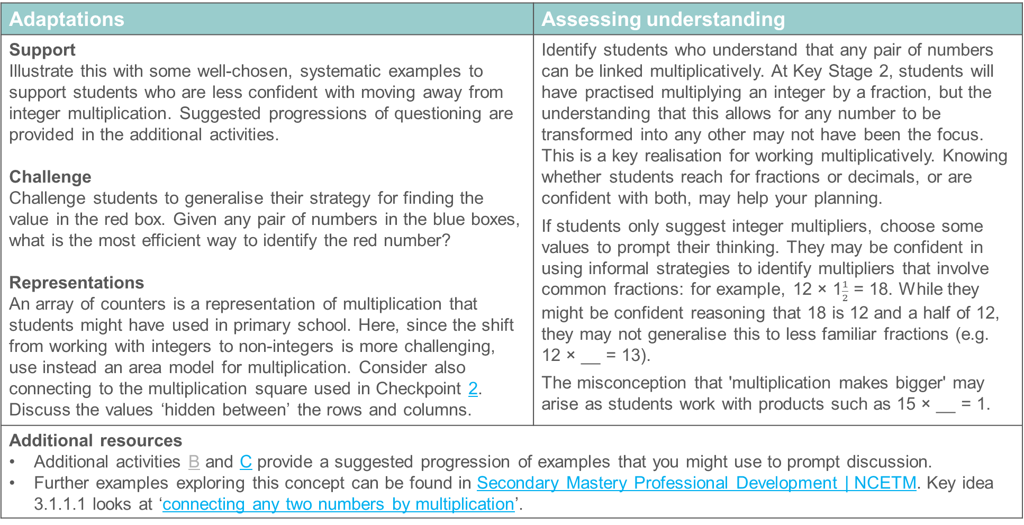
Checkpoint 5: Guidance
Adaptations | Assessing understanding
Support Illustrate this with some well-chosen, systematic examples to support students who are less confident with moving away from integer multiplication. Suggested progressions of questioning are provided in the additional activities. Challenge Challenge students to generalise their strategy for finding the value in the red box. Given any pair of numbers in the blue boxes, what is the most efficient way to identify the red number? Representations An array of counters is a representation of multiplication that students might have used in primary school. Here, since the shift from working with integers to non-integers is more challenging, use instead an area model for multiplication. Consider also connecting to the multiplication square used in Checkpoint 2. Discuss the values ‘hidden between’ the rows and columns. | Identify students who understand that any pair of numbers can be linked multiplicatively. At Key Stage 2, students will have practised multiplying an integer by a fraction, but the understanding that this allows for any number to be transformed into any other may not have been the focus. This is a key realisation for working multiplicatively. Knowing whether students reach for fractions or decimals, or are confident with both, may help your planning. If students only suggest integer multipliers, choose some values to prompt their thinking. They may be confident in using informal strategies to identify multipliers that involve common fractions: for example, 12 × 1$\frac{1}{2}$ = 18. While they might be confident reasoning that 18 is 12 and a half of 12, they may not generalise this to less familiar fractions (e.g. 12 × __ = 13). The misconception that 'multiplication makes bigger' may arise as students work with products such as 15 × __ = 1.
Additional resources Additional activities B and C provide a suggested progression of examples that you might use to prompt discussion. Further examples exploring this concept can be found in Secondary Mastery Professional Development | NCETM. Key idea 3.1.1.1 looks at ‘connecting any two numbers by multiplication’.

Slide 20
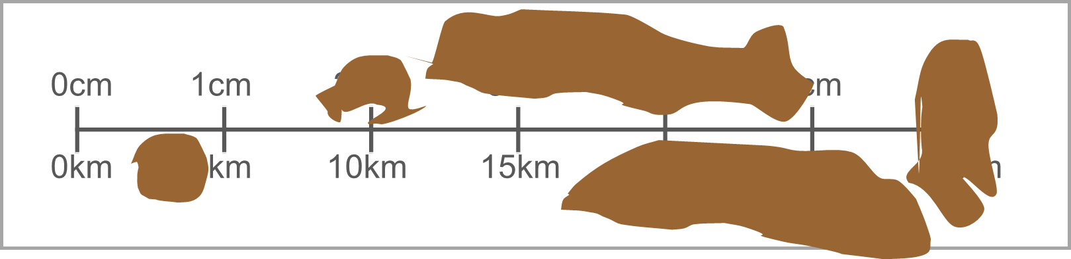
Checkpoint 6: Muddy map
Bennie is out hiking. His map got muddy so he can’t read all of the scale!
Fill in the missing numbers.
Bennie measures that his campsite is 5 cm away on the map. How many kilometres will he need to walk to get there?
He plans to stop at a church that is 10 km away. How many centimetres will this be on the map?
Bennie knows that the nearest town is 40 km away from the church. How many centimetres will this be on the map?
Bennie walks along a path that is 4 km long. How many centimetres will this be on the map?
Bennie can walk at a pace of 6 km per hour. How long will it take him to walk each of the routes in parts b) to e)?
Notes:
This slide is animated. Each question will appear separately so you can choose the pace at which to work with your class. Printable resources are available on slides 79 (this scale) and 80 (a blank scale so you can change the values if required).
Answers
a) Top row: 0 cm, 1 cm, 2 cm, 3 cm, 4 cm, 5 cm, 6 cm. Bottom row: 0 km, 5 km, 10 km, 15 km, 20 km, 25 km, 30 km
b) 25 km
c) 2 cm
d) 8 cm
e) 0.8 cm
? b) 25 km would take 4 hours 10 minutes (or 250 minutes).
c) 10 km would take 1 hour 40 minutes (or 100 minutes).
d) 40 km would take 6 hours 40 minutes (or 400 minutes).
e) 4 km would take 40 minutes.
Suggested questioning
What do you notice about how each part of the number line steps up?
What do you notice about the relationship between the ‘matching’ numbers on the number line?
How did you work out your answer to part __? Did you use the number line or a different strategy?
Is there more than one way to do this?
Can you use any of your answers to help with other answers?
Things to think about
Throughout this deck, there are Checkpoints where a double number line representation may be a useful, if not familiar, representation. Students may not have seen them in an abstract mathematical context, but they are more likely to be aware of a double number line used as a scale on a map, as here. The numbers here are straightforward (1 cm to 5 km), and so a blank printable version is also provided (see slide 80) if you wish to assess if students are able to work with more challenging relationships.

Slide 21
Checkpoint 6: Guidance
Adaptations | Assessing understanding
Support Model the double number line on squared paper (with 5 squares between 0 and 1) to help students use counting up to understand the connection between the values. Labelling the printable version of the line may also help. Challenge The further thinking question introduces speed – a further multiplicative relationship. Ask students to compare Bennie’s speed to a different speed. Representations The double number line here is used in the context of a map, rather than as a standalone representation. The values are straightforward in case students are unfamiliar; an editable printable version is also available. | This checkpoint explores whether students can complete and use a double number line, to support future planning and gauge how readily students might be able to use them for multiplicative reasoning. (Students should have experience of maps from geography, although scales are not specifically mentioned in the national curriculum.) From part b onwards, students use the double number line to reason about distances on the map and in real life. These questions build from using the markings on the double number line, to values beyond the number line, and finally to values that are between the markings on the number line. Pay attention to whether students use the line to support their reasoning, or if they have a different strategy. Students may notice that they can work between questions – for example, that their answer to part e needs to be ten times smaller than their answer to part d. This indicates a greater depth of understanding.
Additional resources Within Primary Mastery Professional Development | NCETM, Teaching Point 3 of Scale factors, ratio and proportional reasoning | NCETM explores using scales for maps; Key Idea 3.1.2.1 Representing multiplicative relationships using double number lines gives more on double number lines. An example of a map scale can be found in the Key Stage 2 SATs papers: 2017 Paper 2 (reasoning) question 21. Past papers can readily be found online.

Slide 22
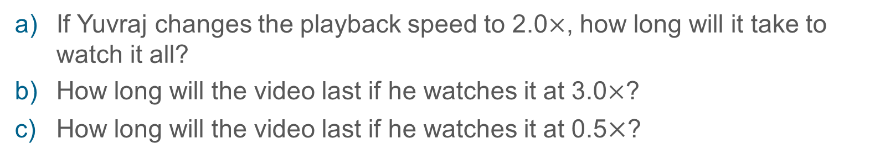
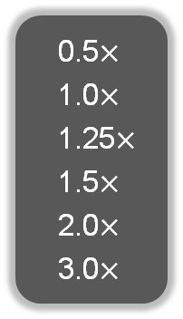
Checkpoint 7: Playback
Share >
Playback Speed >
Yuvraj is watching a video.
The video is 60 minutes long when watched at the normal speed.
Playback Speed >
  0.5$×$
  1.0$×$
  1.25$×$
  1.5$×$
  2.0$×$
  3.0$×$

If Yuvraj changes the playback speed to 2.0$×$, how long will it take to watch it all?
How long will the video last if he watches it at 3.0$×$?
How long will the video last if he watches it at 0.5$×$?
If the video lasted 40 minutes, what playback speed did he choose? How do you know?
Notes:
This slide is animated. Each question will appear separately so you can choose the pace at which to work with your class.
Answers
a) 30 minutes
b) 20 minutes
c) 120 minutes or 2 hours
? 1.5× Students may reason that this is because 40 minutes is between 30 minutes (2.0× playback speed) and 60 minutes (1.0× playback speed), but that 1.25× playback speed would be closer to the original 60 minutes.
Suggested questioning
What happens when you increase the playback speed?
Complete the sentence: As the playback speed increases, the time taken _____.
Why does a one-minute video played at 1.5× not take 45 seconds?
What do you notice about your pattern of answers for the ‘?’ question?
Things to think about
Checkpoint 7 uses a familiar context – video playback speed – to explore students’ reasoning with proportional relationships. Consider modelling the different playback speeds using a short video in class, if this would help students to understand the problem more completely.

Slide 23
Checkpoint 7: Guidance
Adaptations | Assessing understanding
Support If the context of the problem is challenging, use a context such as a race or a car journey to make the task more accessible. Consider scaffolding the final part of the task, maybe by considering the 0.5× playback speed. Challenge The further thinking question suggests that students work with the other possible playback speeds. Challenge students by setting the required playback time – for example, if I want to watch the whole video in one minute, what would they playback speed need to be? How about if I want it to last precisely 59 minutes? Representations Students are likely to reason informally with this context. Capturing their reasoning symbolically (for example, identifying that playing at 2.0× means that the video will last for ½ × 60 minutes, and playing it at 3.0× means that it will last for ⅓ × 60 minutes) may support them in moving toward a more formal mathematical understanding. | Checkpoint 7 uses a familiar context to give students an opportunity to reason with inverse proportion. Students are unlikely to have met proportion or inverse proportion formally in maths lessons, but the concept may be familiar through their lived experience. They should understand, for example, that playing the video at double speed means that it will last for half as long. The intention is to offer a context to take this reasoning further and to explore the possible outcomes. Gauge how readily students are able to reason with proportion and plan to introduce this concept more formally if necessary. The main part of the task is relatively straightforward, although students who are less confident with units of time may find it harder to identify a third of an hour. The further thinking question tackles the common misconception is that 1.5× speed is half way between 1× and 2×. It is structured so that the time is given rather than the speed and students can reason between the options available.
Additional resources Pages 32-34 of Secondary Assessment Materials | NCETM offer some examples of proportion for teaching at Key Stage 3.

Slide 24
Checkpoint 8: Pie charts
Samira records the different ways that students travel to school. She records her results in a pie chart.
Which of these are possible tables for her pie chart? Why?
C
W
C
W
 | Walk
 | Bike
 | Bus
 | Car
A
5 | Walk
5 | Bike
2 | Bus
3 | Car
B
4 | Walk
4 | Bike
2 | Bus
6 | Car
C
6 | Walk
6 | Bike
2 | Bus
8 | Car
C
Bi
Bu
Bi
If Samira recorded 40 children in total, what would the values for each type of transport be?
One of Samira’s sectors represents three children. What could the total number of students in her survey be? How do you know?
Notes:
This slide is animated. Each question, and each individual table, will appear separately so you can choose the pace at which to work with your class.
Answers
a) The only possible table is B. This is because it is the only set of values in the right proportion, where the value for walk/bike is twice the value for bus, and the value for car is three times the value of bus.*
b) Walk 10, bike 10, bus 5, car 15.
*If you ask the suggested question about changing the values in the table to be possible, the solutions could be:
A: Keep bus as 2 but change walk/bike to 4 and car to 6. Keep car as 3 but change walk/bike to 2 and bus to 1. It is not possible to create a table with a value of 5 for walk/bike .
C: Keep bus as 2 but change walk/bike to 4 and car to 6. It is not possible to create a table with a value of 6 for walk/bike or a value of 8 for car.
? If ‘bus’ represented 3 children, then the total number of students would be 24 (walk 6, bike 6, bus 3, car 9). If ‘car’ represented 3 children, then the total number of students would be 8 (walk 2, bike 2, bus 1, car 3). If ‘walk’ or ‘bike’ represented 3, then ‘bus’ would have a value of 1.5 children, which is not possible. So the two possible total numbers of students in the survey are 8 or 24.
Suggested questioning
What can you tell me about the pie chart?
What was the most common mode of transport? What was the least?
How could you change the tables so that they are all possible?
Things to think about
Checkpoint 8 uses the context of pie charts, which are likely to be familiar from primary school, to consider the relationship between different parts of a whole. It may be worth reflecting with your department about when and how pie charts are currently taught within your KS3 curriculum. Are proportional relationships at the centre of your approach? Are there explicit links to work on fractions and ratio?

Slide 25
Checkpoint 8: Guidance
Adaptations | Assessing understanding
Support Show just one table and ask students whether it is possible, or what they would change. Alternatively, model generating your own tables by drawing on different values in the eighths shown on the pie chart (for example, ‘What would the blue sector be worth if each eighth represents one person? How about 2?’). Challenge Ask students to amend the incorrect tables (answers are provided for this). You could also ask students to sketch the pie charts for the incorrect tables. How accurately can they do this? Representations A pie chart is used, which students are likely to have encountered in mathematics in year 6. They are also likely to have used a circle to represent a whole as a representation for fractions. | Checkpoint 8 explores proportional relationships in the context of a pie chart. Rather than asking students to identify what each sector represents, they will identify which set of values is possible. This is to encourage them to think multiplicatively, and to consider the relationships both between the different fractions of the circle and the different values in the tables. Reflect on the approaches your students take. Do they do basic ‘sense checks’ such as looking to see whether the biggest (yellow) sector has the biggest value in the table? Do they look at the relationships between sectors, for example checking that the values for the blue/green sectors are twice the value of the orange sector, or that the yellow is three times the orange? Part b explores how students break down a total amount into the proportions given. Note whether students divide this into eight parts, or if they start with quarters and then find it more challenging to tackle the yellow and orange sectors. It may also be interesting to see whether students explicitly use the language and notation of fractions here, without being prompted to do so.
Additional resources For an example of the kind of questions that might be asked about pie charts, see p25 and p37 of the Year 6 Primary Assessment Materials | NCETM

Slide 26



Checkpoint 9: What’s best?
Which of the two offers below is better?
Explain why you think it’s better.
Is the multipack below a better offer?
Is it better than both the others, or just one?
Explain why you think this.
2 for £3
3 for 2
3 for £4
Popcorn Multipack
6 × 16 g
£1.70
Large Popcorn
180 g
£2.00
Regular Popcorn
60 g
£0.75
£1.78/100g
£1.11/100g
£1.25/100g
Notes:
This slide is animated. The multibuy offers (in the red boxes) will appear separately so you can choose whether to reveal these to your class with the rest of the information. The further thinking question will also appear separately.
Answers
These answers are not exhaustive. For more about the potential justifications, see the Guidance slide.
Students might choose large popcorn as it is cheaper per 100 g (£1.11 vs £1.25).
Students might choose regular popcorn as, if you buy three packets, the ‘3 for 2’ deal means it’s £1.50 for 180 g. This is cheaper than large popcorn at £2.00 for 180 g.
Students might suggest both are the same value, as 360 g has a value of £3 (once the multi-buy offers are applied).
? Students may argue that it is a worse deal than both of the original offers, as it is a higher cost per 100 g. Alternatively, students may argue that having individual bags is more useful in some situations, for example packing lunchboxes for a family. In this case, the ‘3 for £4’ deal means that you can get 18 individual bags for £4, but it would cost £9 to buy 18 individual regular popcorn bags.
Suggested questioning
How can you compare these?
How can you make something the same to help you compare?
Does which one is best change when you include the deal marked in red?
Is it always fair to compare different packets of snacks?
Is there a reason why you might choose the more expensive snack?
Things to think about
Checkpoint 9 is one of the more open tasks, with the intention being that students have lots of different options to demonstrate their comparisons and reasoning rather than there being one right answer. Students are likely to have seen some examples of ‘best buy’ type problems before, but these may have been more limited. For this reason, the details for each product have been given in textboxes rather than as an image, so that you can choose to remove some information if you feel it would be best for your class.

Slide 27
Checkpoint 9: Guidance
Adaptations | Assessing understanding
Support Reduce the amount of information by hiding or removing the multibuy offers (and the price per 100 g given in grey). Challenge Ask students to create their own best buy situations, particularly one where the inclusion of a multibuy offer changes which product is best. Representations Write lists of multiples of packet weights against costs – for example, model how many 60 g packets would be needed for 180 g, and how the cost would increase in multiples of 75 p. Students are unlikely to formalise these into a double number line (comparing cost with weight) but this may be a natural next step for this representation. | Checkpoint 9 offers a familiar context for students to work informally with rates to compare and find the best value. It is a deliberately open task, to allow students to bring their own reasoning to it. Key to this task is the understanding that one element needs to be the same to make a comparison. Look for the different types of comparison used by students. Some might choose to use the cost per 100 g, or calculate a similar weight comparison, whilst others might think about the weight bought for a specific value such as £1. The multibuy offers add further complexity, and you may choose to hide these or reveal them separately. The further thinking question also adds potential for non-mathematical reasoning by offering many more bags, although at a lower weight. Ask students for a context in which each of the offers could be considered 'the best' for that situation. Some students might place their value elsewhere, and consider the price per bag as this makes sharing equally with friends easier. Or they might reason that, if there are three siblings in the house, then having more smaller bags is more convenient. Ask students to justify when each offer is 'the best’.
Additional resources Some of the thinking that students might need to access this problem can also be found in the Key Stage 2 SATs papers (e.g. 2017 Paper 2 (reasoning) questions 12 and 14). Past papers can readily be found online.

Slide 28
Fractions as an example of multiplicative relationships
Checkpoints 10–17

Slide 29
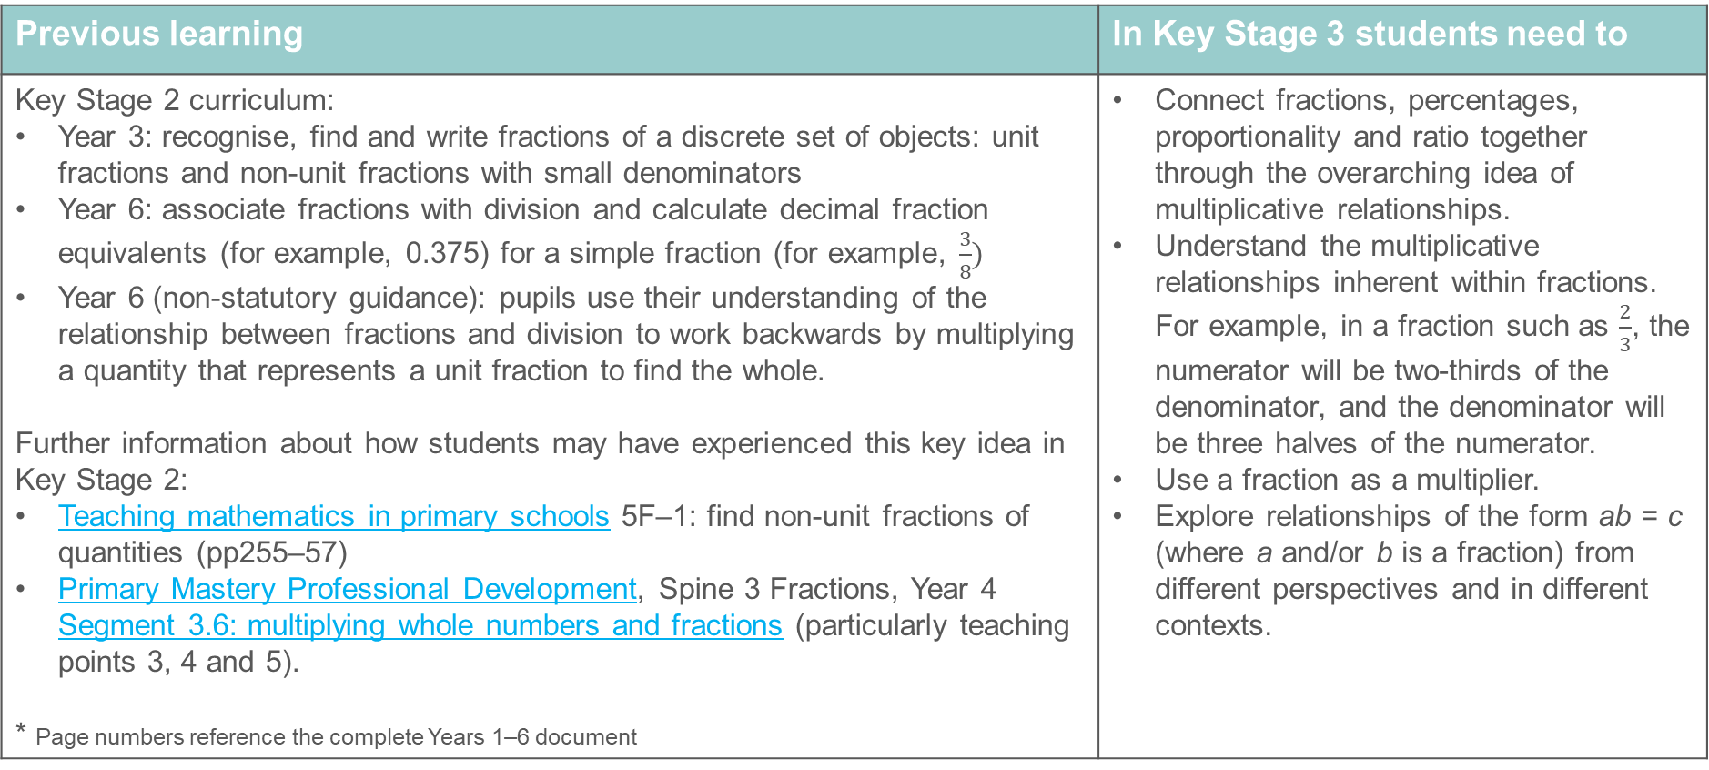
Fractions as an example of multiplicative relationships
Previous learning | In Key Stage 3 students need to
Key Stage 2 curriculum: Year 3: recognise, find and write fractions of a discrete set of objects: unit fractions and non-unit fractions with small denominators Year 6: associate fractions with division and calculate decimal fraction equivalents (for example, 0.375) for a simple fraction (for example, $\frac{3}{8})$ Year 6 (non-statutory guidance): pupils use their understanding of the relationship between fractions and division to work backwards by multiplying a quantity that represents a unit fraction to find the whole. Further information about how students may have experienced this key idea in Key Stage 2: Teaching mathematics in primary schools 5F–1: find non-unit fractions of quantities (pp255–57) Primary Mastery Professional Development, Spine 3 Fractions, Year 4 Segment 3.6: multiplying whole numbers and fractions (particularly teaching points 3, 4 and 5). * Page numbers reference the complete Years 1–6 document | Connect fractions, percentages, proportionality and ratio together through the overarching idea of multiplicative relationships. Understand the multiplicative relationships inherent within fractions. For example, in a fraction such as $\frac{2}{3}$, the numerator will be two-thirds of the denominator, and the denominator will be three halves of the numerator. Use a fraction as a multiplier. Explore relationships of the form ab = c (where a and/or b is a fraction) from different perspectives and in different contexts.
Notes:
This slide is animated. Each question will appear separately so you can choose the pace at which to work with your class.
Answers
a)
Suggested questioning
What
Things to think about

Slide 30
Checkpoint 10: Splitting bars
Choose a fraction to complete each sentence.
This bar is split into equal parts.
___ of the whole bar is white.
___ of the whole bar is grey.
This bar is also split into equal parts.
___ of the whole bar is white.
___ of the whole bar is grey.
One bar is stretched and the other squashed.
Would your answers to parts a) to d) change?
Complete these sentences for each bar:
The grey is ___ of the white. The white is ___ of the grey.
Notes:
This slide is animated. Each question will appear separately so you can choose the pace at which to work with your class.
Answers
a) $\frac{3}{5}$ of the whole bar is white.
b) $\frac{2}{5}$ of the whole bar is grey.
c) $\frac{6}{10}$(or $\frac{3}{5}$) of the whole bar is white.
d) $\frac{4}{10}$(or $\frac{2}{5}$) of the whole bar is grey.
e) No, the proportions remain the same.
? The grey is $\frac{2}{3}$ of the white. The white is $\frac{3}{2}$ of the grey. This is the same for all of the bars given, although students might suggest equivalent fractions such as $\frac{4}{6}$ and $\frac{6}{4}$.
Suggested questioning
What do you notice about your pairs of numerators?
What does the denominator represent?
What is the same/different about your answers to a/b and c/d?
What is the same/different about the bars in part e, compared with the first two bars?
Things to think about
Checkpoint 10 is the first in a set of tasks that deal more explicitly with fractions as multiplicative relationships. When students work through a series of questions, they don’t always stop to consider the connection between them. Do your students notice that their answers to a/b are the same as c/d, and that they remain unchanged for e? If not, how will you draw their attention to this?

Slide 31
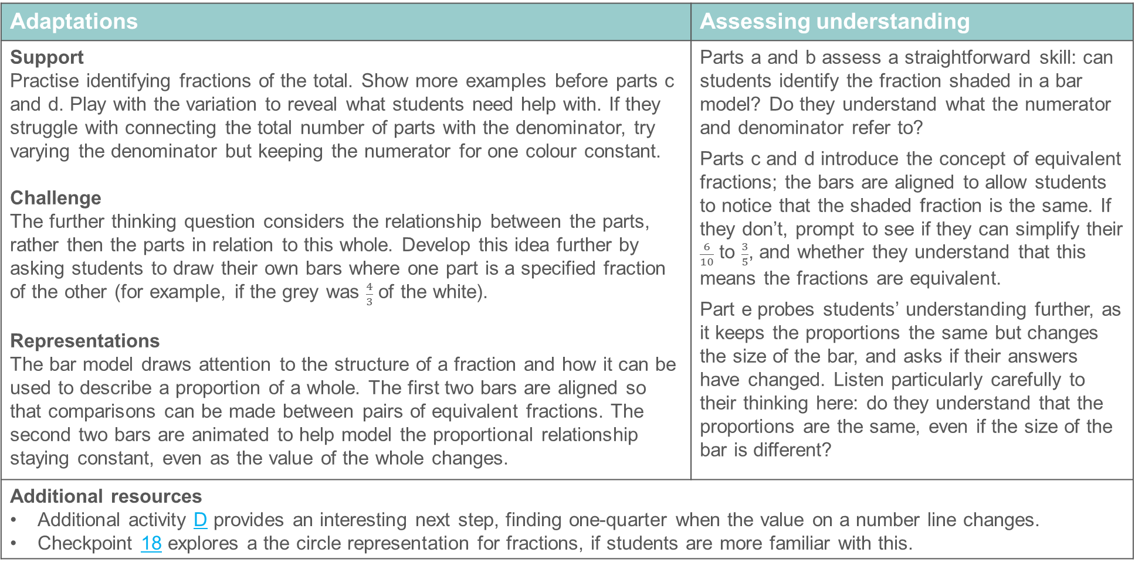
Checkpoint 10: Guidance
Adaptations | Assessing understanding
Support Practise identifying fractions of the total. Show more examples before parts c and d. Play with the variation to reveal what students need help with. If they struggle with connecting the total number of parts with the denominator, try varying the denominator but keeping the numerator for one colour constant. Challenge The further thinking question considers the relationship between the parts, rather then the parts in relation to this whole. Develop this idea further by asking students to draw their own bars where one part is a specified fraction of the other (for example, if the grey was $\frac{4}{3}$ of the white). Representations The bar model draws attention to the structure of a fraction and how it can be used to describe a proportion of a whole. The first two bars are aligned so that comparisons can be made between pairs of equivalent fractions. The second two bars are animated to help model the proportional relationship staying constant, even as the value of the whole changes. | Parts a and b assess a straightforward skill: can students identify the fraction shaded in a bar model? Do they understand what the numerator and denominator refer to? Parts c and d introduce the concept of equivalent fractions; the bars are aligned to allow students to notice that the shaded fraction is the same. If they don’t, prompt to see if they can simplify their $\frac{6}{10}$ to $\frac{3}{5}$, and whether they understand that this means the fractions are equivalent. Part e probes students’ understanding further, as it keeps the proportions the same but changes the size of the bar, and asks if their answers have changed. Listen particularly carefully to their thinking here: do they understand that the proportions are the same, even if the size of the bar is different?
Additional resources Additional activity D provides an interesting next step, finding one-quarter when the value on a number line changes. Checkpoint 18 explores a the circle representation for fractions, if students are more familiar with this.

Slide 32
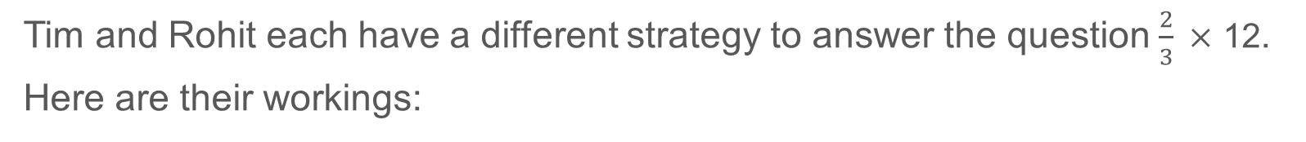
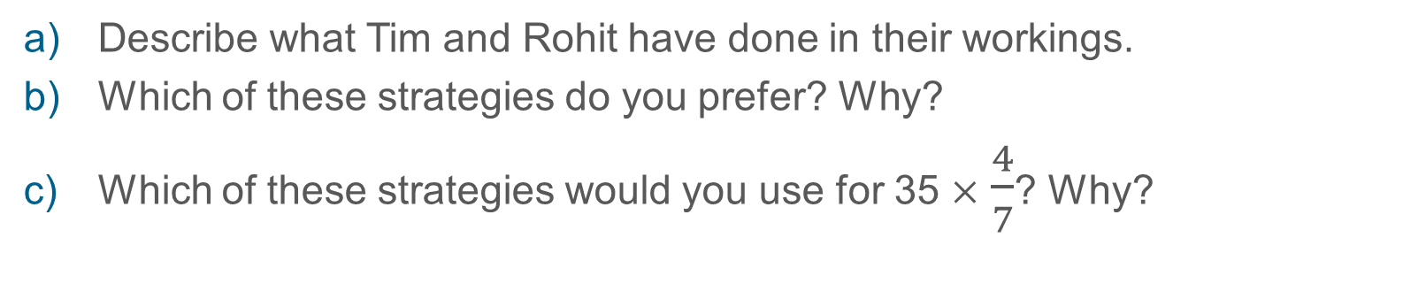
Checkpoint 11: Strategies
Tim and Rohit each have a different strategy to answer the question $\frac{2}{3} ×$ 12.
Here are their workings:
Tim
12 ÷ 3 = 4
4 × 2 = 8
Rohit
2
3
12
1
=
24
3
=
8
1
×
Describe what Tim and Rohit have done in their workings.
Which of these strategies do you prefer? Why?
Which of these strategies would you use for 35 $×$ $\frac{4}{7}$? Why?
These are Gavinder’s workings. Explain what she has done. When might you use her strategy?
12 ÷ 3 = 4
12 - 4 = 8
Notes:
This slide is animated. Each question will appear separately so you can choose the pace at which to work with your class.
Answers
a) Tim has divided the total by the denominator (3) and then multiplied by the numerator (2). Rohit has written 12 as a fraction by giving it a denominator of 1, and then multiplied the numerator of the multiplicand by the numerator of the multiplier (and the same for the pair of denominators). He has then simplified his fraction to be an integer.
b) Students’ responses to this may vary according to their experience and confidence with either method. Justifications for Tim’s method might include its simplicity and the fact that starting with a division means that you are multiplying smaller values in the second step. Justifications for Rohit’s method might include its connection to multiplying two fractions (and therefore only having to recall one process).
c) Again, students’ responses may vary. There is a potential that Tim’s method might be preferred by the majority, as the first step would be 35 $÷$ 7, which uses known multiplication facts, instead of 35 $×$ 4, which goes beyond 12 $×$ 12.
? Gavinder has found $\frac{1}{3}$ of 12 and then subtracted this from 12. This might be a useful strategy when the fraction is close to one whole, particularly when it is exactly one unit fraction from the whole.
Suggested questioning
What steps has each person done? Why?
Do you use either or both of these strategies? If you use both, when do you choose to use each one? If you use neither, what do you do instead?
Which is clearest to you?
Things to think about
Checkpoint 11 is one of the more closed Checkpoints: it focuses specifically upon the strategies that students use when multiplying integers by fractions, modelling two of the likely processes that students may have experienced. If students are not familiar with either Tim or Rohit’s strategies, consider when you might introduce them. Do you think they both equally important for students to understand?

Slide 33
Checkpoint 11: Guidance
Adaptations | Assessing understanding
Support Focus first on one of the strategies. Write the method ‘live’, rather then showing the whole method. Ask students to describe what is happening and where the values have come from. Challenge Ask students to create questions where each of the three methods might be the most useful, and to generalise about each: for example, when might Gavinder’s workings be most efficient? Representations This Checkpoint explores written methods and as such focuses on abstract representations of the mathematics: students might find a bar model useful to explain Tim or Gavinder’s workings. Rohit’s workings may be less supported by a visual representation: although an area model could be used, it is less likely that students will have seen this at primary school. | The two examples suggest strategies that students might have experienced – Tim’s ‘divide by the denominator and multiply by the numerator’ and Rohit’s ‘write the integer as a fraction and multiply’. Assess whether students are aware of one or both strategies, and whether they have a preference. Part c and the further thinking question assess whether the numbers involved might lead students towards a more efficient strategy, rather than using the same strategy every time. In part c, check whether students recognise the commutativity of multiplication when one of the values is a fraction. If students do not recognise either strategy, don’t dwell on explanations at this stage – rather, this should be useful information for planning how to introduce multiplication of fractions or finding fractions of an amount. In this case, move on to a more visual checkpoint, such as Checkpoint 14 (bars).
Additional resources Year 6 Primary Assessment Materials | NCETM bottom rows of p21 explore methods for finding fractions of an amount. To find representations and language students may be familiar with, Topic 3.6 Multiplying whole numbers and fractions | NCETM and Topic 3.9 Multiplying fractions and dividing fractions by a whole number | NCETM from Primary Mastery Professional Development | NCETM.

Slide 34
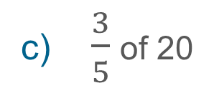
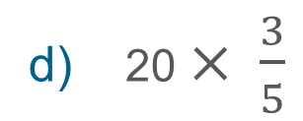
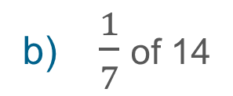
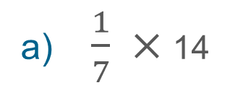
Checkpoint 12: Same and different calculations
Use a strategy of your choice to calculate:
$\frac{1}{7} ×$ 14
$\frac{1}{7}$of 14
$\frac{3}{5}$of 20
20 $× \frac{3}{5}$
What is the same and what is different about the calculations?
What was the same and different about your strategies?
Write a worded question for each calculation.
Notes:
This slide is animated. Each question will appear separately so you can choose the pace at which to work with your class.
Answers
a) 2
b) 2
c) 12
d) 12
e) The questions are in matching pairs: a and b ask the same thing, as do c and d.
f) Students’ answers will vary depending on their understanding of the situation: they might use the same approach for each pair of questions or have a different approach for questions written using the word ‘of’ instead of a multiplication symbol (see ‘Assessing understanding’ on the Guidance slide for more information).
? Any valid worded context. Students may choose the same contexts for the matching questions.
Suggested questioning
Which of these questions did you find the easiest? Why?
Which of the questions have the same answer?
Did you use the same strategy for the pairs of questions with the same answer? Why or why not?
Things to think about
Like Checkpoint 11, Checkpoint 12 is a relatively closed task addressing whether students recognise the equivalence of fraction multiplication and finding fractions ‘of’ an amount. Consider the order in which you might use Checkpoints 11 and 12: is there a benefit to exploring the strategies for solving the problems before comparing different ways that the problems might be expressed?

Slide 35
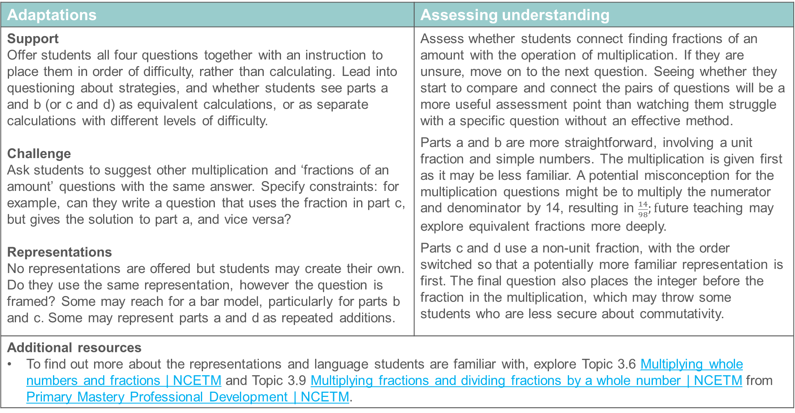
Checkpoint 12: Guidance
Adaptations | Assessing understanding
Support Offer students all four questions together with an instruction to place them in order of difficulty, rather than calculating. Lead into questioning about strategies, and whether students see parts a and b (or c and d) as equivalent calculations, or as separate calculations with different levels of difficulty. Challenge Ask students to suggest other multiplication and ‘fractions of an amount’ questions with the same answer. Specify constraints: for example, can they write a question that uses the fraction in part c, but gives the solution to part a, and vice versa? Representations No representations are offered but students may create their own. Do they use the same representation, however the question is framed? Some may reach for a bar model, particularly for parts b and c. Some may represent parts a and d as repeated additions. | Assess whether students connect finding fractions of an amount with the operation of multiplication. If they are unsure, move on to the next question. Seeing whether they start to compare and connect the pairs of questions will be a more useful assessment point than watching them struggle with a specific question without an effective method. Parts a and b are more straightforward, involving a unit fraction and simple numbers. The multiplication is given first as it may be less familiar. A potential misconception for the multiplication questions might be to multiply the numerator and denominator by 14, resulting in $\frac{14}{98};f$uture teaching may explore equivalent fractions more deeply. Parts c and d use a non-unit fraction, with the order switched so that a potentially more familiar representation is first. The final question also places the integer before the fraction in the multiplication, which may throw some students who are less secure about commutativity.
Additional resources To find out more about the representations and language students are familiar with, explore Topic 3.6 Multiplying whole numbers and fractions | NCETM and Topic 3.9 Multiplying fractions and dividing fractions by a whole number | NCETM from Primary Mastery Professional Development | NCETM.

Slide 36

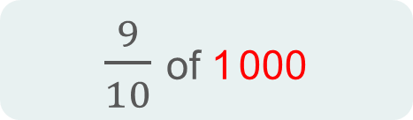

Checkpoint 13: Nine-tenths or minus 10
Which is the greater calculation in each pair?
$\frac{9}{10}$ of 100
a)
100 – 10
$\frac{9}{10}$ of 1 000
b)
1 000 – 10
Choose a value to complete this set of questions.
$\frac{9}{10}$ of ___
___ – 10
Can you choose a value so that the left-hand calculation is the greater? Is there more than one value that would work?
Notes:
This slide is animated. Each question will appear separately so you can choose the pace at which to work with your class.
Answers
a) The two calculations are equal; both give the answer 90.
b) The right-hand calculation is greater, as 1000 – 10 (990) is greater than $\frac{9}{10}$ of 1000 (900).
? Any value between 0 and 100 would mean the left-hand calculation was greater. Any value above 100 or below 0 would result in the right-hand calculation being greater (although students are unlikely to consider negative numbers in their solutions).
Suggested questioning
Which is easier to calculate, the fraction or the subtraction? Why?
Why is it that the two different calculations give the same answer in part a, but different answers in part b? What's changed?
Things to think about
While Checkpoint 13 only has two questions, the conversations they elicit will be both rich and useful. How do students explain to you why the ‘subtract 10’ is a fixed amount, but $\frac{9}{10}$ changes? Do they use representations to support their explanations? The language and visuals they reach for may help you to plan the most appropriate introduction to further work on fractions at Key Stage 3.

Slide 37
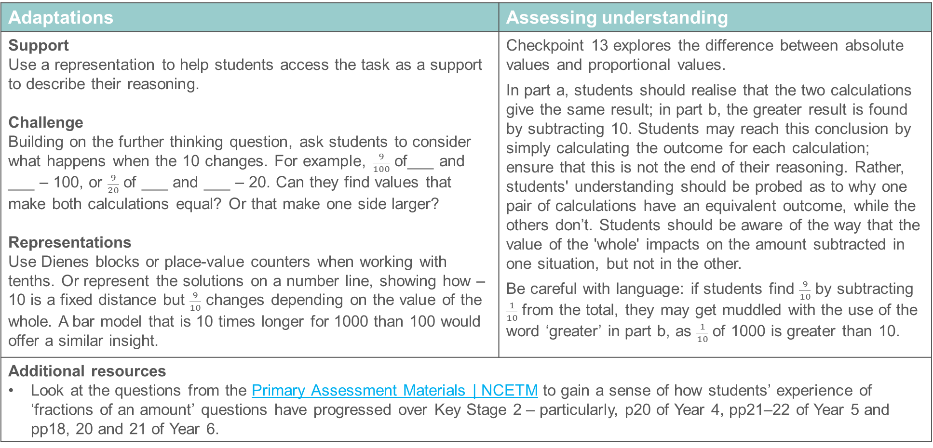
Checkpoint 13: Guidance
Adaptations | Assessing understanding
Support Use a representation to help students access the task as a support to describe their reasoning. Challenge Building on the further thinking question, ask students to consider what happens when the 10 changes. For example, $\frac{9}{100}$ of___ and ___ – 100, or $\frac{9}{20}$ of ___ and ___ – 20. Can they find values that make both calculations equal? Or that make one side larger? Representations Use Dienes blocks or place-value counters when working with tenths. Or represent the solutions on a number line, showing how – 10 is a fixed distance but $\frac{9}{10}$ changes depending on the value of the whole. A bar model that is 10 times longer for 1000 than 100 would offer a similar insight. | Checkpoint 13 explores the difference between absolute values and proportional values. In part a, students should realise that the two calculations give the same result; in part b, the greater result is found by subtracting 10. Students may reach this conclusion by simply calculating the outcome for each calculation; ensure that this is not the end of their reasoning. Rather, students' understanding should be probed as to why one pair of calculations have an equivalent outcome, while the others don’t. Students should be aware of the way that the value of the 'whole' impacts on the amount subtracted in one situation, but not in the other. Be careful with language: if students find $\frac{9}{10}$ by subtracting $\frac{1}{10}$ from the total, they may get muddled with the use of the word ‘greater’ in part b, as $\frac{1}{10}$ of 1000 is greater than 10.
Additional resources Look at the questions from the Primary Assessment Materials | NCETM to gain a sense of how students’ experience of ‘fractions of an amount’ questions have progressed over Key Stage 2 – particularly, p20 of Year 4, pp21–22 of Year 5 and pp18, 20 and 21 of Year 6.

Slide 38
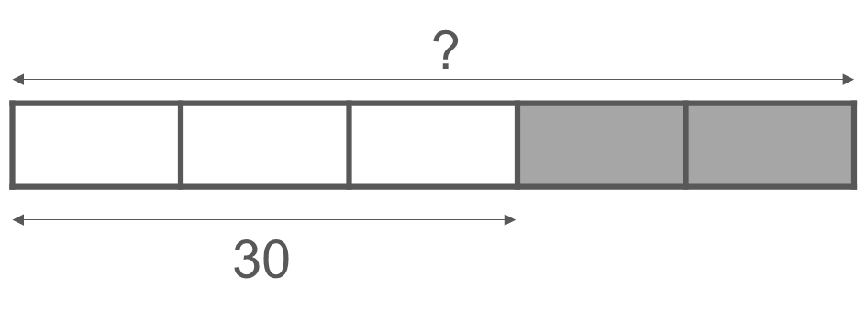
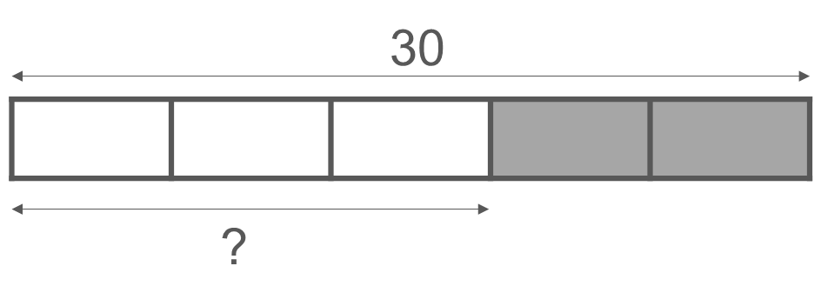
Checkpoint 14: Same and different bars
What is the same and what is different about these bar models?
Find the missing value each time. How is your strategy different each time?
Write a worded problem for each bar model.
Where else could you have written 30 on the bar model?
What would the other parts of the bar model then represent?
Notes:
This slide is animated. Each question will appear separately so you can choose the pace at which to work with your class.
Answers
a) Same: bar models involve five parts, with three parts (or $\frac{3}{5}$) shaded white and two parts (or $\frac{2}{5}$) shaded grey.
Different: the part that is labelled 30 is different. In the first bar, $\frac{3}{5}$ of the bar has a value of 30, but in the second bar, the whole (or $\frac{5}{5}$) of the bar has a value of 30. The part that we are being asked to find also changes: in the first bar, we are asked to find the value of the whole bar, but in the second bar we are asked to find the value of $\frac{3}{5}$ of the whole.
b) First bar: 50; second bar: 18
c) Any valid context where the appropriate values are given and asked for. For example, the first bar needs a context where the total is missing but $\frac{3}{5}$ of the total is identified as 30. For example, ‘Ben spends $\frac{3}{5}$ of his birthday money on a new game. If the game cost £30, how much money did he get for his birthday?’ The second bar needs a context where the total is given as 30, and $\frac{3}{5}$ is missing. For example, ‘Ben is given £30 for his birthday, and spends $\frac{3}{5}$ of the money on a new game. How much did it cost?’
? 30 could also have been written on the section representing $\frac{2}{5}$ (grey), so $\frac{3}{5}$ (white) would have represented 45 and the whole bar 75. Alternatively, 30 could have represented a single part ($\frac{1}{5}$), so $\frac{3}{5}$ (white) would have a value of 90, $\frac{2}{5}$ (grey) would have a value of 60, and the whole bar a value of 150.
Suggested questioning
What is the same? What is different?
Which bar has the biggest total value?
How can you find the value of a single part? What do you need to divide by?
If you know __, what else do you know?
Things to think about
Much like Checkpoint 13, Checkpoint 14 focuses on two similar questions, giving students an opportunity to show you what they know. Encourage students to articulate what the bar models show, and how they can use this information to find out the missing values. Consider using this Checkpoint in conjunction with Checkpoint 15: an interesting point to notice is whether students find the ‘reverse’ fraction problem easier in one or other context.

Slide 39
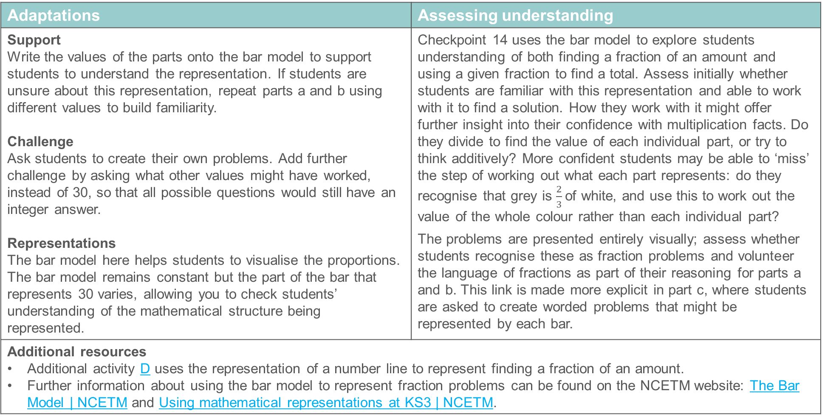
Checkpoint 14: Guidance
Adaptations | Assessing understanding
Support Write the values of the parts onto the bar model to support students to understand the representation. If students are unsure about this representation, repeat parts a and b using different values to build familiarity. Challenge Ask students to create their own problems. Add further challenge by asking what other values might have worked, instead of 30, so that all possible questions would still have an integer answer. Representations The bar model here helps students to visualise the proportions. The bar model remains constant but the part of the bar that represents 30 varies, allowing you to check students’ understanding of the mathematical structure being represented. | Checkpoint 14 uses the bar model to explore students understanding of both finding a fraction of an amount and using a given fraction to find a total. Assess initially whether students are familiar with this representation and able to work with it to find a solution. How they work with it might offer further insight into their confidence with multiplication facts. Do they divide to find the value of each individual part, or try to think additively? More confident students may be able to ‘miss’ the step of working out what each part represents: do they recognise that grey is $\frac{2}{3}$of white, and use this to work out the value of the whole colour rather than each individual part? The problems are presented entirely visually; assess whether students recognise these as fraction problems and volunteer the language of fractions as part of their reasoning for parts a and b. This link is made more explicit in part c, where students are asked to create worded problems that might be represented by each bar.
Additional resources Additional activity D uses the representation of a number line to represent finding a fraction of an amount. Further information about using the bar model to represent fraction problems can be found on the NCETM website: The Bar Model | NCETM and Using mathematical representations at KS3 | NCETM.

Slide 40
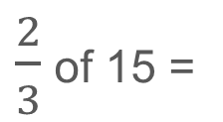
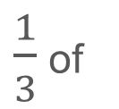
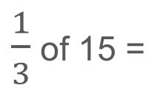
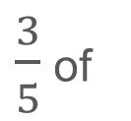
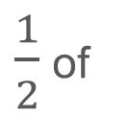
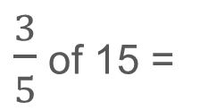
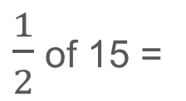
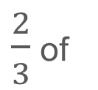
Checkpoint 15: Fifteen
a)
$\frac{1}{2}$ of 15 =
$\frac{1}{2}$ of
= 15
b)
$\frac{1}{3}$ of 15 =
$\frac{1}{3}$ of
= 15
c)
d)
$\frac{2}{3}$ of 15 =
$\frac{2}{3}$ of
= 15
e)
f)
Write your own pairs of fraction questions using 15.
Can you write a pair using quarters?
How about tenths?
$\frac{3}{5}$ of 15 =
$\frac{3}{5}$ of
g)
h)
= 15
Notes:
This slide is animated. Each question will appear separately so you can choose the pace at which to work with your class. A printable resource featuring bar models for each question is available on slide 81.
Answers
a) 7.5
b) 30
c) 5
d) 45
e)10
f) 22.5
g) 9
h) 25
? Any valid question where 15 is the solution to one, and the total to the other. For example, $\frac{1}{4}$ of 15 = 3.75 and $\frac{1}{4}$ of 60 = 15 or , $\frac{3}{10}$ of 15 = 4.5 and $\frac{3}{10}$ of 50 = 15.
Suggested questioning
What is the same/different about each question?
How did you work out the left-hand column?
How did you work out the right-hand column?
Which question did you find easiest/hardest? Why?
Did you use any of your answers to work out the other questions?
Things to think about
Checkpoint 15 features pairs of fractions questions, where the same fraction is used but the whole changes. This is a similar comparison to that used in Checkpoint 14, which represented these two mathematical structures using a bar model. Consider the order in which you use these two tasks: would students’ approaches to Checkpoint 15 likely be different if they saw Checkpoint 14 first? Would using 15 first provide a ‘purer’ assessment, or using 14 first provide a familiar tool to support students to access the task.

Slide 41
Checkpoint 15: Guidance
Adaptations | Assessing understanding
Support After some ‘productive struggle’, suggest a bar model, and ascertain if students are then able to access the task. A printable version with bar models is on slide 81. Challenge Increase the challenge of the further thinking question by specifying a number to connect with 15. For example, ‘Write a pair of fraction questions linking 20 to 15.’ Representations The questions are presented without representations so that students can choose their own if it helps them. A bar model is likely to be their preference. Students who draw circles may find it more challenging to draw thirds and fifths. | This Checkpoint is a companion to Checkpoint 14, in that it explores students’ understanding of both finding a fraction of an amount and using a given fraction to find a total. This time, the questions are presented without representations so the assessment focus shifts to their own strategies. Students may bring more of their own understanding and potential misconceptions. The questions are presented in pairs and build up in level of difficulty: from half, to a different unit fraction, to a non-unit fraction with the same denominator and an unrelated non-unit fraction. The value of 15 is used throughout to draw attention to what is different each time, which should help to highlight misconceptions. Pay particular attention to any students who do not have a secure strategy but who also do not generate their own representations to support them. Differentiate between those who rely on a visual but are relatively independent in creating it, and those who are still not secure enough to create representations to support themselves.
Additional resources The questions from the Primary Assessment Materials | NCETM may give a sense of how students’ experience of ‘fractions of an amount’ questions have progressed over Key Stage 2 – see p20 of Year 4, pp21–22 of Year 5 and pp18, 20–21 of Year 6.

Slide 42
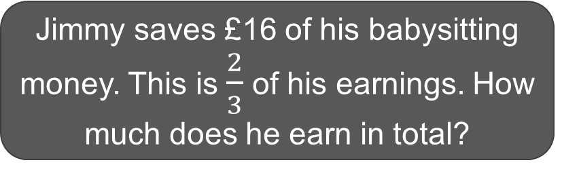
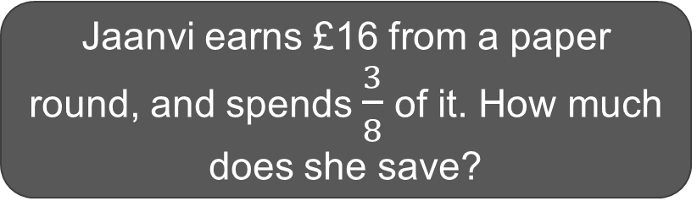
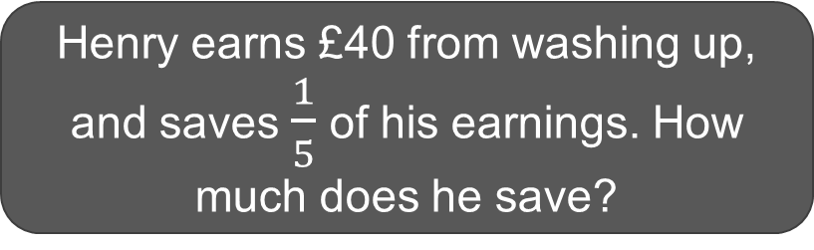
Checkpoint 16: Savings
Four students earn money from part-time jobs. They spend some and save the rest.
Henry earns £40 from washing up, and saves $\frac{1}{5}$ of his earnings. How much does he save?
Jaanvi earns £16 from a paper round, and spends $\frac{3}{8}$ of it. How much does she save?
Nishma earns £40 from dog walking, and saves £16. What fraction of her earnings does she save?
Jimmy saves £16 of his babysitting money. This is $\frac{2}{3}$ of his earnings. How much does he earn in total?
Order the students according to the amount that they save.
Now order the students according to the fraction of their earnings that they save.
What is the same/different about your two answers? Why?
Notes:
This slide is animated. The questions will appear clockwise from top left, and the further thinking question will appear separately so you can choose the pace at which to work with your class. A printable version can be found on slide 82: this uses the same four situations but re-purposes the task to be a match-up activity with supporting bar models. This version also separates Nishma’s question, as it asks for a fraction rather than an amount as its solution.
Answers
Henry saves £8.
Jaanvi saves £10.
Jimmy earns £24.
Nishma saves $\frac{2}{5}$ of her earnings.
? Ordered by amount: Henry (£8), Jaanvi (£10), Nishma (£16), Jimmy (£16).
Ordered by fraction: Henry ($\frac{1}{5}$), Nishma ($\frac{2}{5}$), Jaanvi ($\frac{5}{8}$), Jimmy ($\frac{2}{3}$)
Same: in both lists, Henry saves the least and Jimmy the most.
Different: Nishma’s position changes. When ordered by amount, she is equal top with Jimmy, saving more than Jaanvi. When ordered by fraction, she is below both Jaanvi and Jimmy.
This is because her earnings are greater than both Jimmy and Jaanvi, so the savings are a smaller proportion of the total.
Suggested questioning
What is the same and what is different about, for example, the questions about Henry and Jaanvi?
What do we know? What do we need to find out?
Could you represent this question visually?
Which do you find the hardest? Which do you find the easiest? Why?
Things to think about
Any worded question presents an assessment challenge for teachers: are students struggling because they cannot understand the question, or do they understand the question but not have the appropriate mathematical knowledge/skills to solve it? Or is there some complex interplay between both extremes? While the Checkpoints activities need not be used in any particular order, we suggest that the language element of Checkpoint 16 means that it is most appropriate to use it after some of the mathematical knowledge and skills involved have been assessed (for example, by using Checkpoints 14 and 15 first).

Slide 43
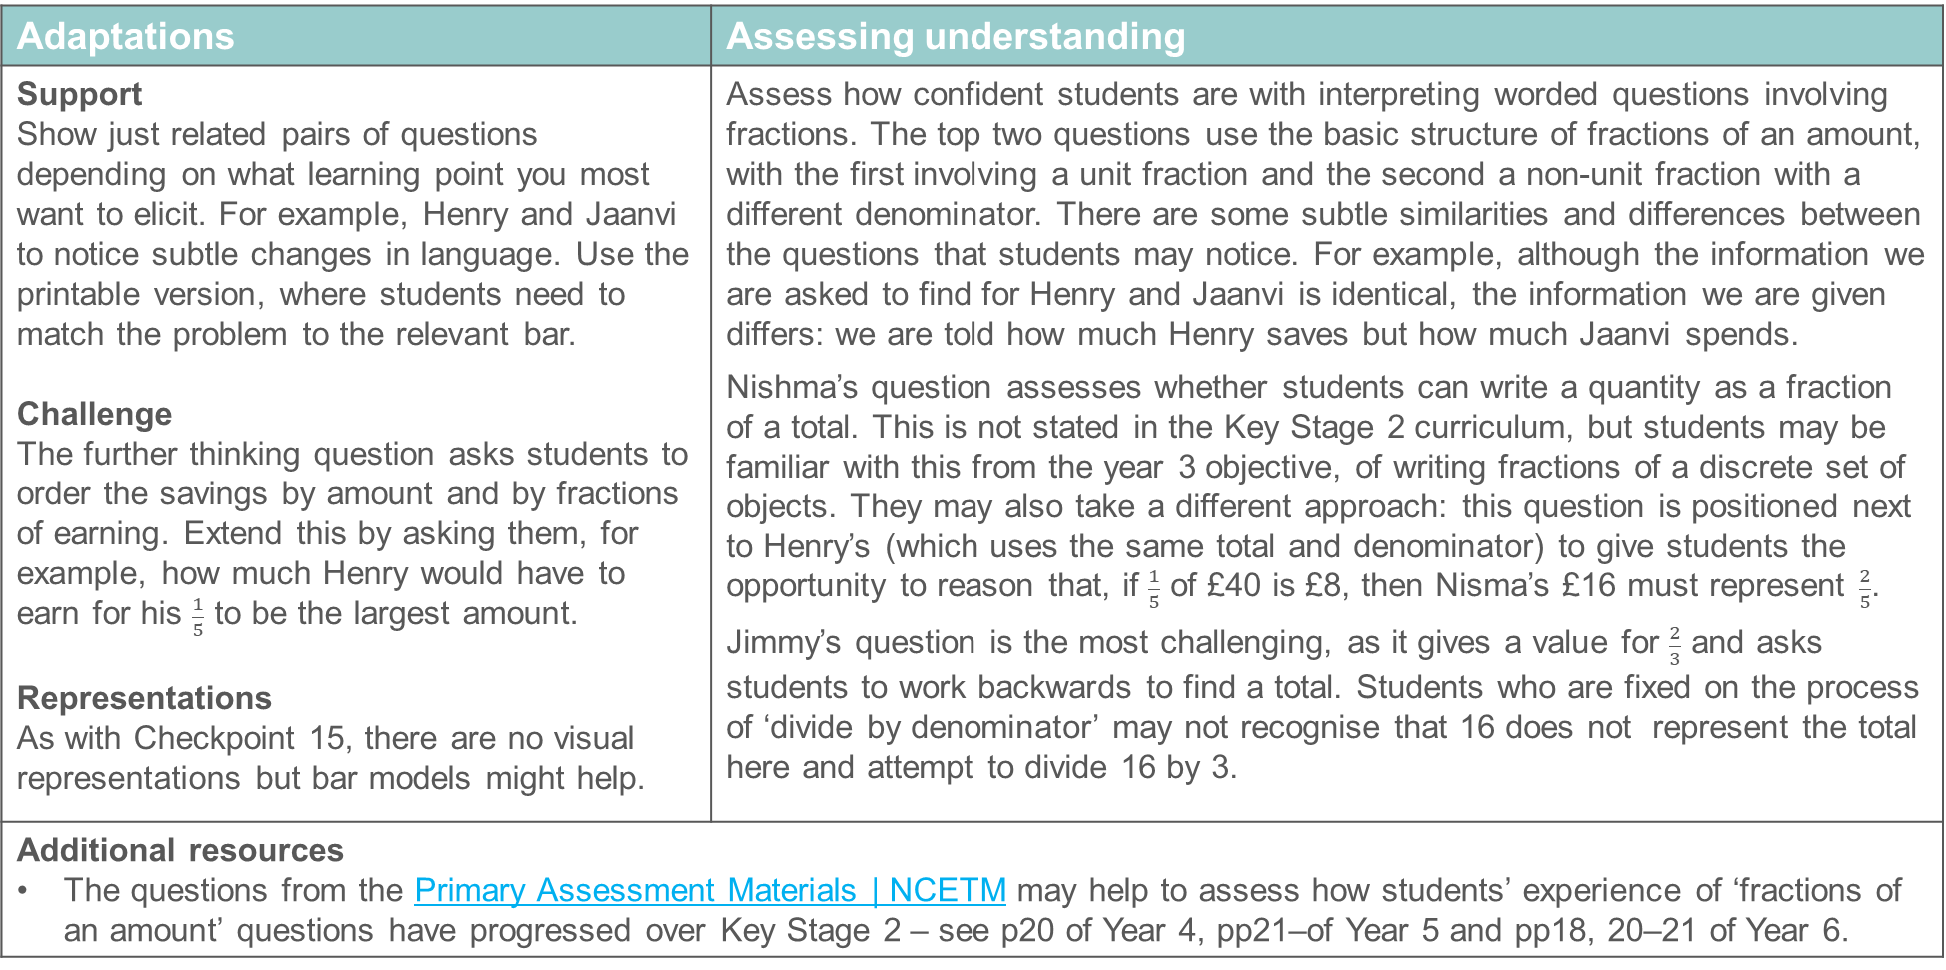
Checkpoint 16: Guidance
Adaptations | Assessing understanding
Support Show just related pairs of questions depending on what learning point you most want to elicit. For example, Henry and Jaanvi to notice subtle changes in language. Use the printable version, where students need to match the problem to the relevant bar. Challenge The further thinking question asks students to order the savings by amount and by fractions of earning. Extend this by asking them, for example, how much Henry would have to earn for his $\frac{1}{5}$ to be the largest amount. Representations As with Checkpoint 15, there are no visual representations but bar models might help. | Assess how confident students are with interpreting worded questions involving fractions. The top two questions use the basic structure of fractions of an amount, with the first involving a unit fraction and the second a non-unit fraction with a different denominator. There are some subtle similarities and differences between the questions that students may notice. For example, although the information we are asked to find for Henry and Jaanvi is identical, the information we are given differs: we are told how much Henry saves but how much Jaanvi spends. Nishma’s question assesses whether students can write a quantity as a fraction of a total. This is not stated in the Key Stage 2 curriculum, but students may be familiar with this from the year 3 objective, of writing fractions of a discrete set of objects. They may also take a different approach: this question is positioned next to Henry’s (which uses the same total and denominator) to give students the opportunity to reason that, if $\frac{1}{5}$ of £40 is £8, then Nisma’s £16 must represent $\frac{2}{5}$. Jimmy’s question is the most challenging, as it gives a value for $\frac{2}{3}$ and asks students to work backwards to find a total. Students who are fixed on the process of ‘divide by denominator’ may not recognise that 16 does not represent the total here and attempt to divide 16 by 3.
Additional resources The questions from the Primary Assessment Materials | NCETM may help to assess how students’ experience of ‘fractions of an amount’ questions have progressed over Key Stage 2 – see p20 of Year 4, pp21–of Year 5 and pp18, 20–21 of Year 6.

Slide 44
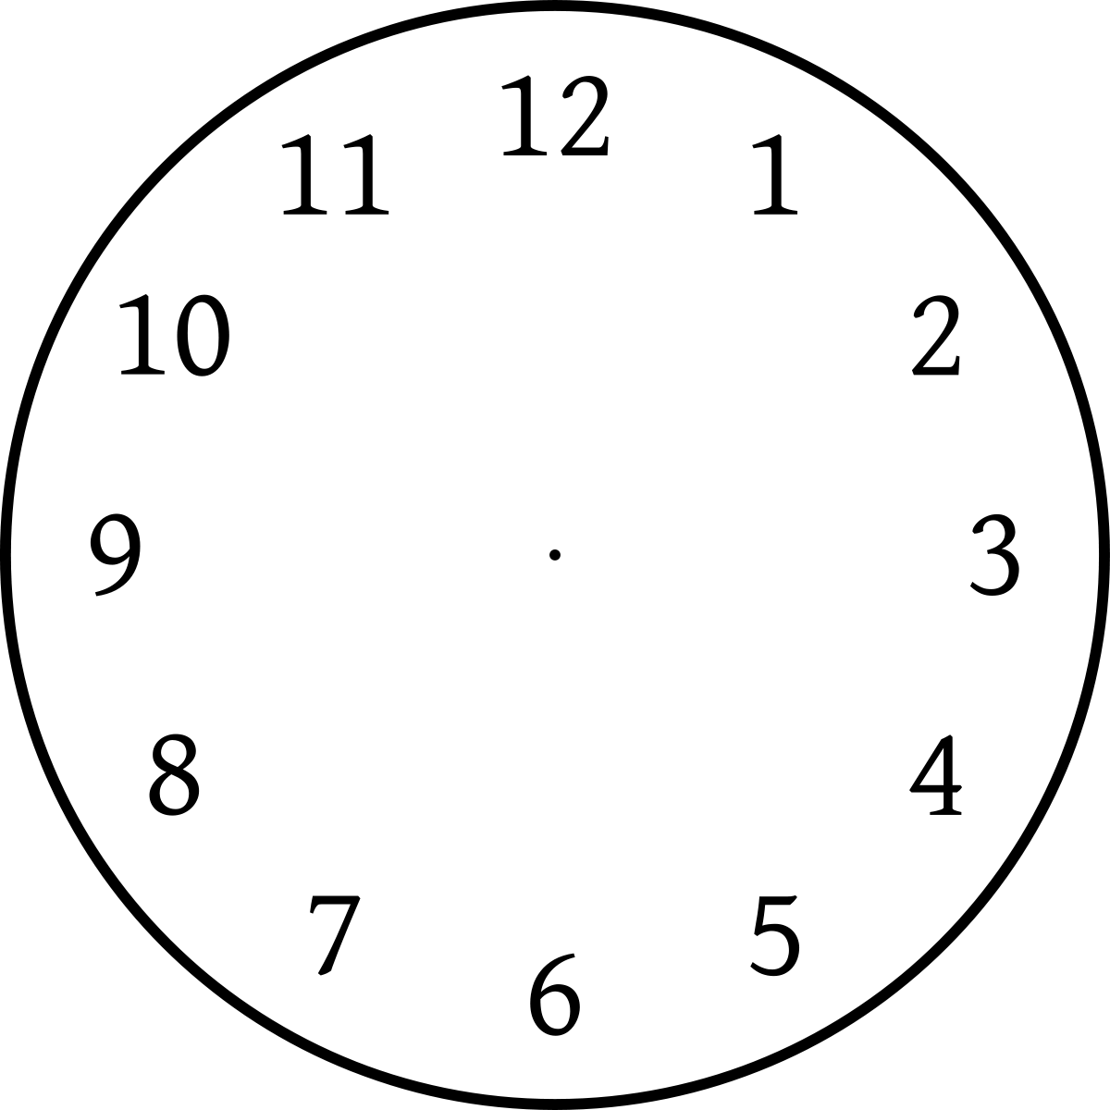

Checkpoint 17: Clocks
Abimbola has an unusual clock. Rather than having hands, it shows the fraction of the hour that has passed.
For each clock below, write:
what fraction of an hour has passed
how many minutes this is.
Normal clock
Abimbola’s clock
a)
b)
c)
d)
e)
Choose two of the clocks. What is the difference between them?
Which pair of clocks has the biggest difference? Which pair has the smallest?
Notes:
This slide is animated. Each question will appear separately so you can choose the pace at which to work with your class.
Answers
a) $\frac{1}{4}$ hour = 15 minutes
b) $\frac{1}{6}$ hour = 10 minutes
c) $\frac{11}{12}$ hour = 55 minutes
d) $\frac{5}{12}$ hour = 25 minutes
e) $\frac{1}{20}$ hour = 3 minutes
(NB e is not as clearly marked and so $\frac{1}{15}$ hour = 4 minutes would also be a reasonable answer.)
? Biggest difference: c and e (52 minutes or $\frac{52}{60}=\frac{13}{15}$ hour). Smallest difference: b and a (5 minutes or $\frac{1}{12}$ hour).
Suggested questioning
Which fractions did you ‘just know’? Which fractions did you need to work out?
How did you find the number of minutes?
Did you use your knowledge of clocks and telling the time?
Things to think about
Circles and bars are two of the most common representations for fractions. We have limited the use of circles throughout this and previous Checkpoints decks, as they offer no sense of fractions as numbers (an essential understanding for ‘Arithmetic procedures with fractions’). The are arguably less flexible than bar models, which can be used to connect students’ understanding of fractions with other multiplicative relationships such as ratio. However, it is a representation that students may reach for and so this Checkpoint, alongside Checkpoint 8, assesses students’ familiarity and confidence with fractions using this representation. Additionally, some students may reach Year 7 without a solid understanding of reading an analogue clock, and the dual nature of this Checkpoint should help you to identify and support those students.

Slide 45
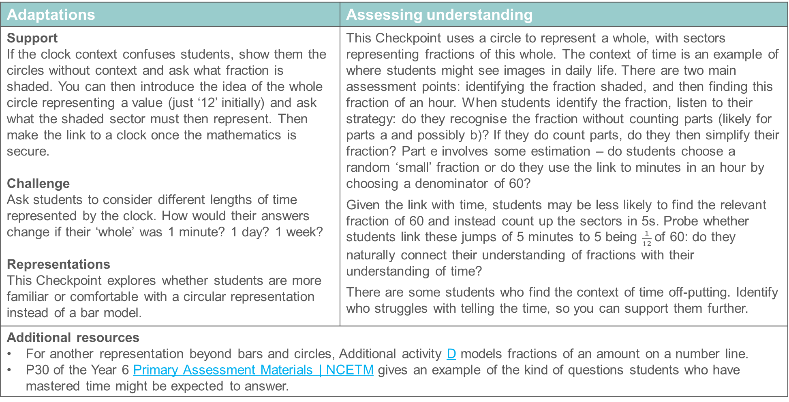
Checkpoint 17: Guidance
Adaptations | Assessing understanding
Support If the clock context confuses students, show them the circles without context and ask what fraction is shaded. You can then introduce the idea of the whole circle representing a value (just ‘12’ initially) and ask what the shaded sector must then represent. Then make the link to a clock once the mathematics is secure. Challenge Ask students to consider different lengths of time represented by the clock. How would their answers change if their ‘whole’ was 1 minute? 1 day? 1 week? Representations This Checkpoint explores whether students are more familiar or comfortable with a circular representation instead of a bar model. | This Checkpoint uses a circle to represent a whole, with sectors representing fractions of this whole. The context of time is an example of where students might see images in daily life. There are two main assessment points: identifying the fraction shaded, and then finding this fraction of an hour. When students identify the fraction, listen to their strategy: do they recognise the fraction without counting parts (likely for parts a and possibly b)? If they do count parts, do they then simplify their fraction? Part e involves some estimation – do students choose a random ‘small’ fraction or do they use the link to minutes in an hour by choosing a denominator of 60? Given the link with time, students may be less likely to find the relevant fraction of 60 and instead count up the sectors in 5s. Probe whether students link these jumps of 5 minutes to 5 being $\frac{1}{12}$of 60: do they naturally connect their understanding of fractions with their understanding of time? There are some students who find the context of time off-putting. Identify who struggles with telling the time, so you can support them further.
Additional resources For another representation beyond bars and circles, Additional activity D models fractions of an amount on a number line. P30 of the Year 6 Primary Assessment Materials | NCETM gives an example of the kind of questions students who have mastered time might be expected to answer.

Slide 46
Ratio as an example of multiplicative relationships
Checkpoints 18–27

Slide 47
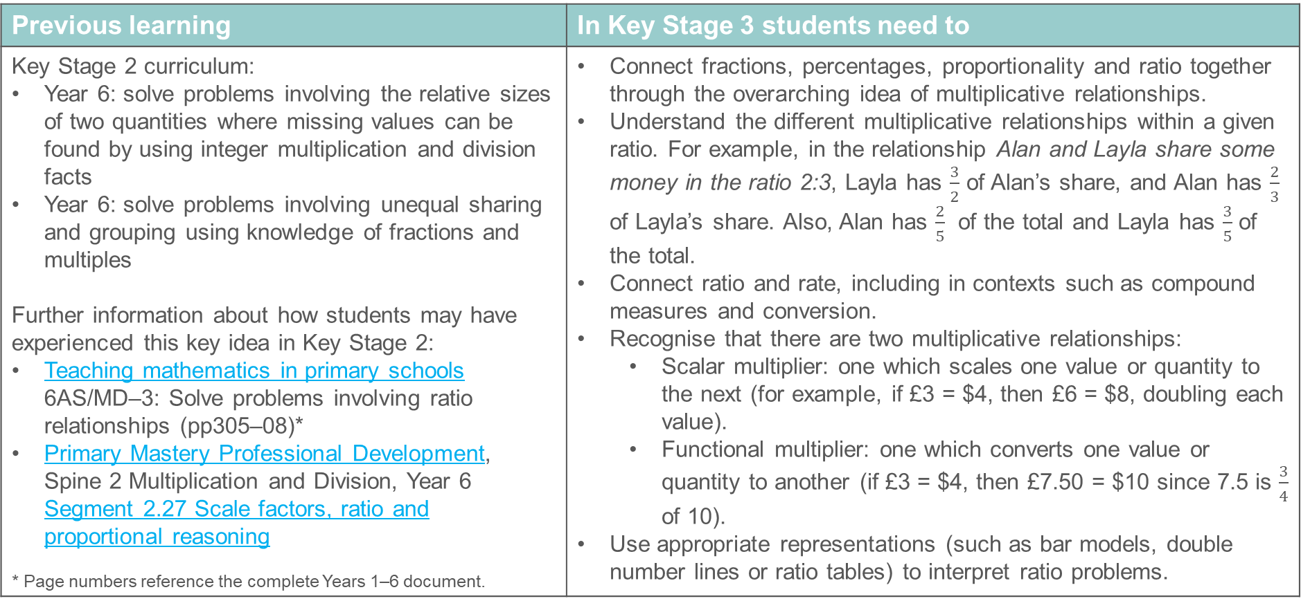
Ratio as an example of multiplicative relationships
Previous learning | In Key Stage 3 students need to
Key Stage 2 curriculum: Year 6: solve problems involving the relative sizes of two quantities where missing values can be found by using integer multiplication and division facts Year 6: solve problems involving unequal sharing and grouping using knowledge of fractions and multiples Further information about how students may have experienced this key idea in Key Stage 2: Teaching mathematics in primary schools 6AS/MD–3: Solve problems involving ratio relationships (pp305–08)* Primary Mastery Professional Development, Spine 2 Multiplication and Division, Year 6 Segment 2.27 Scale factors, ratio and proportional reasoning * Page numbers reference the complete Years 1–6 document. | Connect fractions, percentages, proportionality and ratio together through the overarching idea of multiplicative relationships. Understand the different multiplicative relationships within a given ratio. For example, in the relationship Alan and Layla share some money in the ratio 2:3, Layla has $\frac{3}{2}$ of Alan’s share, and Alan has $\frac{2}{3}$ of Layla’s share. Also, Alan has $\frac{2}{5}$ of the total and Layla has $\frac{3}{5}$ of the total. Connect ratio and rate, including in contexts such as compound measures and conversion. Recognise that there are two multiplicative relationships: Scalar multiplier: one which scales one value or quantity to the next (for example, if £3 = $4, then £6 = $8, doubling each value). Functional multiplier: one which converts one value or quantity to another (if £3 = $4, then £7.50 = $10 since 7.5 is $\frac{3}{4}$ of 10). Use appropriate representations (such as bar models, double number lines or ratio tables) to interpret ratio problems.

Slide 48




Checkpoint 18: Shades of orange
This orange paint is made using two cans of yellow for every one can of red.
Graham, Phil and Alison are given the orange paint.
They each add three more cans to the mix, using only red and yellow.
What can you say about the colour of the cans of paint that were added in each case?
Graham’s paint turns lighter.
Phil’s paint stays the same colour.
Alison’s paint turns darker.
+ 3 cans
+ 3 cans
+ 3 cans
One can of red and one can of yellow is added to each of the three paint mixes. Does each one become more red or more yellow?
Notes:
This slide is animated. Each question will appear separately so you can choose the pace at which to work with your class.
Answers
a) The paint has become more yellow, so the ratio of paint must include more yellow than red, and it must be a higher proportion of yellow than the original. Since there are three cans used, they must all be yellow as one red and two yellow would maintain the original colour.
b) The paint stays the same colour so the paint added must be the same as the original mix, so two yellow and one red.
c) The paint becomes more red, so either all three cans are red, or two are red and one is yellow. It's not possible to tell which.
? Paint mix a: more red. Paint mix b: more red (as red now represents a greater proportion of the whole mix than previously). Paint mix c: more yellow.
Suggested questioning
Has the added paint made it turn more red, more yellow, or stay the same?
What would happen if we mixed two cans of the same coloured paint together?
Things to think about
Mixing paint is a fairly common context for exploring ratio, but in this Checkpoint the focus is less on precision and more on a sense of what will happen to the tone of the paint. As with the majority of the tasks in this section, the relationship is described using the language of ‘for every’, rather than using the mathematical notation of ratio. Some students may be familiar with the notation, as it is in the non-statutory guidance. However, it is certainly not an expectation. Instead, the assessment focus is on the multiplicative thinking that is needed to underpin future work on ratio.

Slide 49
Checkpoint 18: Guidance
Adaptations | Assessing understanding
Support Consider only the first situation, and scaffold with prompts. For example, ‘Is the paint added more yellow or more red than the original?’ Or consider the middle situation first to assess understanding of combining ratios. Challenge Challenge students to combine and recombine the paints used in the original task. Ask about the minimum number of cans of paint needed to be added to each situation to return the paint to its original colour, or to consider whether combining all three of the resulting colours would end up with a paint that was more yellow or more red than the original. Representation The context is a visual represention of a proportional relationship, but might be challenging to imagine. Show students the parts ‘separately’: draw boxes/bars to represent each individual tin and label with the colour. | Checkpoint 18 gives a context in which students can reason with ratios. Although ratio notation is not used, some students may be familiar with this and choose to represent the situation in this way. It is mentioned in the non-statutory guidance for Year 6. There is no expectation of a particular notation; part of the purpose of the assessment is to see what language students bring to their explanations. The reasoning here can be quite challenging. Look for students who understand that adding a mix that is the same ratio of red and yellow will maintain the colour (the central situation). They may then reason about the first situation as there is only one possible way that three cans can be added. The final situation is more challenging as there is more than one possible answer. Ask for all possible answers.
Additional resources For more about familiar representations and language, explore Topic 2.27 Scale factors, ratio and proportional reasoning | NCETM from Primary Mastery Professional Development | NCETM. Key Idea 3.1.2.2 from Secondary Mastery Professional Development | NCETM explores ‘the language and notation of ratio’ and gives ideas about how to develop this concept further at Key Stage 3.

Slide 50
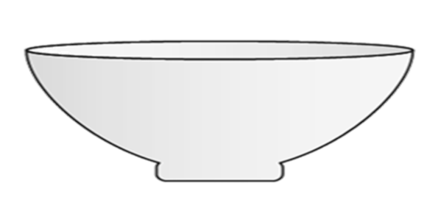
Checkpoint 19: Dough
Most bread doughs start with flour and water.
To make chapati, for every two cups of flour, you add one cup of water.
To make pizza base, for every three cups of flour, you add two cups of water.
In each bowl, is it chapati dough, pizza base dough, or neither?
a)
9 cups flour
6 cups water
b)
12 cups flour
8 cups water
c)
12 cups flour
6 cups water
d)
e)
24 cups flour
12 cups water
f)
18 cups flour
12 cups water
24 cups flour
18 cups water
What would you need to add to each bowl to swap the dough to make the other kind? Is there more than one way to do this?
Notes:
This slide is animated. Each question will appear separately so you can choose the pace at which to work with your class.
Answers
a) Pizza base
b) Pizza base
c) Chapati
d) Pizza base
e) Chapati
f) Neither. To make pizza base, it should be 24 cups flour and 16 cups water.
? These answers suggest the minimum that needs to be added to each mixture; there are an infinite number of possible answers, provided that (for chapati) there is twice as much flour as water or (for pizza base) there is one and a half times as much flour as water.
a) three cups of flour; b) four cups of flour; c) two cups of water; d) six cups of flour; e) four cups of water; f) To make pizza, add three cups of flour. To make chapati, 12 cups of flour.
Suggested questioning
How do you work out which dough it is? Do you use the same strategy each time?
What do you notice about all of the flour values for the __ dough?
Do you notice anything about any of the other values?
Which was the hardest to work out? Why?
Things to think about
Checkpoints 19 and 20 both explore the first steps of recipes that only involve two ingredients, so that students can focus on the relationship between two parts, rather than keeping track of lots of ingredients. The structure of each Checkpoint is subtly different, so that you can explore different aspects that underpin the teaching of ratio at Key Stage 3. Here, they are identifying which dough is in which bowl, which touches on understanding of equivalent ratios.

Slide 51
Checkpoint 19: Guidance
Adaptations | Assessing understanding
Support Visual representations may help (see below). You might also just show the ratio for chapati, and ask more simply “which bowls have this dough in?” Challenge The examples here have been approximated from existing recipes for ease of calculation. Show students actual recipes for different doughs and ask them to describe the relationship between flour and water. Are these real recipes closer in ratio to the pizza or the chapati? Representations No representations are given on the slide, but it may be helpful to suggest a visual aid to support students. Using different coloured counters to represent the two ingredients will make them easier to compare. Bar models may also be helpful, as would double number lines (if they are familiar – check this by using Checkpoint 6). | This Checkpoint explores a multiplicative relationship without formally using the notation of ratio; language such as ‘for every’ is likely to be familiar from primary school. Explore what strategies students bring to the problem, rather than expecting them to take a certain approach or to think about this problem in the way they might in Key Stage 3. For example, do not expect students to simplify the ratios in the bowls to check which of the given ratios is equivalent. Students may use representations such as bar models, or write out lists of multiples of each part of the ratio to support them. Consider what each of these approaches tell you about their reasoning: both suggest an deep understanding of the structure of the mathematics involved, although the latter may suggest less fluency with the multiplication facts needed. Some students may not formally calculate but may reason about the relationship between the given values, such as recognising that, if the larger number is not twice the smaller number, it cannot be chapati.
Additional resources Year 6 Primary Assessment Materials | NCETM p23 gives examples of the language that students might be familiar with in proportional reasoning questions.

Slide 52
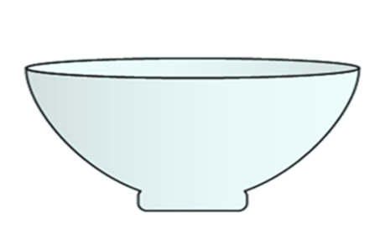
Checkpoint 20: Imperfect meringues
To make the perfect meringue, for every three eggs you add 150 g sugar.
150 g sugar
3 eggs
What do you need to add to each mixture below to make the meringue perfect?
a)
200 g sugar
6 eggs
b)
450 g sugar
7 eggs
c)
400 g sugar
9 eggs
d)
500 g sugar
9 eggs
e)
500 g sugar
10 eggs
What other combinations of eggs and sugar would make a perfect meringue? Could you make one with 20 eggs? How about one with 20 g sugar? Why or why not?
Notes:
This slide is animated. Each question will appear separately so you can choose the pace at which to work with your class.
Answers
These answers suggest the minimum that needs to be added to each mixture; there are an infinite number of possible answers, provided that the weight of sugar is always 50 times the number of eggs.
a) Six eggs, 200 g sugar: add 100 g sugar
b) Seven eggs, 450 g sugar: add two eggs
c) Nine eggs, 400 g sugar: add 50 g sugar
d) Nine eggs, 500 g sugar: add one egg (or add three eggs and 100 g sugar)
e) 10 eggs, 500 g sugar: this is a perfect meringue, although students might choose to add two eggs and 100 g sugar.
? Any combination where the weight of sugar is 50 times the number of eggs. Yes, you could make a meringue with 20 eggs. It would require 1000 g sugar. No, you could not easily make one with 20 g sugar as it would require $\frac{2}{5}$ of one egg. Students might argue that you could crack the egg and weigh it, pouring only $\frac{2}{5}$ of its weight in – but a more mathematically valuable discussion might be had around eggs being a discrete unit that must be added in integer amounts.
Suggested questioning
What is the same? What is different?
Which is closest to being a ‘perfect’ meringue already?
When do you need to add eggs? When do you need to add sugar? When do you need to add both?
How do you know when the amounts are correct? What is your strategy?
Things to think about
As with Checkpoint 19, meringues are used as an example of a two-ingredient recipe. An interesting point to notice is whether students ‘simplify’ the ratio (although this is not language likely to have been used in Key Stage 2) and think about 50 g sugar per egg, or whether they continue to work in multiples of three eggs and 150 g sugar. Think ahead about which question might be an appropriate stage to nudge them to this realisation, if you think it would be an appropriate discussion for your class.

Slide 53
Checkpoint 20: Guidance
Adaptations | Assessing understanding
Support Use a visual representation (see below) to draw out the relationship each time, so students can add parts until it matches the ‘perfect’ ratio. Challenge This could be linked to common multiple problems. For example, tell students that eggs are sold in boxes of one dozen and sugar in bags of 1 kg. Can they work out the minimum number of boxes/bags that can be purchased, if there is to be none of either ingredient left over? Representations Visual representations may help support the connection between the number of eggs and the weight of sugar. Use bar models, double number lines (if familiar), or even images of eggs labelled in multiples of 50 g. | Checkpoint 20 uses a familiar context for multiplicative relationships: that of a recipe. As with most of the other Checkpoints involving ratio, the language of ‘for every’ is used to describe the relationship, as this is likely to be familiar from primary school. Meringues are used as an example of a recipe with only two ingredients, with a particular mathematical interest as one ingredient is ‘discrete’ (eggs must be added in integer units) while the other is continuous. Assess how confidently students are able to interpret the problem, and what reasoning they bring to solve it, rather than trying to elicit particular strategies. Unlike Checkpoint 21, where students needed to identify which pairs of values held the same multiplicative relationship, here students need to adjust the quantities until they satisfy the relationship specified. In parts a to c, this involves adjusting until the eggs are multiples of three. Students’ approaches in parts d and e might vary according to the depth of their understanding. They might, for example, add both eggs and sugar to keep the value of eggs as a multiple of three, and sugar as a multiple of 150 g. More confident students might recognise that this relationship could also be described as 50 g sugar per egg, and add just one ingredient, or recognise that part e is already perfect. See how flexibly they can think about this problem to help you to plan for the more formal ratio that is in the Key Stage 3 curriculum.
Additional resources Key Idea 3.1.4.3 from Secondary Mastery Professional Development | NCETM explores ‘Ratio: determining parts given a part and the ratio’ and gives ideas about how to develop this concept at Key Stage 3.

Slide 54

Checkpoint 21: Flowers
A flower has three petals and two leaves.
Number of flowers | 1 | 2 | 3 | 6 | 18 | 20
Number of petals
Number of leaves
Complete the first table.
Complete the second table.
  How was your strategy different this time?
Number of flowers | 30
Number of petals |  | 30
Number of leaves |  |  | 30
Is it possible to complete the third table? Why or why not?
Number of flowers | 31
Number of petals |  | 32
Number of leaves |  |  | 33
Notes:
This slide is animated. Each question will appear separately so you can choose the pace at which to work with your class. A printable version of the tables can be found on slide 83, with additional columns so that you can explore beyond the given values if you choose to.
Answers
a) Reading along each row from left to right:
Number of flowers: 1, 2, 3, 6, 18, 20
Number of petals: 3, 6, 9, 18, 54, 60
Number of leaves: 2, 4, 6, 12, 36, 40
b) Reading along each row from left to right:
Number of flowers: 30, 10, 15
Number of petals: 90, 30, 45
Number of leaves: 60, 20, 30
? The second and third columns are impossible. The number of petals must be divisible by three and the number of leaves must be divisible by two.
Suggested questioning
What is your strategy for completing the tables? Will you fill in the columns in order from left to right?
Do you use any of your previous columns to help you with the column you’re working on?
What is the relationship between the rows?
Which value is the smallest each time? Which is the biggest?
Things to think about
Checkpoint 21 is a companion to Checkpoint 22, offering a different structure to explore the same multiplicative relationships. You might choose to use just one of the two Checkpoints, or it may be interesting to try both and see if students interact differently with the problem when the relationships are modelled more explicitly, as they are in the tables here. Choosing which Checkpoint to use first may depend on how confidently students have handled other assessment tasks involving multiplicative relationships. Would using the tables first lead them too much, or provide them with a structure to support their reasoning?

Slide 55
Checkpoint 21: Guidance
Adaptations | Assessing understanding
Support Provide students with a table to complete. A printable version of the table is provided on slide 83, with additional columns so that students can choose the values they want to use, including filling in columns that are ‘in between’ those given. Challenge Extend the ideas in the further thinking question by asking students which other values are not possible for each row. Representations A table of values is used to organise the information about the different parts of the flower, so that students can directly compare the number of petals and leaves per flower. This may help students to recognise and work with the multiplicative relationships in a different way to Checkpoint 22, where the information is presented in isolation. | In the first table, the number of flowers is always given so students only need to multiply to find the missing values. Encourage them to complete the columns in the order that makes most sense to them, and listen carefully to their strategies. Do they work ‘down’ the columns by multiplying the number of flowers by three (for petals) or two (for leaves)? Or do they work ‘along’ the rows by writing a sequence of values that increases by three or two, and then doubles for the fourth column? Both show an understanding of the relationships involved, but does this extend to choosing the most efficient strategy or spotting the less obvious relationships in the table? Do they, for example, notice that they can multiply their second column by 10 to complete the last column? In the second table, the number 30 is constant but its position in the table varies, so students need to both multiply and divide. Those who relied on the relationships ‘along’ the rows in part a may find this question more challenging.
Additional resources Checkpoint 22 uses the same relationship, but without the structure of the tables. To find out what representations and language students are familiar with, explore Topic 2.27 Scale factors, ratio and proportional reasoning | NCETM from Primary Mastery Professional Development | NCETM.

Slide 56

Checkpoint 22: Bunches of flowers
A flower has three petals and two leaves.
Five children each pick a bunch of these flowers.
Who has the most flowers in their bunch?
I counted 60 leaves.
I counted 80 leaves.
I counted 30 flowers.
Anya
Deb
I counted 60 petals.
Neihal
I counted 90 petals.
Hafsa
Glenn
Could you swap the words ‘petals’ and ‘leaves’ above and still make a bunch of these flowers, with none left over? Why or why not?
Notes:
This slide is animated. Each instruction and speech bubble will appear separately so you can choose the pace at which to work with your class.
Answers
Neihal has the most flowers:
Deb: 30 flowers
Hafsa: 20 flowers
Anya: 30 flowers
Glenn: 30 flowers
Neihal: 40 flowers
? Yes, if the value is a common multiple of both two and three. Hafsa: yes, 60 leaves = 30 flowers; Anya: yes, 60 petals = 20 flowers; Glenn: yes, 90 leaves = 45 flowers; Neihal:, no, 80 petals = 26$\frac{2}{3}$ flowers.
Suggested questioning
What is the same/different about Anya and Hafsa’s bunches?
Whose bunches are the same?
Is the biggest value always the biggest bunch?
Things to think about
Checkpoint 22 is a companion to Checkpoint 21, offering a different structure to explore the same multiplicative relationships. You might use just one of the two Checkpoints, or try both and see if students interact differently with the problem when the relationships are modelled less explicitly, as they are here. What are the advantages and disadvantages of using this more open task first?

Slide 57
Checkpoint 22: Guidance
Adaptations | Assessing understanding
Support Although using multiples of 10 gives straightforward numbers to work with, starting with smaller numbers might make it easier for students to represent the number of petals/leaves/flowers visually and therefore make sense of the situation and relationships. Challenge The further thinking question starts to make the link to common multiples and thinking about which integer values are possible with this relationship. Extend this further by asking students to create flowers with a different relationship. For example, how many leaves/petals could each flower have if 40 leaves and 40 petals were both possible? Representations No representations are provided on this slide, so that you can explore whether students seek their own representations to support them. Sketched flower images or bar models help them to keep track of the multiplicative relationships. A table of values, as in Checkpoint 21, might also be a supportive representation, although this be more informal lists of multiples. | Checkpoint 22 is a companion to Checkpoint 21, offering a different structure to explore the same multiplicative relationships. Use just one of the two Checkpoints, or try both and see if they interact differently with the problem when the relationships are modelled more or less explicitly. Use familiar language such as ‘for every __ there are __’, to draw attention to the multiplicative relationship. There is no expectation of a specific strategy such as scaling. The values have been chosen to allow for comparison between specific pairs to help you assess students’ understanding of the relationships. For example, you might ask students to compare Anya and Hafsa – who both counted the same value – and ask if they know, without calculating, who must have the most flowers. Then use a strategy of their choice to see if their initial instincts were correct.
Additional resources The Key Stage 2 SATs papers contain other examples of proportional reasoning. For example, 2018 Paper 2 (reasoning) question 20, and 2018 Paper 3 (reasoning) question 9. Past papers can readily be found online.

Slide 58
Checkpoint 23: Running
Monday
Tuesday
Jiang and Eric do a week-long running challenge.
Jiang records her runs in kilometres.
Eric records his runs in miles.
They know that eight kilometres is the same as five miles.
Who runs the furthest each day?
Jiang: 8 km
Eric: 4 miles
Jiang: 4 km
Eric: 4 miles
Wednesday
Thursday
Jiang: 7 km
Eric: 5 miles
Jiang: 10 km
Eric: 5 miles
Friday
Saturday
Jiang: 16 km
Eric: 10 miles
Jiang: 12 km
Eric: 7 miles
They run the same distance over the whole week.
How far did they each run on Sunday?
Notes:
This slide is animated. Each question will appear separately so you can choose the pace at which to work with your class.
Answers
Monday: Jiang
Tuesday: Eric
Wednesday: Eric
Thursday: Jiang
Friday: they ran the same distance
Saturday: Jiang
? Any pair of values, where Eric’s value is 1 km (or $\frac{5}{8}$ mile) greater than Jiang’s. In the six days, Jiang has run 57 km and Eric has run 35 miles. Thirty-five miles is equivalent to 56 km, so Eric needs to ensure that, whatever distance Jiang runs, he runs 1 km/$\frac{5}{8}$ mile further than her.
Suggested questioning
What is your strategy? Is it the same for each question?
Which was easiest to do?
Could you do any without calculating?
Which day did they run the same distance? How do you know?
Could you create another pair of distances that are the same?
Things to think about
Students are likely to have encountered conversion between miles and kilometres towards the end of Key Stage 2. Some may have formalised a consistent strategy. A key aspect here is that the same strategy might not be the most efficient for each set of numbers. A scaled conversion is not the only way to make the comparisons and, particularly for the earlier days, students may not need to calculate to reason about who has run further. Consider what you might want students to write or to say to convince you: is there merit in asking students to show workings when they can reason verbally?

Slide 59
Checkpoint 23: Guidance
Adaptations | Assessing understanding
Support Show a day at a time, building confidence with the more straightforward comparisons, and use visuals to support the rest. Challenge Repeat the task with more challenging numbers, with less obvious comparisons. Representations A double number line might seem a suitable representation, but it may be unlikely that students are familiar with them (do Checkpoint 6 to check). Bar models may be more appropriate. Create a set of two bars, one split into five parts and one split into eight parts, and use them to compare. | Encourage students to bring their own strategies, and assess their reasoning around multiplicative relationships. Using the same approach for each set of values is less efficient than thinking about the actual values in each pair. Some are obvious – for example, Monday, Wednesday and Thursday can all be reasoned by comparing to the stated fact that 8 km = 5 miles, with no need for scaling. For Tuesday, students might talk about the relative size of miles and kilometres, and reason that if the values are the same, then Eric must have run further as miles are a bigger unit. Listen for students who are confused that the ratio given had a bigger value, and assume that kilometres are therefore the bigger unit. Friday/Saturday may involve scaling. Students’ approaches could inform your future planning on ratio. Do they consider Friday as an ‘equivalent ratio’? Do they use the language of doubling? For Saturday, do they choose to scale one of the values to be a multiple of the given ratio (for example, km to be a multiple of 5)? Or convert one unit of measurement to another? Do they use a representation such as a bar model to compare the values? The final question will be challenging for some, but even if they do not reach an answer, their attempts will give information about their starting point for future teaching of multiplicative reasoning.
Additional resources An example of the kind of question students may have seen involving conversion between km and m can be found within the Key Stage 2 SATs papers: 2019 Paper 3 (reasoning) question 15. Past papers can readily be found online. Key Idea 3.1.2.2 from Secondary Mastery Professional Development | NCETM explores ‘the language and notation of ratio’.

Slide 60

Checkpoint 24: How many times?
A bag contains some red and some blue counters.
Three-quarters of the counters in the bag are red.
There are more red counters than blue counters. How many times more?
How would your answer to part a change if four-fifths of the counters were red?
What fraction would be red if there were twice as many red counters as blue counters?
How would your answer to part c) change if there were ten times as many red counters as blue counters?
How would your answer to part b) change if three-fifths of the counters were red?
Notes:
This slide is animated. The questions will appear separately so you can choose the pace at which to work with your class.
Answers
a) There are three times as many red counters as blue.
b) There would be four times as many red as blue.
c) Two-thirds would be red.
d) Ten-elevenths would be red.
? There would be one-and-a-half times as many red as blue.
Suggested questioning
How might you draw a diagram that represents this situation?
What fraction would be red if there were __ times as many red as blue?
How many of each colour might there be?
What do you notice about the fractions that are red and blue, and how many times more red than blue there are?
Things to think about
Checkpoint 24 explores whether students make a connection between describing a proportion as a fraction, and describing the same proportion as a ratio. The language and notation of ratio is not explicitly used. In this case, the language of ‘how many times more’ is used to describe the relationship. This is more straightforward in the main part of the task, where one of the colours is a unit fraction, although students may find part d to be particularly unintuitive. Consider how you might make links back to Checkpoints 3 to 5 if students find it hard to articulate the non-integer multiplier in the further thinking question.

Slide 61
Checkpoint 24: Guidance
Adaptations | Assessing understanding
Support Before starting the task, model the language of ‘how many times more’ by showing some examples and asking students to describe them. For example, explore how to describe the following situations in words: five red and one blue, followed by 10 red and two blue, and then 10 red and one blue. Then ask students to suggest their own possible scenarios and to say how many times more red there are than blue in each situation. Challenge The further thinking question begins to move towards generalisation. Ask students to describe their answer for four-fifths, then two-fifths, or maybe a 'peculiar' fraction such as thirteenths, before generalising fully. Representations A set of counters to represent some possible scenarios may help to make the task accessible. Bar models can also be a helpful way to model the relationship between the parts and the whole. | This task gives an opportunity for students to show what they know about multiplicative comparison, and whether they are able to interpret fractions in this way. There may be a temptation for students to say that there are four times more red than blue, because they associate quarters with 'four equal parts’, but this context relies on the awareness that three-quarters is three times more than one quarter. Because the units are the same (quarters) then a multiplicative comparison can be easily made. This can be generalised in parts b, c and d. Students may find it unintuitive that twice as many results in a denominator of three, and that ten times results in a denominator of 11. The further thinking question challenges them to consider a situation where neither fraction is a unit fraction, so a deeper understanding of the relationship may emerge. Underlying the assessment within this Checkpoint is an awareness of fractions representing the relationship of the part in relation to the whole, and then the words ‘times bigger’ representing the relationship of the part in relation to the other part. This is a key understanding that needs to be in place for future work on ratio and fractions within Key Stage 3. It is worth probing ahead of new teaching.
Additional resources If this is too open, Additional activity E offers a more scaffolded version that explores the same mathematical structure.

Slide 62

Checkpoint 25: Chocolates
The chocolates in this box either have red or blue wrappers.
The ratio of red to blue is 2:1.
Draw a possible number of chocolates in the box.
If there are 10 red chocolates, how many blue chocolates are there?
If there are 10 blue chocolates, how many red chocolates are there?
Is it possible for there to be 10 chocolates in total? Why or why not?
There are 10 more red chocolates than blue. How many are there in total?
How would your answers for b) to e) change if the number was 12 instead of 10?
Notes:
This slide is animated. Each question will appear separately so you can choose the pace at which to work with your class.
Answers
a) Any valid pair of numbers, where the number of red is twice the number of blue (and the total number of chocolates is therefore a multiple of three).
b) Five blue chocolates.
c) Twenty red chocolates.
d) No, as 10 is not a multiple of three. Every two red needs one blue, meaning that chocolates are ‘added’ in groups of three.
e) Thirty chocolates (20 red, 10 blue).
? b) Six blue chocolates; c) 24 red chocolates; d) yes, as 12 is a multiple of three and there could therefore be eight red and four blue; e) 36 chocolates (24 red, 12 blue).
Suggested questioning
What do you notice about everyone’s answers to part a? What is the same about all of these values?
What is the same/different about parts __ and __?
In which situation will there be the most chocolates in total?
Which of these questions did you find easiest? Why?
Things to think about
Four of the five questions in Checkpoint 25 use the same value so students have to pay close attention to the detail of the wording. The relationship between the chocolates is considered in different ways: parts b and c require an understanding of one part to another, while parts d and e require an understanding of the parts in relation to the whole. Do students find one relationship more challenging than the other?

Slide 63
Checkpoint 25: Guidance
Adaptations | Assessing understanding
Support Use counters or cubes to model making up the box, building up from just two red and one blue and modelling different possibilities for part a. Challenge Link to students’ understanding of multiples by asking them questions around the possible values in the questions. Which value would work for all parts? Do they recognise the need for the value to be a common multiple of two and three? Representations Students are asked to ‘draw’ a possible number of chocolates for part a and they might use circles or boxes rather than a formal model for this. Some might link this to a bar model, which is helpful for students to visualise the difference between red and blue in part e. | Assess whether students have experience of the notation of ratio. This is unlikely: the only reference is in the non-statutory guidance for year 6, stating that students, ‘might use the notation a:b to record their work.’ If they do not recognise this notation, do not teach it but rather rephrase the question to read, ‘For every two red chocolates, there is one blue chocolate.’ Additional activity F is an identical version using this language. Then assess understanding of the relationship through questions a to e. Part a asks students to draw possible numbers of chocolates; this might be a useful moment to stop and compare some of the answers given by different students and see whether they notice that all of the correct answers are multiples of 3. This is picked up again in part d. Parts b-e explore different possible questions involving the ratio, keeping the value of 10 constant but varying what the 10 refers to within the relationship. This allows you to check whether they can identify which part of the relationship is referred to, and then whether they can use this to work out the value needed. Pay attention to students’ approaches: do they work in the abstract, or do they find a visual representation helpful? This may help inform your own teaching on more formal ratio notation at a later date.
Additional resources Additional activity F is the same task without ratio notation; G offers another context using formal ratio notation. The first row of questions on p25 of the Year 6 Primary Assessment Materials | NCETM also use ratio notation.

Slide 64
Checkpoint 26: Unequal shares
Darren and Ali are given £50 between them to help unpack a delivery. Ali does more work than Darren, so they decide that she should be paid more.
Which of the options below could they choose?
For those they could choose, how much would each person get?
a)
For every £1 Darren gets, Ali gets £2.
b)
For every £1 Darren gets, Ali gets £3.
c)
For every £1 Darren gets, Ali gets £4.
d)
For every £2 Darren gets, Ali gets £3.
e)
For every £2 Darren gets, Ali gets £4.
In total, the job took about an hour, but Darren left after 45 minutes. Which option is the fairest way to share? Can you think of a fairer way?
Notes:
This slide is animated. Each option, and the further thinking question, will appear separately so you can choose the pace at which to work with your class.
Answers
All answers are given assuming that the amount each person gets will NOT be rounded, but you may wish to discuss solutions that do involve rounding. For example, for part a, Darren and Ali could each receive £16.67 and £33.33 respectively; you may which to clarify that this isn't precise and discuss with students whether the level of accuracy matters
a) For every £1 Darren gets, Ali gets £2 is not possible as £50 cannot be divided into three parts without rounding.
b) For every £1 Darren gets, Ali gets £3 is possible, although not with whole numbers of pounds. Darren gets £12.50, Ali gets £37.50.
c) For every £1 Darren gets, Ali gets £4 is possible. Darren gets £10, Ali gets £40.
d) For every £2 Darren gets, Ali gets £3 is possible. Darren gets £20, Ali gets £30.
e) For every £2 Darren gets, Ali gets £4 is not possible as £50 cannot be divided into six parts without rounding.
? Their time is split in the ratio 3:4, so Ali does $\frac{4}{3}$, or one-and-a-third, times more work than Darren. This means the fairest of these options would be option d, for every £2 Darren gets, Ali gets £3. Ali receives $\frac{3}{2}$, or one-and-a-half, times more money than Darren. It is not possible to split £50 exactly in the ratio of the minutes they worked, although a potentially fairer option would be to split £49 instead, so that for every £3 Darren gets, Ali gets £4, so £21 and £28 respectively.
Suggested questioning
How can you work out which options are possible?
What is the same/different about options c and d?
What is the same/different about options a and e?
Which is most fair? Which is least fair?
Things to think about
Checkpoint 26 explores a context for ratio that may well be familiar for students: the idea of unequal shares. This differs from previous Checkpoints exploring ratio as, here, a total is being shared rather than an existing relationship being described and then explored.

Slide 65
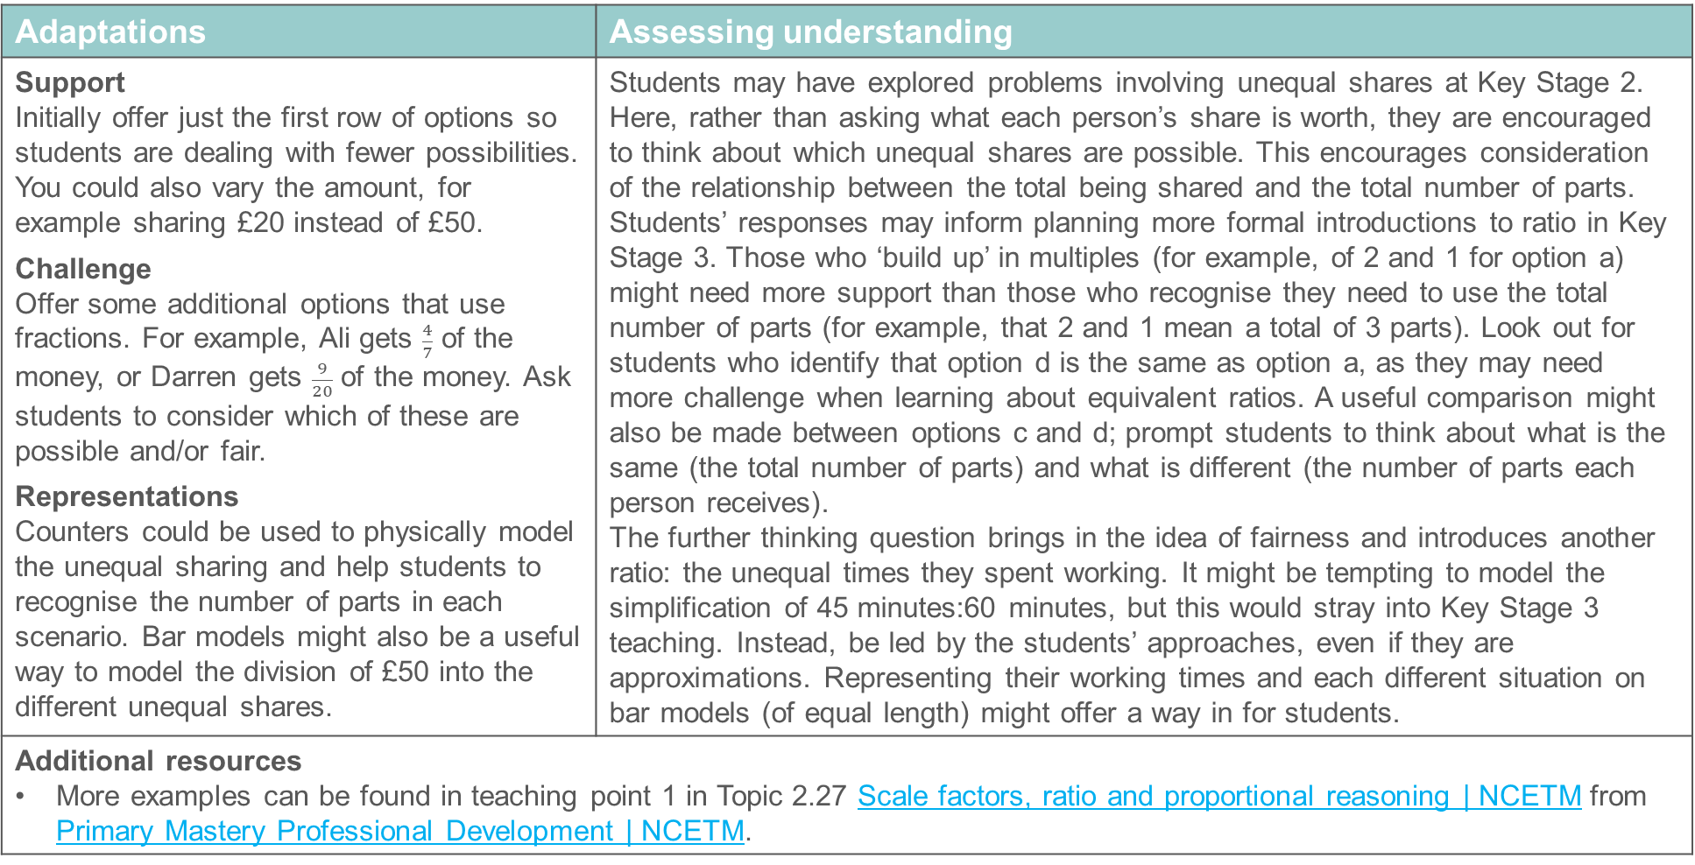
Checkpoint 26: Guidance
Adaptations | Assessing understanding
Support Initially offer just the first row of options so students are dealing with fewer possibilities. You could also vary the amount, for example sharing £20 instead of £50. Challenge Offer some additional options that use fractions. For example, Ali gets $\frac{4}{7}$ of the money, or Darren gets $\frac{9}{20}$ of the money. Ask students to consider which of these are possible and/or fair. Representations Counters could be used to physically model the unequal sharing and help students to recognise the number of parts in each scenario. Bar models might also be a useful way to model the division of £50 into the different unequal shares. | Students may have explored problems involving unequal shares at Key Stage 2. Here, rather than asking what each person’s share is worth, they are encouraged to think about which unequal shares are possible. This encourages consideration of the relationship between the total being shared and the total number of parts. Students’ responses may inform planning more formal introductions to ratio in Key Stage 3. Those who ‘build up’ in multiples (for example, of 2 and 1 for option a) might need more support than those who recognise they need to use the total number of parts (for example, that 2 and 1 mean a total of 3 parts). Look out for students who identify that option d is the same as option a, as they may need more challenge when learning about equivalent ratios. A useful comparison might also be made between options c and d; prompt students to think about what is the same (the total number of parts) and what is different (the number of parts each person receives). The further thinking question brings in the idea of fairness and introduces another ratio: the unequal times they spent working. It might be tempting to model the simplification of 45 minutes:60 minutes, but this would stray into Key Stage 3 teaching. Instead, be led by the students’ approaches, even if they are approximations. Representing their working times and each different situation on bar models (of equal length) might offer a way in for students.
Additional resources More examples can be found in teaching point 1 in Topic 2.27 Scale factors, ratio and proportional reasoning | NCETM from Primary Mastery Professional Development | NCETM.

Slide 66
Checkpoint 27: Euros
A group of three friends are going on holiday. They all exchange some pounds for euros.
Who got the best deal?
I got €90 for £60.
I got €120 for £100.
I got €30 for £20.
Leila
Josh
Reese
A fourth friend, Keshana, exchanged €110 for £100. Whose deal was hers most similar to?
Notes:
This slide is animated. Each question will appear separately so you can choose the pace at which to work with your class.
Answers
Answers are given using the number of euros per pound, but this is not an expectation from students. They may choose different comparisons or scaling to reach their conclusions; for example, by working out how much Reese would have got for £100.
Reese and Leila both got the best deal (€1.50 for every £1.00) while Josh received €1.20 for every £1.00.
? Keshana receives €1.10 for every £1.00, so her deal is closer to Josh’s than the other two.
Suggested questioning
Why can't we compare them easily as they are at the moment?
Which two are easiest to compare? Why?
Could you say, for example, how many € Josh got for £10?
Things to think about
This final Checkpoint is perhaps the closest to a Key Stage 3-style question but with numbers that are approachable enough for most Year 7 students to be able to make some attempt. It provides another real-life context for multiplicative reasoning, to allow you to see what strategies and representations students use to break down the problem.

Slide 67
Checkpoint 27: Guidance
Adaptations | Assessing understanding
Support Ask students to write down other values that they can find. How you present the task to students may help them to make connections – for example, arrange in lists of multiples or on a double number line. Challenge On holiday, it's useful to have a strategy to estimate the cost of an item in £ when it is displayed in €. Ask students to devise methods they can do quickly in their heads, that they could use for the exchange rates in the task. Representations If your students are familiar with double number lines, it is a useful representation to use here. | Checkpoint 27 offers students a chance to reason proportionally and to use known facts to find other facts. Although the context may not be familiar, students should be able to reason that if, for example, €120 cost £100, then the cost of other quantities can be found. This may be a first step in accessing the task, and a first assessment point. Consider also whether students can target particular values so that they are able to make comparisons. For example, they may be comfortable with doubling and halving values, but less confident when comparing Reese and Leila’s exchange rates since a factor of three is required. Note whether they know that making two of the values the same is a key part of comparing. While the intention is that students bring their own strategies so that you can assess readiness for working with ratio at Key Stage 3, you may need some prompts help to ‘unlock’ the situation. All the values are divisible by 10, so asking students how many Euros they would receive for £10 in each situation may support them in making the required comparison. For those who are familiar with foreign travel and exchanging currency, clarify that there are no additional charges in this example.
Additional resources Key Idea 3.1.2.2 from Secondary Mastery Professional Development | NCETM explores ‘the language and notation of ratio’ and gives ideas about how to develop this concept further at Key Stage 3.

Slide 68
Additional activities
Activities A–M

Slide 69
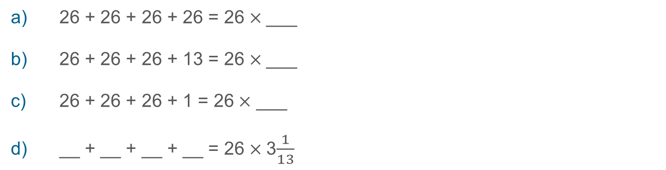
Activity A: Multiply 26
26 + 26 + 26 + 26 = 26$×$ ___
26 + 26 + 26 + 13 = 26$×$ ___
26 + 26 + 26 + 1 = 26$×$ ___
__ + __ + __ + __ = 26$×$ 3$\frac{1}{13}$
What other calculations can you write with ‘3 and a bit’ 26s?
Notes:
This slide is animated. Each question will appear separately so you can choose the pace at which to work with your class.
Answers
All answers are given as mixed numbers, with the fractional part in its simplest form. Equivalent fractional or decimal answers are also valid.
a) 26 + 26 + 26 + 26 = 26 × 4
b) 26 + 26 + 26 + 13 = 26 × 3$\frac{1}{2}$
c) 26 + 26 + 26 + 1 = 26 × 3$\frac{1}{26}$
d) 26 + 26 + 26 + 2 = 26 × 3$\frac{1}{13}$
? Any valid statement in the pattern 26 + 26 + 26 + 26 + n = 26 × $3\frac{n}{26}$, for example 26 + 26 + 26 + 5 = 26 × $3\frac{5}{26}$
Suggested questioning
What is the same/different about each product?
What fraction of 26 is being added when you add 13? How about 1? How can this help you write the product?
Could any number be used as the fourth number in the addition? Why?
Could you use these to write any other calculations?
Things to think about
Additional activity A uses the same structure as Checkpoint 3, but uses a number with fewer factors that is less likely to have familiarity from known multiplication facts. Can students apply the same reasoning here? The variety of answers that they generate for the further thinking question will be particularly telling. See the guidance slide for Checkpoint 3 for more assessment information.

Slide 70












Activity B: Missing multipliers (version 1)
Write a number in each red box so that the multiplication is correct.
$$×$$
$$=$$
$$×$$
$$=$$
6
9
d)
10
1
a)
$$×$$
$$=$$
$$×$$
$$=$$
6
8
e)
6
1
b)
$$×$$
$$=$$
$$×$$
$$=$$
c)
6
7
f)
15
1
Create your own examples. Can you create an example where the product is not an integer?
Notes:
This slide is animated. The questions will appear separately so you can choose the pace at which to work with your class.
Answers
All answers are given as mixed numbers, with the fractional part in its simplest form. Equivalent fractional or decimal answers are also valid. Example equivalent answers are only provided for decimals that might potentially be known to Year 7 students (although there is no expectation that these will be known).
a) 6 × 1$\frac{1}{2}$ = 9 or 6 × 1.5 = 9 or equivalent
b) 6 × 1$\frac{1}{3}$ = 8 or 6 × 1.$\dot{3}$ = 8 or equivalent
c) 6 × 1$\frac{1}{6}$ = 7 or 6 × 1.$1\dot{6}$ = 7 or equivalent
d) 10 × $\frac{1}{10}$ = 1 or 10 × 0.1 = 1 or equivalent
e) 6 × $\frac{1}{6}$ = 1 or 6 × 0.$1\dot{6}$ = 1 or equivalent
f) 15 × $\frac{1}{15}$ = 1 or equivalent
? Any correct multiplication.
Suggested questioning
Is the multiplier an integer? How do you know?
Will you use fractions or decimals for your multipliers? Why?
How could you use one of the other examples to help you?
Things to think about
Additional activity B offers a set of questions to support conversations around non-integer multipliers. The values and design have been chosen so that the activity could act as a follow up to Checkpoint 5. Parts a to c look at the same multiplier, with a sequence of products that reduces by one each time. Can students reason about the relationship between them? They may find this easier if their answer to part a is written using sixths rather than its simplest form. Parts d to f look at the misconception that ‘multiplication always makes bigger’, keeping the product of one constant throughout. Do students recognise that their answer each time will be a unit fraction, with the multiplicand as the denominator? Ten is chosen as the ‘springboard’ into this set as students may be familiar with the equivalence of dividing by 10 and multiplying by one-tenth.

Slide 71
















Activity C: Missing multipliers (version 2)
Write a number in each red box so that the multiplication is correct.
$$×$$
$$=$$
a)
8
16
$$×$$
$$=$$
10
16
$$×$$
$$=$$
b)
8
12
$$×$$
$$=$$
9
16
$$×$$
$$=$$
c)
8
10
$$×$$
$$=$$
7
16
$$×$$
$$=$$
d)
8
9
$$×$$
$$=$$
e)
8
13
Notes:
This slide is animated. The questions will appear separately so you can choose the pace at which to work with your class.
Answers
All answers are given as mixed numbers, with the fractional part in its simplest form. Equivalent fractional or decimal answers are also valid. Example equivalent answers are only provided for decimals that might potentially be known to year 7 students (although there is not necessarily an expectation that these will be known).
a) 8 × 2 = 24
b) 8 × 1$\frac{1}{2}$ = 12 or 8 × 1.5 = 12 or equivalent
c) 8 × 1$\frac{1}{4}$ = 10 or 8 × 1.25 = 10 or equivalent
d) 8 × 1$\frac{1}{8}$ = 9 or 8 × 1.125 = 9 or equivalent
e) 8 × 1$\frac{5}{8}$ = 13 or 8 × 1.625 = 13 or equivalent
?
f) 10 × 1$\frac{3}{5}$ = 16 or 10 × 1.6= 16 or equivalent
g) 9 × 1$\frac{7}{9}$ = 16 or equivalent
h) 7 × 2$\frac{2}{7}$ = 16 or equivalent
Suggested questioning
Is the multiplier an integer? How do you know?
Will you use fractions or decimals for your multiplier? Why?
How could you use one of the other examples to help you?
Things to think about
Additional activity C offers another set of questions to support conversations around non-integer multipliers. The values and design have been chosen so that the activity could act as a follow up to both Checkpoints 4 and 5. Note that the further thinking question keeps the product constant but varies the multiplicand, so that students cannot use related multiplications to support them as they may have done in the main task. Students’ approaches to this problem may reveal how flexibly they think about multiplication and fractions. They may attempt to divide 16 by each value, resulting in long strings of decimals, or they may realise that they can write the remainder as a fraction with the multiplicand as the denominator. The most confident students may be able to reason this without formally dividing (for example, reasoning that if 7 × 2 = 14, then 7 × 2$\frac{2}{7}$ = 16). This may indicate a greater level of fluency with improper fractions.

Slide 72



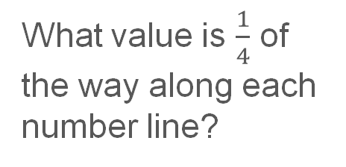
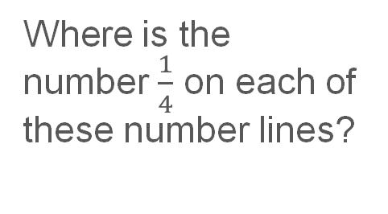
Activity D: What is one-quarter?
What value is $\frac{1}{4}$ of the way along each number line?
a)
0
1
b)
0
2
c)
0
10
d)
Where is the number $\frac{1}{4}$ on each of these number lines?
0
$$\frac{3}{4}$$
e)
0
$$\frac{1}{3}$$
f)
0
$$\frac{1}{5}$$
Notes:
This slide is animated. Each question will appear separately so you can choose the pace at which to work with your class. A printable resource can be found on slide 84.
Answers
a) $\frac{1}{4},$b) $\frac{1}{2},$c) 2$\frac{1}{2},$d) $\frac{3}{16},$e) $\frac{1}{12},$f) $\frac{1}{20}$
? The answers to this can be found on next slide, which is animated.
Suggested questioning
What position will $\frac{1}{4}$ be in? Is this the same or different each time?
What will the value of $\frac{1}{4}$ be? Is this the same or different each time?
How can you find $\frac{1}{4}$? What other values might help you?
Which is the easiest? Which is the most challenging?
Are the easiest/most challenging the same for the further thinking question?
Things to think about
Additional activity D may be familiar to those that have used the ‘Arithmetic procedures with fractions’ deck of Checkpoints. This uses the same structure as Checkpoint 2 from that deck but reverses the main task and the further thinking question. In its original form, the Checkpoint was entitled ‘Where is one-quarter?’ and focused on the position of the number one-quarter within the number system. Here, the title is ‘What is one quarter?’ and the focus is on using the number line as a visual representation for fractions of an amount. The position of the missing number won’t change, but its value will, depending on the number given further along the line each time. Consider how comparing and contrasting the two tasks might probe students’ understanding of fractions as both the process needed to find and answer, and as an answer in their own right. More information about this dual understanding can be found on p9 of the 1.3 Core Concept document, from within the Secondary Mastery Professional Development materials: https://www.ncetm.org.uk/classroom-resources/secmm-13-ordering-and-comparing/

Slide 73






Activity D: What is one-quarter? (animated solutions for further thinking questions)
a)
0
$$\frac{1}{4}$$
1
b)
0
$$\frac{1}{4}$$
2
c)
0
$$\frac{1}{4}$$
10
d)
Where is the number $\frac{1}{4}$ on each of these number lines?
0
$$\frac{1}{4}$$
$$\frac{3}{4}$$
e)
0
$$\frac{1}{4}$$
$$\frac{1}{3}$$
f)
0
$$\frac{1}{5}$$
$$\frac{1}{4}$$
Notes:
Clicking through this slide will reveal the position of $\frac{1}{4}$ in parts a to f. Please note that there is no expectation of particularly accurate positioning, rather that students have a general sense of the relative size of $\frac{1}{4}$ compared with the given value each time.

Slide 74
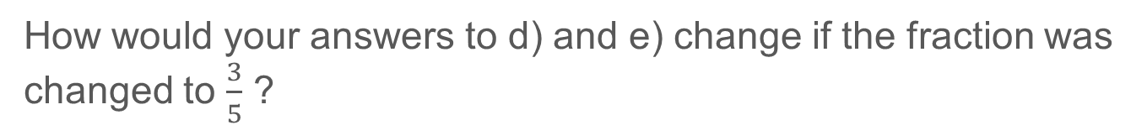
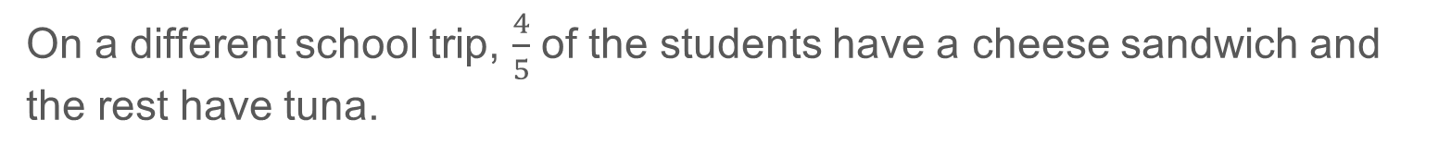
Activity E: Sandwiches
On a school trip, $\frac{3}{4}$ of the students have a cheese sandwich and the rest have tuna.
Which of these is a possible number of each type of lunch?
30 cheese and 40 tuna
30 cheese and 10 tuna
How many times more cheese sandwiches are there than tuna?
Suggest some more possible numbers of cheese and tuna sandwiches
On a different school trip, $\frac{4}{5}$ of the students have a cheese sandwich and the rest have tuna.
How many times more cheese sandwiches are there than tuna?
Suggest some possible numbers of cheese and tuna sandwiches.
How would your answers to d) and e) change if the fraction was changed to $\frac{3}{5}$ ?
Notes:
This slide is animated. Each question will appear separately so you can choose the pace at which to work with your class.
Answers
a) 30 cheese and 10 tuna.
b) There are three times more cheese sandwiches than tuna.
c) Any valid pair of numbers where the number of cheese is three times the number of tuna, for example 33 and 11 or 45 and 15.
d) Four times more cheese sandwiches than tuna.
e) Any valid pair of numbers where the number of cheese is four times the number of tuna, for example 44 and 11 or 60 and 15.
? d) There would now be $1\frac{1}{2}$ times more cheese than tuna.
e) The total number of sandwiches could stay the same, but the proportions involved would change so that cheese was $1\frac{1}{2}$ times the value of tuna – for example 44 and 11 would change to 33 and 22, and 60 and 15 would change to 50 and 25.
Suggested questioning
Why is 30 cheese and 40 tuna not the same as $\frac{3}{4}$ cheese?
If it was 30 cheese and 40 tuna, what fraction would be cheese?
What is the same and different between parts a to c and d to e?
Could you have the same total number of sandwiches for parts c and e?
Things to think about
Additional activity E probes the same understanding as Checkpoint 24: whether students can interpret a relationship described in terms of the relationship of a part to the whole, and use this to describe the relationship between the parts. Further assessment information about this general concept can be found on the guidance slide to that Checkpoint. Here, the fractions given are the same but more scaffolding is provided to break down the reasoning for students – particularly by giving examples of possible values which feature a correct answer and a common misconception. This may help students to visualise the relationship, and could be further supported by a representation such as a bar model. Asking students to provide their own suggested numbers allows you to reinforce that the total number of sandwiches is irrelevant here, as long as the same relationship between the two types is maintained.

Slide 75
Activity F: Chocolates
The chocolates in this box either have red or blue wrappers.
For every two red chocolates, there is one blue chocolate.
Draw a possible number of chocolates in the box.
If there are 10 red chocolates, how many blue chocolates are there?
If there are 10 blue chocolates, how many red chocolates are there?
Is it possible for there to be 10 chocolates in total? Why or why not?
There are 10 more red chocolates than blue. How many are there in total?
How would your answers for b) to e) change if the number was 12 instead of 10?
Notes:
This slide is animated. Each question will appear separately so you can choose the pace at which to work with your class.
Answers
a) Any valid pair of numbers, where the number of red is twice the number of blue (and the total number of chocolates is therefore a multiple of three).
b) Five blue chocolates.
c) Twenty red chocolates.
d) No, as 10 is not a multiple of three. Every two red needs one blue, meaning that chocolates are ‘added’ in groups of three.
e) 30 chocolates (20 red, 10 blue).
? b) Six blue chocolates; c) 24 red chocolates; d) Yes, as 12 is a multiple of three and there could therefore be 8 red and four blue; e) 36 chocolates (24 red, 12 blue)
Suggested questioning
What do you notice about everyone’s answers to part a? What is the same about all of these values?
What is the same/different about parts __ and __?
In which situation will there be the most chocolates in total?
Which of these questions did you find easiest? Why?
Things to think about
Activity F is identical to Checkpoint 25, but presents the relationship between the parts in words rather than using ratio notation. Use this as an alternative if students are entirely unfamiliar with the notation. (This is possible, as it is only mentioned in non-statutory guidance for Year 6). This will allow you to still assess the understanding of the relationship through the rest of the questions. See the Guidance slide for Checkpoint 25 for more information.

Slide 76
Activity G: Photographs
On a standard photo, the ratio of the length of the short side to the length of the long side is 2:3.
Which of these could be standard photographs?
E
D
7 inches
3 cm
A
4.5 cm
C
B
100 mm
33 cm
36 cm
5 inches
60 mm
10 cm
F
21 cm
15 cm
30 mm
24 cm
G
2 cm
How could you change one measurement of any of the photos so that they were standard photographs?
Notes:
This slide is animated. Each question will appear separately so you can choose the pace at which to work with your class. It is suggested that part G is only used if your class would benefit from the additional challenge of mixed units of measurement.
Answers
B, E, F and G could be standard photos.
?
A: Change 7 inches to 7.5 inches. An alternative, but less likely, answer would be to change to 5 inches to $\frac{14}{3}$ = $4\frac{2}{3}$ inches.
C: Change 100 mm to 90 mm. An alternative, but less likely, answer would be to change to 60 mm to $\frac{200}{3}$ = $66\frac{2}{3}$ mm.
D: Change 21 cm to 22 cm. An alternative, but less likely, answer would be to change to 33 cm to 31$\frac{1}{2}$ cm).
Suggested questioning
What does the ratio 2:3 mean?
Can you describe the relationship between the longest and shortest lengths another way?
How can you check if these are in the ratio 2:3?
Which was most obvious? Which was least obvious?
Things to think about
As with Checkpoint 25, this Activity is unusual among this deck of Checkpoints as it explicitly uses the ratio notation that students will be taught at Key Stage 3. This activity is intended for those students who have readily understood the notation and relationships. At Key Stage 3, you may expect students to think about scaling the given ratio (2:3) using one of the lengths given, to see if the other length matches; or to divide the longer length by the shorter to give a value of 1.5. Before teaching at Key Stage 3, Year 7 students may not use such formal approaches but still have sound reasoning; the intention is to see what understanding they bring, and how they naturally notate their thinking. Further challenge is introduced through the conversion of units in part G. Consider not including this question if students will find the extra step confusing. Conversely, consider changing the units on more of the questions if you are giving this task as extra challenge for those who are confident.

Slide 77
Printable resources

Slide 78

Notes:
This printable resource (two per page) is for use with Checkpoint 2.

Slide 79
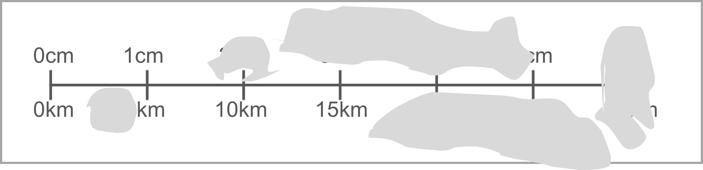
Notes:
This printable resource is for use with Checkpoint 6.

Slide 80
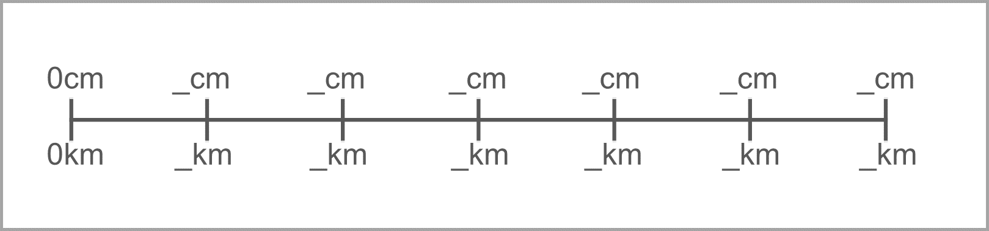
Notes:
This blank printable resource could be used to adapt Checkpoint 6 with more challenging values.

Slide 81
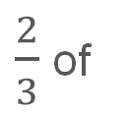
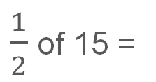






a)
$\frac{1}{2}$ of 15 =
$\frac{1}{2}$ of
= 15
b)
$\frac{1}{3}$ of 15 =
$\frac{1}{3}$ of
= 15
c)
d)
$\frac{2}{3}$ of 15 =
$\frac{2}{3}$ of
= 15
e)
f)
$\frac{3}{5}$ of 15 =
$\frac{3}{5}$ of
g)
h)
= 15
Notes:
These bar models are for use with Checkpoint 15.

Slide 82






Match the bar model to the question.
Then use the bar model to help you answer the question.
Henry earns £40 from washing up, and saves $\frac{1}{5}$ of his earnings. How much does he save?
Jaanvi earns £16 from a paper round, and spends $\frac{3}{8}$ of it. How much does she save?
Jimmy saves £16 of his babysitting money. This is $\frac{2}{3}$ of his earnings. How much does he earn?
Which of the three bar models might help you to answer this question?
Nishma earns £40 from dog walking, and saves £16. What fraction of her earnings does she save?
Notes:
This printable resource is a slightly adapted version of Checkpoint 16. The first three questions have been represented using bar models, which students first need to match to the appropriate question. Nishma’s question uses a different structure, and so it is presented separately and students need to choose which of the previous 3 bar models might help them.
Answers
Henry – bottom bar model (saves £8)
Jaanvi – top bar model (saves £10)
Jimmy – middle bar model (earns £24)
Nishma – the bottom bar model (saves $\frac{2}{5}$)

Slide 83
Number of flowers
Number of petals
Number of leaves
Number of flowers
Number of petals
Number of leaves
Number of flowers
Number of petals
Number of leaves
Number of flowers
Number of petals
Number of leaves
Notes:
These tables are for use with Checkpoint 21.

Slide 84



a)
0
1
b)
0
2
c)
0
10
d)
0
$\frac{3}{4}$
e)
0
$\frac{1}{3}$
f)
0
$\frac{1}{5}$
Notes:
This printable resource is for use with Additional activity D.

