Slide 1
2.3 Times tables: Groups of 2 and commutativity (part 1)
Representations | Year 2
Multiplication and Division

Slide 2
How to use this presentation
You can find the teacher guide 2.3 Times tables: Groups of 2 and commutativity (part 1) by following the link below.

Slide 3
2.3 The 2 times table and commutativity Step 1:1
0
2
4
6
8
10
12
14
16
18
20
22
24

Slide 4
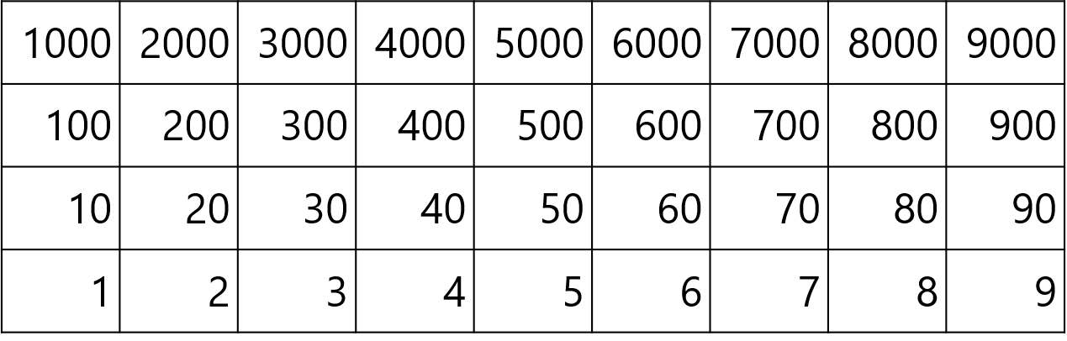
2.3 The 2 times table and commutativity Step 1:1

Slide 5






2.3 The 2 times table and commutativity Step 1:1
10
12
14
16
18
20
22
24
0
2
4
6
8
twenty-four
twenty-two
eighteen
fourteen
sixteen
twenty
twelve
eight
zero
four
two
ten
six

Slide 6
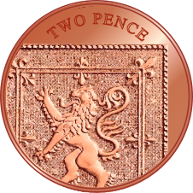
2.3 The 2 times table and commutativity Step 1:1
10
12
14
16
18
20
22
24
0
2
4
6
8
twenty-four
twenty-two
eighteen
fourteen
sixteen
twenty
twelve
eight
zero
four
two
ten
six

Slide 7



2.3 The 2 times table and commutativity Step 1:2
3 × 2 = 6
6 = 3 × 2
Notes:
How many shoes are there? Count in groups of two.
There are six shoes.
How many groups of shoes are there? How many shoes are there in each group?
‘There are three groups of shoes. There are two shoes in each group.‘
There are three groups of two; there are six altogether.

Slide 8
2.3 The 2 times table and commutativity Step 1:3
3 | × | 2 | = | 6
factor | × | factor | = | product
6 | = | 3 | × | 2
product | = | factor | × | factor

Slide 9

2.3 The 2 times table and commutativity Step 1:4
4 × 2 = 8
8 = 4 × 2
Notes:
There are four bicycles.
Each bicycle has two wheels.
There are four groups of two.
How many wheels are there altogether?
Two, four, six, eight
There are eight wheels
Four is a factor. Two is a factor.
The product of four and two is eight.
Eight is the product of four and two.

Slide 10





2.3 The 2 times table and commutativity Step 1:5
2 × 2 = 4
1 × 2 = 2
0 × 2 = 0
3 × 2 = 6

Slide 11
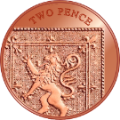

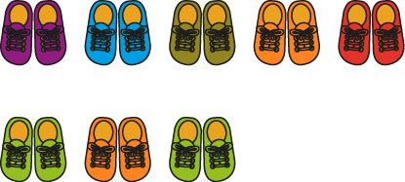
2.3 The 2 times table and commutativity Step 1:6
8 × 2 = 16
5 × 2 = 10
3 × 2 = 6
Notes:
Match each equation with the correct picture.

Slide 12

2.3 The 2 times table and commutativity Step 1:6
Complete the drawing
12 = 6 × 2
Notes:
Iniko started drawing some pairs of mittens. Complete his drawing to match the equation.

Slide 13

2.3 The 2 times table and commutativity Step 2:1
Number of pairs of shoes | Number of shoes
0 × 2 = 0
0
0
1 × 2 = 2
1
2
2 × 2 = 4
2
4
3 × 2 = 6
3
6
4 × 2 = 8
4
8

Slide 14
2.3 The 2 times table and commutativity Step 2:2
Number of pairs of shoes | Number of shoes
0 | 0
1 | 2
2 | 4
3 | 6
4 | 8
5 | 10
6 | 12
7 | 14
8 | 16
9 | 18
10 | 20
11 | 22
12 | 24
0 × 2 = 0
1 × 2 = 2
2 × 2 = 4
3 × 2 = 6
4 × 2 = 8
5 × 2 = 10
6 × 2 = 12
7 × 2 = 14
8 × 2 = 16
9 × 2 = 18
10 × 2 = 20
11 × 2 = 22
12 × 2 = 24

Slide 15



2.3 The 2 times table and commutativity Step 2:4
one 2 is 2
two 2s are 4
three 2s are 6
four 2s are 8
five 2s are 10
eleven 2s are 22
twelve 2s are 24
seven 2s are 14
eight 2s are 16
nine 2s are 18
ten 2s are 20
six 2s are 12
1 × 2 = 2
2 × 2 = 4
3 × 2 = 6
4 × 2 = 8
5 × 2 = 10
10 × 2 = 20
11 × 2 = 22
12 × 2 = 24
6 × 2 = 12
7 × 2 = 14
8 × 2 = 16
9 × 2 = 18

Slide 16

2.3 The 2 times table and commutativity Step 2:5
How many eyes do the children have altogether?
3 × 2 =
6
Notes:
Complete the equation to show how many eyes the children have altogether.

Slide 17
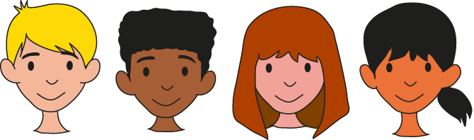
2.3 The 2 times table and commutativity Step 2:5
How many eyes do the children have altogether?
4
× 2 =
8
Notes:
Complete the equation to show how many eyes the children have altogether.

Slide 18

2.3 The 2 times table and commutativity Step 2:5
How many eyes do the children have altogether?
5
×
2
=
10
Notes:
Complete the equation to show how many eyes the children have altogether.

Slide 19


2.3 The 2 times table and commutativity Step 2:7
 | × 2
0 | 0
1 | 2
2 | 4
3
4 | 8
5 | 10
6 | 12
7
8 | 16
9 | 18
10 | 20
11 | 22
12 | 24
 | × 2
2 | 4
3
14
↑ − 2
↓ + 2
3 × 2 = 2 × 2 + 2
7 × 2 = 8 × 2 − 2
6
 | × 2
7
8 | 16
+ 2
− 2
0
2
4
6
8
10
12
14
16
18
20

Slide 20
2.3 The 2 times table and commutativity Step 2:7
 |  | Factor
 | × | 1 | 2
Factor | 1
 | 2
 | 3
 | 4
 | 5
 |  | Factor
 | × | 1 | 2
Factor | 1
 | 2
 | 3
 | 4
 | 5
 | 6
5 × 2 =
10
6 × 2 =
5 × 2 +
2
6 × 2 =
10 +
2
6 × 2 =
12

Slide 21
2.3 The 2 times table and commutativity Step 3:1
0 × 2 = 0
1 × 2 = 2
2 × 2 = 4
3 × 2 = 6
4 × 2 = 8
5 × 2 = 10
6 × 2 = 12
7 × 2 = 14
8 × 2 = 16
9 × 2 = 18
10 × 2 = 20
11 × 2 = 22
12 × 2 = 24
2 × 0 = 0
2 × 1 = 2
2 × 2 = 4
2 × 3 = 6
2 × 4 = 8
2 × 5 = 10
2 × 6 = 12
2 × 7 = 14
2 × 8 = 16
2 × 9 = 18
2 × 10 = 20
2 × 11 = 22
2 × 12 = 24

Slide 22
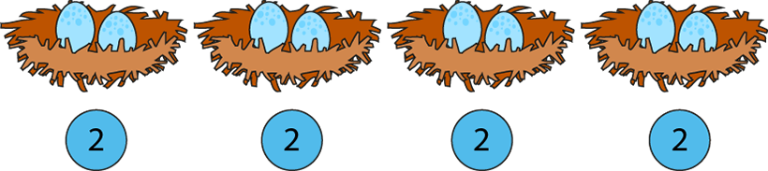
2.3 The 2 times table and commutativity Step 3:3
2 + 2 + 2 + 2 = 8
4 × 2 = 8
2 × 4 = 8
Notes:
There are four groups of two eggs. There are eight eggs altogether.
There are two eggs, four times. There are eight eggs altogether.

Slide 23

2.3 The 2 times table and commutativity Step 3:4
4 × 2 =
8
2 × 4 =
8

Slide 24
2.3 The 2 times table and commutativity Step 3:4
9
×
2
=
18
2
×
9
=
18

Slide 25
2.3 The 2 times table and commutativity Step 3:4
7 × 2 = 14
2 × 7 = 14

