Slide 1
Similar Shapes
KS3 Mastery PD Materials: Exemplified Key Ideas
Materials for use in the classroom or to support professional development discussions
(From 6.1 Geometrical properties)
Summer 2021

Slide 2
About this resource
These slides are designed to complement the 6.1 Geometrical properties Core Concept document and its associated Theme Overview document 6 Geometry, both found in the Secondary Mastery Professional Development pages.
These slides re-present the key examples from the Core Concept document so that the examples can be used either directly in the classroom or with a group of teachers. There are prompt questions alongside the examples, and further clarification in the notes.
These slides do not fully replicate the Core Concept document, so should be used alongside it. Reference to specific page numbers, and to other useful NCETM resources, can be found in the notes for each slide.
This slide deck is not designed to be a complete PD session, rather it is a selection of resources that you can adapt and use as needed when planning a session with a group of teachers.

Slide 3


About this resource
The slides are structured as follows:
  The big picture:
    Where does this fit in?
    What do students need to understand?
    Why is this key idea important?
  Prior learning
  Misconceptions
  Exemplified key ideas
  Reflection questions
  Appendices:
    Key vocabulary
    Representations and structure
    Previous and Future learning
    Useful links
The exemplified key idea slides have the following symbols to indicate how they have been designed to be used:
Into the classroom
The examples are presented on these slides so that they could be used in PD, but also directly in the classroom. The notes feature suggested questions and things teachers might consider when using with students.
PD discussion prompts
These slides look at the examples in more detail, with question prompts to promote discussion among maths teachers. The notes feature reference to further information and guidance within the Core Concepts document.

Slide 4
Where does this fit in?
The NCETM has identified a set of six ‘mathematical themes’ within Key Stage 3 mathematics that bring together a group of ‘core concepts’.
The sixth of these themes is Geometry, which covers the following interconnected core concepts:
6.1 Geometrical properties
6.2 Perimeter, area and volume
6.3 Transforming shapes
6.4 Constructions
Notes:
Linked on this slide is the Theme Overview document of Geometry. This document includes why it is important, the key underpinning knowledge and links to prior and future learning. There is also guidance about how the five big ideas of Teaching for Mastery relate specifically to this theme.

Slide 5
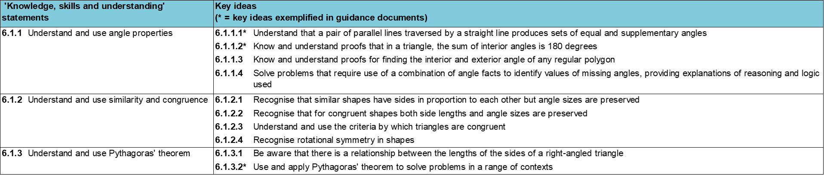
Where does this fit in?
Within this core concept, 6.1 Geometrical properties, there are three statements of knowledge, skills and understanding.
These, in turn, are broken down into ten key ideas. The highlighted key idea is exemplified in this slide deck.
Notes:
For key ideas marked with an asterisk, we have exemplified the common difficulties and misconceptions that students might have and included elements of what teaching for mastery may look like. We have provided examples of possible student tasks and teaching approaches.
Within these slides are ‘classroom-ready’ versions of the examples for the key idea that has been highlighted. There are also slides that may be useful for discussion in a professional development session

Slide 6
What do students need to understand?
6.1.2.1 Recognise that similar shapes have sides in proportion to each other but angle sizes are preserved
Appreciate the relationship between corresponding sides in similar shapes is multiplicative
Find the scalar multiplier between two sides in similar shapes
Find the functional multiplier between two sides within similar shapes
Understand angles are preserved in similar shapes
  What prior knowledge might your students already have?
  What language might they use to describe this key idea?
  What questions might you want to ask to assess their prior learning?

Slide 7
Why is this key idea important?
Students will already be familiar with similarity through their work on proportional reasoning. In this set of key ideas, the focus shifts to properties that may not have been explicitly addressed before, particularly the preservation of angle size when shapes are enlarged.
In studying similarity and congruence, students are required to go beyond intuitively recognising when shapes are similar or congruent, and to think about what can change and what has to stay the same for these properties to hold.
Exploring similarity and congruence with a range of polygons and triangles should help students refine their understanding of these concepts and avoid confusion between them.
Notes:
A more detailed overview of the core concept of Geometrical properties can be found on pages 8-11 of the 6.1 Core Concept document.
The background to each key idea is also explored in more detail on the following pages:
6.1.1 Understand and use angle properties – page 8
6.1.2 Understand and use similarity and congruence – page 9
6.1.3 Understand and use Pythagoras’ theorem – pages 9-11

Slide 8
Prior learning
Upper Key Stage 2 Learning Outcome
Recognise angles where they meet at a point, are on a straight line, or are vertically opposite, and find missing angles
Compare and classify geometric shapes based on their properties and sizes and find unknown angles in any triangles, quadrilaterals, and regular polygons
Solve problems involving similar shapes where the scale factor is known or can be found
  What prior knowledge might your students already have?
  What language might they use to describe this key idea?
  What questions might you want to ask to assess their prior learning?
Notes:
You may find it useful to speak to your partner schools to see how the above has been covered and the language used.
You can find further details regarding prior learning in the following segment of the NCETM primary mastery professional development materials¹:
Year 6: 2.27 Scale factors, ratio and proportional reasoning
Within the 6 Theme Overview document, you can also find a broader description of students’ potential previous learning (page 3), alongside further information about key underpinning knowledge (page 2).

Slide 9
Checking prior learning
The following slides contain questions for checking prior learning.
  What representations might students use to support their understanding of these questions?
  What variation might you put in place for these questions to fully assess students’ understanding of the concept?
  How might changing the language of each question change the difficulty?
  Why are these such crucial pre-requisites for this key idea?

Slide 10
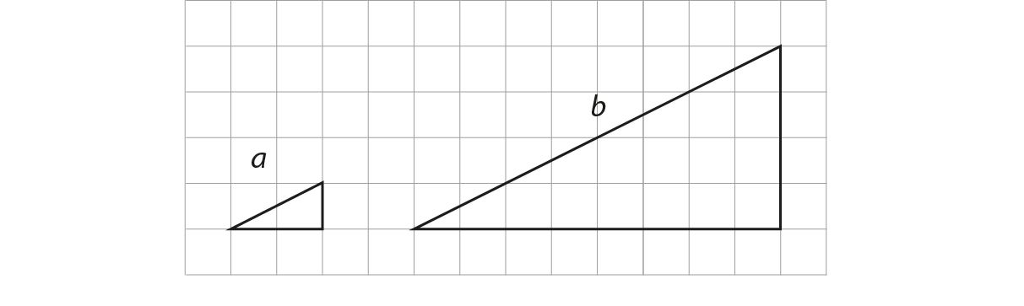
Checking prior learning (1)
a) Here are two similar right-angled triangles. Write the ratio of side a to side b.
Notes:
References to the questions (links on final slide):
a) 2017 Key Stage 2 Mathematics Paper 2: reasoning, Question 22

Slide 11
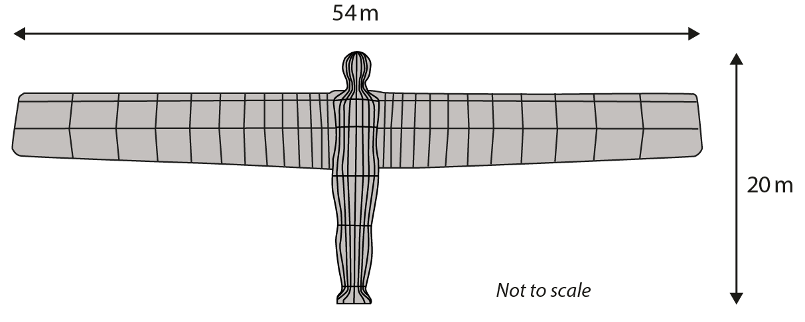
Checking prior learning (2)
b) The Angel of the North is a large statue in England.
It is 20 metres tall and 54 metres wide.
Ally makes a scale model of the Angel of the North.
Her model is 40 centimetres tall.
How wide is her model?
Notes:
References to the questions (links on final slide):
a) 2018 Key Stage 2 Mathematics Paper 3: reasoning, Question 9

Slide 12
Common difficulties and misconceptions
What aspects of this key idea might pupils find challenging?
What misconceptions might pupils have?
When teaching this topic, you may find students encounter difficulties with…
Recognising the multiplicative structure/finding the multipliers
The mathematical definition of ‘similarity’
More information, and some suggestions for overcoming these challenges, can be found on the following slides

Slide 13
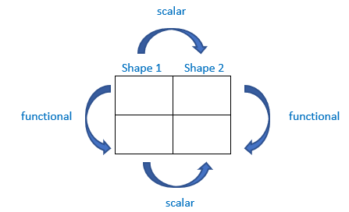
Common difficulties and misconceptions (1)
Students can intuitively recognise similar and congruent shapes without fully appreciating what can change and what has to stay the same for these properties to hold. It is important for students to go beyond their intuition and think deeply about the multiplicative relationships connecting the sides of similar shapes.
Some students may have difficulties recognising the multiplicative structure and finding the multipliers, so resort to additive methods (see Examples 3 and 4). Some students may also not appreciate angle preservation in similar shapes (see Examples 6 and 7).
A ratio table is a powerful representation to explore and find the scalar and functional multipliers in similar shapes.
Notes:
More detail can be found on page 23 of the 6.1 Core Concept document.

Slide 14
Common difficulties and misconceptions (2)
Some students have difficulties with the concept of similarity as they use the English dictionary definition of the word ‘similar’ – i.e. shapes with a resemblance in appearance without being identical – rather than the mathematical definition.
“Similar shapes have corresponding sides proportional and corresponding angles equal.”
Notes:
This can also be found on page 23 of the 6.1 Core Concept document.

Slide 15





Appreciate the relationship between corresponding sides in similar shapes is multiplicative
Example 1
Which photos are similar?
A
B
C
D
E
Notes:
Suggested questioning:
What does ‘similar’ mean?
How does the circle/smiley face help you to see where photos are not similar?
Where the shapes are NOT similar, what would need to change to make them similar?
Things for you to think about:
The images in Example 1 are designed to prompt discussions about what can change and what has to stay the same for photos to be similar and the use of a regular shape, in this case a circle, means that distortions are easily seen.

Slide 16
Appreciate the relationship between corresponding sides in similar shapes is multiplicative
Example 1
  How do you define ‘similar’ with your students?
  How might an example like this support students to appreciate the mathematical definition of similarity?
  What else do students need experience of to ‘complete’ their definition?
Which photos are similar?
A
B
C
D
E
Notes:
This example can be found on page 23 of the 6.1 Core Concept document.

Slide 17
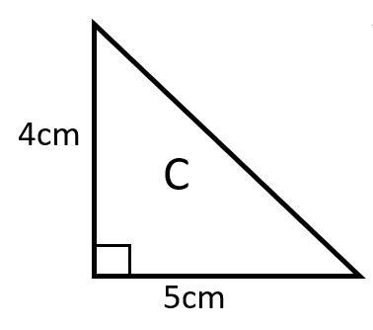
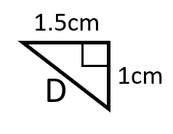
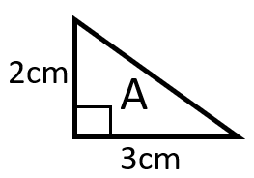
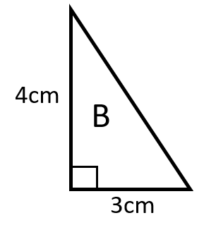
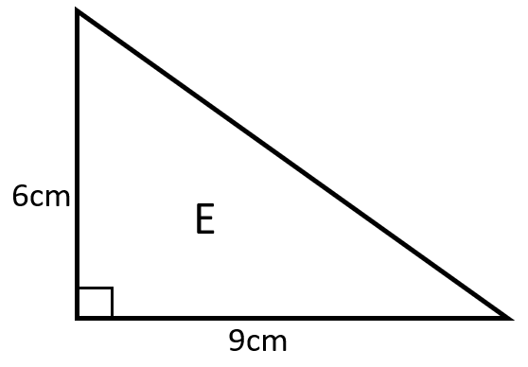
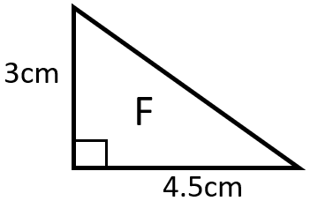
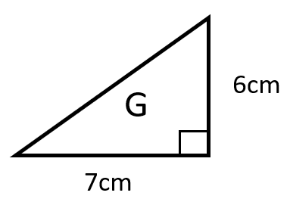
Appreciate the relationship between corresponding sides in similar shapes is multiplicative
Example 2
Tick the triangles similar to triangle A.
Notes:
Suggested questioning:
Can you create some more triangles similar to A?
How could you change your non-similar triangles to ensure that they are similar? Is there more than one way to do this?
Things for you to think about:
The introduction of dimensions in Example 2 requires students to go beyond intuitively recognising when shapes are congruent. The triangle support students’ awareness of what can change and appreciate the relationship between corresponding sides in similar shapes is multiplicative (triangles D, E and F) not additive (triangle C and G).
Students’ thinking can be deepened by asking more probing questions such as: “find two triangles similar to triangle C”, “find two triangles similar to triangle E with non-integer values”.

Slide 18
Appreciate the relationship between corresponding sides in similar shapes is multiplicative
Example 2
  Do we present similar shapes in ‘standard’ or different orientations such as triangles D and G in Example 2?
  Does the different orientation encourage students to use the measures rather than intuition?
  Example 2 uses right-angled triangles. What range of shapes might be useful to help students refine their understanding of similarity?
Tick the triangles similar to triangle A.
Notes:
This example can be found on page 24 of the 6.1 Core Concept document.

Slide 19
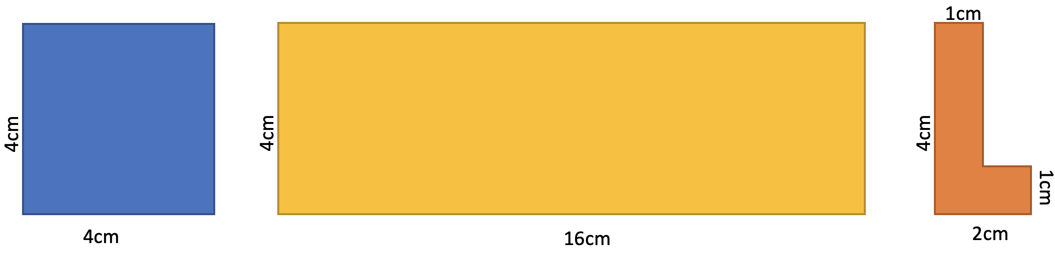
Appreciate the relationship between corresponding sides in similar shapes is multiplicative
Example 3
Emma, Feona and Georgia are asked to create a set of shapes that are similar to these.
I’m going to add 5 to each length
I’m going to multiply each length by 0.5
I’m going to multiply each length by 5
Emma
Feona
Georgia
All of the methods work for one of the shapes. Which shape is it?
Which methods work for all three shapes? Would those methods work for every shape?
Notes:
This slide is animated so as not to overwhelm students with too much information in one go.
Suggested questioning:
Is adding 5 an appropriate method? Why does it work for one of the shapes?
What happens when you use Emma’s method on the other shapes? Why does this happen?
(An example of a possible outcome for Emma’s method on the L-shape is on page XX of the 6.1 Core Concept document)
Things for you to think about:
Example 3 draws attention to the importance of multiplicative rather than additive enlargement. The square is used here as an example of a context where an additive approach will create a similar shape. Attention could be drawn to this and students asked which other types of might this additive approach work for? The intention here is for students to understand this as a special case while the multiplicative approach will work for all situations. The L-shape provides a strong representation of what happens when an additive approach is used and you might like to ask groups of students to ‘enlarge’ each shape using each method so that this can be discussed.

Slide 20
Appreciate the relationship between corresponding sides in similar shapes is multiplicative
Example 3
Emma, Feona and Georgia are asked to create a set of shapes that are similar to these.
I’m going to add 5 to each length
I’m going to multiply each length by 5
I’m going to multiply each length by 0.5
Emma
Feona
Georgia
All of the methods work for one of the shapes. Which shape is it?
Which methods work for all three shapes? Would those methods work for every shape?
  What different discussion opportunities do the three shapes provide here? Are there any other shapes you feel it would be valuable to discuss?
  Why might it be beneficial to explicitly address a misconception such as Emma’s?
Notes:
Due to space constraints, the image on this PD discussion slide is very small. PD Leads might like to use or print the ‘in the classroom’ version of this slide for teachers to access during discussions.
This example can be found on pages 24 and 25 of the 6.1 Core Concept document.

Slide 21
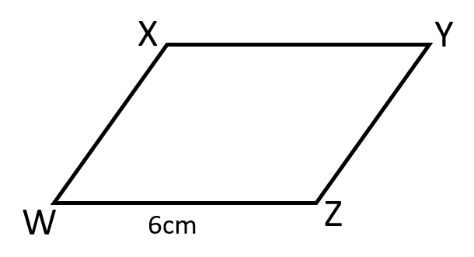
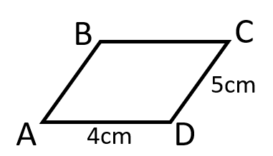
Find the scalar multiplier between two sides in similar shapes
Example 4
Parallelograms ABCD and WXYZ are similar.
Mary thinks YZ = 7cm.
Do you agree? Explain your reasoning
Notes:
Suggested questioning:
What has Mary done to get the answer of 7? What should she do?
What is the relationship between AC and CD? What should the relationship between WZ and YZ be?
What is the relationship between AC and WZ? What should the relationship between CD and YZ be?
Which relationship is easier to use to work out YZ?
What is YZ?
Things for you to think about:
The ‘what it’s not’ question in Example 4 has been chosen to support students’ awareness that the relationships between similar shapes is multiplicative not additive and the scalar multiplier does not always have to be a whole number. In this particular case because the scalar multiplier is 1.5, Mary has incorrectly chosen an additive method of adding two to CD rather than finding the multiplier.

Slide 22
Find the scalar multiplier between two sides in similar shapes
Example 4
Parallelograms ABCD and WXYZ are similar.
Mary thinks YZ = 7cm.
Do you agree? Explain your reasoning
  Do you use ‘what it’s not’ type questions to secure students’ understanding?
  Why might a ‘what it’s not’ question be useful?
  How might we best use such questions - verbally as discussion prompts or written responses?
Notes:
This example can be found on page 25 of the 6.1 Core Concept document.

Slide 23
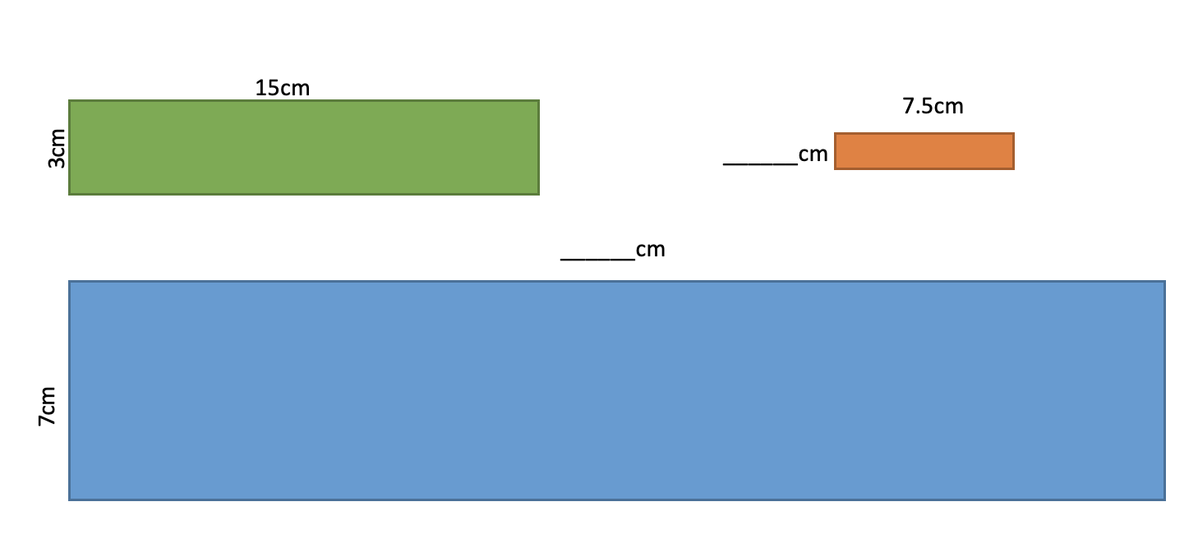
Find the functional multiplier between two sides in similar shapes
Example 5
The three rectangles are mathematically similar.
What calculations are needed to find the missing lengths?
Notes:
Suggested questioning:
What is the relationship between side lengths within the shapes?
What is the relationship between corresponding side lengths across the shapes?
Which relationship is easier to use? Is it always the same relationship?
Things for you to think about:
Example 5 is designed to raise students’ awareness of the relationship between sides within the same shape (functional multiplier) and between similar shapes (scalar multiplier). It is common for students to identify the scalar multiplier more easily, even when that offers a less ‘friendly’ calculation than to use the functional multiplier. In this case, working between the green and red rectangle is likely to be seen as simpler than working between the green and blue.
Ratio tables are very powerful representations for students to notice and find both the scalar and the functional multipliers. See the next slide for some possible ratio tables you may wish to share with students to reinforce these relationships.

Slide 24
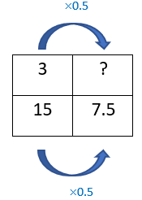
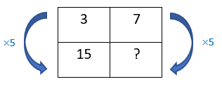
Find the functional multiplier between two sides in similar shapes
Example 5 (cont’d)
The three rectangles are mathematically similar.
How might these ratio tables help you to find the missing lengths?
Green to red (using the scalar multiplier)
Green to blue (using the functional multiplier)
Notes:
For suggested questioning and things for you to think about, see the previous slide. This slide is animated so that two different ratio tables appear, demonstrating the scalar multiplier for green to red, and the functional multiplier for green to blue.

Slide 25
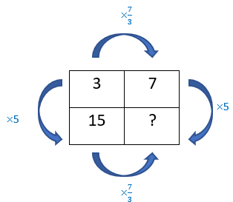
Find the functional multiplier between two sides in similar shapes
Example 5
  How might the ratio table representation (as on slide 24) be used to support students to recognise multiplicative relationships in similar shapes?
The three rectangles are mathematically similar.
What calculations are needed to find the missing lengths?
  Is important to know that both multiplicative relationships are always present. Should both scalar and functional multipliers always be written on the ratio table as below?
Notes:
Due to space constraints, the image on this PD discussion slide is very small. PD Leads might like to use or print the ‘in the classroom’ version of this slide for teachers to access during discussions.
This example can be found on pages 25 and 26 of the 6.1 Core Concept document.

Slide 26
Understand angles are preserved in similar shapes
Example 6
Steve uses a ruler and protractor to measure some triangles and their enlargements.
He records the lengths and angles.
Complete Steve’s table:
Triangle |  | Scale Factor | Enlarged triangle
Dimensions | Angles |  | Dimensions | Angles
3cm, 3cm, 3cm | 60°, 60°,60° | 2
5cm, 5cm, 7cm | 45°, 45°,90° |  | 15cm, 15cm , 21cm
 | 60°, 60°,60° | 6 | 24cm, 24cm, 24­cm
 |  | 2 | 8cm, 12cm, 12cm | 40°, 70°, 70°
Notes:
Suggested questioning:
What is the same/different about the enlarged triangles and the original triangles?
How can you work out the scale factor?
What types of triangles are these? How do you know?
Are any rows similar to each other?
Billy says “row 2 and 4 are both isosceles so they must be similar”. Do you agree?
Things for you to think about:
Using the triangles in Example 2, students can investigate if angles are preserved in similar shapes. Example 6 is designed to support students’ awareness of angles being preserved while the lengths are scaled in similar shapes.

Slide 27
Understand angles are preserved in similar shapes
Example 6
Triangle |  | Scale Factor | Enlarged triangle
Dimensions | Angles |  | Dimensions | Angles
3cm, 3cm, 3cm | 60°, 60°,60° | 2
5cm, 5cm, 7cm | 45°, 45°,90° |  | 15cm, 15cm , 21cm
 | 60°, 60°,60° | 6 | 24cm, 24cm, 24­cm
 |  | 2 | 8cm, 12cm, 12cm | 40°, 70°, 70°
Steve uses a ruler and protractor to measure some triangles and their enlargements.
He records the lengths and angles.
Complete Steve’s table:
  What are the potential benefits of presenting information in a table like this? What are the drawbacks?
  What questions might you ask students to ensure that they have fully appreciated the relationships and properties in this table?
Notes:
Due to space constraints, the image on this PD discussion slide is very small. PD Leads might like to use or print the ‘in the classroom’ version of this slide for teachers to access during discussions.
This example can be found on page 26 of the 6.1 Core Concept document.

Slide 28
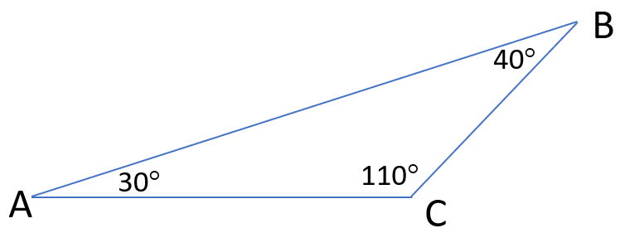
Understand angles are preserved in similar shapes
Example 7
The triangle is enlarged by scale factor of 2.
Tom thinks the value of angle ABC in the enlarged triangle will be 80°.
Explain why Tom is not correct.
Notes:
Suggested questioning:
Why might Tom think this? Why is Tom wrong?
What would have to happen if ABC is doubled? Why is this?
Things for you to think about:
The ‘what it’s not’ question in Example 7 is designed to challenge student’s appreciation of angle preservation in similar shapes. In isolation, angle ABC can be doubled to 80° and still be a reasonable value for an angle in a triangle. However, if the same logic was applied to the other two angles, the angle sum would now be greater than 180°.

Slide 29
Understand angles are preserved in similar shapes
Example 7
The triangle is enlarged by scale factor of 2.
Tom thinks the value of angle ABC in the enlarged triangle will be 80°.
Explain why Tom is not correct.
  How would you manage the discussion around this activity in the classroom?
  What are the benefits and drawbacks of telling students that Tom is incorrect?
  What misconceptions around angles and angle measurement might contribute to students’ understanding here?
Notes:
This example can be found on page 27 of the 6.1 Core Concept document.

Slide 30
Reflection questions
What other mathematical concepts will be supported by students’ stronger understanding of this key idea?
What mathematical language will you continue to use to support pupils to make connections with other areas?
Which representations might you continue to use to further develop students’ understanding?

Slide 32
Appendices
You may choose to use the following slides when planning or delivering a PD session. They cover:
  Key vocabulary
  Representations and structure
  Previous learning
  Future learning
  Library of links

Slide 33
Key vocabulary
Term | Definition
congruent (figures) | Two or more geometric figures are said to be congruent when they are the same in every way except their position in space. Example: Two figures, where one is a reflection of the other, are congruent since one can be transposed onto the other without changing any angle or edge length.
interior angle | At a vertex of a polygon, the angle that lies within the polygon.
similar | Two geometrical objects are said to be similar if they both have the same shape. More precisely, one can be obtained from the other by uniformly scaling (enlarging or reducing), possibly with additional translation, rotation and reflection. Similar shapes have corresponding sides proportional and corresponding angles equal.

Slide 34
Representations and structure
There are a number of different representations that you may wish to use to support students’ understanding of this key idea. These might include:
Ratio tables and double number lines (also known as ‘stacked number lines’)
  The comparison of corresponding entries in two different sets of multiples, such as from a multiplication table, can be a useful context in which to explore multiplicative relationships.
Notes:
More information about the representations and structure involved in this key idea can be found:
On page 7 of the Multiplicative Reasoning Theme Overview document
On page X of the 6.1 Core Concept document.
Within the NCETM’s guidance on ‘Using representations at KS3’
Links to all of these can be found on the final slide.

Slide 35
Previous learning
From Upper Key Stage 2, students will bring experience of:
drawing 2D shapes using given dimensions and angles
recognising, describing and building simple 3D shapes, including making nets
comparing and classifying geometric shapes based on their properties and sizes, and finding unknown angles in any triangles, quadrilaterals and regular polygons
illustrating and naming parts of circles, including radius, diameter and circumference, and knowing that the diameter is twice the radius
recognising angles where they meet at a point, are on a straight line or are vertically opposite, and finding missing angles
drawing and translating simple shapes on the coordinate plane and reflecting them in the axes.
Notes:
Theme 6 Geometry

Slide 36
Future learning (1)
In KS4, students will build on the core concepts in this mathematical theme to:
interpret and use fractional {and negative} scale factors for enlargements
{describe the changes and invariance achieved by combinations of rotations, reflections and translations}
identify and apply circle definitions and properties, including: centre, radius, chord, diameter, circumference, tangent, arc, sector and segment
{apply and prove the standard circle theorems concerning angles, radii, tangents and chords, and use them to prove related results}
construct and interpret plans and elevations of 3D shapes
interpret and use bearings
calculate arc lengths, angles and areas of sectors of circles
calculate surface areas and volumes of spheres, pyramids, cones and composite solids
Please note: Braces { } indicate additional mathematical content to be taught to more highly attaining students.

Slide 37
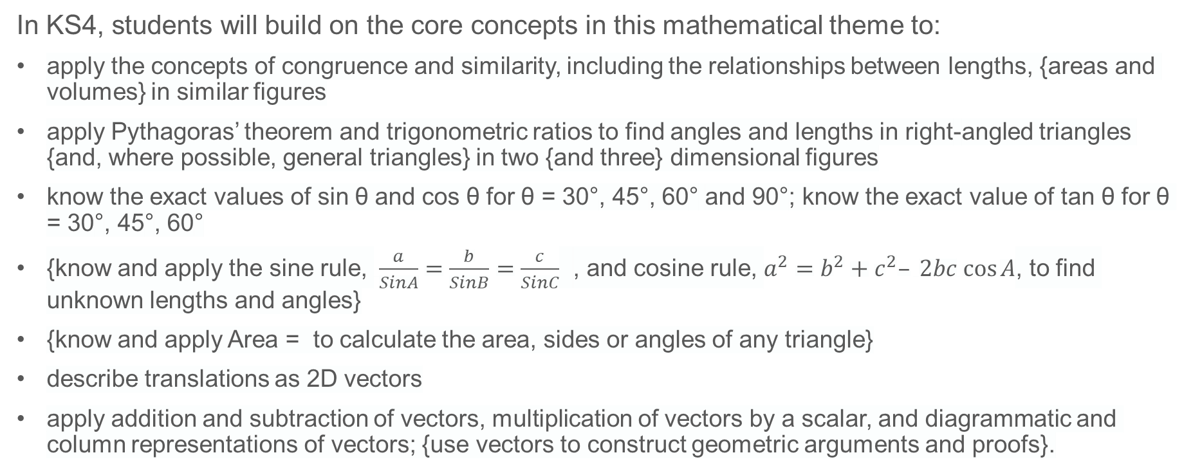
Future learning (2)
In KS4, students will build on the core concepts in this mathematical theme to:
apply the concepts of congruence and similarity, including the relationships between lengths, {areas and volumes} in similar figures
apply Pythagoras’ theorem and trigonometric ratios to find angles and lengths in right-angled triangles {and, where possible, general triangles} in two {and three} dimensional figures
know the exact values of sin θ and cos θ for θ = 30°, 45°, 60° and 90°; know the exact value of tan θ for θ = 30°, 45°, 60°
{know and apply the sine rule, $\frac{a}{SinA}=\frac{b}{SinB}=\frac{c}{SinC}$ , and cosine rule, $a^{2}=b^{2}+c^{2}– 2bc cos⁡A$, to find unknown lengths and angles}
{know and apply Area = to calculate the area, sides or angles of any triangle}
describe translations as 2D vectors
apply addition and subtraction of vectors, multiplication of vectors by a scalar, and diagrammatic and column representations of vectors; {use vectors to construct geometric arguments and proofs}.
Please note: Braces { } indicate additional mathematical content to be taught to more highly attaining students.
Notes:
Theme 6 Geometry

Slide 38
Library of links
The following resources from the NCETM website have been referred to within this slide deck:
  NCETM Secondary Mastery Professional Development
    6 Geometry Theme Overview Document
    6.1 Geometrical properties Core Concept Document
  Using mathematical representations at KS3 | NCETM
  Insights from experienced teachers | NCETM
  NCETM primary mastery professional development materials
There are also references to:
  Standards & Testing Agency’s past mathematics papers

