Slide 1
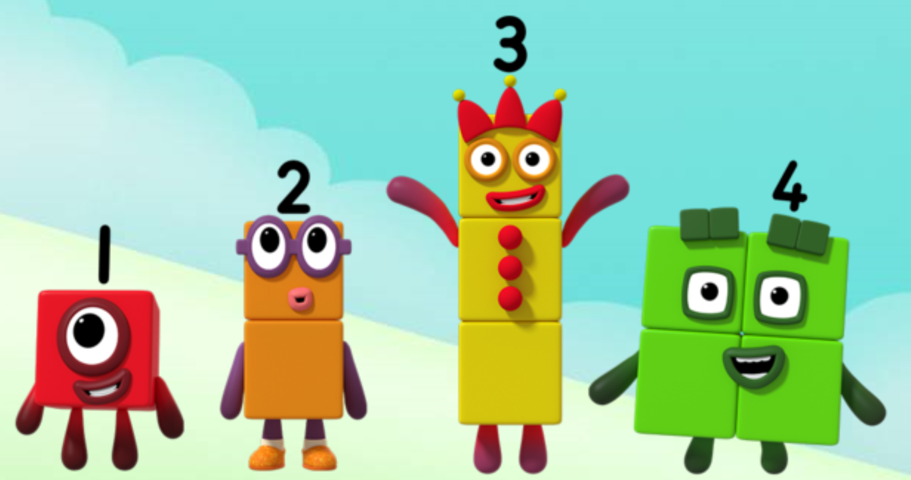
Series 2 Episode 1
Six

Slide 2
Maths in the Episode
To watch this episode, please go to BBC iPlayer –Numberblocks. Look for Series 2: Six.
Recognising dice patterns
In this episode children practise recognising the spot patterns on the dice without counting. This is known as ‘subitising’. Being able to subitise small quantities has been shown to be a key skill in successful maths learning.
Counting from 1 to 6
Count objects up to 6 with your child.
Check to see if your child is counting accurately by touching each object once and saying the numbers one at a time and in the correct order.
If they need help, gently guide their hand so that they only touch each object once and say one number at a time with them.

Slide 3
Talk and discuss together
Watch the episode together.
Ask your child what they noticed and be interested in anything they have to say.
Use the following pictures and activities to explore and talk about the maths involved.

Slide 4
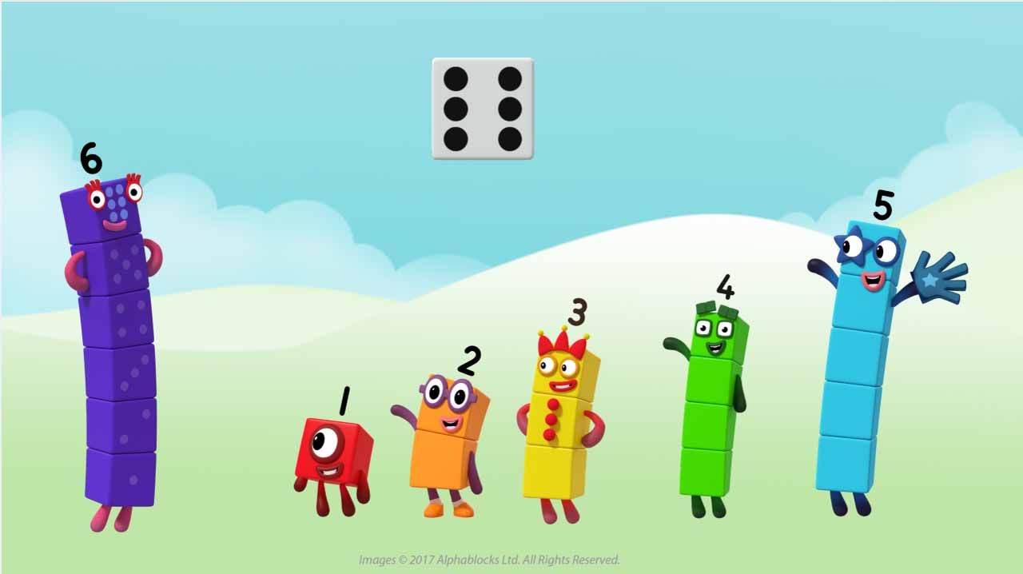
Look at the faces of a dice. Find one in your home or on the internet. What do you notice?

Slide 5
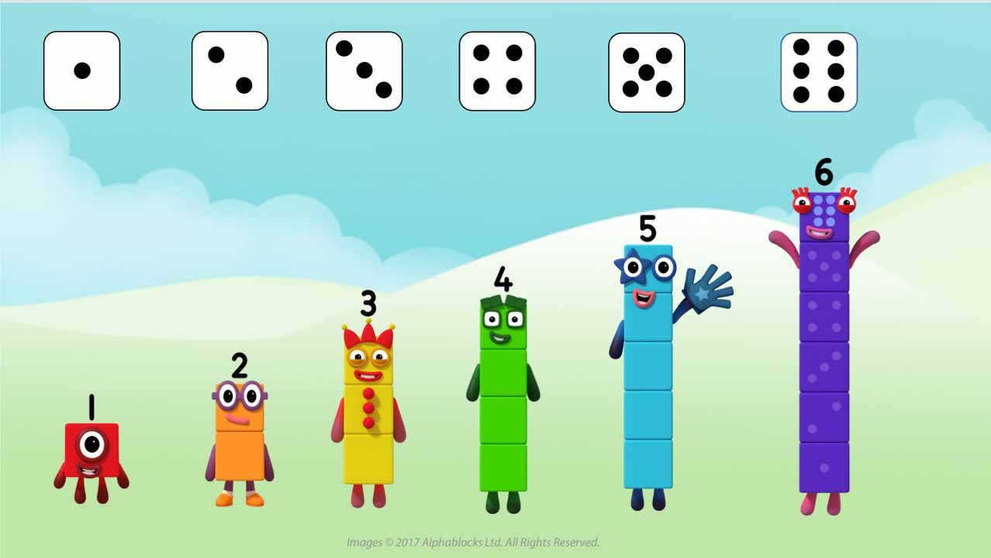
What do you notice about each dice pattern and the matching Numberblock?

Slide 6
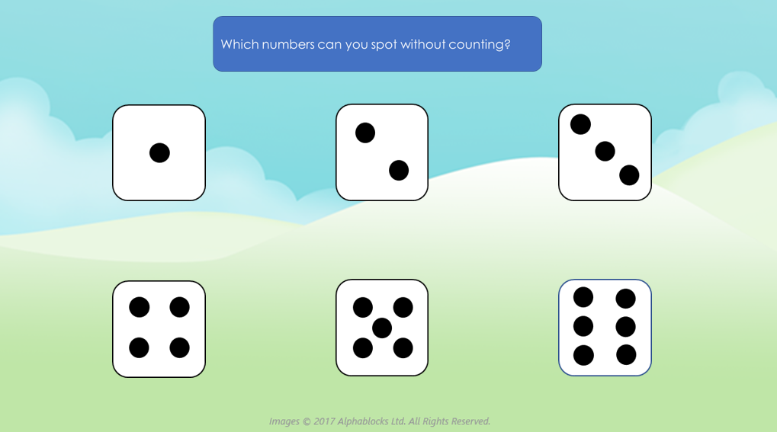

Slide 7

Click through the images or throw a dice and practise saying the numbers without counting.
Images © 2017 Alphablocks Ltd. All Rights Reserved.

Slide 8
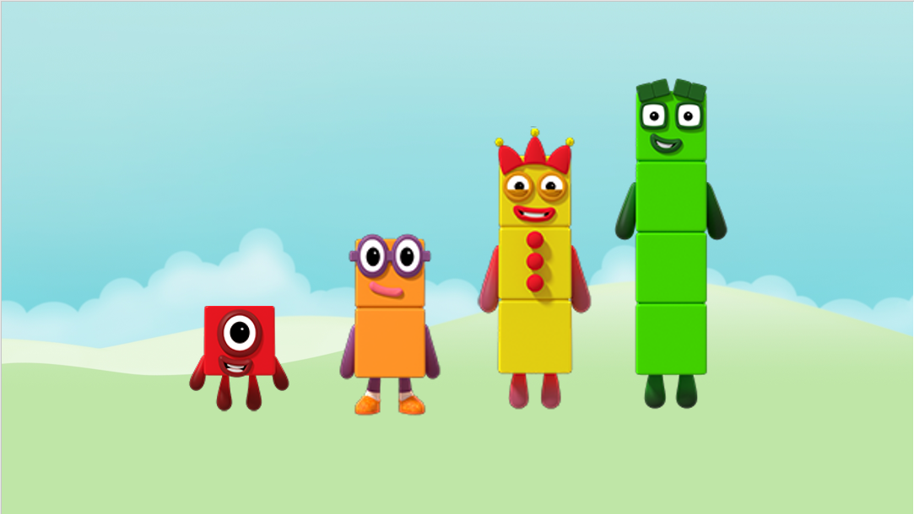
We have lost our numerals! Can you show our number on your fingers when you see us?
Images © 2017 Alphablocks Ltd. All Rights Reserved.

Slide 9
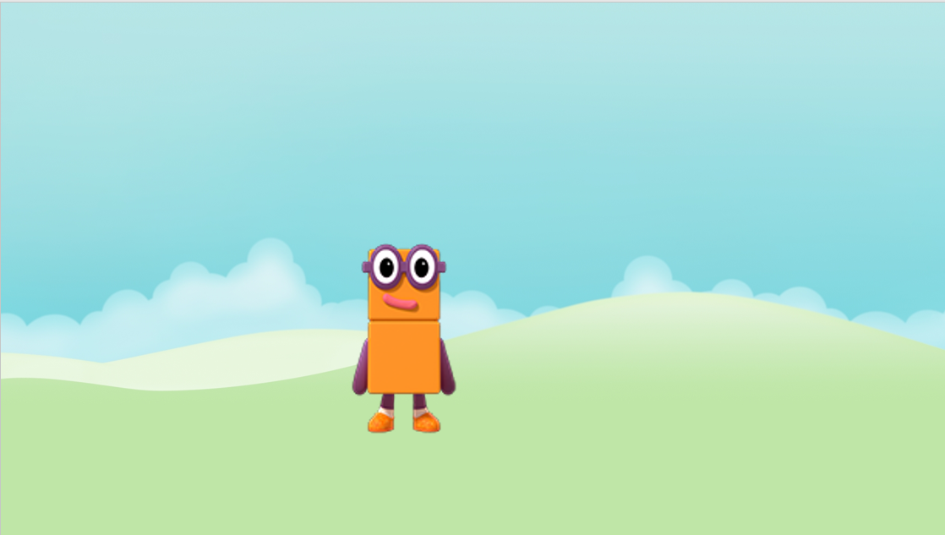
Images © 2017 Alphablocks Ltd. All Rights Reserved.

Slide 10

Images © 2017 Alphablocks Ltd. All Rights Reserved.

Slide 11
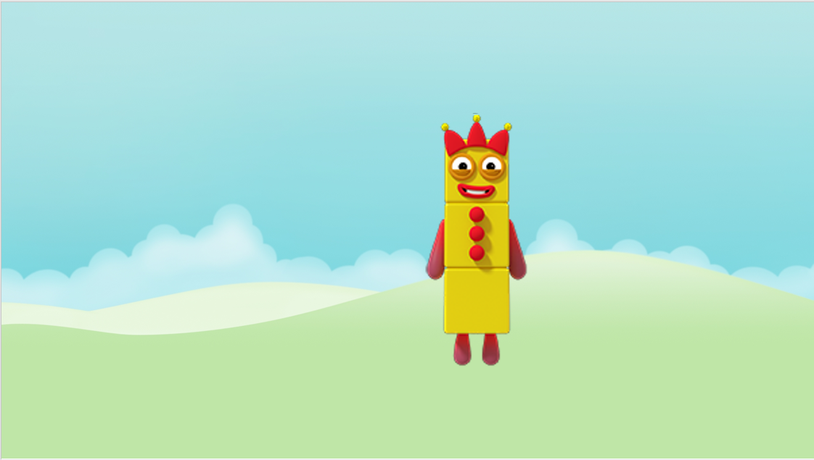
Images © 2017 Alphablocks Ltd. All Rights Reserved.

Slide 12
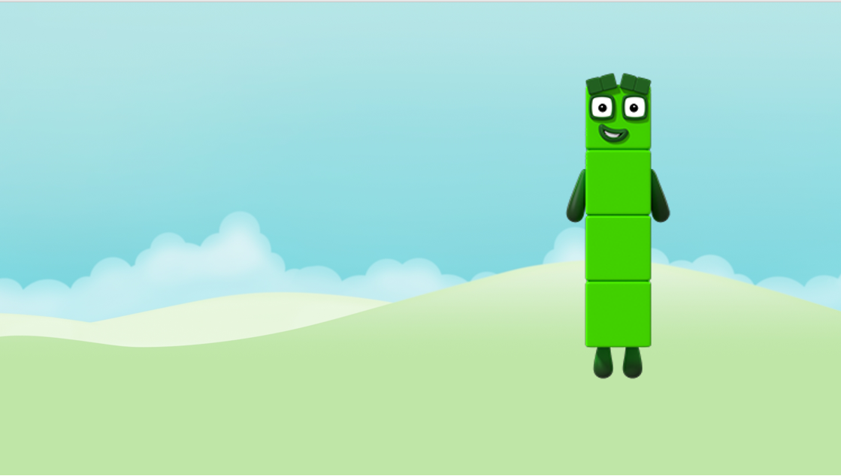
Images © 2017 Alphablocks Ltd. All Rights Reserved.

Slide 13
Around the home
Say the number for small sets of objects without counting. Start with 2, for example: 2 cups, 2 plates, 2 teddies.
Play with a dice, roll the dice and say the number together, then take turns in saying the number. If you do not have a dice you can find a virtual one on the internet. Ask your child to show you on their fingers the number shown on the dice.
Play board games with dice.
Play ‘grab six’ with a box or plate of small objects, for example, small bricks or pasta. Grab a handful and check to see if you have 6 by counting. If you don’t have 6, see if you have more or less than six. You could score a point or win a counter or penny every time 6 is selected. If the objects are too large to grab 6 at once, use 2 hands.
Get a collection of buttons or one penny coins. Can you and your child make the dice pattern for each number to 6 using the buttons or coins? What do you need to do to change one number to another? For example, how can we change four into five?

Slide 14
General tips that can make a difference in maths
Provide lots of opportunities to say how many things you can see (up to 5) without counting.
Whenever you talk about a small set of objects, say the number. For example, please pick up those 3 teddies or look at those 2 dogs.
Count up (starting from one) when walking upstairs and count back when walking downstairs.
Count lots of different objects, big and small, and ask ‘How many are there?’ Your child should be able to tell you without going back and re-counting. If they can’t, then tell them: ‘There are 6 altogether’.
Play with fingers, firstly practise counting fingers.
Ask your child to put their fingers down and then say or hold up a number such as 3. Can they do it without counting? Can they do it using different fingers? Can they do it using fingers from two hands?
Play board games with your child which involve moving along numbered tracks, such as ‘Snakes and Ladders’. Check that your child counts along the track correctly, moving one square for each number counted.
Regular use of these simple ideas, whenever the opportunity arises, will improve your child’s maths.

Slide 15
General tips that can make a difference in maths
Notice when there are two amounts and one is more than the other, or they are the same. For example, I have 2 eyes and 2 ears, or I have more chips than peas.
Talk about and describe shapes you can see outside or around your home. For example, count corners, talk about straight/curved edges, flat/curved surfaces. If you have building blocks then talk about and describe the things that are built.
In the bath or at the sink, play with containers, pouring water, counting how many small pots are needed to fill the big container.
Encourage your child to draw a picture of their number work and explain their mark-making to you, for example, how many leaves they find on a walk. This doesn’t necessarily mean writing the numerals (1, 2, 3, 4… etc.).
Sing counting songs and rhymes. You can find some on the internet, but children love it if you join in with them!
Make a deliberate maths mistake from time to time and ask your child to explain why you are wrong. For example, say that 4 is bigger than 5.
Regular use of these simple ideas, whenever the opportunity arises, will improve your child’s maths.

