Slide 1

Checkpoints
Year 7 diagnostic mathematics activities
Expressions and equations
Sixteen Checkpoint activities
Twelve additional activities
Published in 2021/22

Slide 2
About this resource
This resource is designed to be used in the classroom with Year 7 students, although it may be useful for other students.
The Checkpoints are grouped around the key ideas in the core concept document 1.4 Simplifying and manipulating expressions, equations and formulae, part of the NCETM Secondary Mastery Professional Development materials.
Before each set of Checkpoints, context is explored, to help secondary teachers to understand where students may have encountered concepts in primary school.
The 10-minute Checkpoint tasks might be used as assessment activities, ahead of introducing concepts, to help teachers explore what students already know and identify gaps and misconceptions. (See also the next slide for this particular deck.)
Each Checkpoint has an optional question marked . This will provide further thinking for those students who have completed the rest of the activities on the slide.
The notes for each Checkpoint give answers (if appropriate), some suggested questions and things to consider.
After each Checkpoint, a guidance slide explores suggested adaptations, potential misconceptions and follow-up tasks. These may include the additional activities at the end of this deck.

Slide 3
Using these Checkpoints
Students’ experience of algebraic thinking in primary school is quite different from the formal algebra and conventions that they will learn in Key Stage 3. For this reason, each section progresses from exploring concrete and pictorial representations to introducing more abstract representations.
Some of the additional activities have been designed to act as a bridge between Key Stages, rather than assessing understanding of Key Stage 2 content.
Some activities may be helpful for introducing Key Stage 3 concepts. For example, Additional activity J uses a familiar manipulative from primary (number tiles) and explores a new concept for the secondary classroom (formulae).
Some activities can be used assess understanding in a Key Stage 3 unit of work. For example, Additional activity G is closely related to Checkpoint 12 so interesting comparisons can be made to see how much students’ thinking has moved on.
The notes for each slide make it clear how it is best used.

Slide 4
Checkpoints 1–8
Checkpoint | Underpins | Code
1: Checks and balances | Generalise relationships | 1.4.1*
2: Shape balance | Identify and explain whether a number is or is not a multiple of a given integer
3: Equations from bar models
4: Colouring the number line
5: Number line equations
6: Stick differences
7: Mystery bars
8: Equations for heights
*This three-digit code refers to the statement of knowledge, skills and understanding in the NCETM’s Sample Key Stage 3 Curriculum Framework (see notes below for more information).
Notes:
In the Sample Key Stage 3 Curriculum Framework, statements of knowledge, skills and understanding are arranged to give an example teaching order. The three-digit code for each statement in the framework is a clickable hyperlink to documents with more detailed information, including the key ideas contained within that statement. These key ideas are also shown on the slides 6–7 in this deck.

Slide 5
Checkpoints 9–16
Checkpoint | Underpins | Code
9: Final scores | Unknowns and variables | 1.4.1*
10: Roast dinner
11: x + y = 20
12: Same and different
13: Numbers box
14: Triangle and rectangle values | Unitising and the distributive law | 1.4.2 and 1.4.3
15: Arithmequick
16: Square numbers
*This three-digit code refers to the statement of knowledge, skills and understanding in the NCETM’s Sample Key Stage 3 Curriculum Framework (see notes below for more information).
Notes:
In the Sample Key Stage 3 Curriculum Framework, statements of knowledge, skills and understanding are arranged to give an example teaching order. The three-digit code for each statement in the framework is a clickable hyperlink to documents with more detailed information, including the key ideas contained within that statement. These key ideas are also shown on the next slide in this deck.

Slide 6
Key ideas
Understand and use the conventions and vocabulary of algebra including forming and interpreting algebraic expressions and equations | Code
Understand that a letter can be used to represent a generalised number | 1.4.1.1
Understand that algebraic notation follows particular conventions and that following these aids clear communication | 1.4.1.2
Know the meaning of and identify: term, coefficient, factor, product, expression, formula and equation | 1.4.1.3
Understand and recognise that a letter can be used to represent a specific unknown value or a variable | 1.4.1.4*
Understand that relationships can be generalised using algebraic statements | 1.4.1.5
Understand that substituting particular values into a generalised algebraic statement gives a sense of how the value of the expression changes | 1.4.1.6
*‘There are additional resources exemplifying these key ideas in the Secondary Mastery Professional Development | NCETM.

Slide 7
Key ideas
Simplify algebraic expressions by collecting like terms to maintain equivalence | Code
Identify like terms in an expression, generalising an understanding of unitising | 1.4.2.1
Simplify expressions by collecting like terms | 1.4.2.2
Manipulate algebraic expressions using the distributive law to maintain equivalence | Code
Understand how to use the distributive law to multiply an expression by a term such as 3(a + 4b) and 3p²(2p + 3b) | 1.4.3.1*
Understand how to use the distributive law to factorise expressions where there is a common factor, such as 3a + 12b and 6p³ + 9p²b | 1.4.3.2
Apply understanding of the distributive law to a range of problem-solving situations and contexts (including collecting like terms, multiplying an expression by a single term and factorising), e.g. 10 − 2(3a + 5), 3(a ± 2b) ± 4(2ab ± 6b), etc. | 1.4.3.3
*‘There are additional resources exemplifying these key ideas in the Secondary Mastery Professional Development | NCETM.

Slide 8
Generalise relationships
Checkpoints 1–8

Slide 9
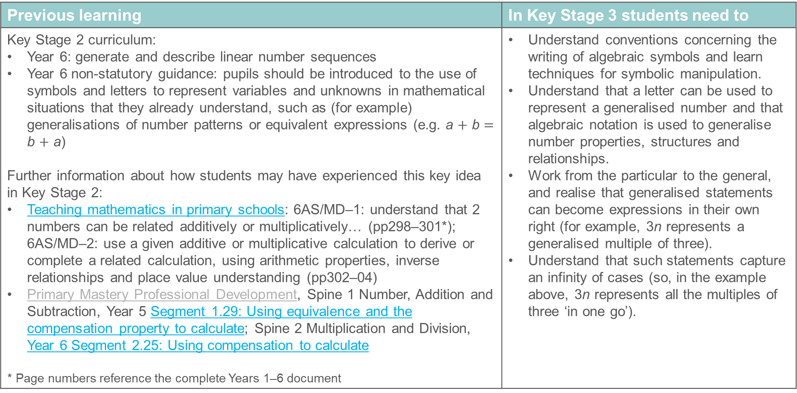
Generalise relationships
Previous learning | In Key Stage 3 students need to
Key Stage 2 curriculum: Year 6: generate and describe linear number sequences Year 6 non-statutory guidance: pupils should be introduced to the use of symbols and letters to represent variables and unknowns in mathematical situations that they already understand, such as (for example) generalisations of number patterns or equivalent expressions (e.g. a $+$ b $=$ b $+$ a) Further information about how students may have experienced this key idea in Key Stage 2: Teaching mathematics in primary schools: 6AS/MD–1: understand that 2 numbers can be related additively or multiplicatively… (pp298–301*); 6AS/MD–2: use a given additive or multiplicative calculation to derive or complete a related calculation, using arithmetic properties, inverse relationships and place value understanding (pp302–04) Primary Mastery Professional Development, Spine 1 Number, Addition and Subtraction, Year 5 Segment 1.29: Using equivalence and the compensation property to calculate; Spine 2 Multiplication and Division, Year 6 Segment 2.25: Using compensation to calculate * Page numbers reference the complete Years 1–6 document | Understand conventions concerning the writing of algebraic symbols and learn techniques for symbolic manipulation. Understand that a letter can be used to represent a generalised number and that algebraic notation is used to generalise number properties, structures and relationships. Work from the particular to the general, and realise that generalised statements can become expressions in their own right (for example, 3n represents a generalised multiple of three). Understand that such statements capture an infinity of cases (so, in the example above, 3n represents all the multiples of three ‘in one go’).

Slide 10
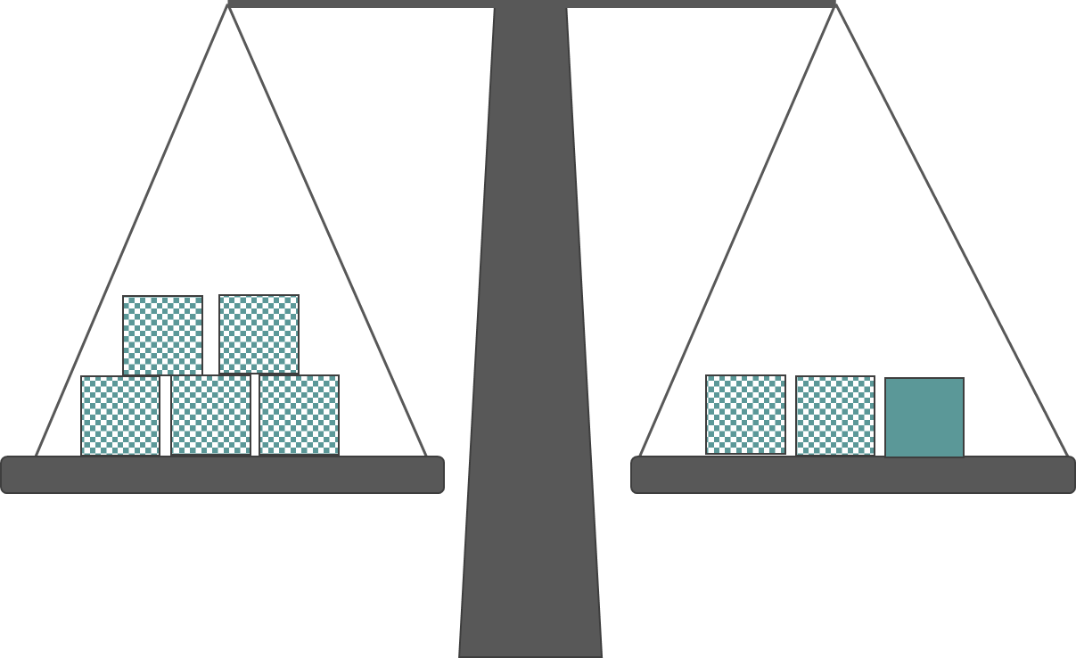
Checkpoint 1: Checks and balances
These scales are balanced.
What do you know about the plain box?
Using the original picture as your starting point, what would happen to the scales if:
The plain box was replaced by a checked box?
A plain box was added to the left-hand side?
How could you keep the scales balanced if:
A plain box was added to the right-hand side?
Two of the boxes on the left-hand side were replaced by plain boxes?
Five more boxes are added. Is it possible for the scales still to be balanced?
Notes:
This slide is animated. Each question will appear separately so you can choose the pace at which to work with your class.
Answers
a) One plain box has the same mass as three checked boxes.
b) The right-hand side would be lighter, so would move up.
c) The left-hand side would be heavier, so would move down.
d) Either add one plain box to the left-hand side or add three checked boxes to the left-hand side
e) Either add four checked boxes to the right-hand side or add one plain box and one checked box to the right-hand side or replace the two checked boxes on the right-hand side with plain ones
?
No, there is no combination of five plain and checked boxes that would balance since each plain box is worth three checked boxes (so one plain could be offset by three checked, leaving another box to unbalance the scales). Five is an odd number so, even if the boxes were all the same, more would have to be added on one side than the other.
Suggested questioning
What mathematical symbol do you think the scales are representing?
Is the plain box heavier or lighter than a checked box? How do you know?
How could you represent this another way?
How many checked boxes is a plain box worth? How could you write this down algebraically?
Things to think about
In Checkpoint 1, students need to think algebraically even if there is no explicit reference to algebra. The representation of a balanced scale is used as one that may be familiar from primary school, or is still readily understood if not.

Slide 11
Checkpoint 1: Guidance
Adaptations | Assessing understanding
Support Students may find this situation easier to understand if they build up the image from a set of empty scales (so adding a checked box to each side, but three checked boxes when the plain box is added). Challenge Build on the ‘further thinking’ question by asking what numbers of boxes would be possible/impossible to add while maintaining balance. Representations A balanced set of scales is used here as a representation of the = sign, which is a common metaphor used as the basis for earlier work on equality, and later work on solving equations. If possible, students may also find it helpful to experience a real set of balance scales as it is not likely to be equipment they encounter regularly. | Starting with the open question of ‘what do you know about the plain box’ will enable teachers to assess students’ understanding of the representation before exploring equality further. Do students understand that the plain box is heavier than the checked box? Do they understand that it is 3× heavier? The questions have been split into two further parts so that, in a and b, teachers can check students understand which side will be ‘heavier’ before, in c and d, exploring how to maintain equality. An important question here is ‘is there more than one way to do this?’, to check if students recognise that both plain and checked boxes can be added, and how many of each.
Additional resources This activity is designed to be completed without using formal algebraic notation, but Additional activities A and B each offer routes towards recording algebraically using this Checkpoint as a starting point. If students struggle to connect the concept of equality with their use of the = sign notation, Additional activity C offers a familiar context to explore common misunderstandings.

Slide 12
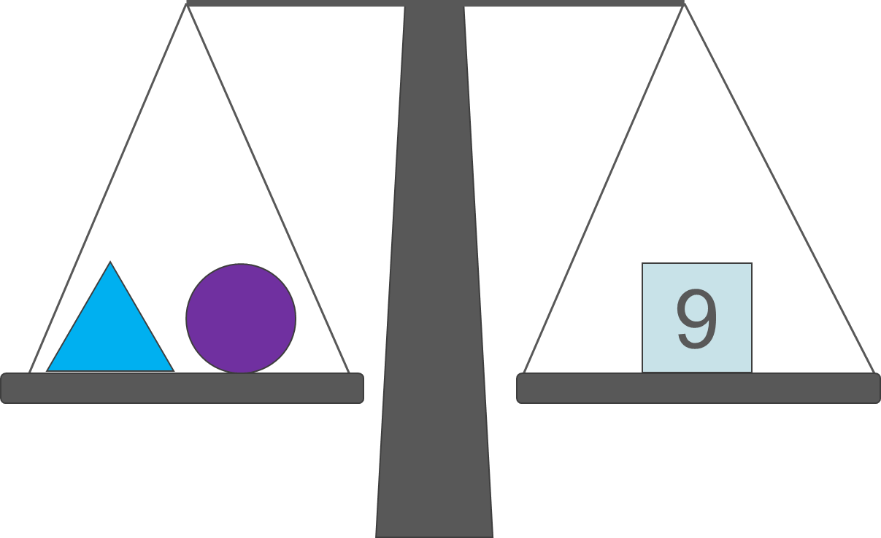
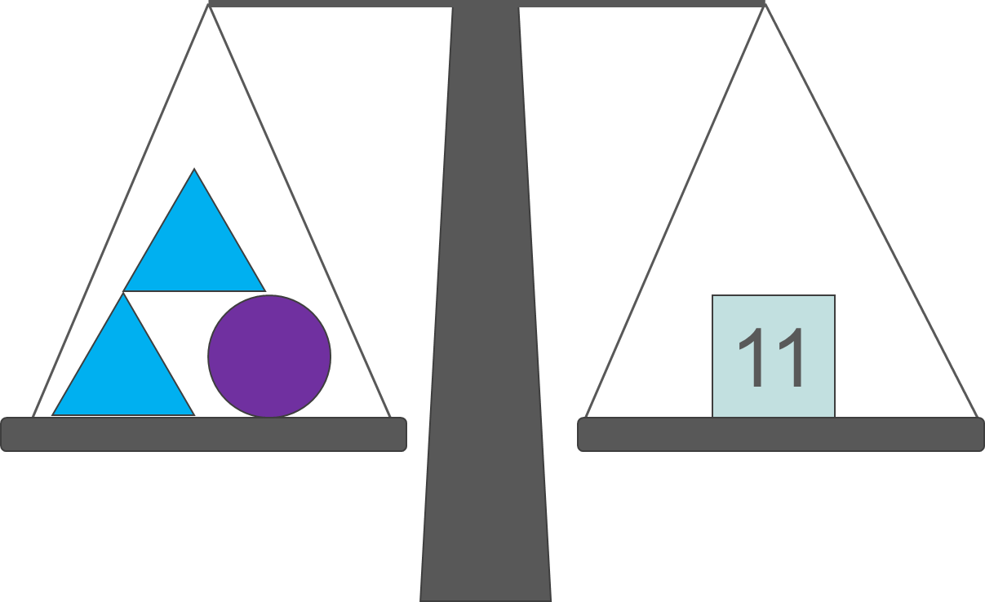
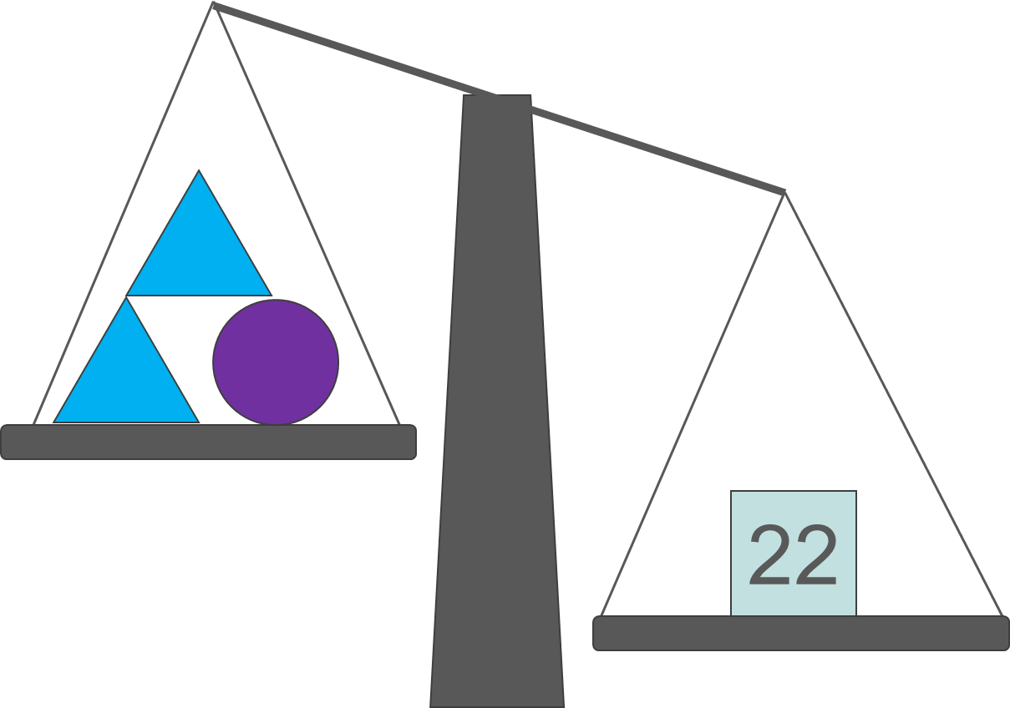
Checkpoint 2: Shape balance
These scales are balanced.
What might be the mass of the triangle and the circle?
Is there more than one answer? Why or why not?
The scales are still balanced.
What might be the mass of the triangle and the circle?
Is there more than one answer? Why or why not?
The scales are no longer balanced.
What could be done to balance them?
Is there more than one answer? Why or why not?
How would your answer to part c change if the mass on the right-hand side of the scales was 19? How about 14? Or 25? Or 30?
Notes:
This slide is animated. Each question will appear separately so you can choose the pace at which to work with your class. You may need to clarify with students that part b builds on from part a, in that one triangle has been added to the left-hand side and two to the right-hand side.
Answers
a) Any answers where triangle + circle = 9. There are an infinite number of answers unless integer is specified).
b) The triangles have a mass of 2, the circle has a mass of 7. There are no other answers.
c) We could double the number of shapes on the left-hand side (add two more triangles and one more circle). Students may also suggest removing a triangle and adding two more circles.
? If it was 19, then this could only be achieved by adding triangles (in this case four to have a value of 8).
If it was 14, then we would need to remove some shapes on the left-hand side before adding any if it were to be possible. Any additional triangles would have a 11 + 2 = 13 and 11 + 2 + 2 = 15. For example, removed two triangles and add a circle.
If it was 25, then we could achieve this either through adding two circles or seven triangles, since both have a value of 14 and 25 is 14 greater than 11.
If it was 30, then we could only add one circle and six triangles.
Suggested questioning
What is the same? What is different?
When can you have multiple answers? When can you only have one answer?
From part b onwards: what numbers is it possible to have on the right-hand side? Is every number possible?
Things to think about
As with Checkpoint 1, Checkpoint 2 uses the representation of a balanced scales to replicate an equation. The language of ‘mass’ rather than ‘value’ is deliberately used to make the context more realistic. The difference between variables and specific unknowns is touched upon in the progression from part a, where the circle and triangle could each represent any mass that sums to 9, to part b, where it is made clear that the mass of the triangle is 2 and therefore the circle is 7. This idea is further developed in Checkpoints 9 to13.

Slide 13
Checkpoint 2: Guidance
Adaptations | Assessing understanding
Support The numbers chosen are straightforward so students can focus on their understanding of the representation. Help students access part a by asking structured questions such as, ‘If the triangle has a mass of _, what is the mass of the circle?’ Challenge The ‘further thinking’ question can be taken further by asking students to generalise about which masses are possible on the right-hand side, which can be achieved by only adding one type of shape, and which can be achieved multiple different ways. Representations As with Checkpoint 1, a balanced set of scales is used as a representation of the equals sign. This time, one side is assigned a value – which, for the representation to work, is described as the total mass of the shapes on the other side. | This Checkpoint takes the premise of the balanced scales and moves students one step closer towards the idea of solving equations. Teachers should be using this as an opportunity to see how readily they might take to this new concept at Key Stage 3. For example, are they able to appreciate why the circle and triangle can take multiple values in part a, but only specific values in part b? Can they use the equals symbol accurately to record their thinking for parts b and c? Do they appreciate how to manipulate to maintain equality in part c and the ‘further thinking’ question?
Additional resources If students struggle to connect the concept of equality with their use of the = sign notation, Additional activity C offers a familiar context to explore common misunderstandings. Example 8 on page 16 of the 2.2 Solving linear equations core concept document explores balancing scales as a representation for solving equations at Key Stage 3. This can be found within Secondary Mastery Professional Development | NCETM.

Slide 14
Checkpoint 3: Equations from bar models
c
Tilly looks at the bar model and writes c – a = 10.
Alice looks at the bar model and writes a different equation. What might Alice have written?
a
10
The bar model changes.
Jas writes c + 6 − a = 16.
Beth looks at the bar model and writes a different equation. What might Beth have written?
c
6
a
10
6
A different bar model shows 10 − p = r.
Draw the bar model.
What other equations can you write with p and r?
Notes:
−
This slide is animated. Each question will appear separately so you can choose the pace at which to work with your class.
Answers
Alice might have written: a + 10 = c, 10 + a = c or c − 10 = a.
Beth might have written: a + 16 = c + 6 or a + 16 − c = 6 or any other relevant equation.
?
The bar model shows p + r as equivalent to 10.
p + r = 10, 10 − r = p or 10 − p = r
Suggested questioning
What is the same about the new bar model? What is different?
How many equations can you write from each bar model?
Can you show a subtraction? Can you show an addition?
Things to think about
Checkpoint 3 offers an opportunity to explore both how confident students are with using the bar model as a representation for additive structures, and also how readily they use a letter in place of a number.

Slide 15
Checkpoint 3: Guidance
Adaptations | Assessing understanding
Support Remind students of the four equations that can be written from a basic part–part–whole bar model. Additional activity E offers a simpler introduction to support this. Challenge Students could be challenged to take the idea of the ‘further thinking’ question further by representing an additive relationship with more terms. Representations This Checkpoint is similar to 4 and 5: it explores the additive structure and writing equations that involve unknowns but a bar model is used instead. More information about bar models, including how they can be used to represent the additive structure and introduce solving equations, can be found in Using mathematical representations at KS3 | NCETM. | Students may offer one of the three remaining relationships shown by the first bar model: a + 10 = c; 10 + a = c; a = c − 10; c − a − 10 = 0; c − (a + 10) = 0. Vary which side of the = sign the calculation and ‘answer’ are written, to check students are happy the symbol represents equality rather than ‘leads to an answer’. The second bar model offers insight into whether they can apply their thinking beyond the basic part–part–whole bar model. Students may find it more challenging to identify relationships with unknowns on both sides of the equation (such as c + 6 = a + 16). Ensure that examples are captured alongside those in a similar format to Jas’s.
Additional resources Additional activity E may be a useful precursor to those students unfamiliar with a bar model. Another bar model problem can also be found on page 12 of the Year 5 Primary Assessment Materials | NCETM In Secondary Mastery Professional Development | NCETM, the final key idea exemplified within the 1.4 Arithmetic Procedures core concept document explores the multiple ways an additive relationship between two variables can be written If students struggle to connect the concept of equality with their use of the = sign notation, Additional activity C offers a familiar context to explore common misunderstandings around the = sign.

Slide 16
Checkpoint 4: Colouring the number line
Sharon colours a section of the number line.
Write a calculation to work out the length of the red section.
Write a calculation to work out the length of the blue section.
132
136
147
Sharon colours a different section of the number line.
She covers the numbers with sticky notes
Write a calculation to work out the length of the new red section.
Write a calculation to work out the length of the new blue section.
7
12
14
Sharon writes purple = yellow − red.
Write an expression for each of the other sticky notes.
Is there more than one way to do this?
Notes:
This slide is animated. Each section will appear separately so you can choose the pace at which to work with your class.
Note, in case any students have a visual impairment around distinguishing colours, point to the relevant sections of the number line each time.
Answers
a) 136 − 132
b) 147 − 136
c) yellow − purple
d) green − yellow
?
Examples could include: yellow = green − blue or yellow = purple + red or green = purple + red + blue or green = yellow + blue or purple = green − blue − red or purple = yellow − red.
Students may be more likely to look for subtractions, in line with parts a–d, and need some prompting to consider calculations with addition.
NB students might use single letters rather than colours to represent the unknowns.
Suggested questioning
What is the relationship between the numbers at either end of the line?
What is the relationship between the two lines?
What is the same and different abut the two stages of this activity?
Things to think about
This Checkpoint, like the previous two, explores additive relationships and introducing unknowns into calculations. This time, a number line is offered as an alternative representation to support students to explore equations and for teachers to assess students’ understanding of additive structures.

Slide 17
Checkpoint 4: Guidance
Adaptations | Assessing understanding
Support Use smaller numbers for parts a and b. Use actual sticky notes to cover the numbers, and show students how the calculations can still be written using unknowns, before giving the example for parts c and d. Challenge Challenge students by introducing other relationships to see how these affect their statements. For example, the yellow sticky note is twice as far from the green as from the purple. Representations This Checkpoint uses a number line to explore the additive structure and writing equations that involve unknowns. The number line representation relies on students having an understanding of subtraction as difference. This should be secure from Key Stage 2 but might not be, especially if column methods have overwritten less formal strategies. It is a very different structure from the bar model (see Checkpoint 3) , which relies on the understanding of aggregation/partitioning. For more information, see Additive structures: introduction to aggregation and partitioning | NCETM, Additive structures: introduction to augmentation and reduction | NCETM and Subtraction as difference | NCETM from Primary Mastery Professional Development | NCETM. | Checkpoint 4 offers another opportunity to check students are able to write calculations involving the additive structure, and that they are happy with the idea that these calculations can still be written when the numbers involved are unknowns. Teachers may find it interesting to see how students choose to notate parts c and d; do they write colours or choose a letter to represent each unknown? This is a relatively accessible task and more students may get onto the ‘further thinking’ question; encourage students to think of multiple ways to express each sticky note in terms of the other unknowns in the diagram.
Additional resources Checkpoint 5 and Additional activity D also use number lines to explore the additive structure with unknowns.

Slide 18

Checkpoint 5: Number line equations
Cerys and Dan each mark a number on a number line.
Dan’s number is larger than Cerys’s.
a) What does the formula n − m = y represent?
b) Cerys and Dan each add 1 to their numbers. What happens to y?
c) Cerys adds 1 to her number. Dan adds 2 to his number. What happens to y?
d) Cerys subtracts 10 from her number. Dan adds 10 to his number. What happens to y?
Cerys and Dan both double their numbers. Does the value of y change? If so, by how much?
Notes:
This slide is animated. Each question will appear separately so you can choose the pace at which to work with your class.
A printable version of the number line is available, alongside representations of parts b, c and d, within ‘Printable resources’.
Answers
a) The difference between Dan and Cerys’s numbers.
b) The value of y does not change.
c) The value of y increases by 1.
d) The value of y increases by 20.
?
Yes, the value of y would also double.
Suggested questioning
How do you represent a larger number on a number line?
What does y represent? How about m? How about n?
Does the value of y change? If so, by how much?
When would y change? When wouldn’t it?
What if y changed by __? How might n or m have changed? Is there more than one answer?
Things to think about
Checkpoint 5, like Checkpoint 4, explores how readily students identify additive relationships between three (or more) variables. Here, another familiar representation from primary school is used: the number line. Whilst the focus in Checkpoint 4 was on writing expressions, here the focus is on manipulating an existing equation and recognising when a change to one or more variables will affect the other variables.

Slide 19
Checkpoint 5: Guidance
Adaptations | Assessing understanding
Support Students may feel more comfortable with this task if they explore additive relationships using example numbers on a number line before removing the numbers. This could be modelled by covering up numbers with sticky notes (as in Checkpoint 4). Blank number lines are provided in ‘Printable resources’. Challenge Students could be challenged to think of different situations where y is changed/not changed – and to represent these algebraically. Representations As with Checkpoint 4, a number line is used to represent an additive relationship. This can be a helpful representation for modelling when the difference is changed (or not changed) by a change to one of the variables. In part b, for example, teachers could show how y has been ‘shifted’ up by 1 but its value remains the same – as modelled in ‘Printable resources’. This contrasts with parts c and d, where m and n are changed by different amounts and so y is changed in value. | This task allows teachers to explore whether students are comfortable using both letters and the number line to represent an additive relationship. See if students volunteer terms such as ‘difference’ to describe y. If not, remind them of this language. Check if they can then use it to explain parts b-d. The number line is entirely abstracted in this Checkpoint, so it provides an opportunity to check students’ current capacity to think and work in general terms, rather than with particular numbers. By asking students to consider when y is changed, teachers will also gain some understanding of students’ starting points for teaching of algebraic manipulation and preserving equality.
Additional resources Additional activity D offers a ‘stepping stone’ towards this Checkpoint, to use first if students find it challenging to identify the unknowns and relationships from the number line. Additional activity I also looks at how the changing one term affects the whole equation.

Slide 20
Checkpoint 6: Stick differences
James has two sticks.
When he balances the sticks on top of each other, the total height is 150 cm.
When he stands them next to each other, the purple stick is 10 cm longer than the green stick.
How long is each stick?
Create your own stick problem. What information must you give to make sure it is solvable?
Notes:
This slide is animated. The problem will appear stage-by-stage.
Answers
a) The purple stick is 80 cm and green stick is 70 cm.
? Students’ responses to this may vary. When they create a problem with two unknowns, they will need to give sufficient information to identify one unknown to then work out the other. This means they can write two independent statements about the unknowns. This might, like here, be the total of the two unknowns and the difference between them.
Suggested questioning
What do you notice about the image?
What do you know about the difference between the green and the purple sticks?
How long are two green sticks? How do you know?
Is there another way to work this out?
Things to think about
Checkpoint 6 looks at a problem that students may be able to solve without formal algebraic notation. Students may need some prompting to identify where the information from the question relates to different parts of the bar model. Problems such as these are likely to be familiar from primary school, even though algebraic notation is not.

Slide 21
Checkpoint 6: Guidance
Adaptations | Assessing understanding
Support It may be easier to visualise when students can manipulate the ‘sticks’ (see Representations). Practise finding unknowns in situations that resemble one part of the problem: two green sticks with a total length of __. Challenge The ‘further thinking’ question could be developed further by specifying certain mathematical relationships to be included in students’ questions. Representations This builds on the bar model used in Checkpoint 3. Here, two ‘sticks’ are described but this could also be modelled using Cuisenaire® rods. Give students two rods to explore the problem and help them identify where each value is in the representation. Make them aware that the actual lengths of the rods are irrelevant. | Give students some time to approach the problem without showing a suggested starting point; this will help in assessing their confidence with unfamiliar problems and how they structure their approach. Seeing the tools that students use will help with planning how to introduce new learning such as writing expressions or solving equations. If students need some prompting to access the task, teachers may consider moving the images to show how a green rod placed on top of the purple rod would leave a difference of 10.
Additional resources The last questions on p14 of the Year 6 Primary Assessment Materials | NCETM are similarly structured problems. Similar problems are in 6AS/MD–4 Solve problems with 2 unknowns (pp308–12 of Teaching mathematics in primary schools) Page 24 of Secondary Assessment Materials | NCETM offers some different explorations of solving equations. An example of a different diagram with two unknowns that students may ‘solve’ without using formal algebraic notation can be found in the Key Stage 2 SATs papers (e.g. 2018 Paper 2 (reasoning) question 21). Past papers can be readily found online. Additional Activity F replicates this Checkpoint but offers two example methods to explore with students.

Slide 22
Checkpoint 7: Mystery bars
The top blue bar and the bottom orange bar each represent a different number.
The top blue bar number is three times the bottom orange bar number.
The difference between the two numbers is 8.
Will the two bulleted statements still be true if:
I add 1 to both of the original numbers?
I double both of the original numbers?
I halve both of the original numbers?
What could the numbers be? Is there more than one possible answer?
Notes:
This slide is animated. Each statement will appear separately so you can choose the pace at which to work with your class.
Answers
a) The first statement is now false but the second is still true.
b) The first statement is still true but the second is now false.
c) The first statement is still true but the second is now false.
?
The original numbers are 4 and 12. There are no other possible answers.
Suggested questioning
How could you represent these statements on the bar model?
How does each number change? How does the relationship change?
Is there more than one possible answer? Why or why not?
Would there be more than one possible answer if you were only given one of the two statements? Why or why not?
How could you represent this using a number line instead?
How could you rewrite this activity using letters instead of a bar model?
Things to think about
Checkpoint 7 assesses algebraic thinking, rather than understanding of algebraic notation, as it uses a bar model to represent unknown numbers. Students need to consider the difference between a multiplicative and an additive relationship. The bar model here is blank so that teachers can discuss with students how the given relationships might be represented on the model (for example, by marking three equal parts on the blue bar, or by drawing on the difference of 8).

Slide 23
Checkpoint 7: Guidance
Adaptations | Assessing understanding
Support Remove the statement ‘The difference between the two numbers is 8’, so students only consider the first statement when deciding whether the changes affect them. The activity could then be repeated for the second statement. Challenge Challenge students to create their own statements to describe two unknown numbers. Can they think of any statements that will stay true for a, b and c? How about statements that will not? Representations Here, a bar model is used as a representation of unknown numbers, so that the focus is on the algebraic thinking rather than notation. A number line may also be a useful visual for explaining, for example, why the difference is unchanged for part a, but not for parts b and c. | Assess whether students can appreciate how multiplicative and additive relationships between numbers are affected by changes. Students may be more comfortable working with numbers rather than unknowns in their explanations. However, in order to assess their starting points for algebraic thinking, try to explore whether students can reason about whether the statements are true or false before asking them to suggest values for the bars.
Additional resources Similar problems can be found within 6AS/MD–4 Solve problems with 2 unknowns (pp308–12 of Teaching mathematics in primary schools). Additional activity I uses a similar premise, but without the support of the bar model representation.

Slide 24
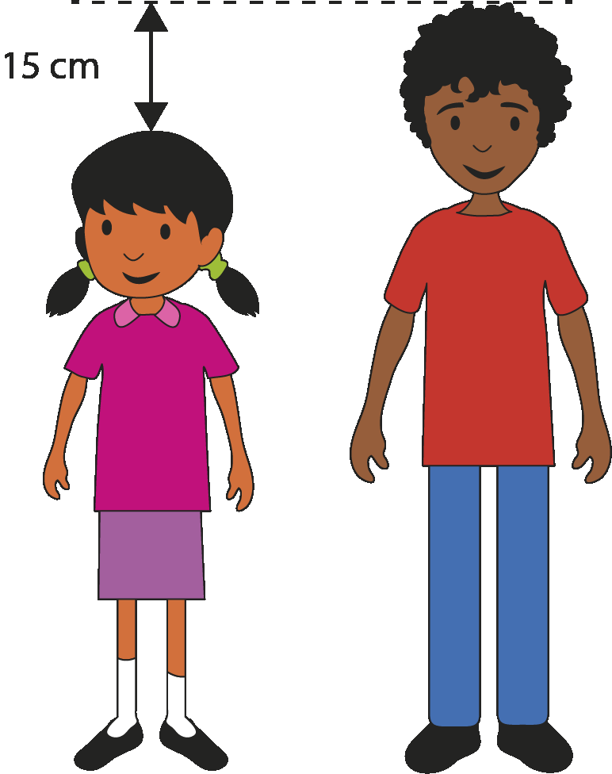
Checkpoint 8: Equations for heights
Look at the picture of Elinor and Ben.
What do you know about their heights? What do you not know?
Elinor writes an equation for their heights: m + 15 = n.
Which letter represents Elinor’s height? Which represents Ben’s height?
Ben stands on a step which is 10 cm high. How does this change the equation?
How would your answer to question b change if Elinor had stood on the step instead?
Oscar is 7 cm shorter than Elinor.
Write an equation connecting Elinor and Oscar’s height
Write an equation connecting Ben and Oscar’s height
Notes:
This slide is animated. Each question will appear separately so you can choose the pace at which to work with your class.
Answers
a) We know that Elinor is 15 cm shorter than Ben (or that Ben is 15 cm taller than Elinor). We do not know either of their heights.
b) m represents Elinor’s height and n represents Ben’s height.
c) The equation will now read m + 25 = n.
d) The equation will now read m + 15 = n + 10 or m + 5 = n.
?
To connect Elinor and Oscar’s height: p + 7 = m or m − 7 = p or m − p = 7.
To connect Ben and Oscar’s height: p + 22 = n or n − 22 = p.
NB The name Oscar has been chosen because students may be tempted to use ‘O’ either as the first letter of Oscar’s name or as the next letter after m and n. This will offer an opportunity to discuss why the letter O is not a sensible choice (as it may be confused with 0, zero) and that the letters are entirely arbitrary.
Suggested questioning
Why is Ben not represented by the letter m?
Which letter represents the taller person? How do you know?
How would parts b and c change if the step was 20 cm high?
How would parts b and c change if the step was replaced by a ‘dip’?
Things to think about
Checkpoint 8 explores whether students understand how to use letters to represent unknowns in the context of a ‘real-life’ situation, but without the support of visual representations such as bar models or balances. This activity may divide the class in terms of understanding from primary, and will provide useful information about

Slide 25
Checkpoint 8: Guidance
Adaptations | Assessing understanding
Support A visual (see ‘Representations’ below) may support students to access this task. Challenge The ‘further thinking’ question asks students to connect Oscar’s height to their equations; asking students to include other elements such as the 10 cm step (or to create their own additions) adds even more challenge. Representations This Checkpoint explores whether students understand how an algebraic statement can represent a relationship between two unknowns. A vertical bar model to represent Elinor and Ben, and the 15 cm difference in their height, might further support students to take meaning from the algebraic representation. | The use of letters to represent unknowns is in the non-statutory guidance for year 6, so students’ experience of this is likely to be mixed. This Checkpoint therefore uses a relatively straightforward situation so that the majority of students will be able to access it, regardless of experience at primary. The letters m and n have been deliberately selected to show that the choice of letter is arbitrary, and to reveal whether students fully understand the additive structure in this example. Students may think that ‘m + 15’ is ‘bigger’ and therefore represents Elinor, rather than fully understanding that n must be bigger as it is 15 more than m. The inclusion of the step further assesses whether students have understood the situation being represented. Do they understand that this will increase the difference by 10 when Elinor stands on it, but reduce it by 10 when Ben does? Can they reflect this understanding in their equations?
Additional resources Examples of questions that explore the meaning of algebraic statements can also be found in the Key Stage 2 SATs papers (e.g. 2019 Paper 3 (reasoning) question 3). Past papers can be readily found online.

Slide 26
Unknowns and variables
Checkpoints 9–13

Slide 27
Unknowns and variables
Previous learning | In Key Stage 3 students need to
Key Stage 2 curriculum: Year 6: express missing number problems algebraically Year 6: find pairs of numbers that satisfy an equation with two unknowns Year 6: enumerate possibilities of combinations of two variables Further information about how students may have experienced this key idea in Key Stage 2: Teaching mathematics in primary schools: 6ASM–4: Solve problems with 2 unknowns (pp308–12*) Primary Mastery Professional Development, Spine 1 Number, Addition and Subtraction, Year 6 Segment 1.31: Problems with two unknowns * Page numbers reference the complete Years 1–6 document | Work from the general to the particular in their interpretation of algebraic expressions and equations. For example, for an algebraic statement such as 3x + 5 or x² − 2, be able to reason how the value of the expression changes as the value of x changes, and when the expression or x will take a particular value. Appreciate that there is a difference between situations where a letter represents a variable which can take any value across a certain domain and where, because of some restriction being imposed (e.g. 3x + 5 = 7, x² − 2 = 9 or 3x + 5 = x² − 2), it has a particular value, which may be as yet unknown.

Slide 28
Checkpoint 9: Final scores
Yusra
Felix
Yusra and Felix are playing a game. They each collect two different types of tokens. These are their final scores.
Who do you think won the game? Why?
If Yusra won the game, what would this tell you about the value of the circle compared to the pentagon?
If the circle is worth 5, what might the pentagon be worth?
If the pentagon is worth 5, what might the circle be worth?
Could you write an expression to describe each person’s final score?
Suggest some other values for the pentagon and circle. What is the smallest and largest each could be?
Notes:
This slide is animated. Each question will appear separately so you can choose the pace at which to work with your class.
Answers
a) Students’ responses may vary. Some may select Felix as he has more tokens. Others may state that they don’t know because they don’t know the value of the tokens. Some may choose Yusra and suggest that circles are worth more.
b) One circle must be worth more than four pentagons.
c) A pentagon could be worth 1 (or any value <1.25).
d) The circle could be worth any value >20.
e) Yusra: 3p + 2c, Felix: 7p + c
?
Any relationship where the value of one circle if greater than the value of four pentagons.
Smallest integer values are pentagon = 1 and circle = 5. There is no limit on the largest values.
Suggested questioning
What is the same/different about Yusra’s and Felix’s scores?
If Felix did not win, what does this mean about the value of a circle compared to a pentagon?
Which is worth more?
What values might the pentagon and circles be worth?
Things to think about
Checkpoint 9 plays with the idea that we cannot know the relative size of two expressions without first knowing
what values they represent. The letters p and c have been used as students are likely to choose them, but they may recognise that the letter choice is arbitrary so long as it is consistent between their two expressions.

Slide 29
Checkpoint 9: Guidance
Adaptations | Assessing understanding
Support Avoid part e, so that students can focus on interpreting the scores before introducing the idea of algebraic expressions in later teaching. Challenge Ask students to suggest some other possible values for the shapes in the ‘further thinking’ question; adding further information (such as ‘Yusra’s score was twice Felix’s score’, or ‘the difference between their scores was even’) could further deepen their thinking. Representations Here, shapes are used to represent unknown numbers as a precursor to letters. The key to understanding of this representation is that, even though Felix has more shapes, we do not know that he has a greater score without more information. | Students may instinctively think that Felix has won as he has more counters, so the first point of assessment is to explore whether they can understand that Yusra winning means that the circle must have a greater value than the pentagon. This leads to a wider point about algebraic expressions: unknowns can take any value, and that we cannot compare their size without first defining either specific values or a range of values. Part e does ask students to write an expression to link this representation to the more formal algebraic learning at Key Stage 3. Depending on students confidence with algebra, teachers may choose not to ask this at this stage. Instead, they may choose to spend more time exploring if students understand how the possible different values of the shapes affect the total scores.
Additional resources A example of a similar premise (but where the combinations of shapes are assigned actual totals so that students can find each value) can be found in the Key Stage 2 SATs papers: 2018 Paper 2 (reasoning) question 21. Past papers can be readily found online.

Slide 30
Checkpoint 10: Roast dinner
Sam is making a roast dinner. He needs to know how long to cook the lamb for. His recipe book gives two options for the cooking times, in minutes:
Medium:
40 × weight (in kg) + 20
Well done:
50 × weight (in kg) + 20
What’s the same and what’s different about the two recipes?
How long will he need to cook the lamb to medium if it weighs:
      1 kg
      2 kg
      1.5 kg.
How much longer would he need each time if he wanted the lamb to be well done?
Sam actually cooked the lamb for 2 hours 20 minutes. What weight might it have been?
Notes:
This slide is animated. Each question will appear separately so you can choose the pace at which to work with your class.
If students need support with organising their workings, a writing frame is provided in ‘Printable resources’.
Answers
a) Students may make observations including:
Same: Both recipes multiply weight by time. In both recipes, 20 minutes is added on after calculating the time based on weight.
Different: The ‘well done’ recipe cooks for 10 minutes longer per kg.
b) 1 kg: 40 + 20 = 60 minutes (1 hour).
2 kg: 80 + 20 = 100 minutes (1 hour 40 minutes). Students may have noticed that this weight is twice the previous one and used this to double 40, then add 20.
1.5 kg: 60 + 20 = 80 minutes (1 hour 20 minutes). Students may have noticed that this weight is between the previous two and used this to appreciate that they could find a value half way between 40 and 80, then add 20.
c) 1 kg: 10 minutes more (so a total of 70 minutes).
2 kg: 20 minutes more (so a total of 120 minutes).
1.5 kg: 15 minutes more (so a total of 95 minutes).
? If medium, the lamb would have been 3 kg (40 × 3 + 20 = 120 + 20 = 140).
If well done, the lamb would have been 2.4 kg (50 × 2.4 + 20 = 120 + 20 = 140).
Suggested questioning
What will happen if he cooks a larger/smaller roast each time?
Is it necessary to re-calculate each time?
Does it take twice as long to cook a 2 kg piece of lamb than a 1 kg piece? Why or why not?
Could you write these in hours?
If Sam plans to eat his roast at 1 pm, at what time should he start cooking for each of his options?
Things to think about
Students are unlikely to have encountered algebraic formulae at primary school but they may, as in Checkpoint 10, have experienced worded ones. This takes a classic context – that of a formula for cooking – but explores how changing the variables affects the answers. The introduction of the second formula in part b explores whether students can make links between their answers and understand which part of their calculation will change when the variable changes, and by how much.

Slide 31
Checkpoint 10: Guidance
Adaptations | Assessing understanding
Support Teachers may wish to give students writing frames for the formulae, with blank spaces to substitute the weights (such as 40 × __ + 20 = __). An example is provided in 'Printable resources’. Challenge Students could be challenged to find more possible weights from given cooking times, particularly with the introduction of actual cooking times. For example, ‘Sam took his lamb out of the oven at 6.15 pm. If he started cooking at 2.40 pm, what weight might he have cooked?’ Representations A worded formula is used here. Other representations are not suggested, as the intention is to check understanding of this formula. However, teachers may find that a bar model or similar visual supports their explanation of constants and variables. | Firstly, see whether students can understand worded formulae, and successfully substitute in values. Part a offers an opportunity to discuss the formulae without considering substitution, to check students are happy with the context and the culinary language. The two formulae, and values selected, have been chosen to see how deep this understanding of the formula goes. Do students think that they need to substitute in each time, or do they recognise the relationships between the weights/times given and use their previous answers? If they do use these relationships, do they also understand that the ‘20 minutes’ is a constant and so is not doubled when the weight is doubled? The understanding teachers glean from this will help support planning of future teaching of algebraic manipulation.
Additional resources Other contexts for worded formulae can be found in the Key Stage 2 SATs papers, including 2017 Paper 2 (reasoning) question 11, 2018 Paper 3 (reasoning) question 15, and 2019 Paper 2 (reasoning) question 10. Past papers can be readily found online. Additional Activity J explores algebraic formulae but with a familiar Key Stage 1/2 representation.

Slide 32
Checkpoint 11: x + y = 20
x + y = 20
Is it possible to find values for x and y if:
They are both odd
They are both even
Only one is even
They are both prime
They are both multiples of 3
They are both multiples of 4
One is three times the other
One is half the other?
Some of the conditions above were impossible. Which ones? How could you change the question to make them possible?
Notes:
This slide is animated. Each question will appear separately so you can choose the pace at which to work with your class.
Answers
a) e.g. x = 11, y = 9
b) e.g. x = 8, y = 12
c) Not possible, as 20 is even and even + odd = odd.
d) x = 3 and y = 17 or x = 17 and y = 3 or x = 7 and y = 13 or x = 13 and y = 7.
e) Not possible as 20 is not a multiple of 3.
f) x = 4 and y = 16 or x = 8 and y = 12 or x = 16 and y = 4 or x = 12 and y = 8.
g) x = 5 and y = 15 or x = 15 and y = 5.
h) x = 6 $\frac{2}{3}$ y = 13 $\frac{1}{3}$ or x = 13 $\frac{1}{3}$ and y = 6 $\frac{2}{3}$.
?
Parts c and e gave impossible conditions: c would only be possible if both values could be even, or if 20 was replaced with an odd number; and e would be possible if they both had to be multiples of 2, 4 or 5, or if 20 was replaced by a multiple of 3.
Suggested questioning
How many different solutions are there each time?
Does your neighbour have the same solutions? Are there any more?
Why are some of these impossible?
Can you create your own conditions that are possible/impossible?
Things to think about
Checkpoint 11 offers a relatively straightforward context for using letters to represent unknowns. Students may well have experienced problems such as this before and be familiar with the idea that a letter can represent a number, but will likely not have been formally introduced to algebraic notation. The inclusion of different constraints adds challenge and offers an opportunity to make connections with prior learning on properties of number.

Slide 33
Checkpoint 11: Guidance
Adaptations | Assessing understanding
Support Just ask ‘can you find values for x and y?’ to check students are happy with the concept of the question before adding constraints. Although students will have encountered the terminology from all eight questions at Key Stage 2, teachers may wish to just ask parts a–c as they are more straightforward and explicitly taught within the primary curriculum Challenge Ask students to find their own impossible and possible constraints – for example, directing them to explore which numbers both x and y can be multiples of. Representations This Checkpoint uses a straightforward context so that teachers can explore how confident students are with letters as representations of unknown numbers. Further representations could be considered to support understanding if teachers find that they are needed, such as a bar model showing two parts to make 20. | Teachers can firstly assess how confident students are with using letters to represent unknown values, and with substituting values in to an equation or expression. There is also an opportunity to consider how many different values x and y can take, to check students’ initial sense of what a ‘variable’ is; Checkpoint 12 looks in more detail at this. The given constraints also check students’ retention of some of the language around properties of number, such as ‘prime’ or ‘multiple’.
Additional resources The stamps problems on p29 of the year 6 Primary Assessment Materials | NCETM offer a potential next step for this task. Students could be asked to represent using letters and to consider why ‘x + y = 93’ does not fully explain the situation. Questions with a similar premise can be found in the Key Stage 2 SATs papers, including 2017 Paper 3 (reasoning) question 18, and 2019 Paper 3 (reasoning) question 17. Past papers can readily be found online.

Slide 34
Checkpoint 12: Same and different
a + b = 10
a + 3 = 10
a + b > 10
a + 3 > 10
What is the same? What is different?
How many different values can you think of for a and b each time?
How have these changed?
How many different values can you think of for a each time?
Is this more or less than before? Why?
Create your own equations and inequalities. Can you create an equation with just one value for a or b? Can you create an equation with more than one value?
Notes:
This slide is animated. Each question will appear separately so you can choose the pace at which to work with your class.
Answers
Left-hand column:
Same: both have a + b on the left-hand side and 10 on the right-hand side of the equals sign.
Different: one has an equals sign and the other has an inequality sign. This means a + b is equal to 10 for the blue (first) equation, but greater than 10 for the red (second) one.
Any relevant values for a and b that sum to 10. The solutions are infinite; you may choose to specify that students are looking for integer pairs.
Right-hand column:
The b has been replaced by 3. This means that a is no longer a variable for the blue (first) equation; it is an unknown with just one value.
a = 7
a > 7
There is only one solution for a + 3 = 10, when there were infinite solutions before.
In a + 3 > 10, a can still take multiple values but now it must be greater than 7.
Suggested questioning
What’s the same and what’s different?
What pairs of numbers could work for a and for b?
Why is there only one solution to a + 3 = 10?
For which of these equations/inequalities could a be 6? For which could a be 7? For which could a be 8?
Things to think about
Checkpoint 12 builds on the premise of Checkpoint 11, but specifically focuses in on how many different values the unknowns can take. It addresses the difference between situations where a letter represents a variable which can take any value and situation where a letter has a particular value (which may be as yet unknown).

Slide 35
Checkpoint 12: Guidance
Adaptations | Assessing understanding
Support Discuss just the two blue equations, so that students are not distracted by discussion about inequalities. This keeps the focus on the main purpose of the task (see ‘Assessing understanding’). Challenge Challenge students to ensure they have included different types of number in their answer for a + b = 10, including decimals, fractions and negatives. Ask them to consider how their sets of answers would change if a + b > 10 were changed to a + b < 10. Representations In this Checkpoint, letters are used as representations of unknown numbers. Teachers should check how confident students are with this premise, and consider whether further representations (such as bar models or number lines) are needed. | Four similar equations/inequalities are given for teachers to select pairs for students to compare. Comparing the blue statements is the main thrust of the task, as it checks that students are really clear about when an unknown can take many values or must take a particular value. Each other comparison draws upon a different aspect of algebraic thinking: Comparing a + 3 = 10 with a + 3 > 10 explores whether students understand how the ‘answer’ of 7 is treated differently in each case: as the answer to a + 3 = 10, and as the boundary of all possible answers in a + 3 > 10. Comparing the red (second) statements explores whether students can define the range of possible values a can take, and understand why it has a minimum value for a + 3 > 10 but not a + b > 10.
Additional resources Additional activity G takes this idea further and could be suitable for re-assessing students’ understanding once they have had some teaching of teaching equations and formulae within Key Stage 3. There are several examples which explore how letters can be used to represent either specific unknown values or variables in the 1.4 Arithmetic Procedures core concept document, which can be found within Secondary Mastery Professional Development | NCETM.

Slide 36
Checkpoint 13: Numbers box
12
0
9
g + h
2
4
1
3
15
Choose a number from the box for g. Choose a different number from the box for h. What is the greatest total you can create?
How would your answers be different if the expression was 2g + h?
Kazia used numbers from the box for 2g + h. Her total was 9. What numbers might she have used for g and h?
Notes:
This slide is animated. Each question will appear separately so you can choose the pace at which to work with your class.
Answers
a) The greatest total is 27 if g = 15 and h = 12 or g = 12 and h = 15.
b) The greatest total is 42 if g = 15 and h = 12.
? Kazia may have used g = 0 and h = 9, g = 4 and h = 1.
Suggested questioning
What is the same/different about parts a) and b)
How does the inclusion of 2g change this activity?
For part b, will you choose the same values to create the greatest total? Why or why not?
Things to think about
Checkpoint 13 explores how confidently students can substitute values for unknowns, and their initial response to the inclusion of a numerical coefficient. They may have seen these in examples from primary school but not been explicitly taught the notation. The language of ‘substitute’, which may not have been explicitly used at primary school, is deliberately avoided in the task.

Slide 37
Checkpoint 13: Guidance
Adaptations | Assessing understanding
Support Rather than using a constraint such as ‘greatest total’, just ask students to choose any two numbers so that they practise substituting different values for g and h before moving onto part b. Challenge The numbers given here are relatively straightforward, so students might be challenged with different numbers. They might also be given constraints, such as ‘the total closest to 0’, or ‘the smallest multiple of 3’. Further challenge could be found with constraints where the unknowns could take multiple values. Representations As with the previous two Checkpoints, representation here is of a letter to represent an unknown number – this time, also introducing a coefficient. A bar model or other symbols might help teachers to explain the difference between the expressions in parts a and b. | Part a checks whether students are able to substitute a value for an unknown with a very simple constraint. Students are likely to find this straightforward but may need some guidance around the fact that the letter is replaced by the number. Whilst this Checkpoint is an opportunity to assess students’ understanding of substituting numbers for letters, teachers might also establish some norms around how students should record substitution in their books. Part b introduces a numerical coefficient (without a multiplication symbol). This is so that teachers can check whether students already have an understanding of what 2g means. This will help plan teaching of formal algebraic notation. Teachers may wish to draw attention to the fact that it does not matter which letter 12 and 15 are assigned to in part a, it does for part b where one of the unknowns is doubled.
Additional resources Additional activity H also explores substitution with various constraints.

Slide 38
Unitising and the distributive law
Checkpoints 14–16

Slide 39
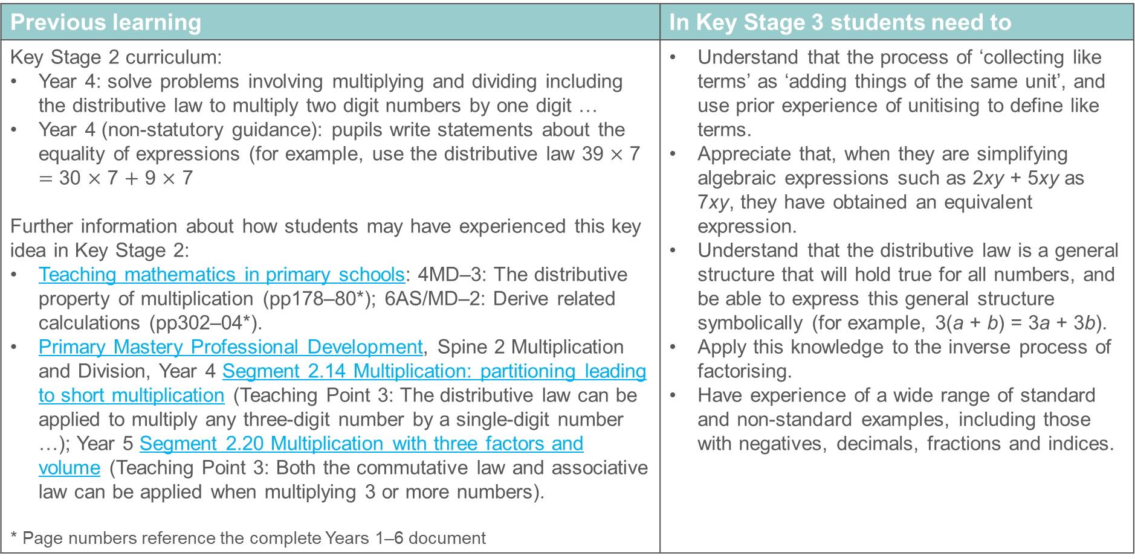
Unitising and the distributive law
Previous learning | In Key Stage 3 students need to
Key Stage 2 curriculum: Year 4: solve problems involving multiplying and dividing including the distributive law to multiply two digit numbers by one digit … Year 4 (non-statutory guidance): pupils write statements about the equality of expressions (for example, use the distributive law 39 $×$ 7 $=$ 30 $×$ 7 $+$ 9 $×$ 7 Further information about how students may have experienced this key idea in Key Stage 2: Teaching mathematics in primary schools: 4MD–3: The distributive property of multiplication (pp178–80*); 6AS/MD–2: Derive related calculations (pp302–04*). Primary Mastery Professional Development, Spine 2 Multiplication and Division, Year 4 Segment 2.14 Multiplication: partitioning leading to short multiplication (Teaching Point 3: The distributive law can be applied to multiply any three-digit number by a single-digit number …); Year 5 Segment 2.20 Multiplication with three factors and volume (Teaching Point 3: Both the commutative law and associative law can be applied when multiplying 3 or more numbers). * Page numbers reference the complete Years 1–6 document | Understand that the process of ‘collecting like terms’ as ‘adding things of the same unit’, and use prior experience of unitising to define like terms. Appreciate that, when they are simplifying algebraic expressions such as 2xy + 5xy as 7xy, they have obtained an equivalent expression. Understand that the distributive law is a general structure that will hold true for all numbers, and be able to express this general structure symbolically (for example, 3(a + b) = 3a + 3b). Apply this knowledge to the inverse process of factorising. Have experience of a wide range of standard and non-standard examples, including those with negatives, decimals, fractions and indices.

Slide 40
Checkpoint 14: Triangle and rectangle values
3 ×▲+ 6 × █ + 7 ×▲+ 9 × █
What is the value of the expression if:
▲= 3 and █ = 0
▲= 0 and █ = 2
▲= 3 and █ = 2
▲= 2 and █ = 3
▲= 6 and █ = 4
▲= 0.8 and █ = 0.8
Was there an easier way to find your answers?
Write a different expression using ▲ and █ that would have the same value.
Notes:
This slide is animated. Each question will appear separately so you can choose the pace at which to work with your class.
Answers
a) 30
b) 30
c) 60
d) 65
e) 120
f) 20
g) Students may have noticed that they could multiply their triangle value by 10, and their rectangle value by 15. They may also have noticed some relationships within the calculations. For example, for c and d, the total triangles and total rectangles had the same value as the triangle value was 1.5 times bigger than the rectangle value (and 10 is 1.5 times smaller than 15). Students may simplify part f to 25 × 0.8 as the distinction between triangle and rectangle is irrelevant.
? Any expression equivalent to 10 triangles + 15 rectangles
Suggested questioning
How else could you write this expression? How many triangles/rectangles are there in total?
What could the values of the triangles and rectangles be if the total was 105? How about 100?
Things to think about
Checkpoint 14 uses shapes to explore unitising, and could be used to check understanding of the distributive law or precede teaching on collecting like terms. Teachers may find that students find the shapes to be more accessible than using numbers or letters.

Slide 41
Checkpoint 14: Guidance
Adaptations | Assessing understanding
Support The number selection is relatively accessible. Give mini whiteboards or a printed version (see ’Printable resources’) so students can write in their values and organise their thoughts, or use the simpler Additional activity K (see below). Challenge Students could be challenged to create their own pairs of values, with constraints. For example, ‘choose values so that the total triangle value is equal to the total rectangle value’, or, ‘choose values so that the total triangle value is four times the total rectangle value’. Representations This activity uses the representation of shapes as an alternative to letters or numbers, to explore the concept of unitising. If teachers have ‘physical’ shapes (such as plastic triangles and rectangles) these could be used to model how there are 10 triangles and 15 rectangles within the calculation. | Students may quickly choose to rearrange the calculation to 10 ×▲+ 15 × █ for efficiency. Explore students’ explanations for why this is possible as this will help them plan their own introductions to collecting like terms. Do students use language such as ‘units’? If students do not make this leap, they may notice it through the process of calculating. The numbers in parts a and b more obviously lead students to notice the totals of 10 triangles and 15 rectangles. The numbers in part f have been chosen so that, if they haven’t already done so, students seek out this more efficient strategy. Note whether students choose to separately ‘× 15’ here, or use their answer to ‘× 10’ to calculate more efficiently.
Additional resources For teachers interested in the concept of unitising and how it builds throughout the primary curriculum, this is a useful article, with links to further resources: What is unitising, and why is it important? | NCETM Additional activity K is a similar but slightly simpler version of this task. Checkpoints 33 and 35 in Arithmetic procedures offer other explorations of unitising and the distributive laws

Slide 42
Checkpoint 15: Arithmequick
Find a quick way to write the answer to:
5 × 37 + 3 × 37 + 2 × 37
7 × 763 254 + 3 × 763 254
7 × 7632.54 + 3 × 7632.54
17 × 837 468 – 7 × 837 468 + 2
3 756 + 3 756 + 3 756 + 3 756 + 3 756 + 3 756 + 3 756 + 3 756 + 3 756 + 3 756 + 9
49 × 8 + 51 × 3 + 51 × 7 + 2 × 49
Explain why you can’t find a quick way to write the answer to:
7 × 23 764 + 3 × 56 982
Find some possible values to make this calculation correct:
___ × 28 + ___ × 28 – ___ × 28 = 280
Notes:
This slide is animated. Each question will appear separately so you can choose the pace at which to work with your class.
Answers
a) 10 × 37 = 370
b) 10 × 763 254 = 7 632 540
c) 10 × 7 632.54 = 76 325.4
d) 10 × 837 468 + 2 = 8 374 680 + 2 = 8 374 682
e) 10 × 3 756 + 9 = 37 560 + 9 = 37 569
f) 10 × 49 + 10 x 51 = 490 + 510 = 1 000
g) Because the numbers being multiplied are all different.
? Any combination of values where __ + __ − __ = 10.
Suggested questioning
What’s the same/different about all of these calculations?
How could you rewrite them to make them look simpler?
Is it always possible to do this? What does your calculation need to have for this to be possible?
What is common to each part of your calculation? What is not?
Things to think about
Checkpoint 15 offers a similar premise to Checkpoint 14, but asks students to identify the shared factors each time rather than using a representation such as a shape or letter. Students may initially be put off by the numbers offered; this is deliberate so that students are not tempted to calculate without first looking for an alternative efficient method.

Slide 43
Checkpoint 15: Guidance
Adaptations | Assessing understanding
Support Part a is a more accessible introductory question; teachers might like to include a version with even simpler numbers before this. At first, it may help students to highlight the common terms in a different colour or to use the triangle and rectangle from Checkpoint 14. Challenge Ask to write their own ‘arithmequick’ calculations and explain why they work. Who can write the most complex-looking one? Representations The concept of unitising can be represented using any item. For example, in parts a–e, the shared factor each time could be represented by a counter. This would support the understanding that, in each calculation, that number could be replaced by any ‘unit’ and there would still be a total of 10 of those units. | Students need to recognise where the distributive law can be used to rewrite calculations with shared factors. They might spot that all of the calculations can be rewritten using ‘10 × _’. Check they can explain why. Explicitly check how students approach multiplication by 10 and challenge where they are relying on ‘adding a zero’. Part c offers an opportunity to address this. From part c onwards, students also have to recognise parts of the calculation that do not share a factor. These additions are relatively straightforward but students may need to be reminded to include them. If they are confident with this activity, give a further example using letters, to act as a generalisation of the distributive law or as an introduction to collecting like terms at Key Stage 3.
Additional resources Checkpoints 35 and 36 in Arithmetic procedures offer other explorations of unitising and the distributive laws Example 1 from key idea 1.4.3.2 within the 1.4 Arithmetic Procedures core concept document looks at using the distributive law to calculate efficiently. This can be found within Secondary Mastery Professional Development | NCETM.

Slide 44
Checkpoint 16: Square numbers
Three tiles are arranged to make a square
Alison, Bola and Celia want to find the area of the square.
Alison did (4 + 3) × 7.
Bola did 4 × 2 + 3 × 7 + 4 × 5.
5
7
Celia did 4 × 7 + 3 × 7.
Each person’s method is correct.
Describe how Alison, Bola and Celia each worked out the problem.
4
Umar replaces the lengths on the diagram with numbers that increase the area of the whole square to 81. What numbers might he have used?
Notes:
This slide is animated. Each question will appear separately so you can choose the pace at which to work with your class.
Answers
Alison found area for the whole square in one go.
Bola found the area for each individual rectangle and added them together.
Celia found the total area of the yellow and red rectangles and added it to the area of the blue rectangle.
Suggested questioning
What’s the same/different about each person’s method?
Whose is most efficient?
Which do you prefer? Why?
Could you do it another way?
Things to think about
Checkpoint 16, similarly to Checkpoint 34 in Arithmetic procedures, looks at how a shape can be sub-divided to find the area as a proxy for understanding the distributive law and equivalent calculations.

Slide 45
Checkpoint 16: Guidance
Adaptations | Assessing understanding
Support Show just one method at a time so that students can concentrate on where the values come from in the diagram. Different coloured highlighters might be a useful tool for highlighting the lengths to make this really clear. Give students the image to annotate: a printable version is provided in ‘Printable resources’. Challenge Take the ‘further thinking’ question on to consider other methods for sub-dividing the square with an area of 81. Representations The area model is used here as a representation to explore equivalent calculations and how the distributive law means that they can be rewritten. | Before starting this activity, check that students can correctly interpret the diagram and identify which lengths are referred to by the arrows. Students may find it easiest to identify the three areas in Bola’s model (as they are individually coloured) but harder to connect his method to the other two. Can students recognise how the 4 × 2 and 4 × 5 in Bola’s method, for example, could be rewritten as 4 × 7? Students may readily make connections between Alison and Celia’s methods; listen to how they explain that they are connected. Do they use the specific example of the rectangles, or do they understand that this is a mathematical structure that applies in all cases? Use follow-up questioning to check if students understand how the distributive law can be applied without the area model visual, for example by offering a similar calculation (such as 6 × 7 + 2 × 7) and asking students how else it could be written.
Additional resources Checkpoint 34 in Arithmetic procedures offers a similar context to explore the distributive law – this can be downloaded from the main Checkpoints page. Additional activity L in this deck builds upon this task to use letters to represent missing lengths

Slide 46
Additional activities
Activities A–L

Slide 47
Activity A: Checks and balances 2
Mr Griffith shows the class these balanced scales:
John writes this equation:
5a = 2a + b
What is the same/different about the scales and John’s equation?
What can you work out? Do you find the scales or the equation easier for this?
5a = 15. What does this tell you about the value of a and b?
John changes the + sign to a − sign on the right-hand side of his equation. How does the left-hand side of his equation need to change? Is there more than one way to do this?
Notes:
This slide is animated. Each question will appear separately so you can choose the pace at which to work with your class.
Please note that this activity is designed for use once students have experienced some teaching of algebra at Key Stage 3.
Answers
Same: the scales and John’s equation both have five of one term (checked boxes or a) on the left-hand side, and two of the same term plus one of a different term (plain boxes or b) on the right-hand side. Also, both sides are equal. Different: the scales use boxes to represent the unknown mass but John’s equation uses letters.
That b has the same value as 3a. Some students may find it easier to use the visual aid of the scales to see this, while others might easily be able to see that 2a + 3a = 5a and, therefore, that b must be 3a.
This tells us that a = 3 and b = 9. Students may find it straightforward to identify a = 3 (as 5 × 3 = 15, but need some prompting to recognise that the equation can then be written as 6 + b = 15, so b = 9.
? 2a − b would be 2 × 3 − 9 = -3. Students may make links to recent work on negative numbers to recognise that the equation should now be -a = 2a − b. Students may also write equivalent expressions (such as 5a – 6a).
Suggested questioning
What is the same and what is different?
What does the a represent on Mr Griffith’s scales?
What does the plain box represent in John’s equation?
Which representation do you prefer to work out the unknown values?
How would your answer to part c change if 5a = __?
Things to think about
Additional activity A is not designed for use as a Checkpoint: this uses mathematical knowledge that is not taught in Key Stage 2. However, like Additional activity B, it takes the premise of Checkpoint 1 (which is likely to be familiar to students from primary school) and offers a potential next step to support students to make links between the balancing scales representation and their new learning on algebraic notation.

Slide 48
Activity B: Checks and balances 3
5a = 2a + b
Jenny writes this equation:
What do you know about b?
Using the original equation as your starting point each time, how could you keep the equation balanced if:
The b was replaced by another a?
A b was added to the left-hand side?
Another b was added to the right-hand side?
2a was replaced by 2b on the left-hand side?
Jenny wants to add five more a terms and two more b terms to the equation. Can she do this and keep the equation balanced? Why or why not?
Notes:
This slide is animated. Each question will appear separately so you can choose the pace at which to work with your class.
Please note that this activity is designed for use once students have experienced some teaching of algebra at Key Stage 3.
Answers
a) That b must have the same value as 3a.
b) Remove 2a from the left-hand side, or add 2a to the right-hand side as well.
c) Add b (or 3a) to the right-hand side.
d) Add one b (or 3a) to the left-hand side .
e) Add 4a to the right-hand side, or replace 5a with 3b.
?
No this is not possible. It would be possible if there were an even number of each term (as one could be added to each side) or if the a terms were a multiple of 3 (as 3a = b), and the total number of b terms was even. For example, 6 a terms and 2 b terms or 3 a terms and 1 b term.
Suggested questioning
Could you draw a diagram to represent this equation?
What does = mean?
What do you need to change to the left-hand side of the equation when you make a change to the right-hand side, and vice versa?
Is there more than one way to answer part c?
Things to think about
Additional activity B is not designed for use as a Checkpoint: this uses mathematical knowledge that is not taught at Key Stage 2. However, like Additional activity A, it takes the premise of Checkpoint 1 (which is likely to be familiar to students from primary school) and offers a potential next step to support students to make links between the balancing scales representation and their new learning on algebraic notation.

Slide 49
Activity C: Equals sign
12 cm
Billy:
3 cm
3 x 12 = 36 ÷ 2 = 18
Billy and Maya both use the formula base × height ÷ 2 to work out the area of this triangle to be 18 cm².
What is the same and what is different about their workings?
Who has used the = sign correctly?
Maya:
(3 x 12) ÷ 2 = 36 ÷ 2 = 18
How many different ways can you write the workings for the area of a triangle with base 15 cm and height 4 cm?
Notes:
This slide is animated. Each question will appear separately so you can choose the pace at which to work with your class.
Answers
Same: both of their workings show that they have multiplied the base by the height then divided by 2. Different: Billy did not show his intention to divide by 2 in the first step of his workings.
Maya has used the equals sign correctly.
Suggested questioning
What is the same and what is different?
What does = mean?
How else could Maya have written her workings?
Why is it important to use = properly?
Things to think about
Use this activity if students have misunderstood or misuse the equals sign in their workings. Many students (particularly where they have primarily worked with the calculation on the left-hand side of an equals sign, and a solution on the right) can come to view the equals sign as a process or a symbol that indicates what ‘makes’ the answer. They might, like Billy in this example, write strings of calculations connected by the = symbol without realising that each calculation needs to be equal for this notation to have been used correctly. Indeed, some students may struggle to identify any mistake on this slide. This misunderstanding can make later work on manipulation of expressions (while maintaining equivalence) or solving equations to be very challenging. Here, the familiar context of finding the area of a triangle is used to expose such issues and provide teachers with an opportunity to correct students’ use of the equals sign if necessary.

Slide 50

Activity D: Number line equations 2
Sifan and Laura each think of a number. Sifan’s number is larger than Laura’s.
Both numbers are marked on a number line.
a) Which letter represents Sifan’s number?
b) Which letter represents Laura’s number?
c) How much more than Laura’s number is Sifan’s number?
d) What calculations can you write using Laura and Sifan’s numbers?
Eden thinks of a number. Eden’s number is f smaller than Laura’s number.
Mark a possible position for Eden’s number on the number line.
How many calculations can you write using Eden’s number?
Notes:
This slide is animated. Each question will appear separately so you can choose the pace at which to work with your class.
Answers
The t represents Sifan’s number. We know that Sifan’s number is larger so it will be further along the number line.
Laura’s number is represented by w. We know this because it is lower down the number line.
Sifan’s number is r more than Laura’s number. We can see this as the difference on the number line.
Calculations include: t − w = r, w + r = t, t − r = w
?
Eden’s number will be lower down the number line, indicating a difference of f between e and w.
Calculations include: e = w − f, e + f = w, t − r − f = e, e + f + r = t, etc.
Suggested questioning
How do you know which letter represents which number?
How many different calculations can you write?
Which letter represents the difference between the two numbers?
What could the values of w, r and t be?
Where would f be? How would your answer be different if Eden’s number was f smaller than Sifan’s number?
Things to think about
Additional activity D is a slightly easier starting point to Checkpoint 5. Each part looks more explicitly at what each letter represents and how to construct expressions using this relationship, rather than how the relationship is changed by different conditions. Students may initially find it uncomfortable to answer question c with r rather than with a known number. If students are familiar with a bar model for representing additive relationships, model how w + r = t, and the other answers to d, can also be represented using a bar model.

Slide 51
Activity E: Introduction to equations from bar models
Daisy looks at the bar model and says, ‘Blue minus red is equal to yellow.’
Stan looks at the bar model and says a different equation.
a) What might Stan have said?
The bar model changes a little. Daisy writes c + a = 10.
Stan looks at the bar model and writes a different equation.
b) What might Stan have written?
10
a
c
A different bar model shows 10 + b = e.
Draw the bar model.
What other equations can you write with b and e?
Notes:
This slide is animated. Each question will appear separately so you can choose the pace at which to work with your class. If any students cannot distinguish the colours, point to the relevant areas.
Answers
a) yellow + red = blue; blue − yellow = red
b) a + c = 10; 10 − a = c; 10 − c = a
Suggested questioning
What is the same about the new bar model? What is different?
How many equations can you write from each bar model?
Can you show a subtraction? Can you show an addition?
Things to think about
Additional activity E offers simpler version of Checkpoint 3, in case students are unfamiliar with bar models used to represent part̄−part−whole models. Here, the first bar model refers just to the colours, to remove any potential distractions provided by letters, and the second bar model introduces the ‘known’ value as the whole, rather than one of the parts. Please also refer to the notes and guidance for Checkpoint 3.

Slide 52
Activity F: Stick difference methods
a)
James has two sticks.
b)
How do Montel and Jake’s workings compare to your thinking? What should they do next?
When he balances the sticks on top of each other, the total height is 150 cm.
When he stands them next to each other, the purple is 10 cm taller than the green.
How long is each stick?
Montel
Jake
P = G + 10
P + G = 150
G + 10 + G = 150
G + G = 140
150
10
The small bit of purple is worth 10, so the two greens are worth 140.
Create your own stick problem. What information must you give to make sure it is solvable?
Notes:
This slide is animated. The problem will appear stage-by-stage, as will the two example student workings, so that you can choose the pace to work with your class. The further thinking question appears before part b, as you may or may not wish to use the examples given as part of your discussion.
Answers
a) The purple stick is 80 cm and green stick is 70 cm.
b) Montel has imagined the second diagram on top of the first, so that he can see the difference between two green sticks as 10. Jake has described the purple stick in terms of the green stick, so that he can just work with one type of stick to work out its length.
Both students now need to divide 140 by 2 to work out the value of one green stick, and then add 10 back onto this to work out the length of the purple stick.
? Students’ responses to this may vary. When they create a problem with two unknowns, they will need to give sufficient information to identify one unknown to then work out the other. This means they can write two independent statements about the unknowns. This might, like here, be the total of the two unknowns and the difference between them.
Suggested questioning
What do you notice about the diagram?
What do you know about the gap between the green and the purple sticks?
How long is two green sticks? How do you know?
Is there another way to work this out?
Things to think about
Part a of this activity is identical to Checkpoint 6; see the Guidance slide from this Checkpoint for more information. Part b offers two different approaches as a starting point for discussion about how to solve the problem. Teachers may find it helpful to collect responses from the class and draw on these before (or instead of) showing Montel and Jake’s approaches. If using Montel and Jake’s methods as a starting point for discussion, consider what is the same/different about the approaches the students offer. How readily can students continue the two methods started here? Do they prefer the visual or are they already comfortable with algebraic notation?

Slide 53
Activity G: Same and different 2
2a + b = 10
2a + 3 = 10
2a + b > 10
2a + 3 > 10
What is the same? What is different?
How many different values can you think of for a and b each time?
How have these changed?
How many different values can you think of for a each time?
Is this more or less than before? Why?
Create your own equations and inequalities. Can you create an equation with just one value for a or b? Can you create an equation with more than one value?
Notes:
This slide is animated. Each question will appear separately so you can choose the pace at which to work with your class.
Please note that this activity is designed for use once students have experienced some teaching of algebra at Key Stage 3.
Answers
Left-hand column:
Same: both have 2a + b on the left-hand side and 10 on the right-hand side
Different: one has an equals sign and the other has an inequality sign. This means 2a + b is equal to 10 for the blue equation, but greater than 10 for the red one.
Any relevant values for 2a and b that sum to 10 (the solutions are infinite; you may choose to specify that students are looking for positive integer pairs, in which case the solutions are: a = 0 and b = 10, a = 1 and b = 8, a = 2 and b = 6, a = 3 and b = 4, a = 4 and b = 2, a = 5 and b = 0).
Right-hand column:
The b has been replaced by 3. This means that a is no longer a variable for the blue equation; it is an unknown with just one value.
a = 3.5
a > 3.5
There is only one solution for 2a + 3 = 10, when there were infinite solutions before.
In 2a + 3 > 10, a can still take multiple values but now it must be greater than 3.5.
Suggested questioning
What is the same and what is different?
What pairs of numbers could work for a and for b?
Why is there only one solution to 2a + 3 = 10?
For which of these equations/inequalities could a be 3? For which could a be 3.5? For which could a be 4?
Things to think about
Additional activity G is identical to Checkpoint 12, with the exception that now ‘2a’ is used instead of ‘a’. Students may have seen this notation in primary school but are unlikely to have been taught explicitly what it means. This makes it more appropriate for use within teaching of a Year 7 unit on algebra, rather than as a tool to assess understanding from Year 6. Teachers may use Checkpoint 12 as a starting point, and then Additional activity G once students have had some teaching on algebra. The similarities between the two tasks may make for interesting comparisons and help teachers to see how much students’ thinking has moved on. Please refer to the Guidance slides of Checkpoint 12 for more detail about the opportunities for assessment within this activity.

Slide 54
Activity H: Moving twos
Look at these three cards:
a²
2a
a + 2
How would you read each of the cards out loud?
Find a value for a that makes the red (left-hand) card have the greatest value.
Find a value for a that makes the blue (right-hand) card have the greatest value.
Find a value for a that makes the green (middle) card have the lowest value.
Find a value that makes all the cards have an equal value.
Notes:
This slide is animated. Each question will appear separately so you can choose the pace at which to work with your class.
Please note that this activity is designed for use once students have experienced some teaching of algebra at Key Stage 3.
Answers
a) Red card: ‘a squared’ or ‘a to the power of two’; green card: ‘two a’ or ‘two times/multiplied by a’; blue card: ‘a plus two’ or ‘a add two’.
b) a = 3 would make the red card have the greatest value (or any number > 2 or < -1).
c) a = 1 would make the blue card have the greatest value.
d) Any value where a < 0.
Suggested questioning
What is the same? What is different?
If a = 10, which has the greatest value? How does this change if a = 1?
To further extend students: how do your answers change if the cards are a³, 3a and a + 3?
Things to think about
This activity gives teachers an opportunity to prompt students’ understanding of algebraic notation, while further exploring the concept of unknowns and variables. Students’ experience of such notation is likely to be mixed. Many are likely to have seen generalised statements where letters are used in place of numbers but may not have explored these in depth. They may not, for example, have formally been introduced to the idea that ‘2 multiplied by a’ is written as ‘2a’. Similarly, students will probably have seen the notation of ‘a number squared’ in their work on square numbers but may not have seen it generalised in this way. The three cards here are selected for comparison as they are often misinterpreted/confused with each other. If students need more experience of the notation explored here, then Checkpoint 6 in ‘Properties of number’ offers further exploration and could easily be adapted to use letters in place of the given values.

Slide 55
Activity I: Thinking of a number
Zak and Pete are each thinking of a positive number. Their numbers sum to 50.
What will happen to the total if Zak:
Adds 1 to his number?
Subtracts 5 from his number?
Doubles his number?
Subtracts Pete’s number from his number?
What will happen to the total if they both:
Add 1 to their numbers?
Subtract 5 from their numbers?
Double their numbers?
Subtract the other person’s number from their own?
For the questions in the left-hand blue box, what would Pete have to do to his number to ensure that the total of their numbers stayed as 50?
Notes:
This slide is animated. Each question will appear separately so you can choose the pace at which to work with your class.
Answers
a) The total will be 1 larger.
b) The total will be 5 smaller.
c) The total will be larger.
d) The total will be smaller; it will now just be Zak’s number.
e) The total will be 2 larger.
f) The total will be 10 smaller.
g) The total will be 100.
h) The total will be 0.
?
Pete would need to subtract 1 from his number.
Pete would need to add 5 to his number.
Pete would need to subtract Zak’s original number from his own.
Pete would need to double his number.
Suggested questioning
When do you know exactly how much the total has changed by? When do you not?
What is the biggest change? How do you know this?
Could you write these changes as equations?
To further extend students: how would this question change if Zak and Pete’s numbers were not specified as positive?
Things to think about
Additional activity I is similar to Checkpoints 5 and 7, but offers a simpler relationship (z + p = 50) and more possibilities to consider. Depending on when in the curriculum sequence this activity is used, teachers might like to use algebraic notation to represent the changes made in each part. This may, for example, make it easier to see how, in part d, the answer is just Zak’s number (z + p − p = z) or, in part h, the answer is 0 ((z − p) + (p − z) =z − p + p − z = 0).

Slide 56
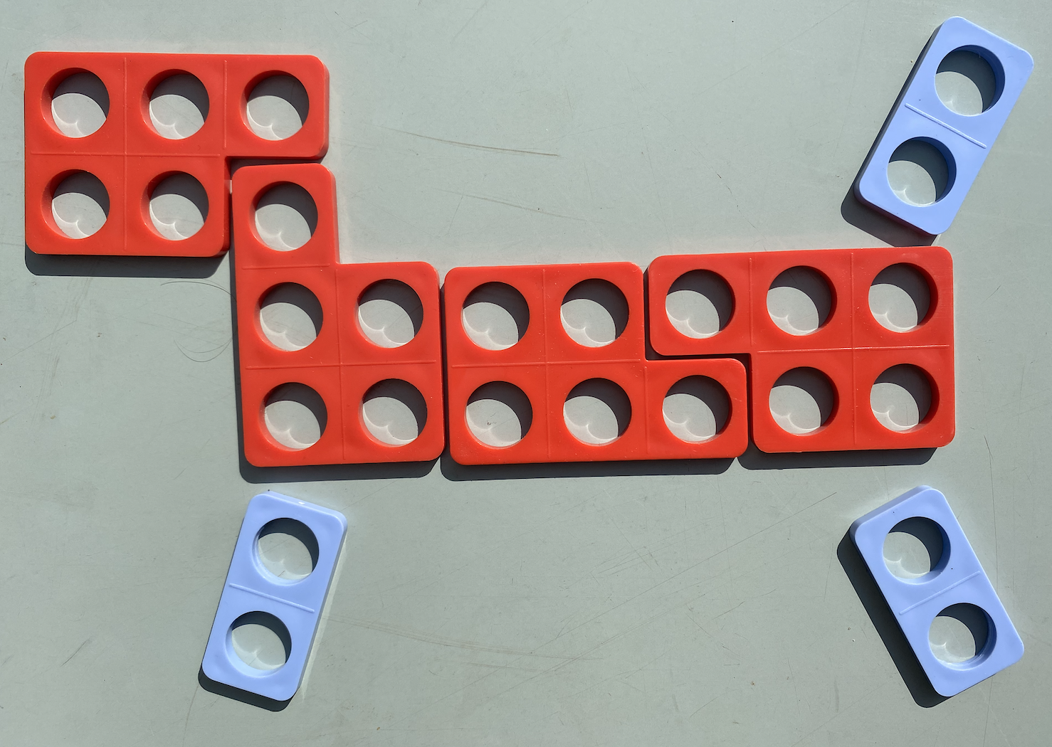
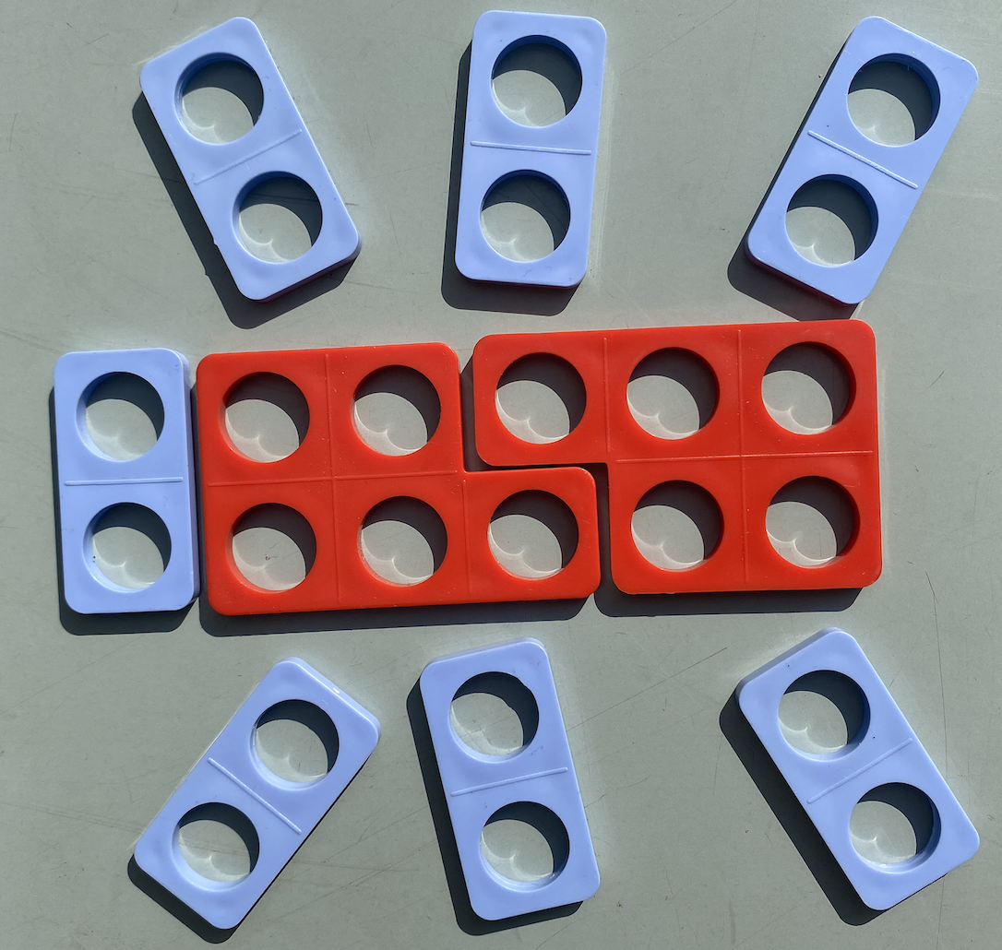
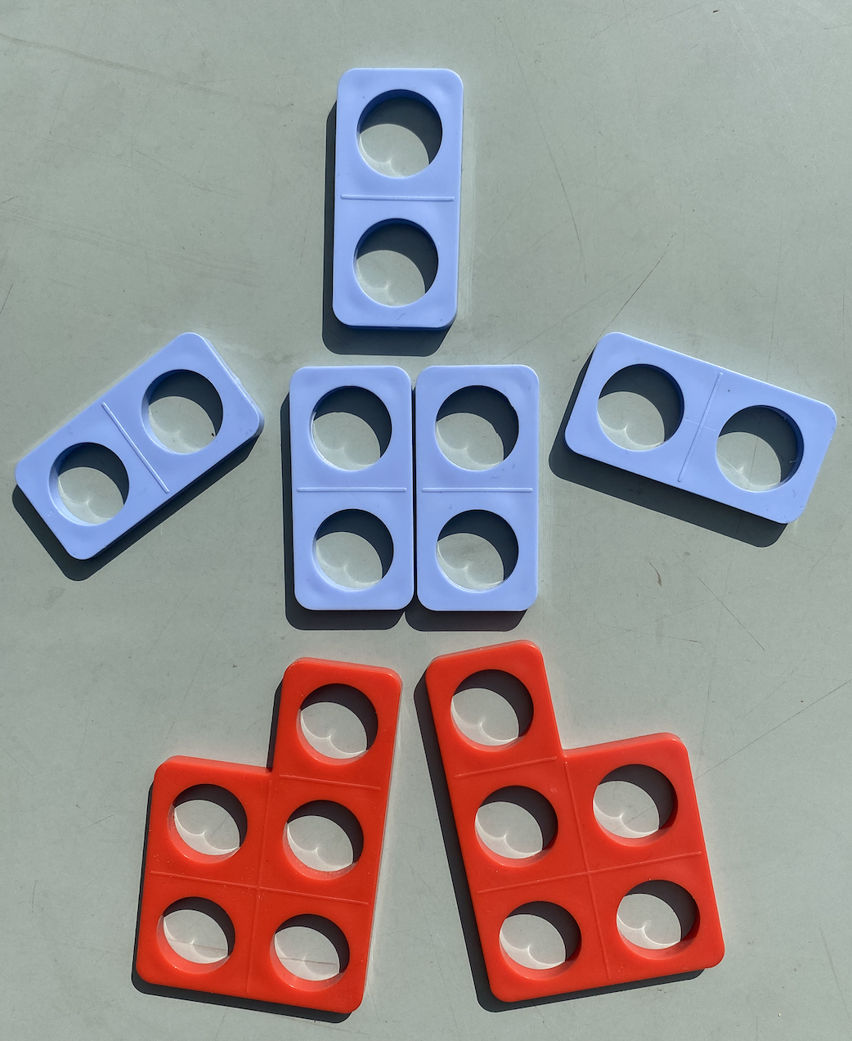
Activity J: Tile animals
Bruno is making pictures out of blue and red tiles.
Bruno says the total number of holes in each of his pictures is 5 × the number of red tiles + 2 × the number of blue tiles. He writes H = 5r + 2b. Do you agree with Bruno’s rule?
1
2
3
Write the value of H for each of the pictures
Bruno makes a picture with 30 holes. Write three possible values for r and b for his new picture.
Bruno makes another picture. He writes H = 320. He then changes his picture and writes H = 330. What changes might he have made? What if he’d written H = 340?
Notes:
This slide is animated. Each question will appear separately so you can choose the pace at which to work with your class.
Please note that this activity is designed for use once students have experienced some teaching of algebra at Key Stage 3.
Answers
a) Yes. Students need to identify that r and b represent the number of red and blue tiles respectively, and that multiplying r by 5 (as there are 5 holes on each tile) and b by 2 (as there are 2 holes on each tile) will result in the total number of holes.
b) Picture 1: H = 26, picture 2: H = 24, picture 3: H = 20
c) r = 2 and b = 10 or r = 4 and b = 5 or r = 0 and b = 15 or r = 6 and b = 0
? For H = 330, 10 more holes have been added: this could be either 2 red or 5 blue tiles.
For H = 340, 20 more holes have bee added: this could be 4 red, 10 blue, or 2 red and 5 blue tiles.
Suggested questioning
Why is this an equation/formula rather than an expression?
What does the H represent? How about the r? The b?
Why is r multiplied by 5? Why is b multiplied by 2?
Things to think about
This activity explores a familiar Key Stage 2 representation but with a specific focus on some new learning at Key Stage 3: understanding formulae. This is therefore not a Checkpoint but rather an activity that teachers might like to use as part of their teaching of algebra in year 7 or beyond. Students may have used simple formulae at primary school, but these are more likely to have been worded (as in Checkpoint 10) rather than algebraic. Here, students need to identify what each variable refers to and understand why the multipliers of 5 and 2 have been used. Part c and the further thinking question ask students to think more deeply about the possible values that r and b could take. Teachers may find that students having access to physical tiles enhances their experience of this activity.

Slide 57
Activity K: Triangle and rectangle values
6 ×▲+ 5 × █ + 4 ×▲
What is the value of the expression if:
▲= 3 and █ = 0
▲= 0 and █ = 2
▲= 1 and █ = 2
▲= 2 and █ = 3
▲= 4 and █ = 8
▲= 0.5 and █ = 0.5
Was there an easier way to find your answers?
Write a different expression using ▲ and █ that would have the same value.
Notes:
This slide is animated. Each question will appear separately so you can choose the pace at which to work with your class.
Answers
a) 30
b) 10
c) 20
d) 35
e) 80
f) 75
Students may have noticed that they could multiply their triangle value by 10, and their rectangle value by 5. They may also have noticed some relationships within the calculations, for example for c and d, the total triangles and total rectangles had the same value as the triangle value was two-times smaller than the rectangle value (and 10 is two-times bigger than 5).
? Any expression equivalent to 10 triangles + 5 rectangles.
Suggested questioning
How else could you write this expression? How many triangles and rectangles are there in total?
What could the values of the triangles and rectangles be if the total was 45? How about 40?
Things to think about
Additional activity K is a simpler version of Checkpoint 14; refer to the notes and guidance slide for more information.

Slide 58
Activity L: Square letters
Three tiles are arranged to make a square.
Which lengths or areas are given by:
a + b
b + c
b × c
a × d
a × d + b × c
c − d
d
c
a
b
How many different ways can you write the total perimeter of the square?
Notes:
This slide is animated. Each question will appear separately so you can choose the pace at which to work with your class. If any students cannot distinguish the colours, point to the relevant areas and/or use the printed version in ‘Printable resources’ in which they are labelled.
Answers
1) The length of a side of the square.
2) The total of the short and long side of the blue rectangle (or ‘half of the perimeter’ of the blue rectangle).
3) The area of the blue rectangle.
4) The area of the yellow rectangle.
5) The total area of the yellow rectangle and the blue rectangle.
6) The width of the red rectangle.
?
Total perimeter is, for example: 4c or 4(a + b) or 2(a + b) + 2c, etc.
Suggested questioning
How do you know which are lengths? How do you know which are areas?
What does perimeter mean? What does area mean?
Could you write an expression for the area of the red rectangle?
Things to think about
Additional activity L uses the same image as Checkpoint 16 as a starting point, so that students are working with a familiar representation when starting to use letters rather than numbers for lengths. It is strongly recommended that teachers use Checkpoint 16 first, to check students are confident with the representation. Students may not have used letters as unknown lengths at primary school, other than to denote missing lengths in problems where other lengths have numerical values, so this activity assesses how readily they can apply their knowledge to situations where all lengths are unknown. Students are also unlikely to have experienced the notation ab to represent multiplication, and so multiplication symbols are used throughout.
This task is likely to challenge students and will be a useful assessment tool for understanding their varying starting points for their learning of algebra at Key Stage 3. Knowledge of area and perimeter are also assessed within this task; these are concepts that are often confused and for this reason only specific lengths, rather than whole perimeters, are referred to within the main body of the task. Particularly draw attention to what is the same and different about parts 2 and 3 to check understanding of this.

Slide 59
Printable resources

Slide 60
Notes:
These blank number lines may be of use for students when working on Checkpoint 5. Representations modelling the answers are given on the next slide.

Slide 61
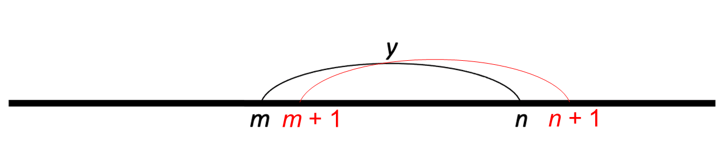
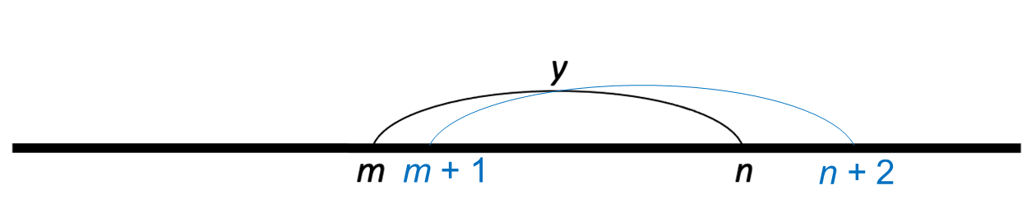
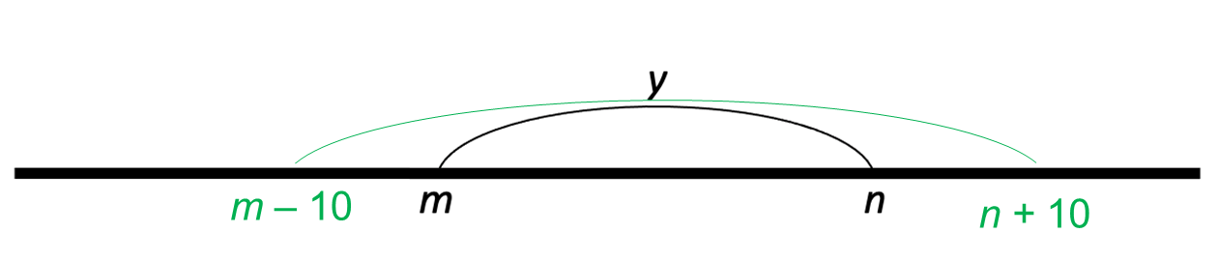
Notes:
These images could be printed if helpful. They are representations of parts b, c and d for use when reviewing Checkpoint 5. Red models part b, blue models part c and green models part d.

Slide 62
Medium:
Well done:
Medium:
Well done:
40 × ___ + 20 =
50 × ___ + 20 =
40 × ___ + 20 =
50 × ___ + 20 =
40 × ___ + 20 =
50 × ___ + 20 =
40 × ___ + 20 =
50 × ___ + 20 =
40 × ___ + 20 =
50 × ___ + 20 =
40 × ___ + 20 =
50 × ___ + 20 =
40 × ___ + 20 =
50 × ___ + 20 =
40 × ___ + 20 =
50 × ___ + 20 =
40 × ___ + 20 =
50 × ___ + 20 =
40 × ___ + 20 =
50 × ___ + 20 =
40 × ___ + 20 =
50 × ___ + 20 =
40 × ___ + 20 =
50 × ___ + 20 =
40 × ___ + 20 =
50 × ___ + 20 =
40 × ___ + 20 =
50 × ___ + 20 =
40 × ___ + 20 =
50 × ___ + 20 =
40 × ___ + 20 =
50 × ___ + 20 =
Notes:
This writing frame may be of use with Checkpoint 10.

Slide 63
3 ×▲+ 6 × █ + 7 ×▲+ 9 × █
3 ×▲+ 6 × █ + 7 ×▲+ 9 × █
3 ×▲+ 6 × █ + 7 ×▲+ 9 × █
3 ×▲+ 6 × █ + 7 ×▲+ 9 × █
3 ×▲+ 6 × █ + 7 ×▲+ 9 × █
3 ×▲+ 6 × █ + 7 ×▲+ 9 × █
3 ×▲+ 6 × █ + 7 ×▲+ 9 × █
Notes:
This is a printable resource that could be used alongside Checkpoint 14.
Students may find it helpful to write in their values for the triangle or the rectangle. Space is provided on the right-hand side if students wish to rewrite their expressions or do interim workings.

Slide 64
Yellow
Blue
Yellow
Blue
Yellow
Blue
5
5
5
7
7
7
Red
Red
Red
4
4
4
Yellow
Blue
Yellow
Blue
Yellow
Blue
Red
Red
Red
Notes:
These images (three to a page) are provided so students have a version of the image from Checkpoint 16, should they find it helpful to annotate. The blank version is to support the ‘further thinking’ question but may also be helpful for Additional activity L.

Slide 65
Extracts from mathematics past papers from Standards & Testing Agency and other Public sector information licensed under the Open Government Licence v3.0.

