Slide 1
Year 2, Unit 13
Multiplication and division – doubling, halving, quotitive and partitive division

Slide 2
Year 2, Unit 13
These materials heavily reflect the prioritisation approach of the ready-to-progress criteria in the DfE Primary Mathematics Guidance 2020 and on the PPTs that exemplify them on the NCETM website. They also include other relevant National Curriculum content. Related sections of the NCETM Primary Mastery Professional Development Materials provide small-step teaching guidance.
Ready-to-progress criteria addressed by this unit
Teaching of this unit does not support any criteria from the ‘DfE Mathematics Guidance: key stages 1 & 2’ (the 335-page document available as a download)
Prior learning
There are no specific ready-to-progress criteria supporting the prior learning for this unit.

Slide 3
Contents
The links below take you to the starting slide of each learning outcome.
1 | Pupils identify the patterns and relationships between the 5 and 10 times tables
2 | Pupils explain the patterns and relationships between the 5 and 10 times tables
3 | Pupils use their knowledge of the 5 and 10 times tables to solve problems
4 | Pupils identify and explain relationships between the 5 and the 10 times tables
5 | Pupils use their knowledge of the 5 and 10 times tables to solve problems
Click the arrow button to return to this Contents slide.

Slide 4
Contents
The links below take you to the starting slide of each learning outcome.
6 | Pupils explain how times table facts can help to find the quotient (10 times table)
7 | Pupils explain how times table facts can help to find the quotient (5 times table)
8 | Pupils explain how times table facts can help to find the quotient (2 times table)
9 | Pupils explain how a division equation with 2 as a divisor is related to halving
10 | Pupils explain each part of a division equation and know how they can be interchanged
Click the arrow button to return to this Contents slide.

Slide 5
Contents
The links below take you to the starting slide of each learning outcome.
11 | Pupils use knowledge of divisibility rules when the divisor is 2 to solve problems
12 | Pupils use knowledge of divisibility rules when then divisor is 10 to solve problems
13 | Pupils use knowledge of divisibility rules when the divisor is 5 to solve problems
14 | Pupils explain how a dividend of zero affects the quotient
15 | Pupils explain how the quotient is affected when the divisor is equal to the dividend
16 | Pupils explain how a divisor of one affects the quotient
Click the arrow button to return to this Contents slide.

Slide 6
Year 2, Unit 13, Learning Outcome 1
Learning Outcome 1
Pupils identify the patterns and relationships between the 5 and 10 times tables
The following slides have been collated to support the teaching of this learning outcome.

Slide 7
Year 2, Unit 13, Learning Outcome 1
Additional teacher guidance for this outcome should be read first and can be found in this segment of the NCETM Primary Mastery Professional Development Materials:
2.5 Commutativity (part 2), doubling and halving
The spine materials are divided into ‘teaching points’ and ‘steps in learning’.
Teaching point | Steps in learning | Pages
4 | 4:1-4:2 | 43-44

Slide 8
2.5 Commutativity, doubling and halving Step 4:1
10
5
5
For every 1 group of 10 there are 2 groups of 5.

Slide 9
2.5 Commutativity, doubling and halving Step 4:1
0 × 5 = 0 | 0 × 10 = 0
1 × 5 = 5 | 1 × 10 = 10
2 × 5 = 10 | 2 × 10 = 20
3 × 5 = 15 | 3 × 10 = 30
4 × 5 = 20 | 4 × 10 = 40
5 × 5 = 25 | 5 × 10 = 50
6 × 5 = 30 | 6 × 10 = 60
7 × 5 = 35 | 7 × 10 = 70
8 × 5 = 40 | 8 × 10 = 80
9 × 5 = 45 | 9 × 10 = 90
10 × 5 = 50 | 10 × 10 = 100
11 × 5 = 55 | 11 × 10 = 110
12 × 5 = 60 | 12 × 10 = 120
Notes:
Products in the ten times table are also in the five times table.

Slide 10
2.5 Commutativity, doubling and halving Step 4:1
0
2
4
6
8
10
12
× 5 = | 0
 | 10
 | 20
 | 30
 | 40
 | 50
 | 60
= 10 × | 0
 | 1
 | 2
 | 3
 | 4
 | 5
 | 6
Notes:
Even multiples of five are also multiples of ten.

Slide 11
2.5 Commutativity, doubling and halving Step 4:2
2
×
5
=
10
half
double
2
×
10
=
20

Slide 12
Year 2, Unit 13, Learning Outcome 2
Learning Outcome 2
Pupils explain the patterns and relationships between the 5 and 10 times tables
The following slides have been collated to support the teaching of this learning outcome.

Slide 13
Year 2, Unit 13, Learning Outcome 2
Additional teacher guidance for this outcome should be read first and can be found in this segment of the NCETM Primary Mastery Professional Development Materials:
2.5 Commutativity (part 2), doubling and halving
The spine materials are divided into ‘teaching points’ and ‘steps in learning’.
Teaching point | Step in learning | Pages
4 | 4:3 | 45-46

Slide 14
2.5 Commutativity, doubling and halving Step 4:3
2 × 10 = 20
two 10s are 20
10 × 2 = 20
10, two times, is 20
2 × 5 = 10
two 5s are 10
5 × 2 = 10
5, two times, is 10
10 is double 5, so two 10s is double two 5s.
5 is half of 10, so two 5s is half of two 10s.

Slide 15
2.5 Commutativity, doubling and halving Step 4:3
3 × 10 = 30
three 10s are 30
10 × 3 = 30
10, three times, is 30
3 × 5 = 15
three 5s are 15
5 × 3 = 15
5, three times, is 15
10 is double 5, so three 10s is double three 5s.
5 is half of 10, so three 5s is half of three 10s.

Slide 16
Year 2, Unit 13, Learning Outcome 3
Learning Outcome 3
Pupils use their knowledge of the 5 and 10 times tables to solve problems
The following slides have been collated to support the teaching of this learning outcome.

Slide 17
Year 2, Unit 13, Learning Outcome 3
Additional teacher guidance for this outcome should be read first and can be found in this segment of the NCETM Primary Mastery Professional Development Materials:
2.5 Commutativity (part 2), doubling and halving
The spine materials are divided into ‘teaching points’ and ‘steps in learning’.
Teaching point | Step in learning | Page
4 | 4:4 | 46

Slide 18
2.5 Commutativity, doubling and halving Step 4:4
How much money does Martin have altogether?
Felicity
Martin
eight 10 p coins
eight 5 p coins
80 p
40 p
? p
Felicity: 8 × 10 = 80
Martin: 8 × 5 =
40
5 is half of 10, so eight 5s is half of eight 10s.
Half of 8 is 4, so half of eight 10s is four 10s.
Notes:
Felicity has eight ten-pence coins; she has 80 p altogether.
Martin has eight five-pence coins.
How much money does Martin have altogether?

Slide 19
Year 2, Unit 13, Learning Outcome 4
Learning Outcome 4
Pupils identify and explain relationships between the 5 and the 10 times tables
The following slides have been collated to support the teaching of this learning outcome.

Slide 20
Year 2, Unit 13, Learning Outcome 4
Additional teacher guidance for this outcome should be read first and can be found in this segment of the NCETM Primary Mastery Professional Development Materials:
2.5 Commutativity (part 2), doubling and halving
The spine materials are divided into ‘teaching points’ and ‘steps in learning’.
Teaching point | Steps in learning | Page
4 | 4:5-4:6 | 47

Slide 21
2.5 Commutativity, doubling and halving Step 4:5
4 × 5 = 20
2 × 10 = 20
four 5s
0
5
10
15
20
two 10s

Slide 22
2.5 Commutativity, doubling and halving Step 4:6
How many 10 p coins does Bo have?
Olaf’s money
Bo’s money
6 ×
=
3
×
6 × 5 =
3
× 10
6 times 5 is equal to half of 6 times 10.
Notes:
Olaf has six five-pence coins.
Bo has some ten-pence coins.
Olaf and Bo have the same amount of money.
How many ten-pence coins does Bo have?

Slide 23
Year 2, Unit 13, Learning Outcome 5
Learning Outcome 5
Pupils use their knowledge of the 5 and 10 times tables to solve problems
The following slide supports the teaching of this learning outcome.

Slide 24
Year 2, Unit 13, Learning Outcome 5
Additional teacher guidance for this outcome should be read first and can be found in this segment of the NCETM Primary Mastery Professional Development Materials:
2.5 Commutativity (part 2), doubling and halving
The spine materials are divided into ‘teaching points’ and ‘steps in learning’.
Teaching point | Step in learning | Page
4 | 4:7 | 48

Slide 25
Year 2, Unit 13, Learning Outcome 6
Learning Outcome 6
Pupils explain how times table facts can help to find the quotient (10 times table)
The following slides have been collated to support the teaching of this learning outcome.

Slide 26
Year 2, Unit 13, Learning Outcome 6
Additional teacher guidance for this outcome should be read first and can be found in this segment of the NCETM Primary Mastery Professional Development Materials:
2.6 Structures: quotitive and partitive division
The spine materials are divided into ‘teaching points’ and ‘steps in learning’.
Teaching point | Steps in learning | Pages
4 | 4:1-4:4 | 40-44

Slide 27
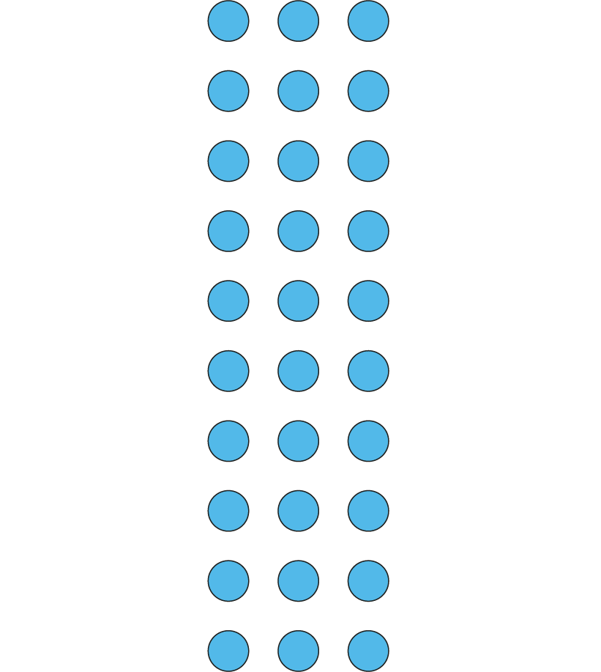
2.6 Quotitive and partitive division Step 4:1
3 × 10 = 30
10 × 3 = 30
30 ÷ 10 = 3

Slide 28
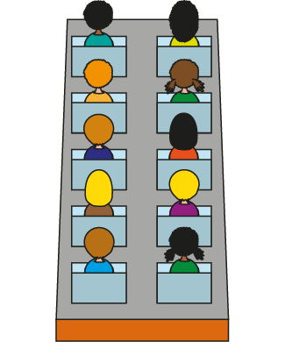
2.6 Quotitive and partitive division Step 4:2
A carriage holds 10 people. How many carriages for 30 people?
3
30 ÷ 10 =
There are 3 groups of 10 in 30, so 30 divided into groups of 10 is 3.
3 × 10 = 30
so 30 ÷ 10 = 3
Notes:
A carriage on a fairground ride holds ten people.
If there are thirty people, how many carriages are needed? Quotitive (grouping) structure

Slide 29
2.6 Quotitive and partitive division Step 4:4
40 cm
40 cm lengths of ribbon. Divide each into 10 equal pieces. Dana and Hari both try.
Notes:
A dressmaker has some forty-centimetre lengths of ribbon. She wants to divide each of them into ten equal pieces. Dana and Hari both try to cut the ribbon into ten equal pieces. Partitive (sharing) structure

Slide 30
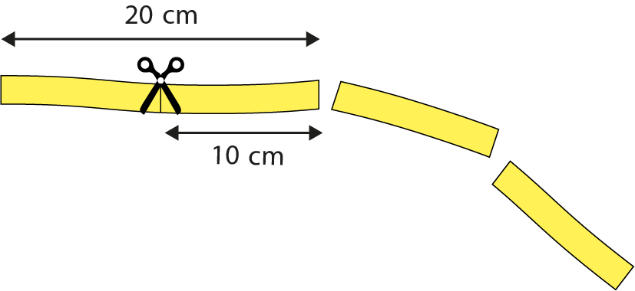
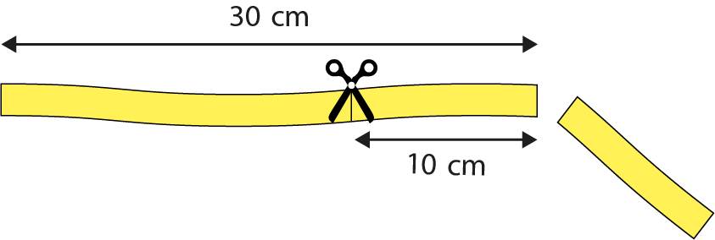
2.6 Quotitive and partitive division Step 4:4
Dana’s method
40 cm
Dana counts in 10s.
She cuts off 10 cm at a time from a 40 cm piece of ribbon.
Three 10s are 30.
Four 10s are 40.
Two 10s are 20.
One 10 is 10.
✗
Has Dana divided the ribbon into 10 equal pieces?
Notes:
Partitive (sharing) structure

Slide 31
2.6 Quotitive and partitive division Step 4:4
Hari’s method
40 cm
Hari writes:
4 x 10 = 40
so
40 ÷ 10 = 4
Each piece must be 4 cm. He cuts the ribbon into 4 cm pieces
✓
Has Hari divided the ribbon into 10 equal pieces?
Notes:
Partitive (sharing) structure

Slide 32
Year 2, Unit 13, Learning Outcome 7
Learning Outcome 7
Pupils explain how times table facts can help to find the quotient (5 times table)
The following slides have been collated to support the teaching of this learning outcome.

Slide 33
Year 2, Unit 13, Learning Outcome 7
Additional teacher guidance for this outcome should be read first and can be found in this segment of the NCETM Primary Mastery Professional Development Materials:
2.6 Structures: quotitive and partitive division
The spine materials are divided into ‘teaching points’ and ‘steps in learning’.
Teaching point | Steps in learning | Pages
4 | 4:1-4:3 and 4:5 | 40-42 and 44-45

Slide 34
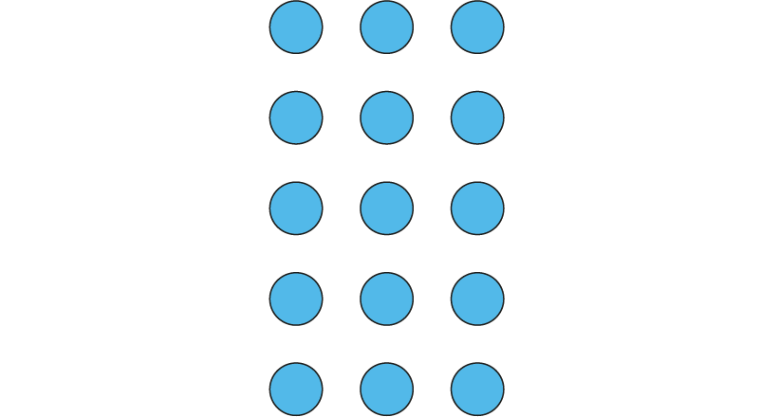
2.6 Quotitive and partitive division Step 4:5
3 × 5 = 15
5 × 3 = 15
15 ÷ 5 = 3

Slide 35
Year 2, Unit 13, Learning Outcome 8
Learning Outcome 8
Pupils explain how times table facts can help to find the quotient (2 times table)
The following slides have been collated to support the teaching of this learning outcome.

Slide 36
Year 2, Unit 13, Learning Outcome 8
Additional teacher guidance for this outcome should be read first and can be found in this segment of the NCETM Primary Mastery Professional Development Materials:
2.6 Structures: quotitive and partitive division
The spine materials are divided into ‘teaching points’ and ‘steps in learning’.
Teaching point | Steps in learning | Pages
4 | 4:1-4:3 and 4:6 | 40-42 and 46-47

Slide 37
2.6 Quotitive and partitive division Step 4:6
3 × 2 = 6
2 × 3 = 6
6 ÷ 2 = 3

Slide 38
Year 2, Unit 13, Learning Outcome 9
Learning Outcome 9
Pupils explain how a division equation with 2 as a divisor is related to halving
The following slides have been collated to support the teaching of this learning outcome.

Slide 39
Year 2, Unit 13, Learning Outcome 9
Additional teacher guidance for this outcome should be read first and can be found in this segment of the NCETM Primary Mastery Professional Development Materials:
2.6 Structures: quotitive and partitive division
The spine materials are divided into ‘teaching points’ and ‘steps in learning’.
Teaching point | Steps in learning | Pages
4 | 4:7-4:9 | 47-50

Slide 40
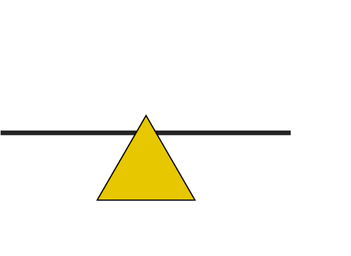
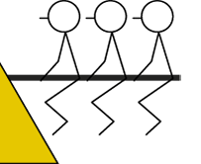
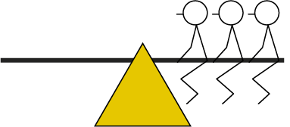
2.6 Quotitive and partitive division Step 4:7
6 children, equal number on each side. How many on each side?
6 ÷ 2
= 3
6 divided between 2 is equal to 3.
Half of 6 is 3.

Slide 41
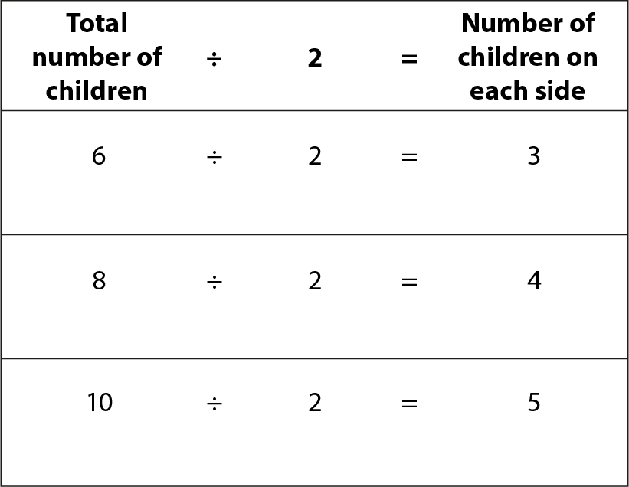
2.6 Quotitive and partitive division Step 4:7
What do you notice?
Notes:
Partitive (sharing) structure

Slide 42
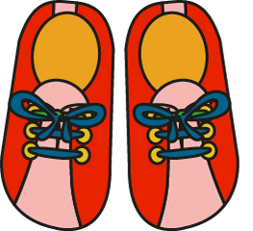
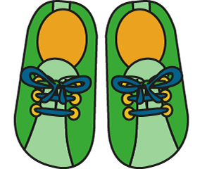
2.6 Quotitive and partitive division Step 4:8
6 shoes, how many pairs?
6 ÷ 2 = 3
6 divided into groups of 2 is equal to 3.
Half of 6 is 3.

Slide 43
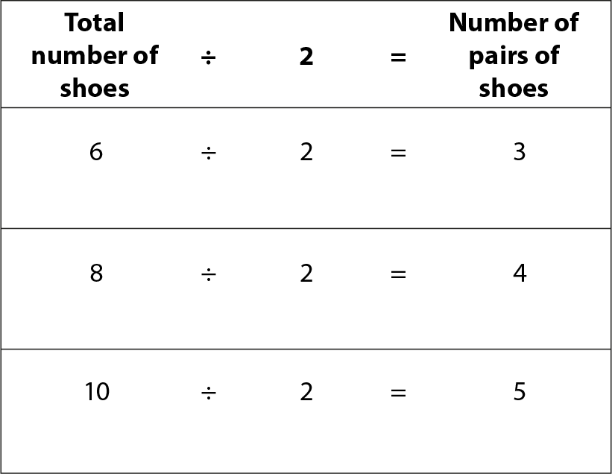
2.6 Quotitive and partitive division Step 4:8
What do you notice?
Notes:
Quotitive (grouping) structure

Slide 44
Year 2, Unit 13, Learning Outcome 10
Learning Outcome 10
Pupils explain each part of a division equation and know how they can be interchanged
The following slide supports the teaching of this learning outcome.

Slide 45
Year 2, Unit 13, Learning Outcome 10
Additional teacher guidance for this outcome should be read first and can be found in this segment of the NCETM Primary Mastery Professional Development Materials:
2.6 Structures: quotitive and partitive division
The spine materials are divided into ‘teaching points’ and ‘steps in learning’.
Teaching point | Step in learning | Pages
4 | 4:10 | 50-51

Slide 46
Year 2, Unit 13, Learning Outcome 11
Learning Outcome 11
Pupils use knowledge of divisibility rules when the divisor is 2 to solve problems
The following slides have been collated to support the teaching of this learning outcome.

Slide 47
Year 2, Unit 13, Learning Outcome 11
Additional teacher guidance for this outcome should be read first and can be found in this segment of the NCETM Primary Mastery Professional Development Materials:
2.6 Structures: quotitive and partitive division
The spine materials are divided into ‘teaching points’ and ‘steps in learning’.
Teaching point | Steps in learning | Pages
4 | 4:11 | 51-52

Slide 48
2.6 Quotitive and partitive division Step 4:11
4
62
2
7
100
5
31
34
48
99
43
Can be divided by 2 | Can’t be divided by 2

Slide 49
Year 2, Unit 13, Learning Outcome 12
Learning Outcome 12
Pupils use knowledge of divisibility rules when then divisor is 10 to solve problems
The following slide supports the teaching of this learning outcome.

Slide 50
Year 2, Unit 13, Learning Outcome 12
Additional teacher guidance for this outcome should be read first and can be found in this segment of the NCETM Primary Mastery Professional Development Materials:
2.6 Structures: quotitive and partitive division
The spine materials are divided into ‘teaching points’ and ‘steps in learning’.
Teaching point | Step in learning | Page
4 | 4:12 | 53

Slide 51
Year 2, Unit 13, Learning Outcome 13
Learning Outcome 13
Pupils use knowledge of divisibility rules when the divisor is 5 to solve problems
The following slide supports the teaching of this learning outcome.

Slide 52
Year 2, Unit 13, Learning Outcome 13
Additional teacher guidance for this outcome should be read first and can be found in this segment of the NCETM Primary Mastery Professional Development Materials:
2.6 Structures: quotitive and partitive division
The spine materials are divided into ‘teaching points’ and ‘steps in learning’.
Teaching point | Step in learning | Pages
4 | 4:13 | 53-54

Slide 53
Year 2, Unit 13, Learning Outcome 14
Learning Outcome 14
Pupils explain how a dividend of zero affects the quotient
The following slides have been collated to support the teaching of this learning outcome.

Slide 54
Year 2, Unit 13, Learning Outcome 14
Additional teacher guidance for this outcome should be read first and can be found in this segment of the NCETM Primary Mastery Professional Development Materials:
2.6 Structures: quotitive and partitive division
The spine materials are divided into ‘teaching points’ and ‘steps in learning’.
Teaching point | Steps in learning | Pages
5 | 5:1-5:3 and 5:6 | 55-56 and 60-62

Slide 55
2.6 Quotitive and partitive division Step 5:6
Fill in the missing numbers.
 | dividend | divisor | quotient
dividend |  |  | 0
divisor |  |  | 5
quotient | 0 | 10
0
10
5
1

Slide 56
Year 2, Unit 13, Learning Outcome 15
Learning Outcome 15
Pupils explain how the quotient is affected when the divisor is equal to the dividend
The following slides have been collated to support the teaching of this learning outcome.

Slide 57
Year 2, Unit 13, Learning Outcome 15
Additional teacher guidance for this outcome should be read first and can be found in this segment of the NCETM Primary Mastery Professional Development Materials:
2.6 Structures: quotitive and partitive division
The spine materials are divided into ‘teaching points’ and ‘steps in learning’.
Teaching point | Steps in learning | Pages
5 | 5:4 | 57-58

Slide 58
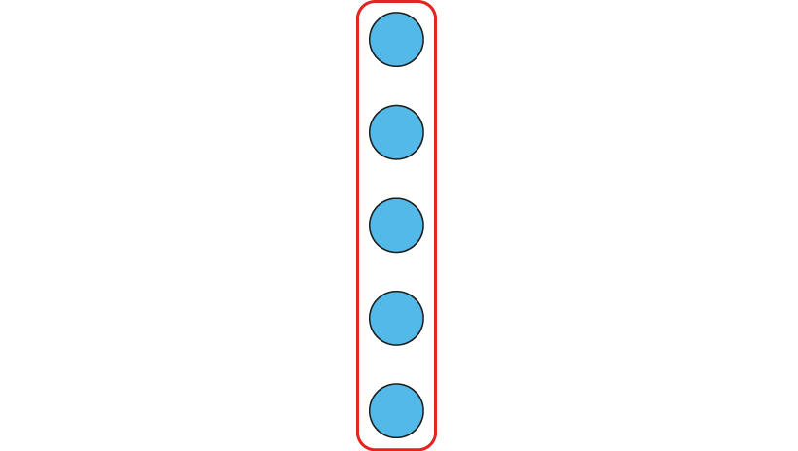
2.6 Quotitive and partitive division Step 5:4
1 × 5 = 5
5 × 1 = 5
One of the factors is 1 so the product is equal to the other factor.
One 5 is equal to 5.
5, one time is equal to 5.

Slide 59
2.6 Quotitive and partitive division Step 5:4
5 biscuits into bags of 5. How many bags?
5 ÷ 5 =
1
Notes:
I am putting biscuits into bags of five. I have five biscuits.
How many bags of five can I make?
Quotitive (grouping) structure

Slide 60
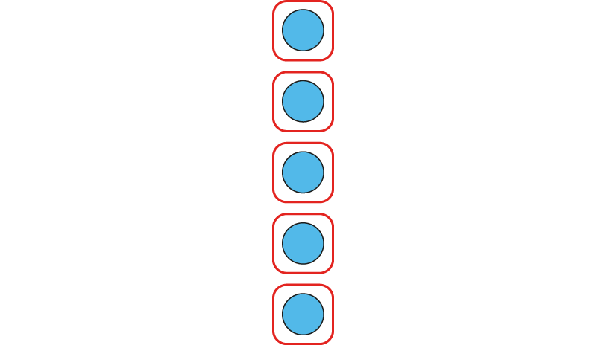
2.6 Quotitive and partitive division Step 5:4
1 × 5 = 5
5 × 1 = 5
One of the factors is 1 so the product is equal to the other factor.
1, five times is equal to 5.
Five 1s is equal to 5.

Slide 61
2.6 Quotitive and partitive division Step 5:4
5 people, 5 apples. How many apples each?
5 ÷ 5 =
1
Notes:
I am sharing apples between five people.
I have five apples. How many will each person get?
Partitive (sharing) structure

Slide 62
Year 2, Unit 13, Learning Outcome 16
Learning Outcome 16
Pupils explain how a divisor of one affects the quotient
The following slides have been collated to support the teaching of this learning outcome.

Slide 63
Year 2, Unit 13, Learning Outcome 16
Additional teacher guidance for this outcome should be read first and can be found in this segment of the NCETM Primary Mastery Professional Development Materials:
2.6 Structures: quotitive and partitive division
The spine materials are divided into ‘teaching points’ and ‘steps in learning’.
Teaching point | Steps in learning | Pages
5 | 5:5-5:6 | 59-62

Slide 64
2.6 Quotitive and partitive division Step 5:5
5 × 1 = 5
1 × 5 = 5
One of the factors is 1 so the product is equal to the other factor.
Five 1s is equal to 5.
1, five times is equal to 5.

Slide 65
2.6 Quotitive and partitive division Step 5:5
5 biscuits into bags of 1. How many bags?
5
5 ÷ 1 =
…
…
…
…
Notes:
I am putting biscuits into bags of one.
I have five biscuits. How many bags of one can I make?
Quotitive (grouping) structure

Slide 66
2.6 Quotitive and partitive division Step 5:5
5 × 1 = 5
1 × 5 = 5
One of the factors is 1 so the product is equal to the other factor.
5, one time is equal to 5
One 5 is equal to 5.

Slide 67
2.6 Quotitive and partitive division Step 5:5
Share 5 apples between 1 person. How many will the person get?
5 ÷ 1
= 5
Notes:
I am sharing apples between one person. I have five apples. How many will the person get?
Partitive (sharing) structure

