Slide 1
Year 1, Unit 3
Numbers 0 to 5

Slide 2
Year 1, Unit 3
These materials heavily reflect the prioritisation approach of the ready-to-progress criteria in the DfE Primary Mathematics Guidance 2020 and on the PPTs that exemplify them on the NCETM website. They also include other relevant National Curriculum content. Related sections of the NCETM Primary Mastery Professional Development Materials provide small-step teaching guidance.
Ready-to-progress criteria addressed by this unit
Teaching of this unit supports the following criteria from the ‘DfE Mathematics Guidance: key stages 1 & 2’ (the 335-page document available as a download)
1NPV-2 Page 20
1AS-1 Page 30
Previous Experience
If the children have the following previous experience, contained in the same DfE guidance document as above, they will be ready to start this unit.
Previous experience prior to 1NPV-2 Page 16
Previous experience prior to 1AS-1 Page 17
Notes:
ANIMATION PROBLEM

Slide 3
Contents
The links below take you to the starting slide of each learning outcome.
1 | Pupils explain that numbers can represent how many objects there are in a set
2 | Pupils explain that ordinal numbers show a position and not a set of objects
3 | Pupils partition numbers one to five in different ways
4 | Pupils partition the numbers one to five in a systematic way
5 | Pupils find a missing part when one part and the whole is known
6 | Pupils show one more and one less than a number using representations. Pupils describe this accurately.
7 | Pupils show one more and one less than a number using representations. Pupils describe this accurately.
8 | Pupils use a bar model to represent a whole partitioned into two parts
Click the arrow button to return to this Contents slide.

Slide 4
Year 1, Unit 3, Learning Outcome 1
Learning Outcome 1
Pupils explain that numbers can represent how many objects there are in a set
The following slides have been collated to support the teaching of this learning outcome.

Slide 5
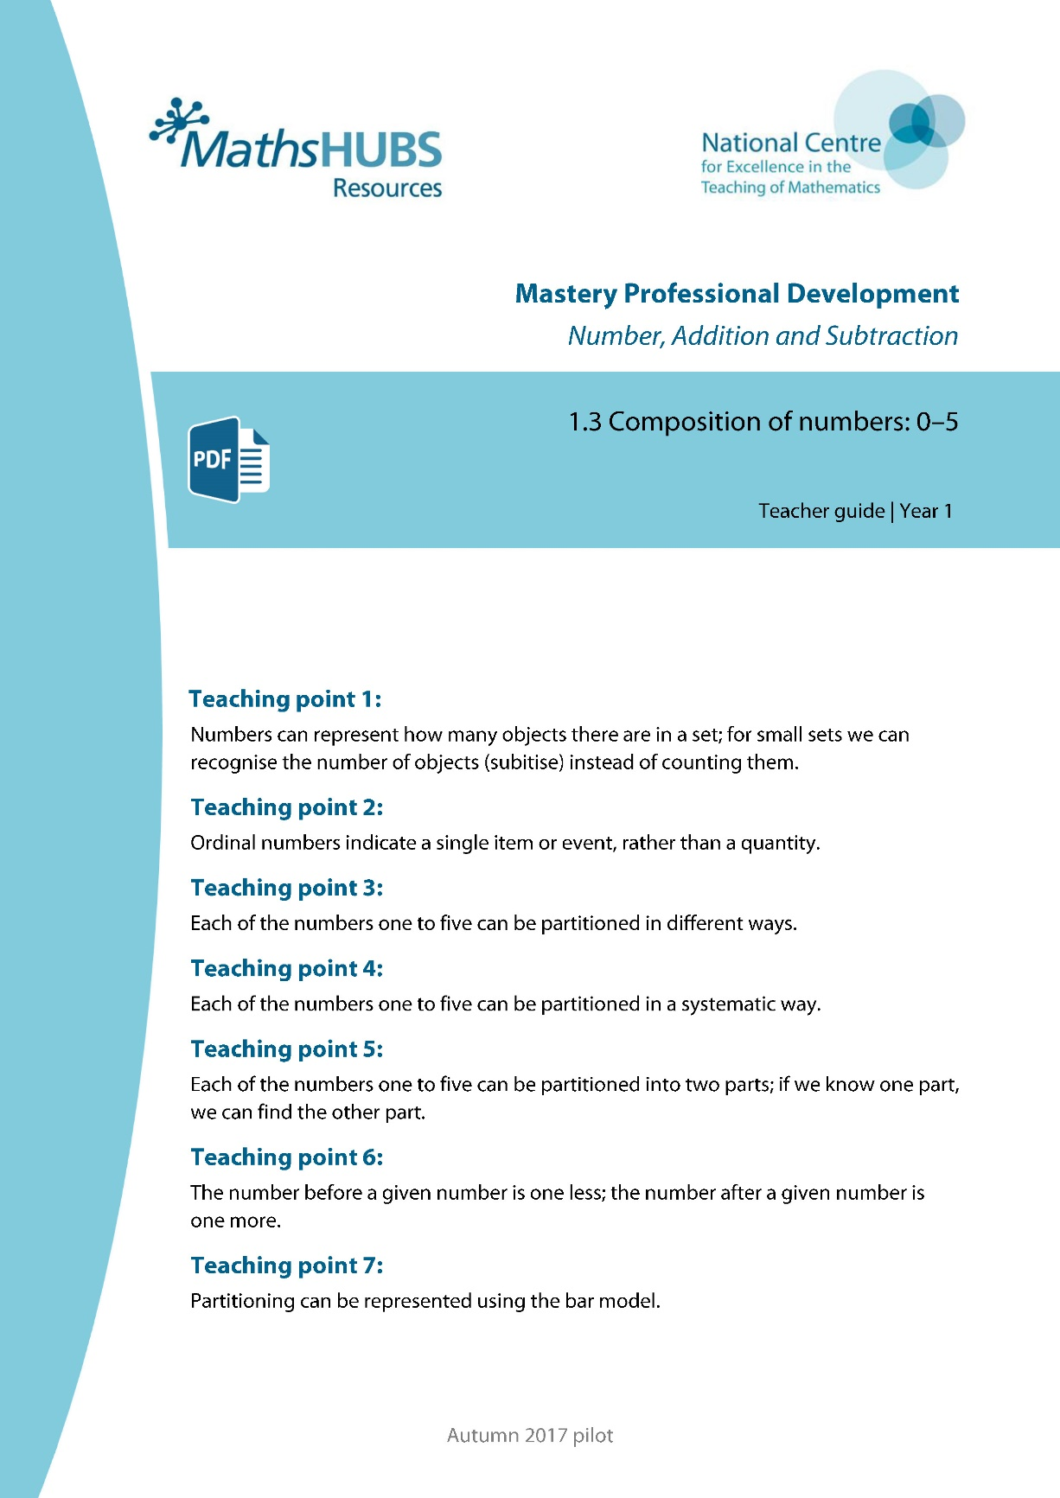
Year 1, Unit 3, Learning Outcome 1
Additional teacher guidance for this outcome should be read first and can be found in this segment of the NCETM Primary Mastery Professional Development Materials:
1.3 Composition of numbers: 0–5
The spine materials are divided into ‘teaching points’ and ‘steps in learning’.
Teaching point | Steps in learning | Pages
1 | 1:1-1:5 | 3-7

Slide 6
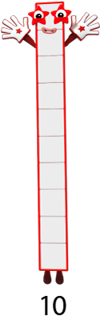









1.3 Composition: 0–5 – step 1:1
Images © 2017 Alphablocks Ltd. All Rights Reserved.

Slide 7









1.3 Composition: 0–5 – step 1:1
1
2
3
4
5
6
7
8
9
10

Slide 8










1.3 Composition: 0–5 – step 1:1

Slide 9



1.3 Composition: 0–5 – step 1:2

Slide 10






1.3 Composition: 0–5 – step 1:2

Slide 11





1.3 Composition: 0–5 – step 1:2

Slide 12

1.3 Composition: 0–5 – step 1:2

Slide 13


1.3 Composition: 0–5 – step 1:2

Slide 14
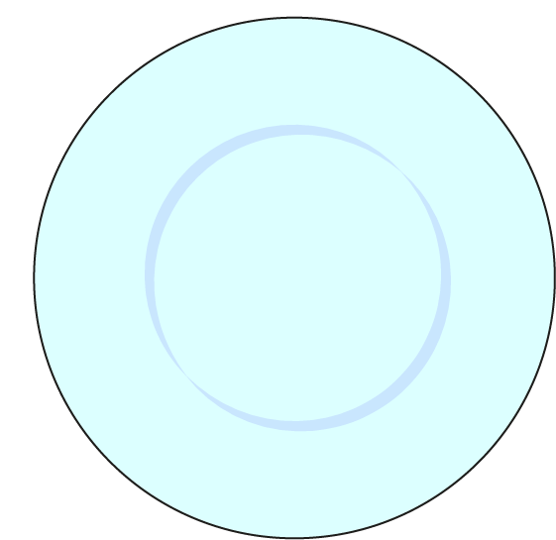



1.3 Composition: 0–5 – step 1:2

Slide 15
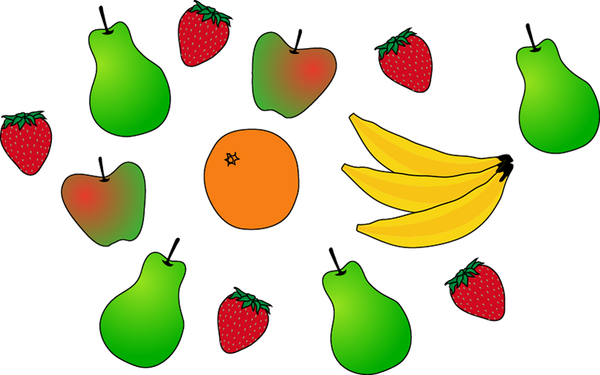
1.3 Composition: 0–5 – step 1:2

Slide 16

1.3 Composition: 0–5 – step 1:3

Slide 17
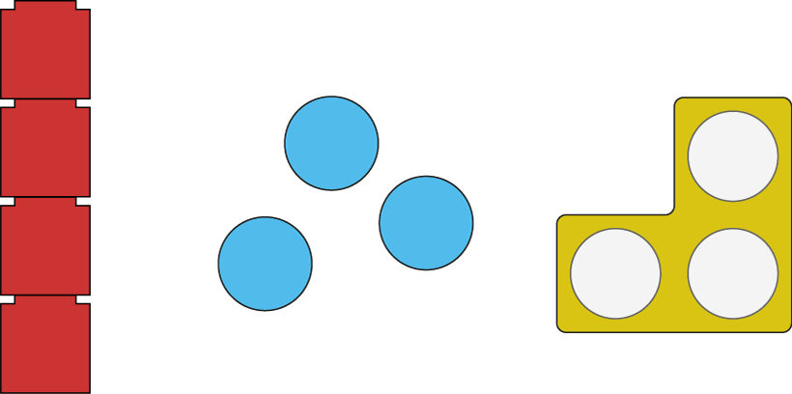
1.3 Composition: 0–5 – step 1:4
4
3
3

Slide 18


1.3 Composition: 0–5 – step 1:4
3
3
4

Slide 19

1.3 Composition: 0–5 – step 1:5
4
four

Slide 20

1.3 Composition: 0–5 – step 1:5
2
two

Slide 21

1.3 Composition: 0–5 – step 1:5
3
three

Slide 22

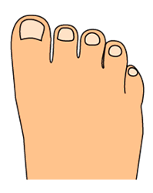
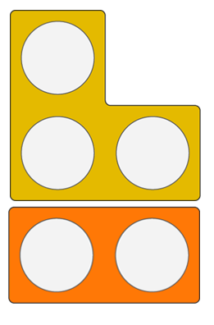









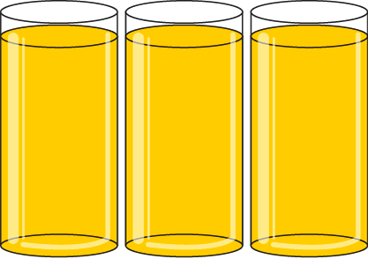

1AS-1 Compose and partition numbers to 10
Tell me what you see!
Did you notice each picture represents five of something?
Can you describe how you can see five in each picture?
Now you can make a ‘Five Museum’ for Numberblock Five using things in your classroom!
Can you make a museum for a different Numberblock? Try to guess your friend’s number!

Slide 23
Year 1, Unit 3, Learning Outcome 2
Learning Outcome 2
Pupils explain that ordinal numbers show a position and not a set of objects
The following slides have been collated to support the teaching of this learning outcome.

Slide 24
Year 1, Unit 3, Learning Outcome 2
Additional teacher guidance for this outcome should be read first and can be found in this segment of the NCETM Primary Mastery Professional Development Materials:
1.3 Composition of numbers: 0–5
The spine materials are divided into ‘teaching points’ and ‘steps in learning’.
Teaching point | Steps in learning | Pages
2 | 2:1-2:3 | 8-9

Slide 25

1.3 Composition: 0–5 – step 2:1
first
second
third
fourth
fifth
1st
2nd
3rd
4th
5th

Slide 26
1.3 Composition: 0–5 – step 2:1
fourth | 5th
first | 3rd
third | 1st
fifth | 4th
second | 2nd

Slide 27
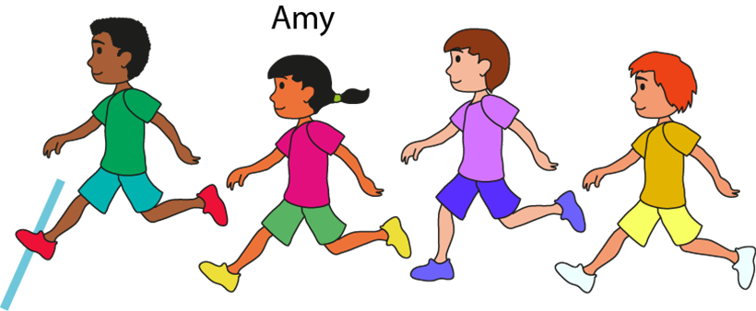
1.3 Composition: 0–5 – step 2:2

Slide 28
1.3 Composition: 0–5 – step 2:3

Slide 29
Year 1, Unit 3, Learning Outcome 3
Learning Outcome 3
Pupils partition numbers one to five in different ways
The following slides have been collated to support the teaching of this learning outcome.

Slide 30
Year 1, Unit 3, Learning Outcome 3
Additional teacher guidance for this outcome should be read first and can be found in this segment of the NCETM Primary Mastery Professional Development Materials:
1.3 Composition of numbers: 0–5
The spine materials are divided into ‘teaching points’ and ‘steps in learning’.
Teaching point | Steps in learning | Pages
3 | 3:1-3:5 | 10-12

Slide 31

1.3 Composition: 0–5 – step 3:1

Slide 32

1.3 Composition: 0–5 – step 3:1

Slide 33

1.3 Composition: 0–5 – step 3:1

Slide 34

1.3 Composition: 0–5 – step 3:1

Slide 35
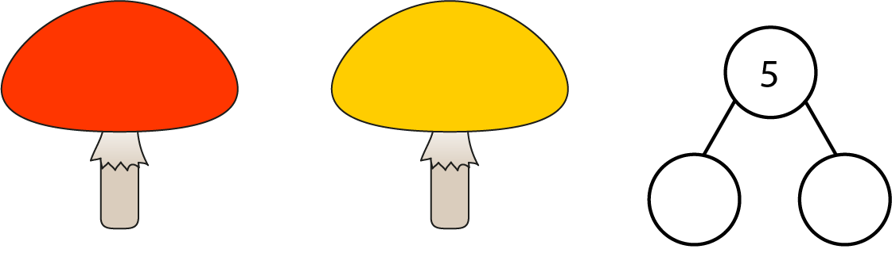
1.3 Composition: 0–5 – step 3:2

Slide 36

1.3 Composition: 0–5 – step 3:2

Slide 37
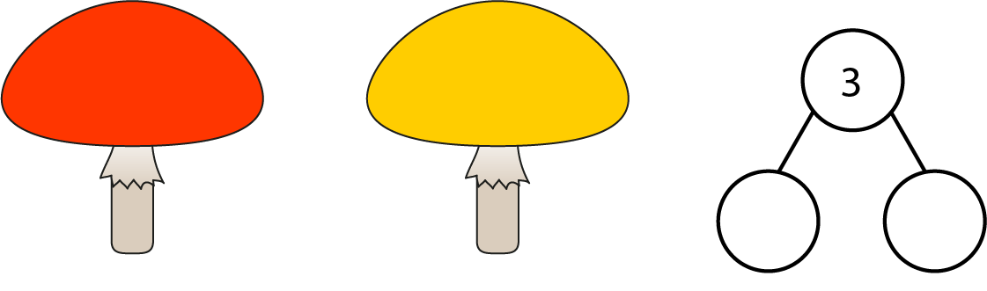
1.3 Composition: 0–5 – step 3:2

Slide 38
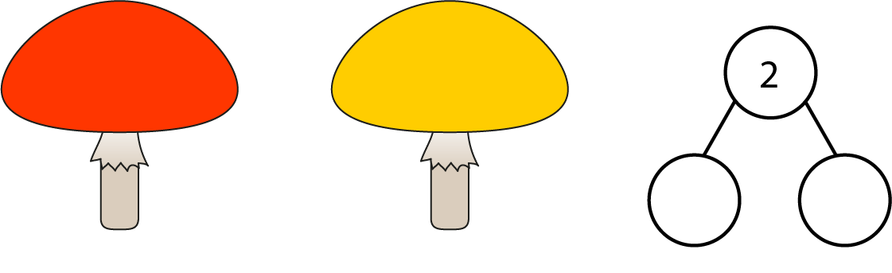
1.3 Composition: 0–5 – step 3:2

Slide 39

1.3 Composition: 0–5 – step 3:2

Slide 40

1.3 Composition: 0–5 – step 3:3

Slide 41





1AS-1 Compose and partition numbers to 10
What do you notice about the cakes in the picture? Why have they been partitioned (separated) in this way?
Which part of the diagram shows the whole and which show the parts? What does a whole mean? It’s a ‘part-part-whole’ diagram!
What happens when we re-combine the parts back together?
3
5
2
There are 5 cakes, 2 have cherries, 3 do not.
5 is the whole, 3 is a part and 2 is a part.

Slide 42
Year 1, Unit 3, Learning Outcome 4
Learning Outcome 4
Pupils partition the numbers one to five in a systematic way
The following slides have been collated to support the teaching of this learning outcome.

Slide 43
Year 1, Unit 3, Learning Outcome 4
Additional teacher guidance for this outcome should be read first and can be found in this segment of the NCETM Primary Mastery Professional Development Materials:
1.3 Composition of numbers: 0–5
The spine materials are divided into ‘teaching points’ and ‘steps in learning’.
Teaching point | Steps in learning | Pages
4 | 4:1-4:3 | 13-15

Slide 44





1.3 Composition: 0–5 – step 4:1

Slide 45
1.3 Composition: 0–5 – step 4:1

Slide 46


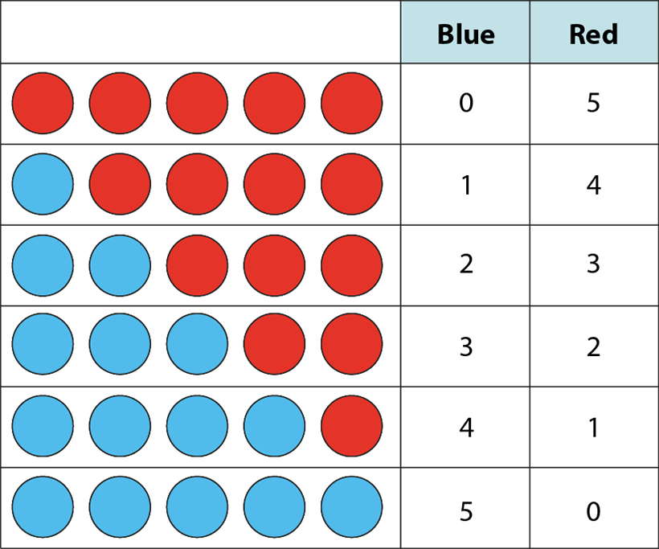
1.3 Composition: 0–5 – step 4:2
0
5
1
4
2
3
3
2
4
1
5
0

Slide 47
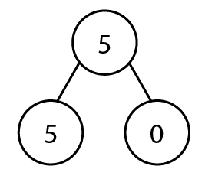
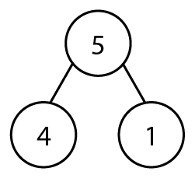
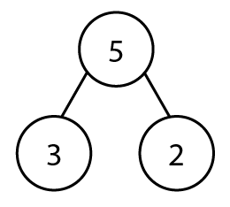
1.3 Composition: 0–5 – step 4:3

Slide 48
Year 1, Unit 3, Learning Outcome 5
Learning Outcome 5
Pupils find a missing part when one part and the whole is known
The following slides have been collated to support the teaching of this learning outcome.

Slide 49
Year 1, Unit 3, Learning Outcome 5
Additional teacher guidance for this outcome should be read first and can be found in this segment of the NCETM Primary Mastery Professional Development Materials:
1.3 Composition of numbers: 0–5
The spine materials are divided into ‘teaching points’ and ‘steps in learning’.
Teaching point | Steps in learning | Pages
5 | 5:1-5:2 | 16-18

Slide 50



1.3 Composition: 0–5 – step 5:1

Slide 51

1.3 Composition: 0–5 – step 5:1

Slide 52
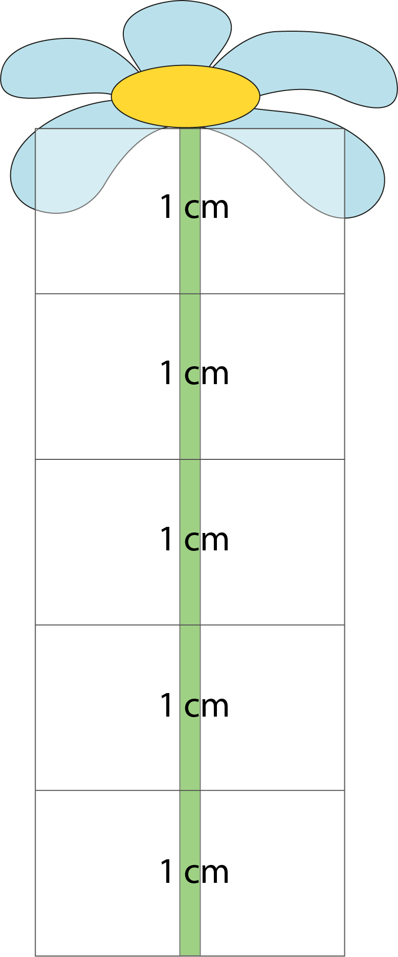

1.3 Composition: 0–5 – step 5:1
3 cm

Slide 53

1.3 Composition: 0–5 – step 5:2
3

Slide 54
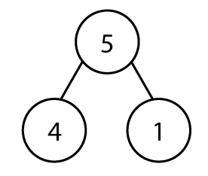

1.3 Composition: 0–5 – step 5:2

Slide 55
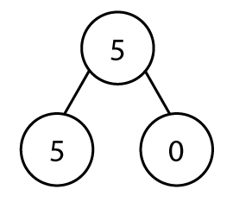
1.3 Composition: 0–5 – step 5:2

Slide 56
Year 1, Unit 3, Learning Outcome 6
Learning Outcome 6
Pupils show one more and one less than a number using representations. Pupils describe this accurately.
The following slides have been collated to support the teaching of this learning outcome.

Slide 57
Year 1, Unit 3, Learning Outcome 6
Additional teacher guidance for this outcome should be read first and can be found in this segment of the NCETM Primary Mastery Professional Development Materials:
1.3 Composition of numbers: 0–5
The spine materials are divided into ‘teaching points’ and ‘steps in learning’.
Teaching point | Steps in learning | Pages
6 | 6:1-6:3 | 19-21

Slide 58


1.3 Composition: 0–5 – step 6:1
0
1
1
2
2
3
3
4
4
5
5
6

Slide 59
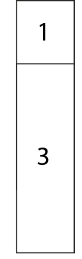
1.3 Composition: 0–5 – step 6:1
0
1
1
2
2
3
3
4
4
5
5
6

Slide 60

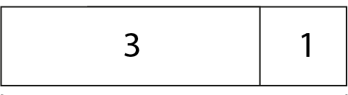

1.3 Composition: 0–5 – step 6:1

Slide 61

1.3 Composition: 0–5 – step 6:2

Slide 62
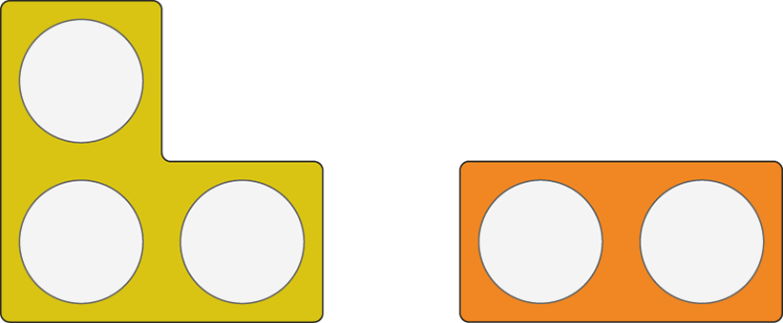
1.3 Composition: 0–5 – step 6:2

Slide 63









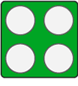


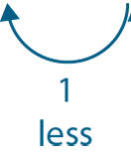
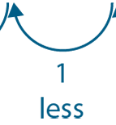
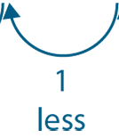
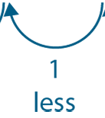
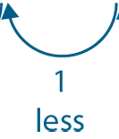
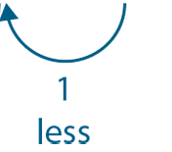
1.3 Composition: 0–5 – step 6:3

Slide 64







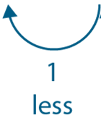
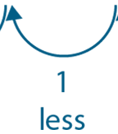


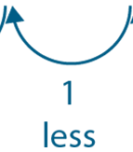
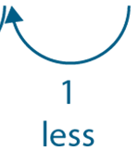
1.3 Composition: 0–5 – step 6:3

Slide 65
1AS-1 Compose and partition numbers to 10
Watch closely each time another block appears. Can you describe what you see? Watch again…
What happened to the numbers each time another red block appeared? How did the number change?
Why is there not a block by zero?
Can you make your own ‘staircase’ using cubes?
Each number is made up of the previous number and one more.
0
1
1
2
2
3
3
4
4
5
5
6

Slide 66
Year 1, Unit 3, Learning Outcome 7
Learning Outcome 7
Pupils show one more and one less than a number using representations. Pupils describe this accurately.
The following slide supports the teaching of this learning outcome.

Slide 67
Year 1, Unit 3, Learning Outcome 7
Additional teacher guidance for this outcome should be read first and can be found in this segment of the NCETM Primary Mastery Professional Development Materials:
1.3 Composition of numbers: 0–5
The spine materials are divided into ‘teaching points’ and ‘steps in learning’.
Teaching point | Steps in learning | Pages
6 | 6:4-6:5 | 21-22

Slide 68
Year 1, Unit 3, Learning Outcome 8
Learning Outcome 8
Pupils use a bar model to represent a whole partitioned into two parts
The following slides have been collated to support the teaching of this learning outcome.

Slide 69
Year 1, Unit 3, Learning Outcome 8
Additional teacher guidance for this outcome should be read first and can be found in this segment of the NCETM Primary Mastery Professional Development Materials:
1.3 Composition of numbers: 0–5
The spine materials are divided into ‘teaching points’ and ‘steps in learning’.
Teaching point | Steps in learning | Pages
7 | 7:1-7:5 | 23-25

Slide 70




1.3 Composition: 0–5 – step 7:1
5

Slide 71

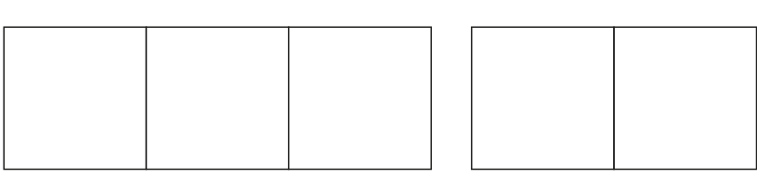



1.3 Composition: 0–5 – step 7:2
3
2

Slide 72
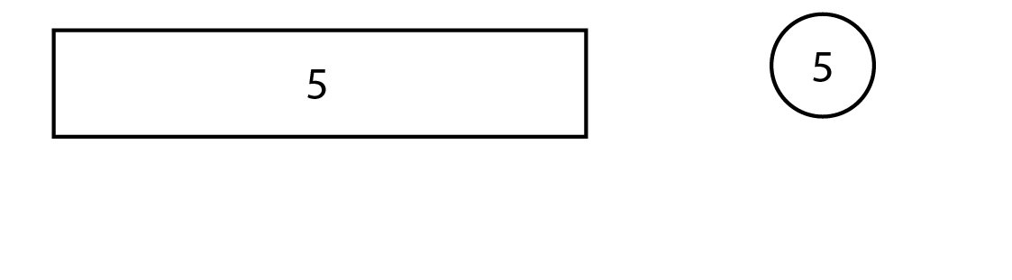
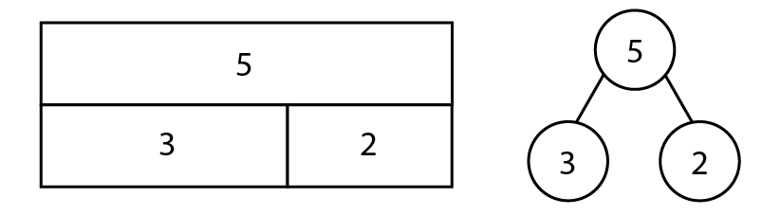
1.3 Composition: 0–5 – step 7:3

